Slide 1
LO: Turning Points of
a Quadratic Graph

Slide 2
y
x
What are some of the key characteristics
of a quadratic graph?

Slide 3
y
x-intercepts
Roots/Solutions
When y = 0
x
Turning Point
Find by completing the square
y-intercept
When x = 0

Slide 4
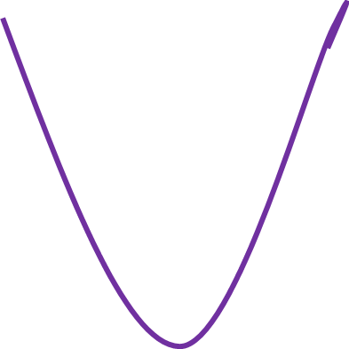
Maximum and Minimum Points
Turning Point (maximum)
Turning Point (minimum)

Slide 5
Turning Points
By completing the square
of a quadratic you can learn the co-ordinate of its
turning point.

Slide 6
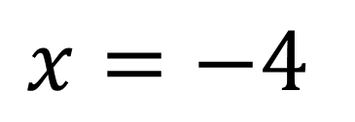
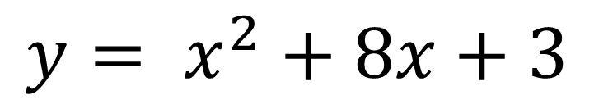
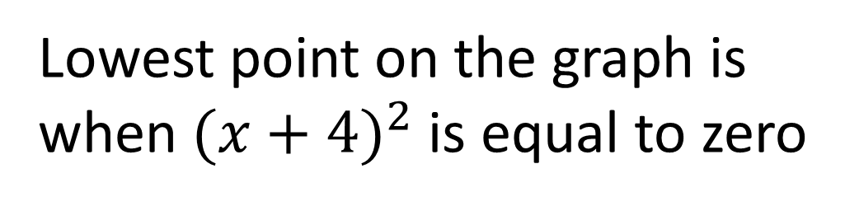
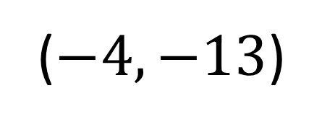
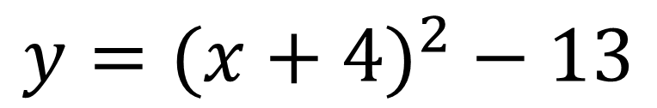
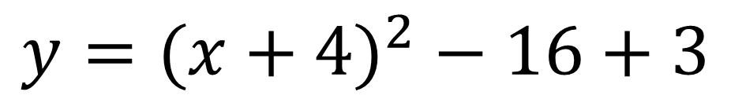
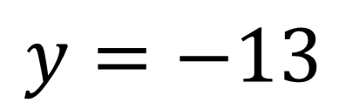
$${y= x}^{2}+8x+3$$
y
$${y=(x+4)}^{2}−16+3$$
$${y=(x+4)}^{2}−13$$
x
Lowest point on the graph is when ${(x+4)}^{2}$ is equal to zero
($−4,−13$)
$$x=−4$$
$$y=−13$$

Slide 7
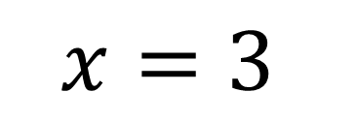
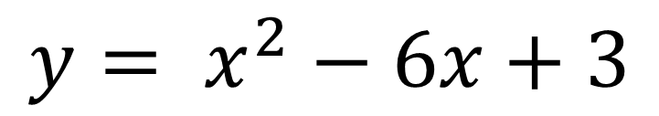
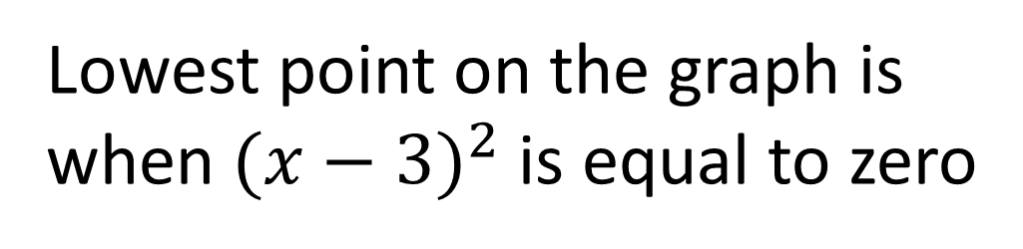
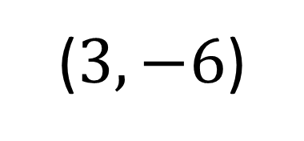
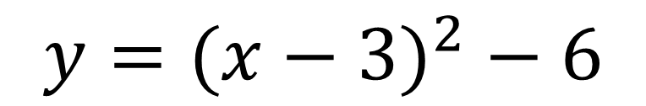
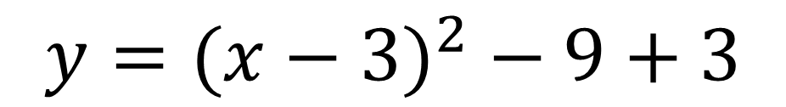
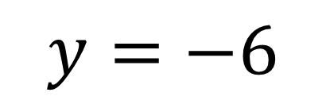
$${y= x}^{2}−6x+3$$
y
$${y=(x−3)}^{2}−9+3$$
$${y=(x−3)}^{2}−6$$
x
Lowest point on the graph is when ${(x−3)}^{2}$ is equal to zero
$$x=3$$
($3,−6$)
$$y=−6$$

Slide 8
Find the turning point of
y = (x + 5)² – 15
(-5, -15)

Slide 9
Find the turning point of
y = (x – 4)² – 11
(4, –11)

Slide 10
Find the turning point of
y = (x – 8)² + 2
(8, 2)

Slide 11
Find the turning point of
y = (x – p)² – q
(p, –q)

Slide 12
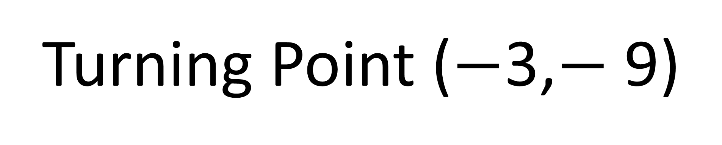
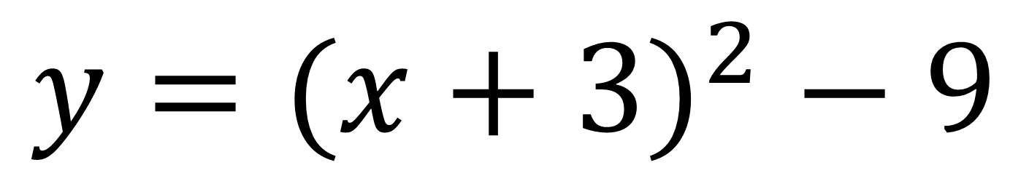
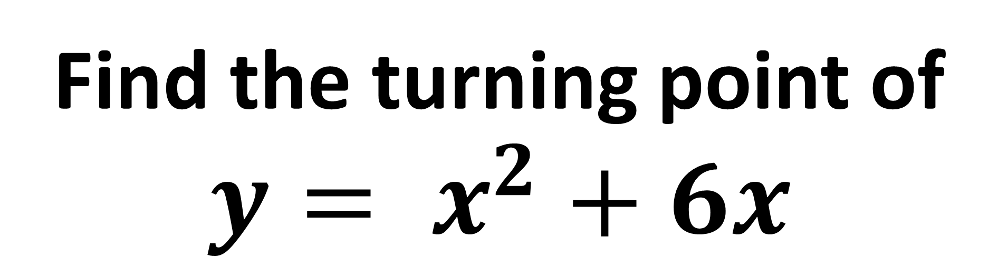
Find the turning point of
$${y= x}^{2}+6x$$
$$y={(x+3)}^{2} − 9$$
Turning Point ($−$3,$−$9)

Slide 13
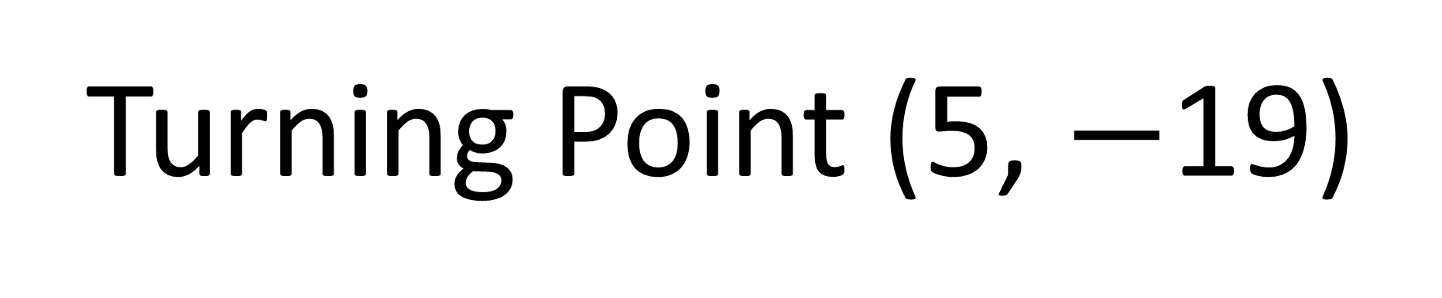
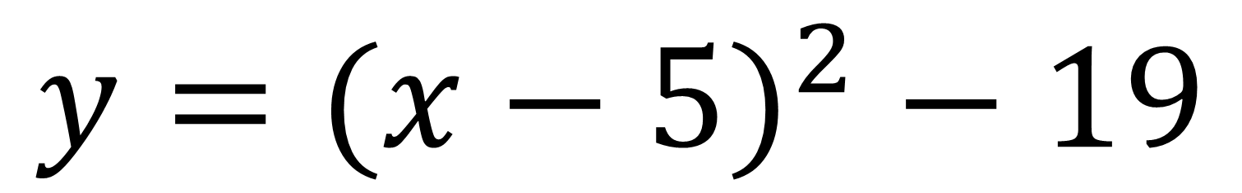
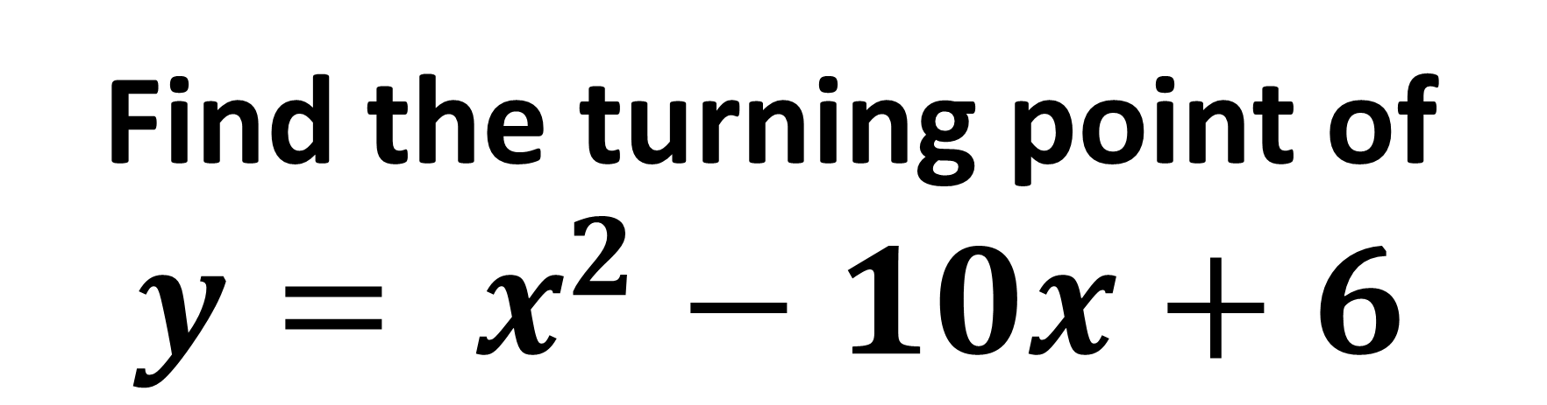
Find the turning point of
$${y= x}^{2}−10x+6$$
$$y={(x−5)}^{2} − 19$$
Turning Point (5, $−$19)

