Slide 1
Elastic Collisions in 1D
Coefficient of Restitution
Chapter 4
(Part 1 of 5)

Slide 2


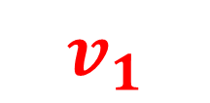
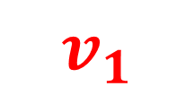


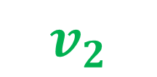
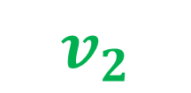



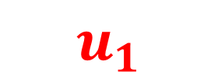
When two objects collide,
the speed at which they move
after the collision is dependent on
the material from which they are made.
$$u_{1}$$
$$u_{1}$$
$${ m}_{1}$$
$${ m}_{2}$$
$${ m}_{1}$$
$${ m}_{2}$$
$$v_{1}$$
$$v_{2}$$
$$v_{1}$$
$$v_{2}$$

Slide 3
Coefficient of Restitution
The coefficient of restitution
is a measure of how
bouncy or elastic an object is.

Slide 4


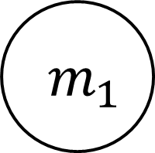

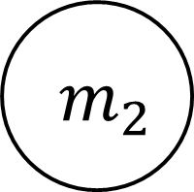

Using the speeds of before and after the collision,
how could you measure how bouncy
(the coefficient of restitution) an object is?
$$u_{1}$$
$$u_{2}$$
$${ m}_{1}$$
$${ m}_{2}$$
$$v_{1}$$
$$v_{2}$$

Slide 5

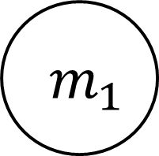

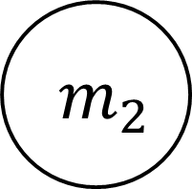


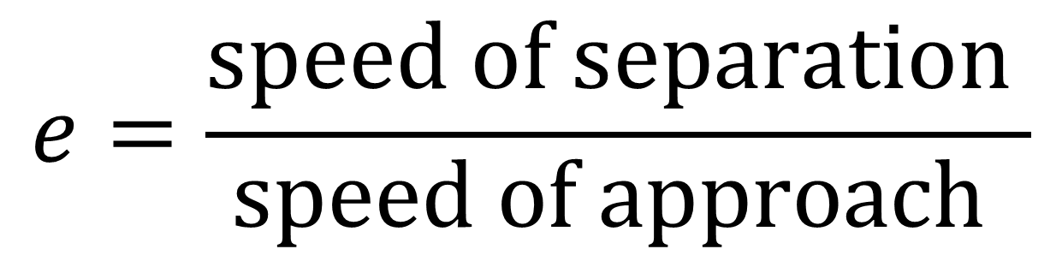
The Coefficient of Restitution
$$u_{1}$$
$$u_{2}$$
$${ m}_{1}$$
$${ m}_{2}$$
$$v_{1}$$
$$v_{2}$$
$$e=\frac{speed of separation }{speed of approach }$$

Slide 6
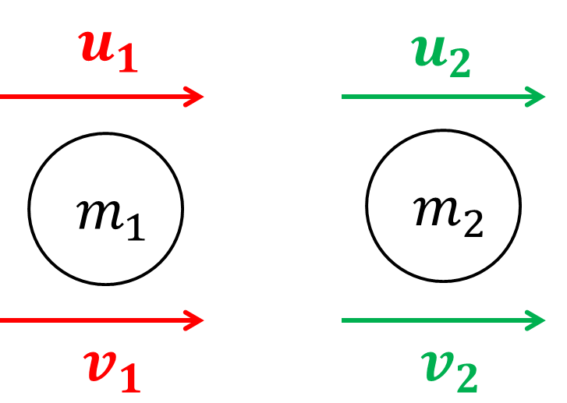
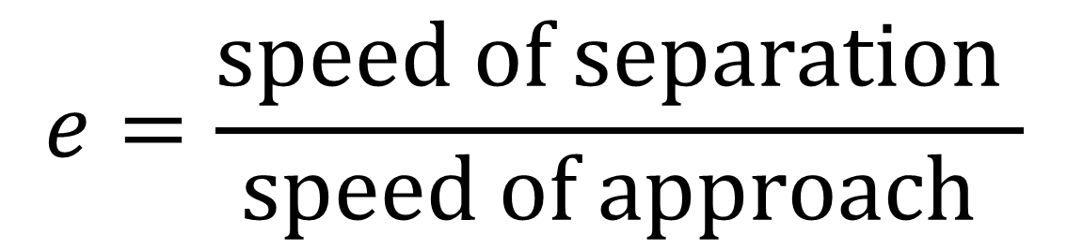
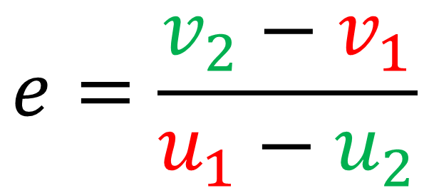
Newton’s Law of Restitution
$$e=\frac{speed of separation }{speed of approach }$$
$$e=\frac{v_{2}−v_{1}}{u_{1}−u_{2}}$$

Slide 7
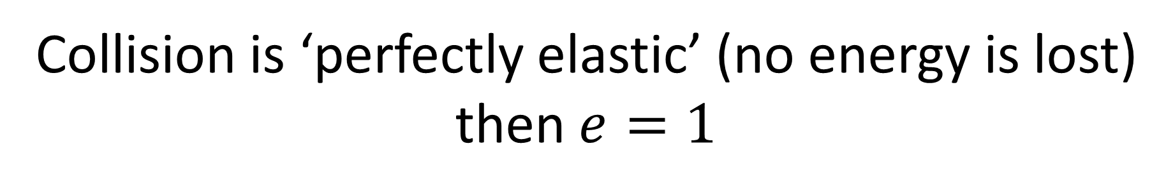
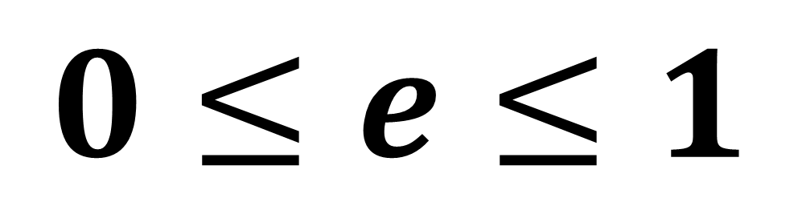
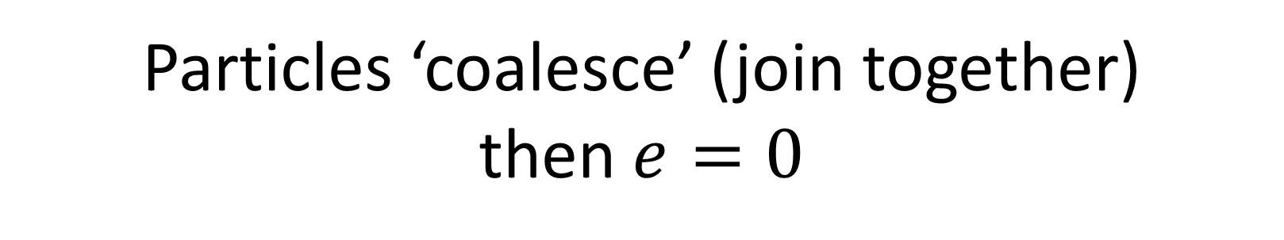
$$0≤e≤1$$
Collision is ‘perfectly elastic’ (no energy is lost)
then $e=1$
Particles ‘coalesce’ (join together)
then $e=0$

Slide 8
Object | Coefficient of Restitution
Golf ball | 0.7 to 0.85
Tennis ball | 0.7 to 0.8
Snooker ball | 0.804
Hand ball | 0.752
Wooden ball | 0.603
Steel ball bearing | 0.597
Glass marble | 0.658
Ball of rubber bands | 0.828
Hollow, Hard plastic ball | 0.688

Slide 9
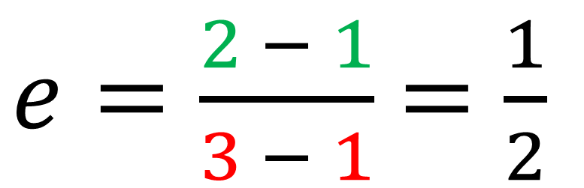

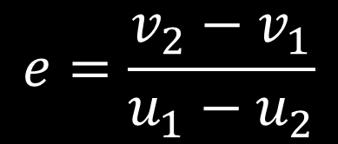
Calculate the value of
the coefficient of restitution.
3
$$e=\frac{v_{2}−v_{1}}{u_{1}−u_{2}}$$
1
$e=\frac{2 − 1}{3 − 1}$ $=\frac{1}{2}$
1
$$2$$

Slide 10


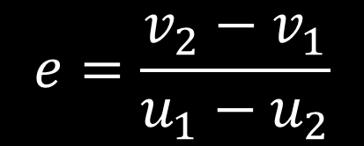
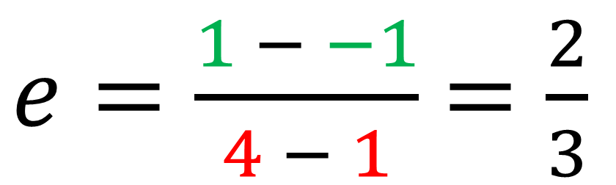
Calculate the value of
the coefficient of restitution.
$$e=\frac{v_{2}−v_{1}}{u_{1}−u_{2}}$$
4
1
$e=\frac{1 − −1}{4 − 1}$ $=\frac{2}{3}$
$−$1
$$1$$

Slide 11
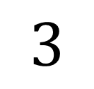
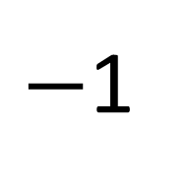
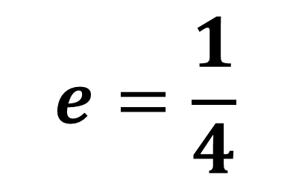
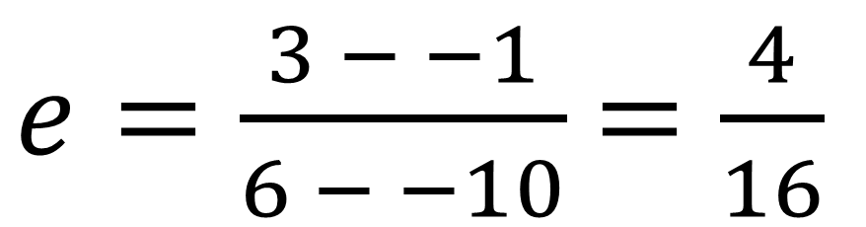
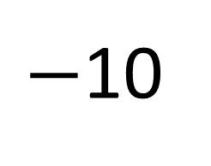
Calculate the value of
the coefficient of restitution.
6
$−$10
$e=\frac{3 − −1}{6 − −10}$ $=\frac{4}{16}$
$$e=\frac{1}{4}$$
$−$1
$$3$$

Slide 12
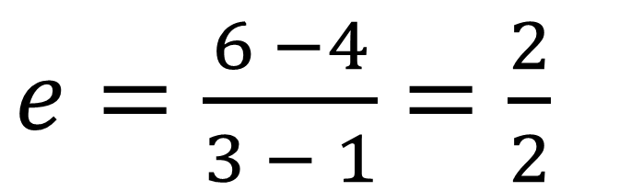
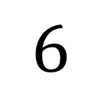
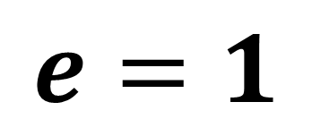
Calculate the value of
the coefficient of restitution.
3
1
$e=\frac{6 −4}{3 − 1}$ $=\frac{2}{2}$
$$e=1$$
4
$$6$$

Slide 13
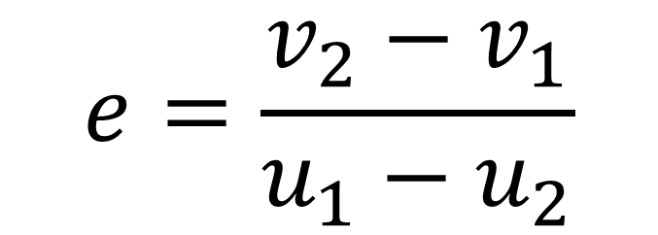
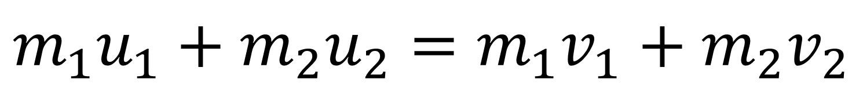
Game Plan
Conservation of Momentum
$${m_{1}u}_{1}+m_{2}u_{2}=m_{1}v_{1}+m_{2}v_{2}$$
The Coefficient of Restitution
$$e=\frac{v_{2}−v_{1}}{u_{1}−u_{2}}$$

Slide 14
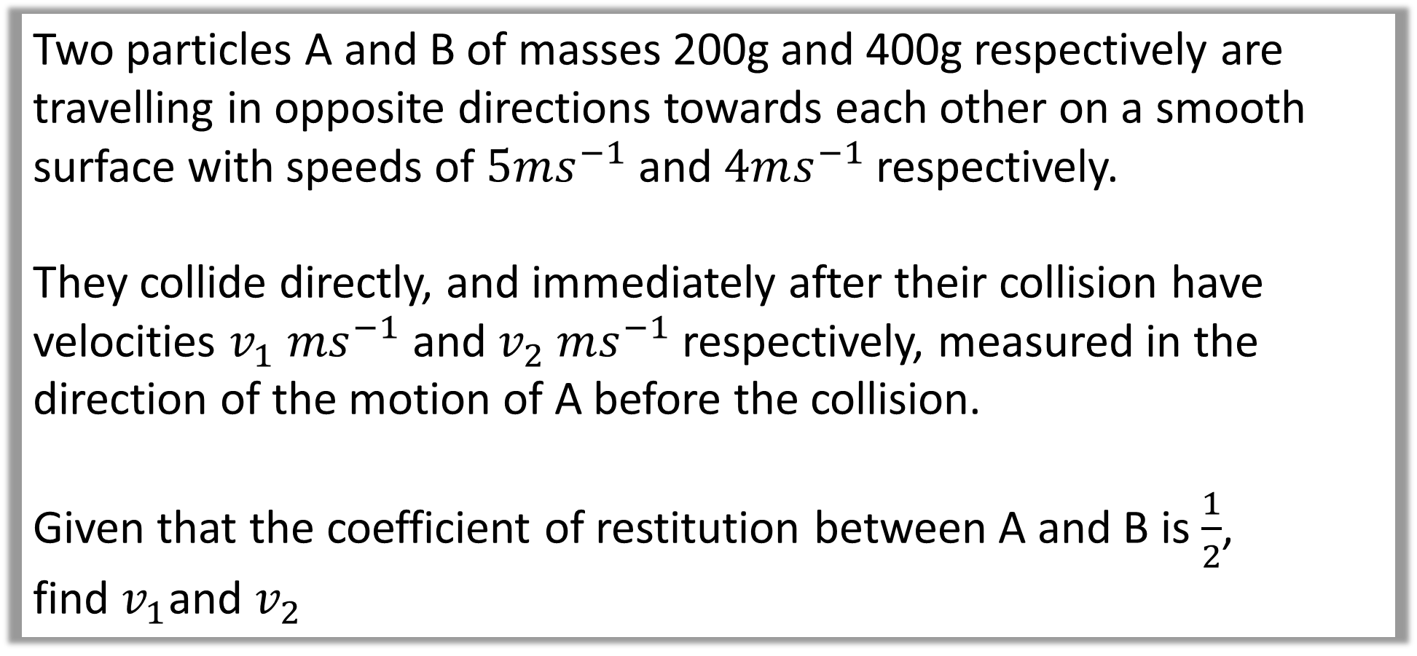
Question A
Two particles A and B of masses 200g and 400g respectively are travelling in opposite directions towards each other on a smooth surface with speeds of $5ms^{−1}$ and $4ms^{−1}$ respectively.
They collide directly, and immediately after their collision have velocities $v_{1} ms^{−1}$ and $v_{2} ms^{−1}$respectively, measured in the direction of the motion of A before the collision.
Given that the coefficient of restitution between A and B is $\frac{1}{2}$,
find $v_{1}$and $v_{2}$

Slide 15
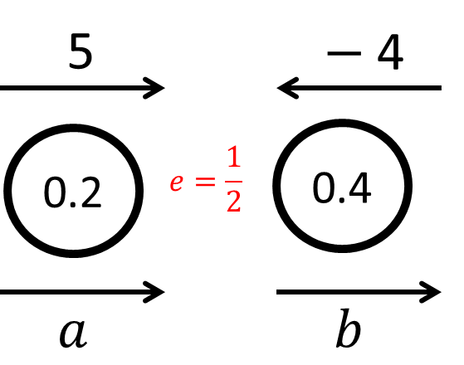

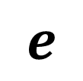
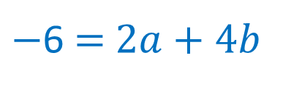



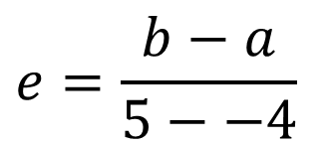

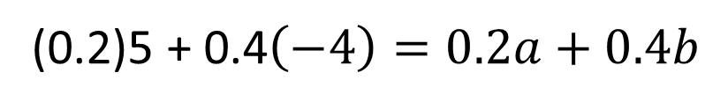

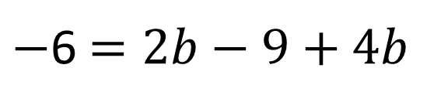
Given that the coefficient of restitution between A and B is $\frac{1}{2}$, find $v_{1}$and $v_{2}$
Solve for $b$
$2a=2b−9$
Sub
CoM
$−$6 $=2b−9+4b$
(0.2)5 + 0.4$\left(−4\right)=0.2a+0.4b$
$6b=3$
$−$6 $=$ $2a+4b$
$$e$$
$$b=0.5$$
$$e=\frac{b−a}{5−−4}$$
$$a=−4$$
$9=2b−2a$

Slide 16
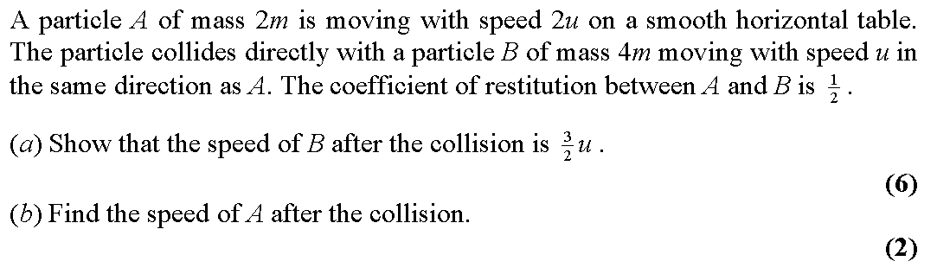
Question B

Slide 17
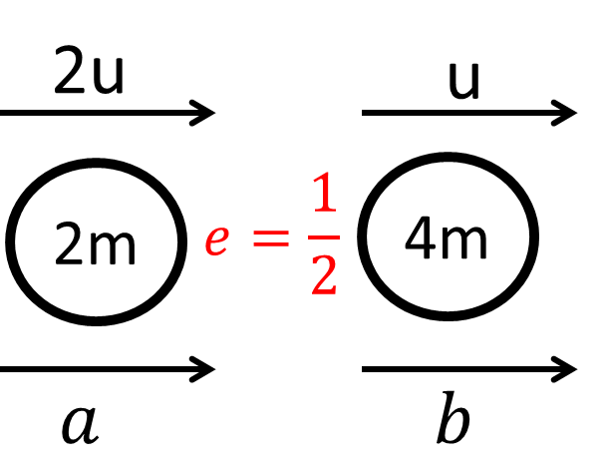






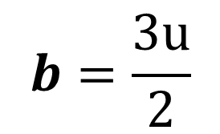
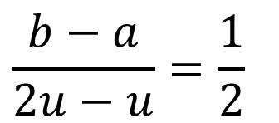



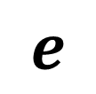

Solve for $b$
$2a=2b−u$
Sub
CoM
$$4u=a+2b$$
$$4mu+4mu=2ma+4mb$$
$$8u=2a+4b$$
$8u=$ $2a+4b$
$4u=$ $a+2b$
$$8u=2b−u+4b$$
$$e$$
$$9u=6b$$
$$\frac{b−a}{2u−u}=\frac{1}{2}$$
$$b=\frac{3u}{2}$$
$$2b−2a=u$$

Slide 18
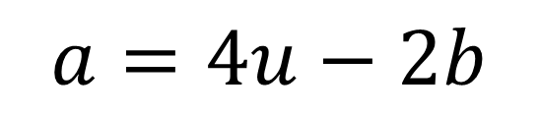
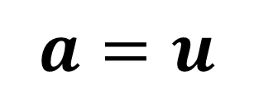
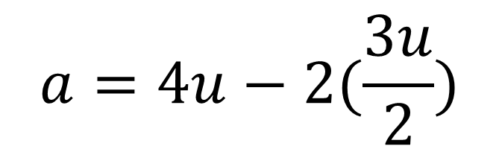

$$b=\frac{3u}{2}$$
$$a=4u−2b$$
$$a=4u−2(\frac{3u}{2})$$
$$a=u$$

