Slide 1
Application of Forces
Statics Rigid Bodies
Ladders
Chapter 7
(Part 3 of 6)

Slide 2
To solve static problems set up three equations.
=
Vertical forces
=
Horizontal forces
=
CW
ACW
Moments

Slide 3
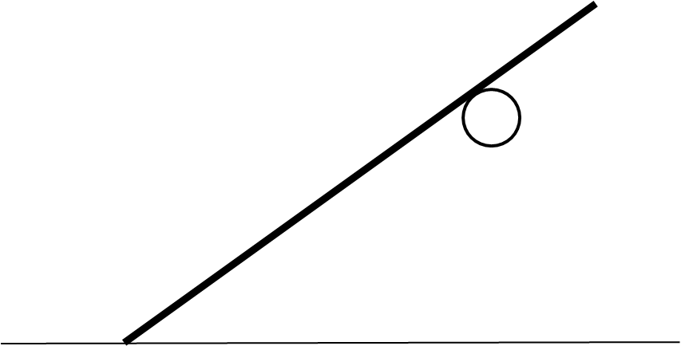
Ladders/Rods and a Peg
Reaction to peg (P)
ϴ
Reaction to ground (R)
Weight (mg)
ϴ
Friction (F)
Rough Floor

Slide 4
Resolving perpendicular to the ladder/rod for moments.
P
R cos ϴ
mg cos ϴ
ϴ
Rough Floor
F sin ϴ

Slide 5
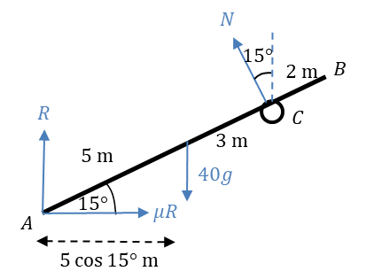

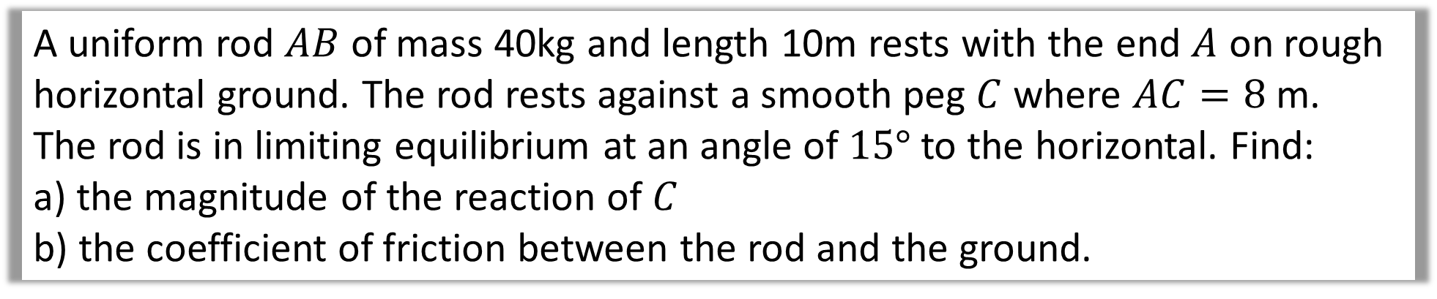



A uniform rod $AB$ of mass 40kg and length 10m rests with the end $A$ on rough horizontal ground. The rod rests against a smooth peg $C$ where $AC=8$ m.
The rod is in limiting equilibrium at an angle of $15°$ to the horizontal. Find:
a) the magnitude of the reaction of $C$
b) the coefficient of friction between the rod and the ground.
P
$$P\sin{15°}$$
$$Resolve Horizontally$$
$$to the floor$$
$$μR=P\sin{15°}$$
$$μR$$

Slide 6



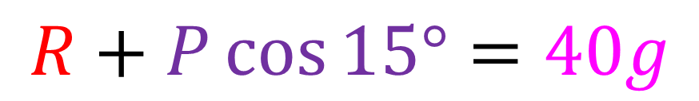

A uniform rod $AB$ of mass 40kg and length 10m rests with the end $A$ on rough horizontal ground. The rod rests against a smooth peg $C$ where $AC=8$ m.
The rod is in limiting equilibrium at an angle of $15°$ to the horizontal. Find:
a) the magnitude of the reaction of $C$
b) the coefficient of friction between the rod and the ground.
P
$$Resolve Vertically$$
$$to the floor$$
$$P\cos{15°}$$
$$R$$
$$R+P\cos{15°}=40g$$
$$40g$$

Slide 7
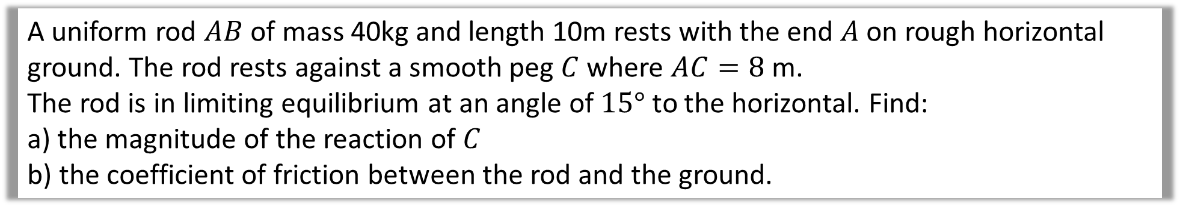
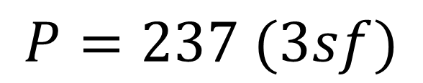
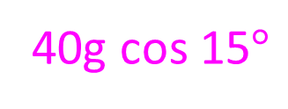
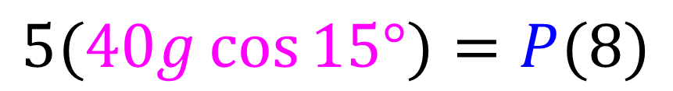
A uniform rod $AB$ of mass 40kg and length 10m rests with the end $A$ on rough horizontal ground. The rod rests against a smooth peg $C$ where $AC=8$ m.
The rod is in limiting equilibrium at an angle of $15°$ to the horizontal. Find:
a) the magnitude of the reaction of $C$
b) the coefficient of friction between the rod and the ground.
P
Moments (A)
$$5(40g\cos{15°)}=P(8)$$
$$P=237 (3sf)$$
40g cos 15$°$
a)
Reaction at C is 237N

Slide 8











A uniform rod $AB$ of mass 40kg and length 10m rests with the end $A$ on rough horizontal ground. The rod rests against a smooth peg $C$ where $AC=8$ m.
The rod is in limiting equilibrium at an angle of $15°$ to the horizontal. Find:
a) the magnitude of the reaction of $C$
b) the coefficient of friction between the rod and the ground.
$$μR=P\sin{15°}$$
$$=61.34N$$
b)
$$Resolve Horizontally$$
$$Resolve Vertically$$
$$R+P\cos{15°}=40g$$
$$R+61.34=40g$$
$$R=163.41$$
Moments (A)
$$P=237$$
$$μR=61.34$$
$$μ(163.41)=61.34$$
$$μ=0.375 (3sf)$$

Slide 9
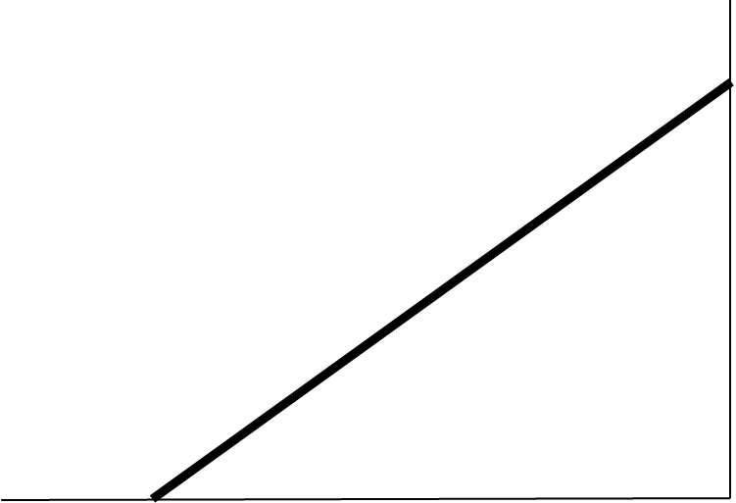
Ladders/Rods and a Smooth Wall
Reaction to the wall (W)
Smooth Wall
Reaction to ground (R)
Weight (mg)
ϴ
Rough Floor
Friction (F)

Slide 10
Resolving perpendicular to the ladder for moments.
w sin ϴ
Smooth Wall
R cos ϴ
mg cos ϴ
ϴ
Rough Floor
F sin ϴ

Slide 11
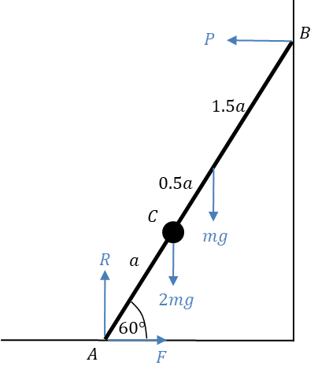
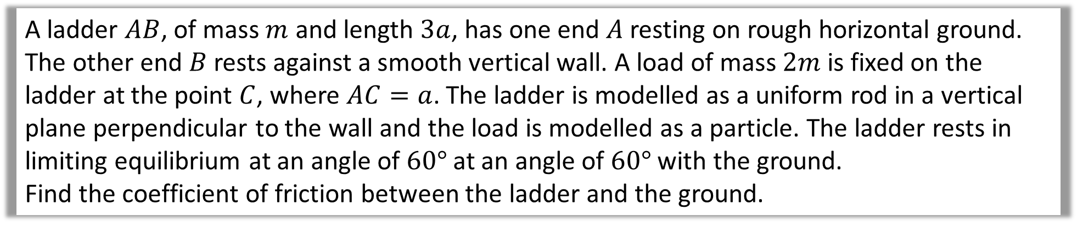
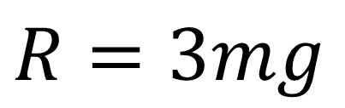
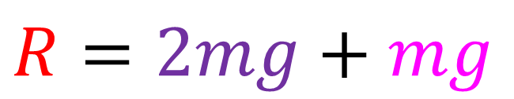
A ladder $AB$, of mass $m$ and length $3a$, has one end $A$ resting on rough horizontal ground. The other end $B$ rests against a smooth vertical wall. A load of mass $2m$ is fixed on the ladder at the point $C$, where $AC=a$. The ladder is modelled as a uniform rod in a vertical plane perpendicular to the wall and the load is modelled as a particle. The ladder rests in limiting equilibrium at an angle of $60°$ at an angle of $60°$ with the ground.
Find the coefficient of friction between the ladder and the ground.
Step 1: Resolve perpendicular to the floor
$$R=2mg+mg$$
$$R=3mg$$

Slide 12
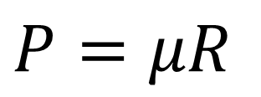
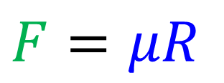
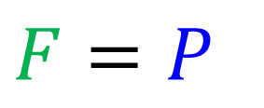
A ladder $AB$, of mass $m$ and length $3a$, has one end $A$ resting on rough horizontal ground. The other end $B$ rests against a smooth vertical wall. A load of mass $2m$ is fixed on the ladder at the point $C$, where $AC=a$. The ladder is modelled as a uniform rod in a vertical plane perpendicular to the wall and the load is modelled as a particle. The ladder rests in limiting equilibrium at an angle of $60°$ at an angle of $60°$ with the ground.
Find the coefficient of friction between the ladder and the ground.
Step 2: Resolve parallel to the floor
$F=P$
$F=μR$
$P=μR$

Slide 13

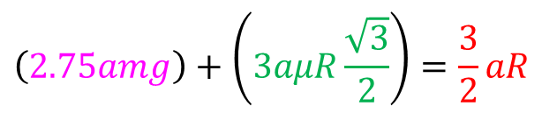

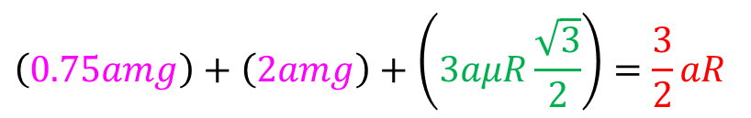

A ladder $AB$, of mass $m$ and length $3a$, has one end $A$ resting on rough horizontal ground. The other end $B$ rests against a smooth vertical wall. A load of mass $2m$ is fixed on the ladder at the point $C$, where $AC=a$. The ladder is modelled as a uniform rod in a vertical plane perpendicular to the wall and the load is modelled as a particle. The ladder rests in limiting equilibrium at an angle of $60°$ at an angle of $60°$ with the ground.
Find the coefficient of friction between the ladder and the ground.
P sin 60
Step 3: Take moment at a point of your choice.
Moments (B)
$\left(mg\cos{60°×1.5a}\right)+\left(2mg\cos{60°}×2a\right)+\left(μR\sin{60°}×3a\right)=R\cos{60°}$ $×3a$
$$\left(0.75amg\right)+\left(2amg\right)+\left(3aμR\frac{\sqrt{3}}{2}\right)=\frac{3}{2}aR$$
mg cos 60
$$\left(2.75amg\right)+\left(3aμR\frac{\sqrt{3}}{2}\right)=\frac{3}{2}aR$$
R cos 60
2mg cos 60
$$\left(5.5mg\right)+\left(3μR\sqrt{3}\right)=3R$$
$μR$ sin 60

Slide 14
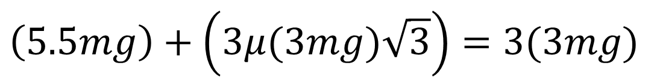
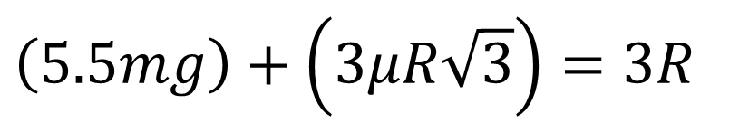




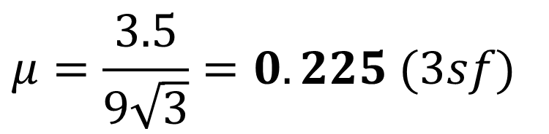

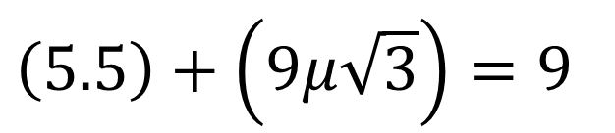

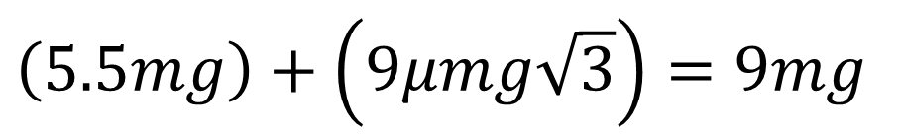
$$Relsove Horizontially$$
$$μR=P$$
$$Relsove Vertcially$$
$$R=3mg$$
$$Moments (B)$$
$$\left(5.5mg\right)+\left(3μR\sqrt{3}\right)=3R$$
$$Solve$$
$$Simultaneous$$
$$\left(5.5mg\right)+\left(3μ(3mg)\sqrt{3}\right)=3(3mg)$$
$$\left(5.5mg\right)+\left(9μmg\sqrt{3}\right)=9mg$$
$$\left(5.5\right)+\left(9μ\sqrt{3}\right)=9$$
$$μ=\frac{3.5}{9\sqrt{3}}=0.225 (3sf)$$

Slide 15
Ladders/Rods and a Rough Wall
Friction (Z)
Reaction to the wall (W)
Rough Wall
Reaction to ground (R)
Weight (mg)
ϴ
Rough Floor
Friction (F)

Slide 16
Resolving perpendicular to the ladder.
Z cos ϴ
w sin ϴ
Rough Wall
R cos ϴ
mg cos ϴ
ϴ
Rough Floor
F sin ϴ

