Slide 1
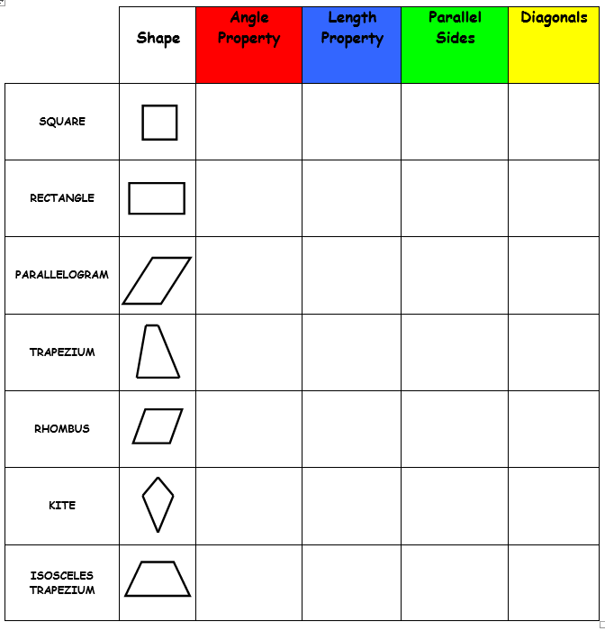
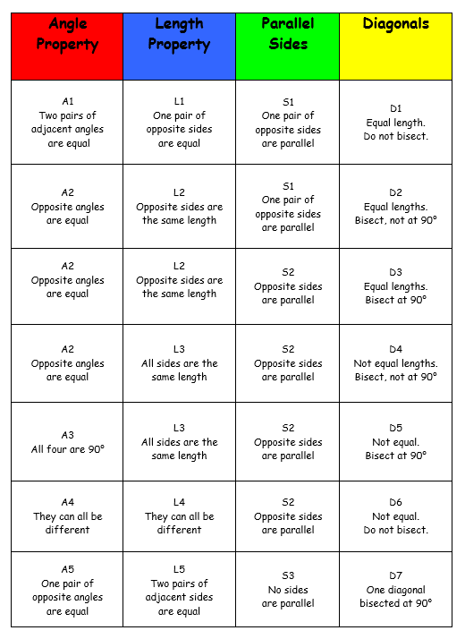

Slide 2
ANSWERS

Slide 3
 | Shape | Angle Property | Length Property | Parallel Sides | Diagonals
SQUARE |  | All four are 90° | All sides are the same length | Opposite sides are parallel | Equal lengths. Bisect at 90°
RECTANGLE |  | Opposite angles are equal | Opposite sides are the same length | Opposite sides are parallel | Equal lengths. Bisect, not at 90°
PARALLELOGRAM |  | Opposite angles are equal | Opposite sides are the same length | Opposite sides are parallel | Not equal lengths. Bisect, not at 90°
TRAPEZIUM |  | They can all be different | They can all be different | One pair of opposite sides are parallel | Not equal. Do not bisect
RHOMBUS |  | Opposite angles are equal | All sides are the same length | Opposite sides are parallel | Not equal. Bisect at 90°
KITE |  | One pair of opposite angles are equal | Two pairs of adjacent sides are equal | No sides are parallel | One diagonal bisected at 90°
ISOSCELES TRAPEZIUM |  | Two pairs of adjacent angles are equal | One pair of opposite sides are equal | One pair of opposite sides are parallel | Equal length. Do not bisect.

