Slide 1
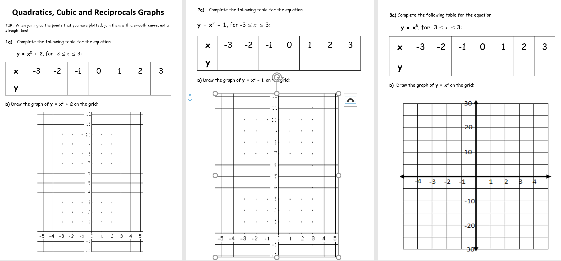
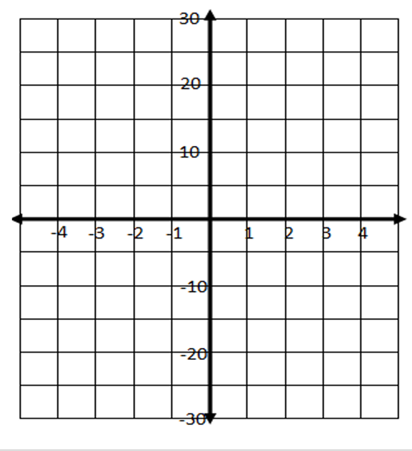
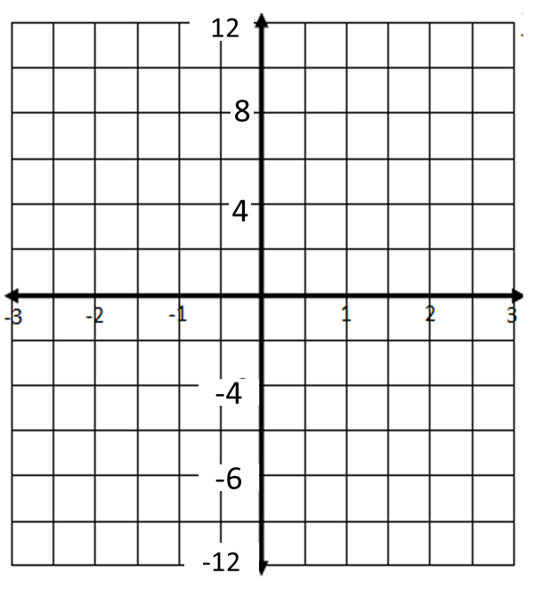
-8
-8

Slide 2
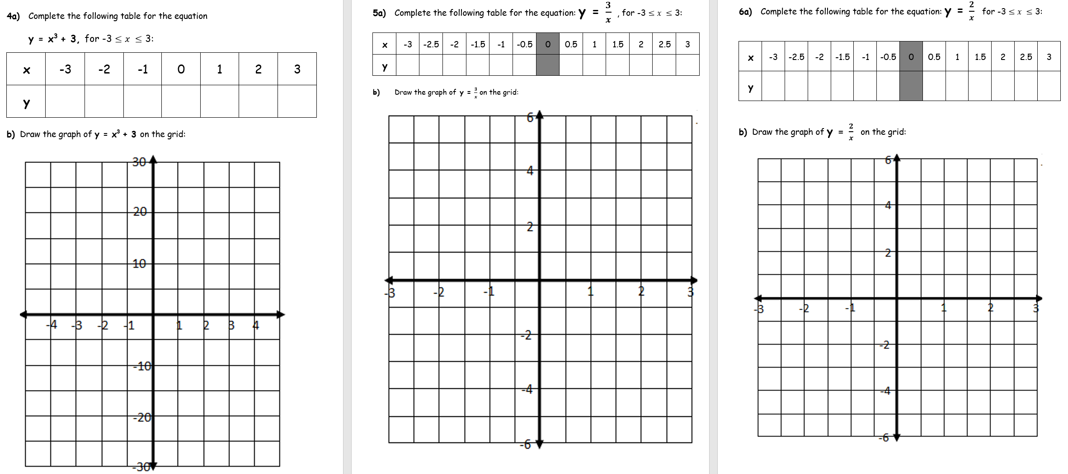

Slide 3
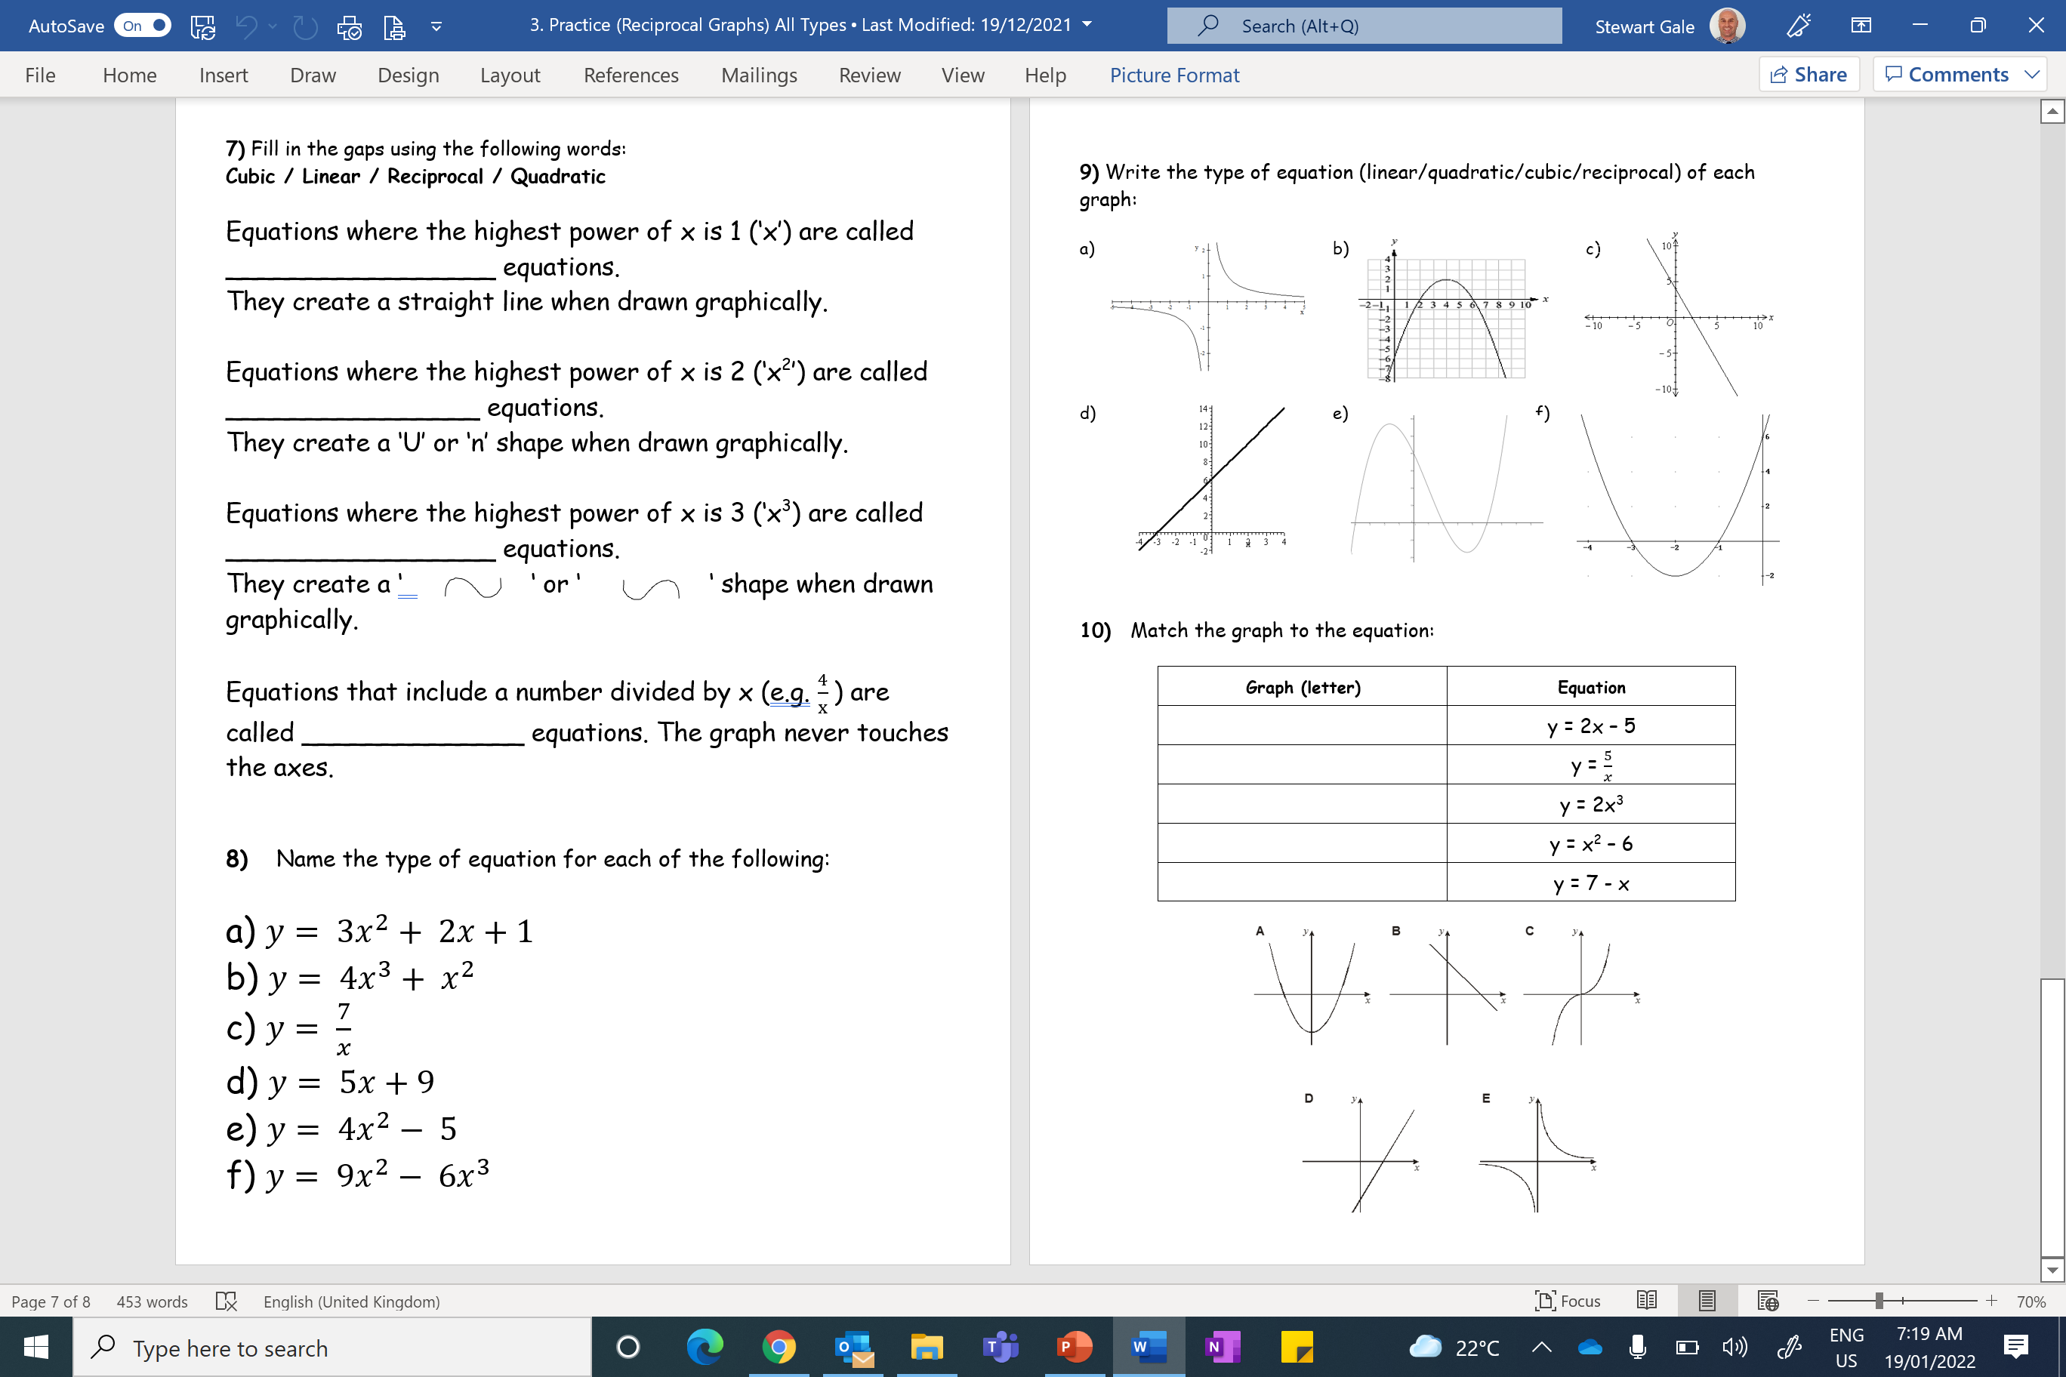

Slide 4
ANSWERS

Slide 5
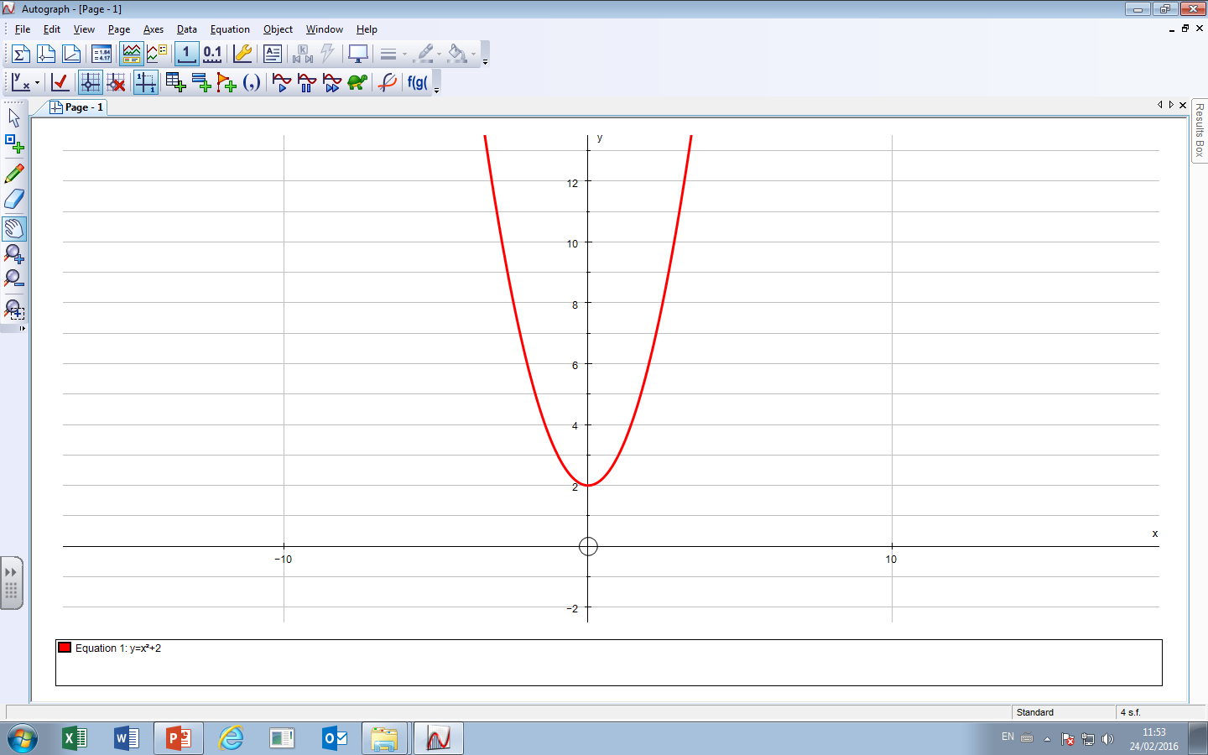
1a) Complete the following table for the equation y = x² + 2, for -3 ≤x ≤ 3:
x | -2 | -1 | 0 | 1 | 2 | 3
y | 6 | 3 | 2 | 3 | 6 | 11

Slide 6
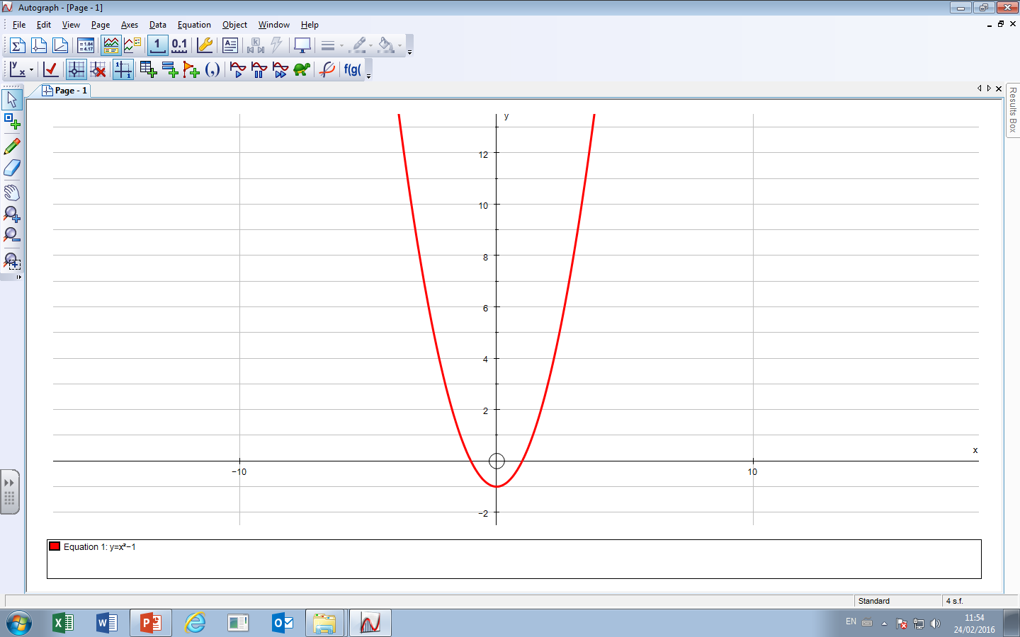
2a) Complete the following table for the equation y = x² - 1, for -3 ≤x ≤ 3:
x | -3 | -2 | -1 | 0 | 1 | 2 | 3
y | 8 | 3 | 0 | -1 | 0 | 3 | 8

Slide 7
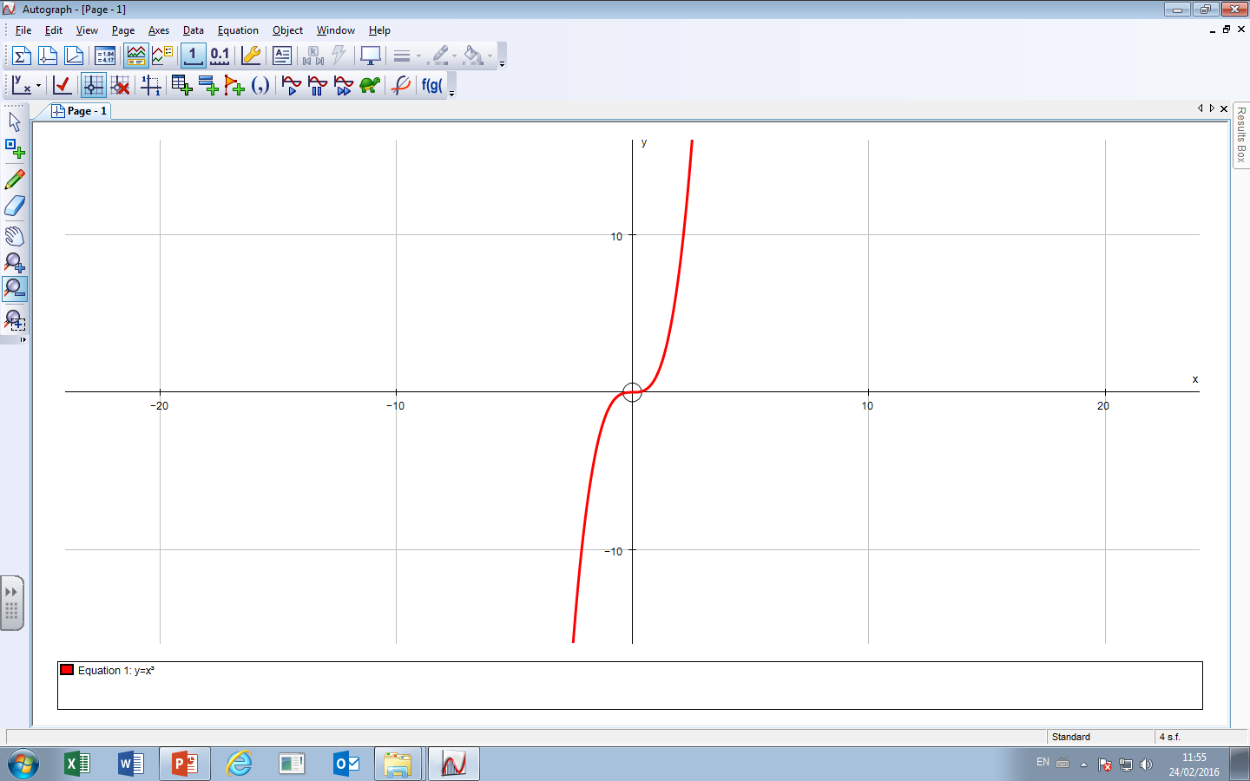
3a) Complete the following table for the equation y = x³, for -3 ≤x ≤ 3
x | -3 | -2 | -1 | 0 | 1 | 2 | 3
y | -27 | -8 | -1 | 0 | 1 | 8 | 27

Slide 8
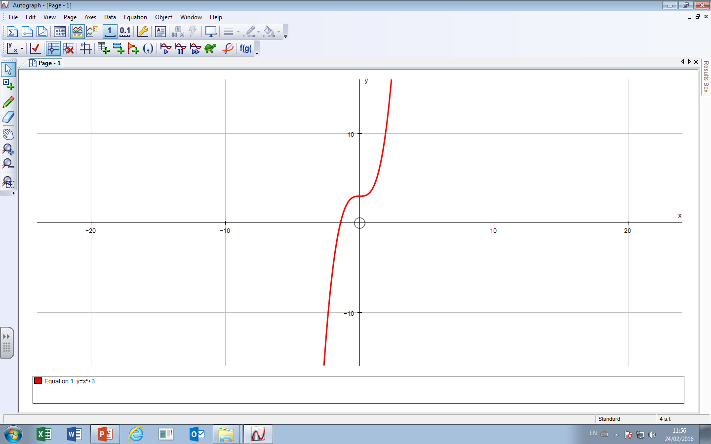
4a) Complete the following table for the equation y = x³ + 3, for -3 ≤x ≤ 3
x | -3 | -2 | -1 | 0 | 1 | 2 | 3
y | -24 | -5 | 2 | 3 | 4 | 11 | 30

Slide 9
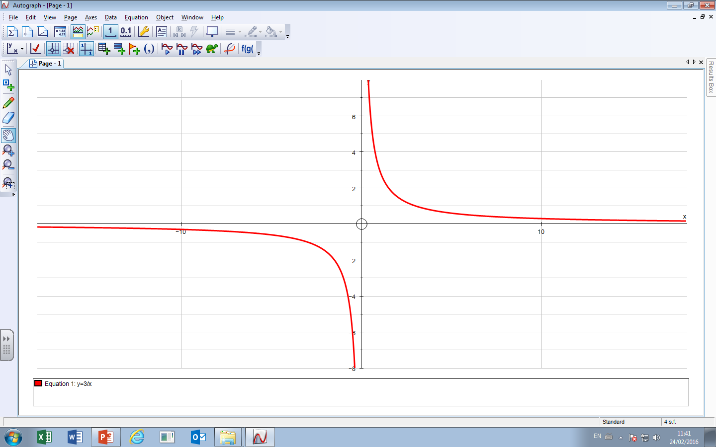
5a) Complete the following table for the equation: y = $\frac{3}{x}$ , for -3 ≤x ≤ 3
x | -3 | -2.5 | -2 | -1.5 | -1 | -0.5 | 0 | 0.5 | 1 | 1.5 | 2 | 2.5 | 3
y | -1 | -1.2 | -1.5 | -2 | -3 | -6 |  | 6 | 3 | 2 | 1.5 | 1.2 | 1

Slide 10
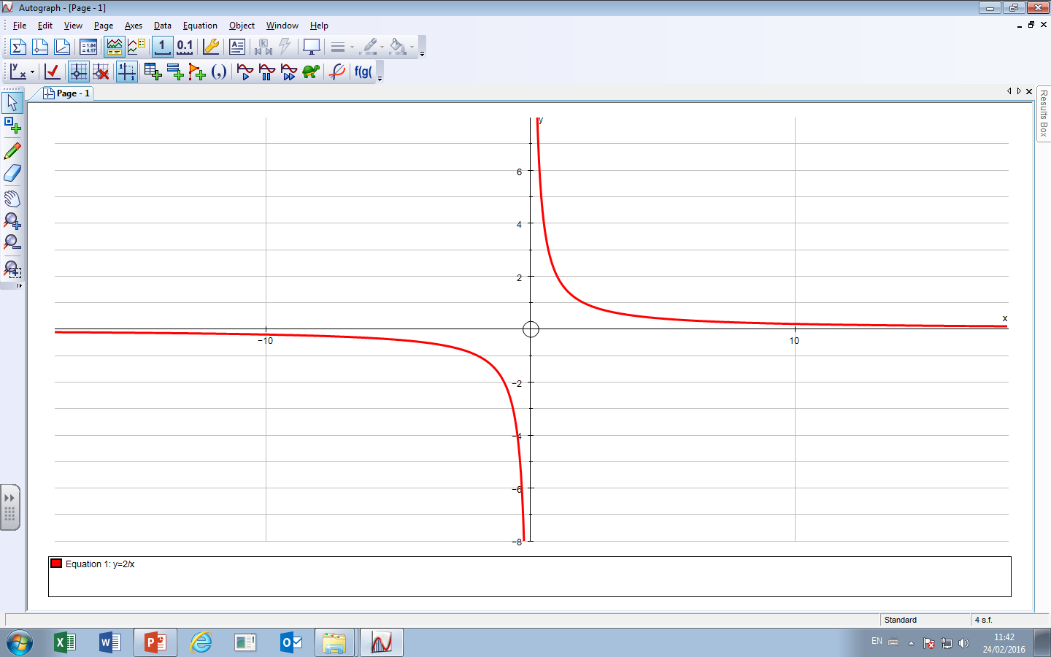
6a) Complete the following table for the equation: y = $\frac{2}{x}$ , for -3 ≤x ≤ 3
x | -3 | -2.5 | -2 | -1.5 | -1 | -0.5 | 0 | 0.5 | 1 | 1.5 | 2 | 2.5 | 3
y | -0.7 | -0.8 | -1 | -1.3 | -2 | -4 |  | 4 | 2 | 1.3 | 1 | 0.8 | 0.7

Slide 11
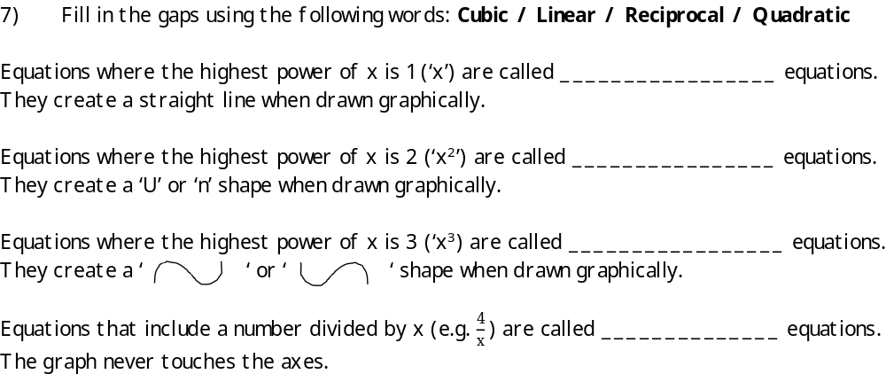
Linear
Quadratic
Cubic
Reciprocal

Slide 12
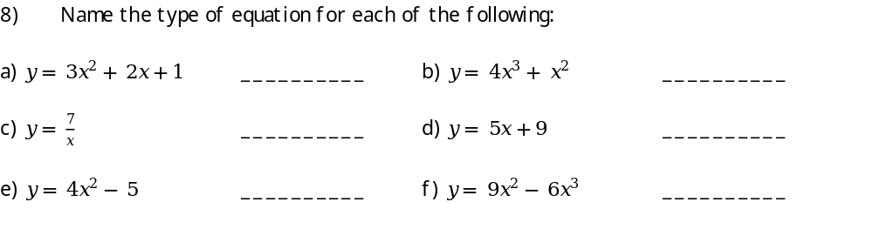
Quadratic
Cubic
Reciprocal
Linear
Quadratic
Cubic

Slide 13
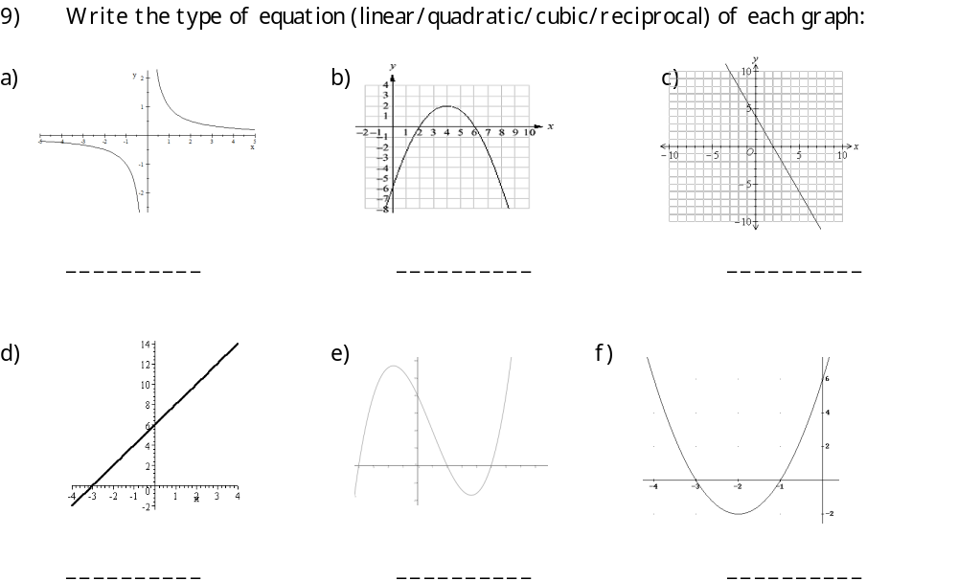
Reciprocal
Quadratic
Linear
Linear
Cubic
Quadratic

Slide 14
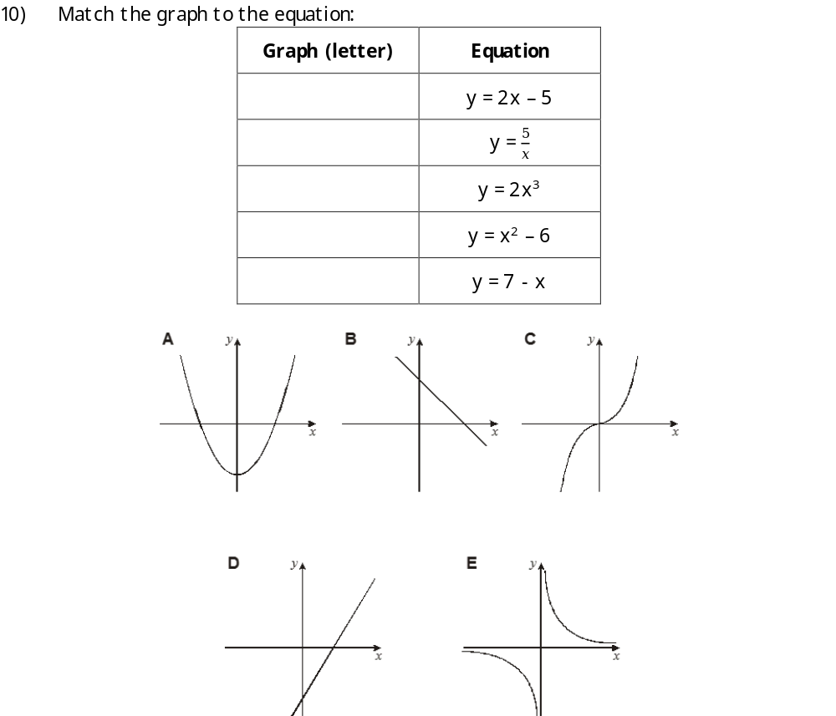
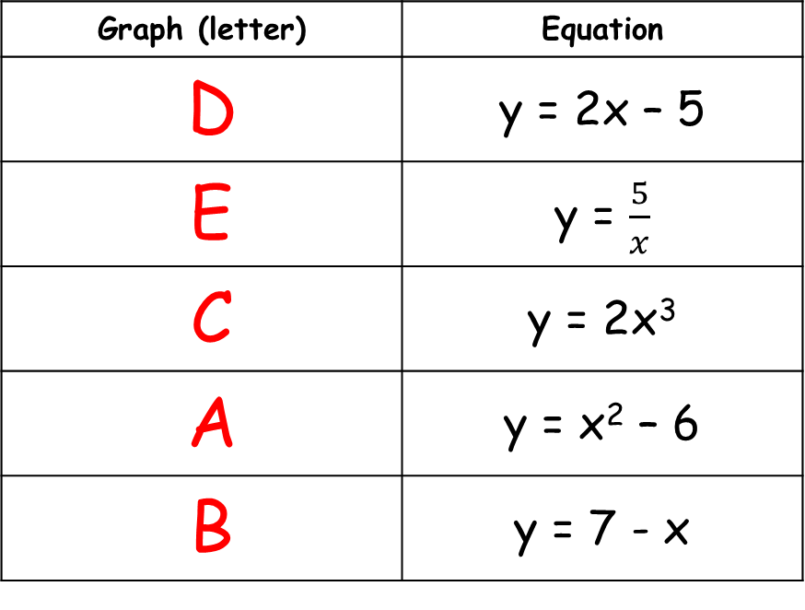
10) Match the graph to the equation:
Graph (letter) | Equation
D | y = 2x – 5
E | y = $\frac{5}{x}$
C | y = 2x³
A | y = x² – 6
B | y = 7 - x

