Slide 1
LO: Factorising
Quadratics
(when a > 1)

Slide 2
2x² + 2x – 4
ax² + bx + c

Slide 3
What is the value of the a, b and c?
3x² – 5x – 3
a = 3 b = -5 c = -3
3
-5
-3

Slide 4
What is the value of the a, b and c?
5x + 3x² – 3
a = 3 b = -5 c = -3
3
5
-3

Slide 5
What is the value of the a, b and c?
2 – 5x – x²
a = 3 b = -5 c = -3
-1
-5
2

Slide 6
Match the Expansions
A) 2x² + 2x - 4 |  |  |  |  | 1) (2x + 1)(x + 3)
B) 2x² + 7x + 3 |  |  |  |  | 2) (3x + 1)(x - 1)
C) 2x² - 6x + 4 |  |  |  |  | 3) (2x - 2)(x - 2)
D) 3x² - 2x - 1 |  |  |  |  | 4) (3x + 1)(x + 2)
E) 3x² + 7x + 2 |  |  |  |  | 5) (2x - 2)(x + 2)

Slide 7
Expand
(2x + 3) (x + 5)
2x² + 10x + 3x + 15
2x² + 13x + 15
Factorise
2x² + 13x + 15
2x² + 10x + 3x + 15
(2x + 3) (x + 5)

Slide 8
Step 1: Identify sum (b) and product (ac)
Step 2: Un-simplify the x term
Step 3: Factorise in pairs
Step 4: Write out the double brackets

Slide 9
2x² + 13x + 15
Product = ac = 30
Sum = b = 13
2x² + 10x + 3x + 15
10 and 3
(2x² + 10x) + (3x + 15)
Factorise in Pairs
2x(x + 5) + 3(x + 5)
(2x + 3)(x + 5)

Slide 10
3x² + 11x + 6
Product = ac = 18
Sum = b = 11
3x² + 9x + 2x + 6
9 and 2
(3x² + 9x) + (2x + 6)
Factorise in Pairs
3x(x + 3) + 2(x + 3)
(3x + 2)(x + 3)

Slide 11
2x² + 2x – 4
Product = ac = -8
Sum = b = 2
2x² + 4x – 2x – 4
4 and -2
(2x² + 4x) + (–2x – 4)
Factorise in Pairs
2x(x + 2) – 2(x + 2)
(2x – 2)(x + 2)

Slide 12
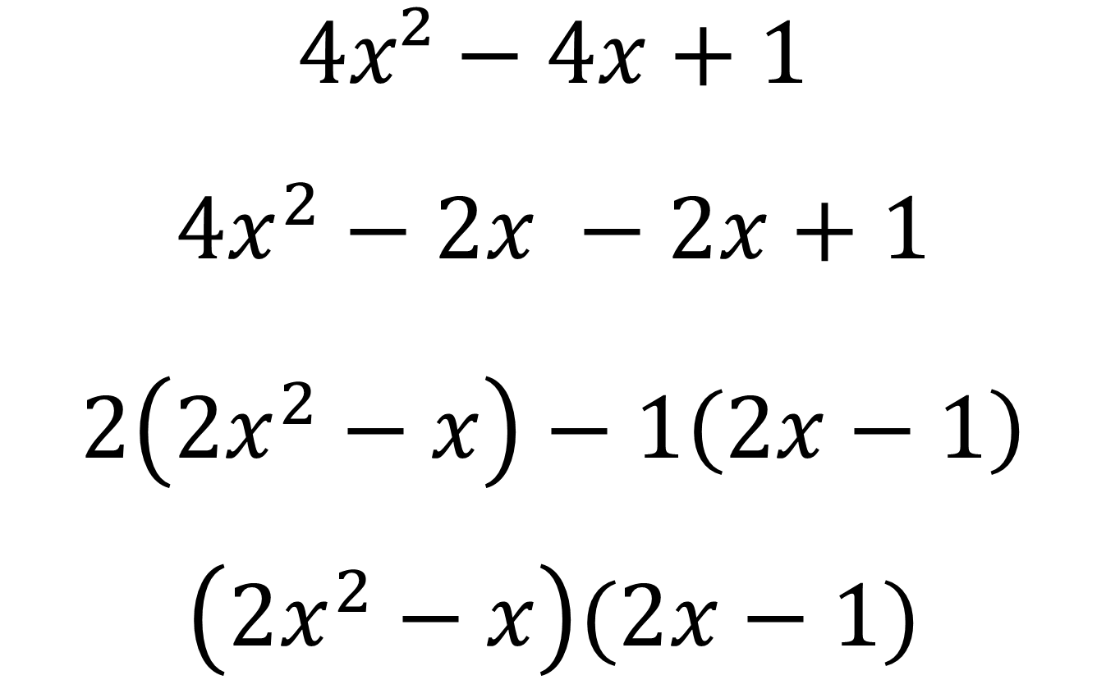
Spot the mistake!
$$4x²−4x+1$$
$$4x^{2}−2x −2x+1$$
$$2\left(2x^{2}−x\right)−1\left(2x−1\right)$$
$$\left(2x^{2}−x\right)(2x−1)$$

