Slide 1
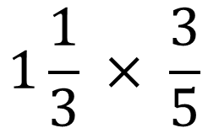
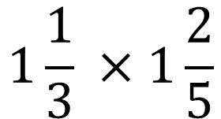
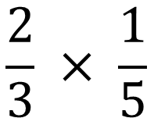
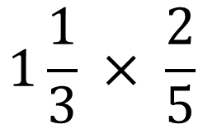
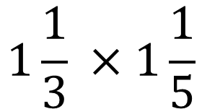
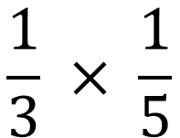
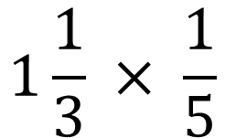
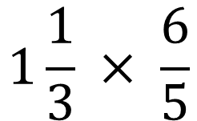
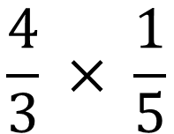
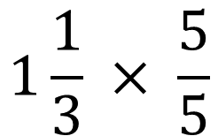
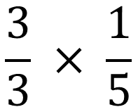
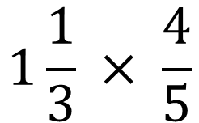
Simplify answers if possible.
$$\frac{1}{3} × \frac{1}{5}$$
$$1\frac{1}{3} × \frac{1}{5}$$
$$1\frac{1}{3} × \frac{5}{5}$$
1)
5)
9)
$$\frac{2}{3} × \frac{1}{5}$$
$$1\frac{1}{3} × \frac{2}{5}$$
$$1\frac{1}{3} × \frac{6}{5}$$
2)
6)
10)
$$\frac{3}{3} × \frac{1}{5}$$
$$1\frac{1}{3} ×1\frac{1}{5}$$
$$1\frac{1}{3} × \frac{3}{5}$$
3)
11)
7)
$$\frac{4}{3} × \frac{1}{5}$$
$$1\frac{1}{3} ×1\frac{2}{5}$$
4)
$$1\frac{1}{3} × \frac{4}{5}$$
8)
12)

Slide 2
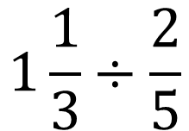
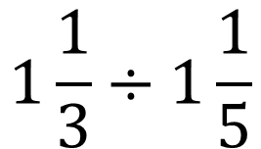
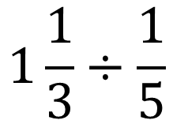
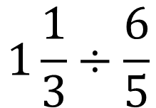
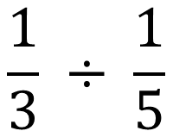
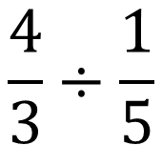
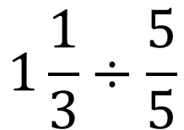
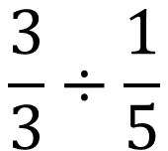
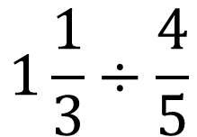
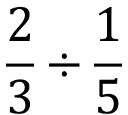
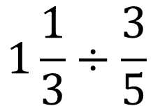
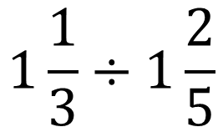
Simplify answers if possible.
$$\frac{1}{3} ÷ \frac{1}{5}$$
$$1\frac{1}{3}÷\frac{1}{5}$$
$$1\frac{1}{3}÷\frac{5}{5}$$
1)
5)
9)
$$1\frac{1}{3}÷\frac{2}{5}$$
$$1\frac{1}{3}÷\frac{6}{5}$$
$$\frac{2}{3}÷\frac{1}{5}$$
2)
$$\frac{3}{3}÷\frac{1}{5}$$
$$1\frac{1}{3}÷1\frac{1}{5}$$
$$1\frac{1}{3}÷\frac{3}{5}$$
3)
11)
7)
$$\frac{4}{3}÷\frac{1}{5}$$
$$1\frac{1}{3}÷\frac{4}{5}$$
$$1\frac{1}{3}÷1\frac{2}{5}$$
4)
8)
12)

Slide 3
ANSWERS

Slide 4
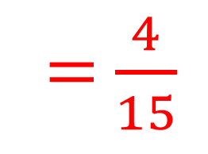
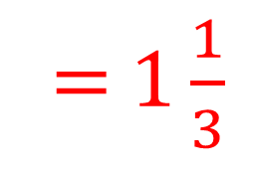
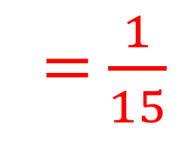
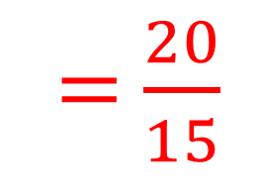
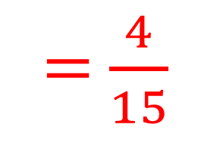
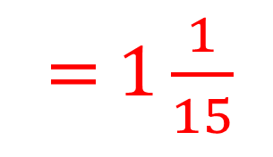
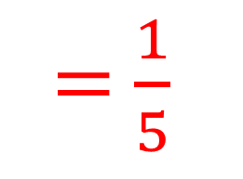
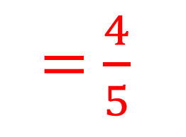
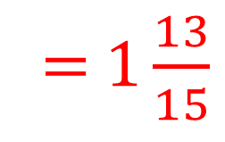
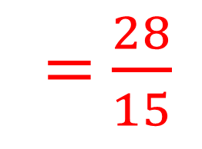
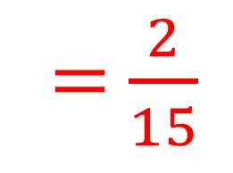
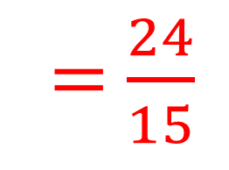
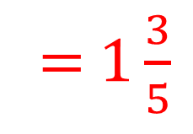
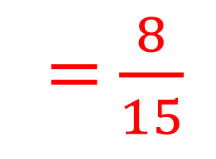
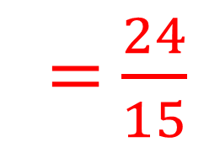
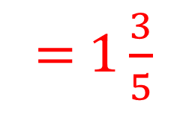
Simplify answers if possible.
$$\frac{1}{3} × \frac{1}{5}$$
= $\frac{1}{15}$
$$1\frac{1}{3} × \frac{1}{5}$$
= $\frac{4}{15}$
$$1\frac{1}{3} × \frac{5}{5}$$
= $\frac{20}{15}$
= $1\frac{1}{3}$
1)
5)
9)
$$\frac{2}{3} × \frac{1}{5}$$
$$1\frac{1}{3} × \frac{2}{5}$$
$$1\frac{1}{3} × \frac{6}{5}$$
= $\frac{24}{15}$
= $1\frac{3}{5}$
= $\frac{2}{15}$
= $\frac{8}{15}$
2)
6)
10)
$$\frac{3}{3} × \frac{1}{5}$$
= $\frac{1}{5}$
= $\frac{4}{5}$
$$1\frac{1}{3} ×1\frac{1}{5}$$
= $\frac{24}{15}$
$$1\frac{1}{3} × \frac{3}{5}$$
= $1\frac{3}{5}$
3)
11)
7)
$$\frac{4}{3} × \frac{1}{5}$$
= $\frac{4}{15}$
$$1\frac{1}{3} ×1\frac{2}{5}$$
= $\frac{28}{15}$
4)
$$1\frac{1}{3} × \frac{4}{5}$$
= $1\frac{1}{15}$
= $1\frac{13}{15}$
8)
12)

Slide 5
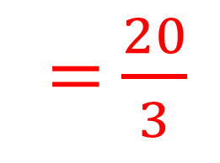
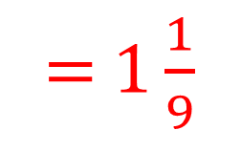
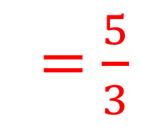
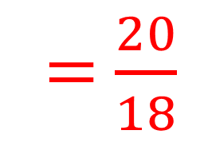
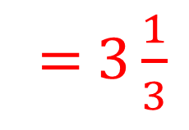
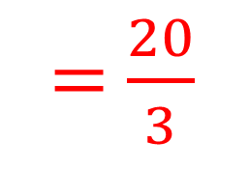
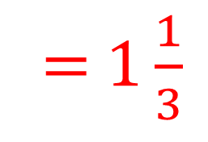
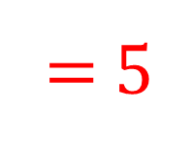
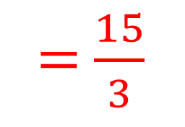
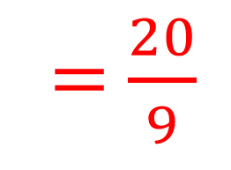











Simplify answers if possible.
$$\frac{1}{3} ÷ \frac{1}{5}$$
= $\frac{5}{3}$
$$1\frac{1}{3}÷\frac{1}{5}$$
= $\frac{20}{3}$
= $6\frac{2}{3}$
$$1\frac{1}{3}÷\frac{5}{5}$$
= $1\frac{1}{3}$
= $1\frac{2}{3}$
5)
1)
9)
$$1\frac{1}{3}÷\frac{6}{5}$$
= $\frac{20}{18}$
= $1\frac{1}{9}$
$$\frac{2}{3}÷\frac{1}{5}$$
= $\frac{10}{3}$
$$1\frac{1}{3}÷\frac{2}{5}$$
= $\frac{20}{6}$
= 3$\frac{1}{3}$
= $3\frac{1}{3}$
10)
2)
6)
$$\frac{3}{3}÷\frac{1}{5}$$
= $\frac{15}{3}$
$$1\frac{1}{3}÷1\frac{1}{5}$$
= $5$
$$1\frac{1}{3}÷\frac{3}{5}$$
= $\frac{20}{9}$
= $2\frac{2}{9}$
= $1\frac{1}{9}$
3)
11)
7)
$$\frac{4}{3}÷\frac{1}{5}$$
= $\frac{20}{3}$
$$1\frac{1}{3}÷\frac{4}{5}$$
= $1\frac{2}{3}$
$$1\frac{1}{3}÷1\frac{2}{5}$$
= $\frac{20}{21}$
= $6\frac{2}{3}$
= $\frac{20}{12}$
4)
8)
12)

