Slide 1
x | 0 | 30 | 60 | 90 | 120 | 150 | 180 | 210 | 240 | 270 | 300 | 330 | 360 | 390 | 420
Sin x | 0 | 0.5 |  | 1 |  |  | 0 |  |  | -1 |  |  |  | 0.5
x | 0 | 30 | 60 | 90 | 120 | 150 | 180 | 210 | 240 | 270 | 300 | 330 | 360 | 390 | 420
Cos x | 1 |  |  |  |  |  |  |  |  | 0 | 0.5
x | 0 | 30 | 60 | 90 | 120 | 150 | 180 | 210 | 240 | 270 | 300 | 330 | 360 | 390 | 420
Tan x
What do you notice when the graphs get to 360⁰?
Can you describe the relationship between the graphs of Sine and Cosine?

Slide 2
ANSWERS

Slide 3
x | 0 | 30 | 60 | 90 | 120 | 150 | 180 | 210 | 240 | 270 | 300 | 330 | 360 | 390 | 420
Sin x | 0 | 0.5 | 0.9 | 1 | 0.9 | 0.5 | 0 | -0.5 | -0.9 | -1 | -0.9 | -0.5 | 0 | 0.5 | 0.9
x | 0 | 30 | 60 | 90 | 120 | 150 | 180 | 210 | 240 | 270 | 300 | 330 | 360 | 390 | 420
Cos x | 1 | 0.9 | 0.5 | 0 | -0.5 | -0.9 | -1 | -0.9 | -0.5 | 0 | 0.5 | 0.9 | 1 | 0.9 | 0.5
x | 0 | 30 | 60 | 90 | 120 | 150 | 180 | 210 | 240 | 270 | 300 | 330 | 360 | 390 | 420
Tan x | 0 | 0.6 | 1.7 | error | -1.7 | -0.6 | 0 | 0.6 | 1.7 | error | -1.7 | -0.5 | 0 | 0.6 | 1.7
What do you notice when the graphs get to 360⁰?
Can you describe the relationship between the graphs of Sine and Cosine?

Slide 4
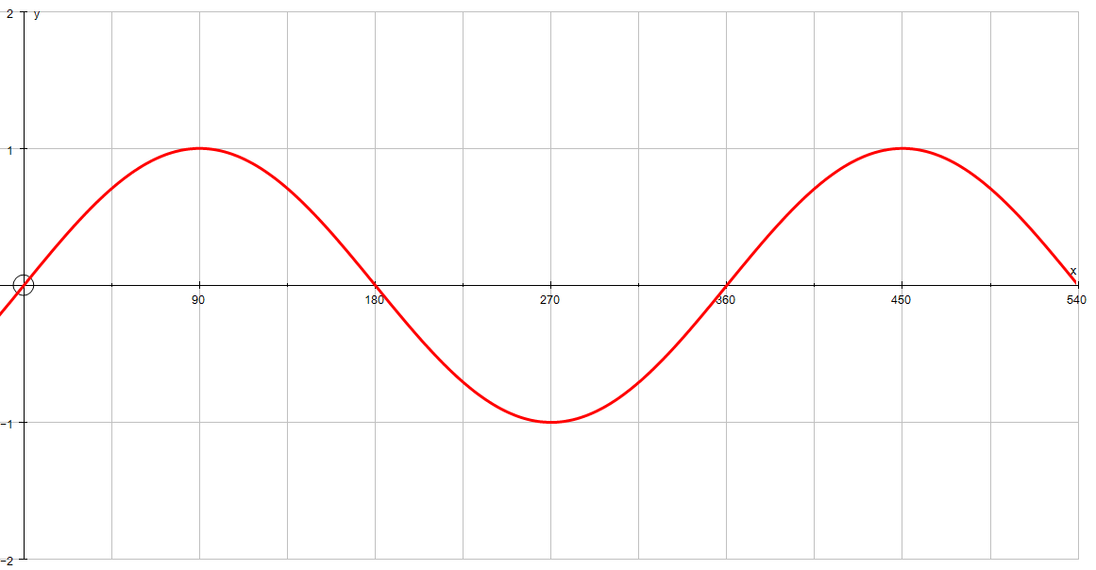
y = sin x

Slide 5
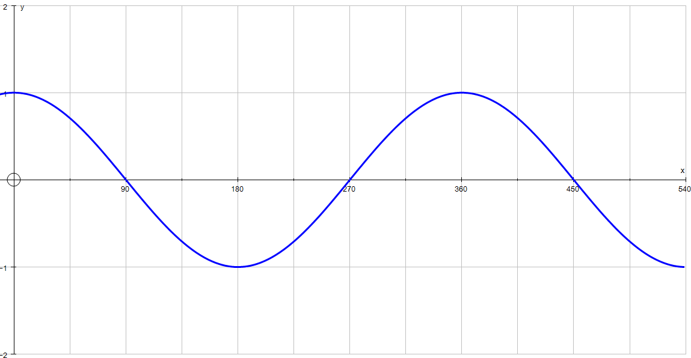
y = cos x

Slide 6
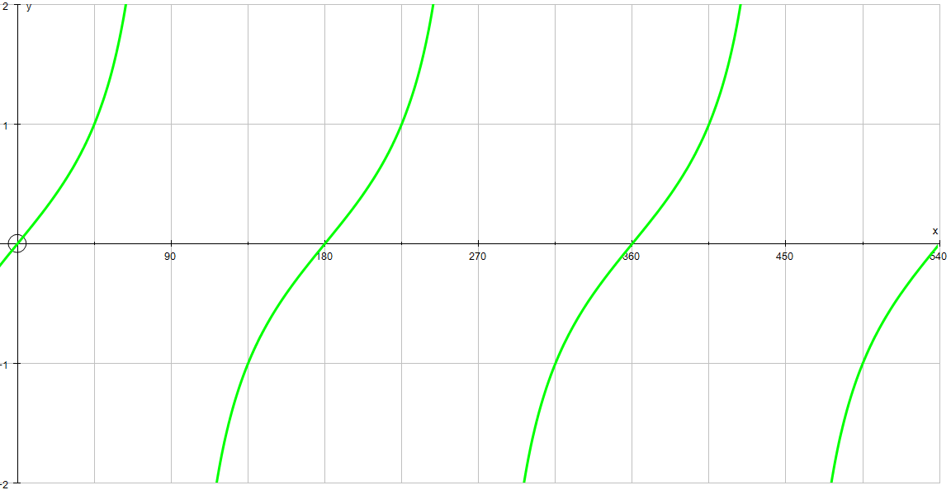
y = tan x

Slide 7
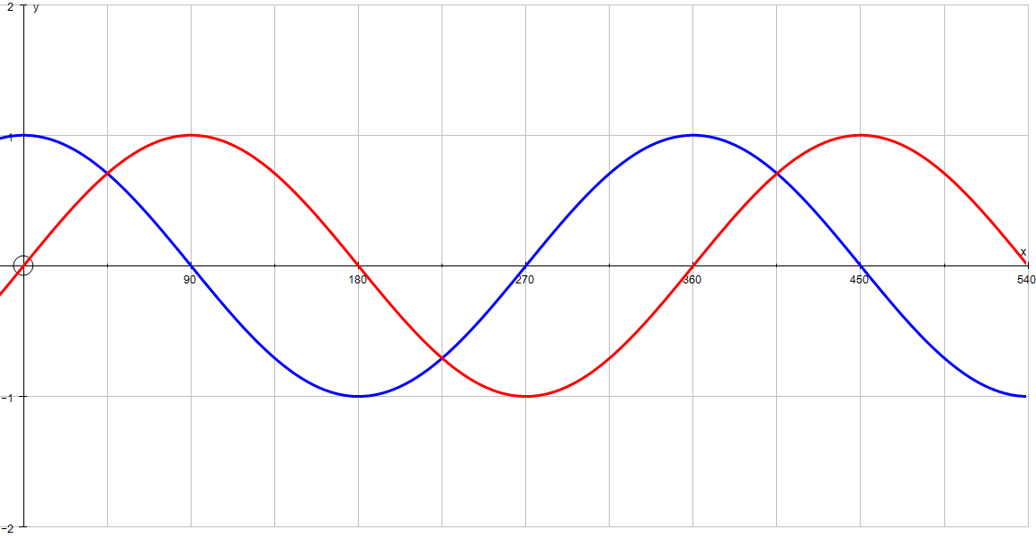
y = sin x y = cos x

