Slide 1
LO: Isometric Paper
and 3D Shapes

Slide 2
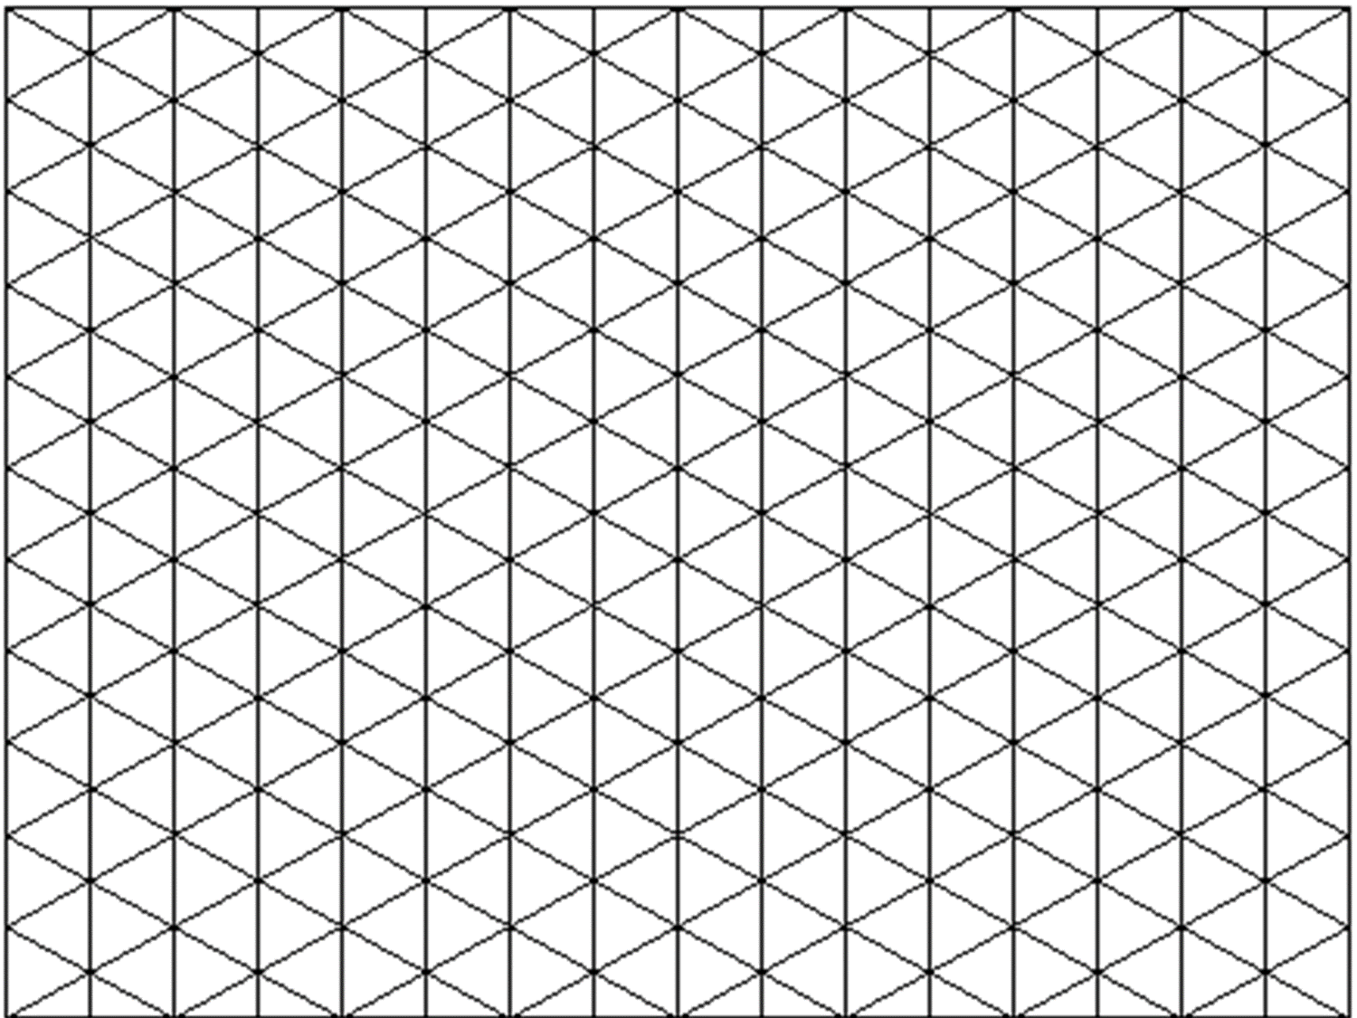
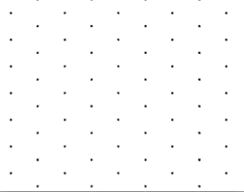
Isometric paper is made up of rhombuses.

Slide 3
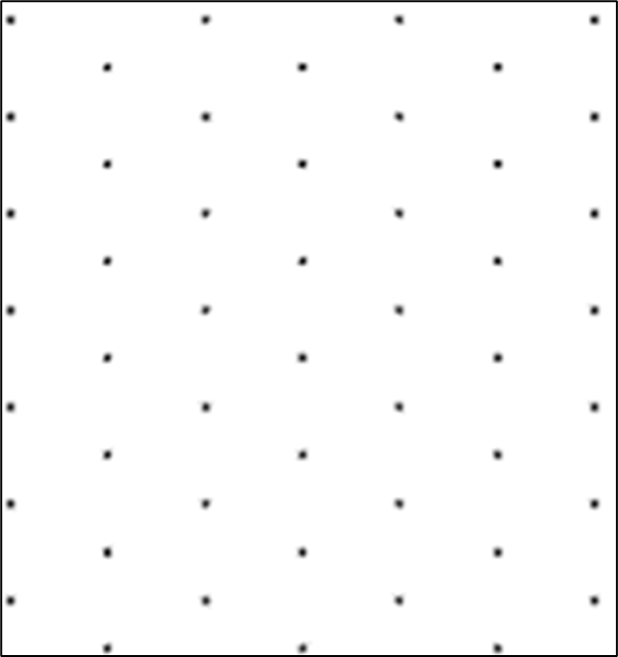
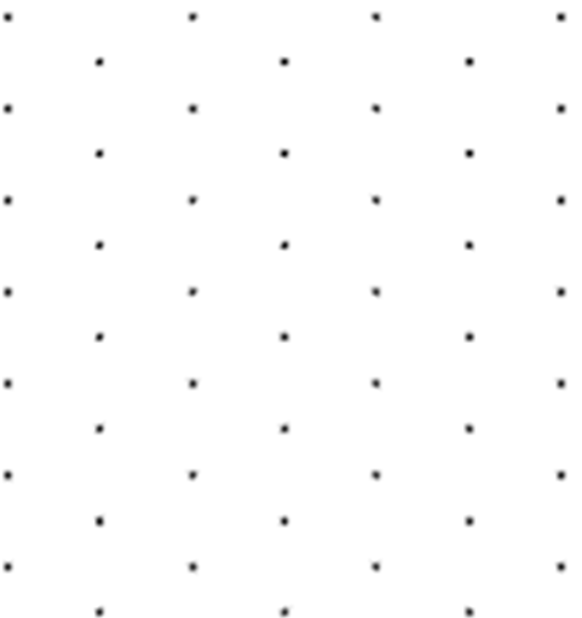


Rule of Using Isometric Paper
Portrait not Landscape.

Slide 4
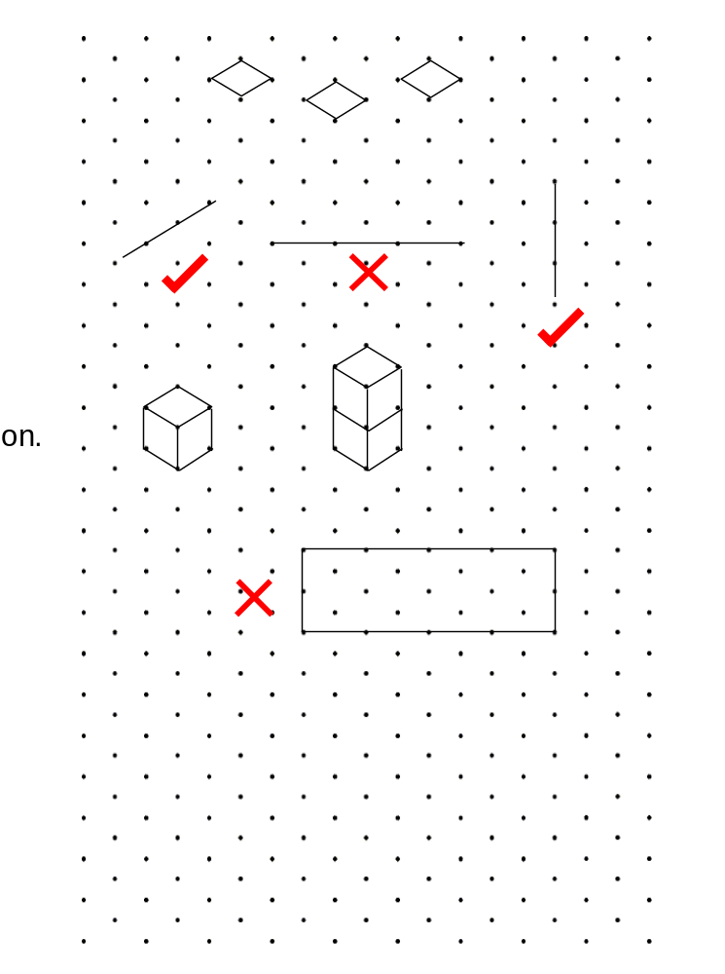
Rule of Using Isometric Paper
Only draw diagonal and vertical lines.

Slide 5
Rule of Using Isometric Paper
Draw rhombuses.

Slide 6
Rule of Using Isometric Paper
Shapes are viewed at an angle
and not straight on.

Slide 7
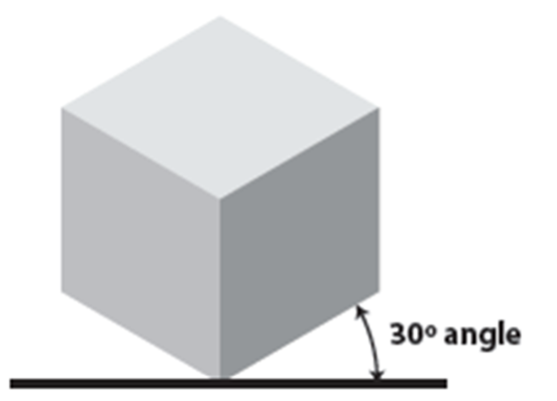
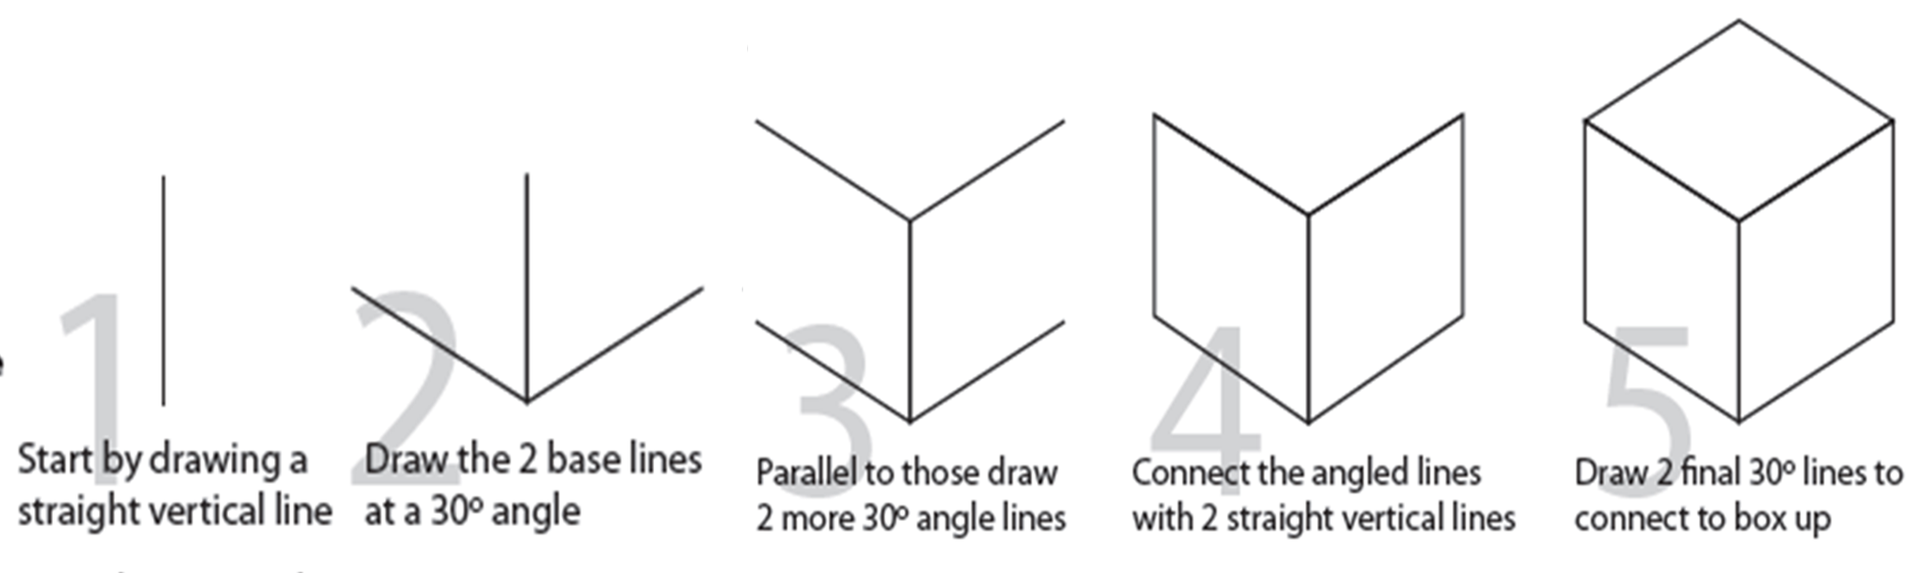

Slide 8
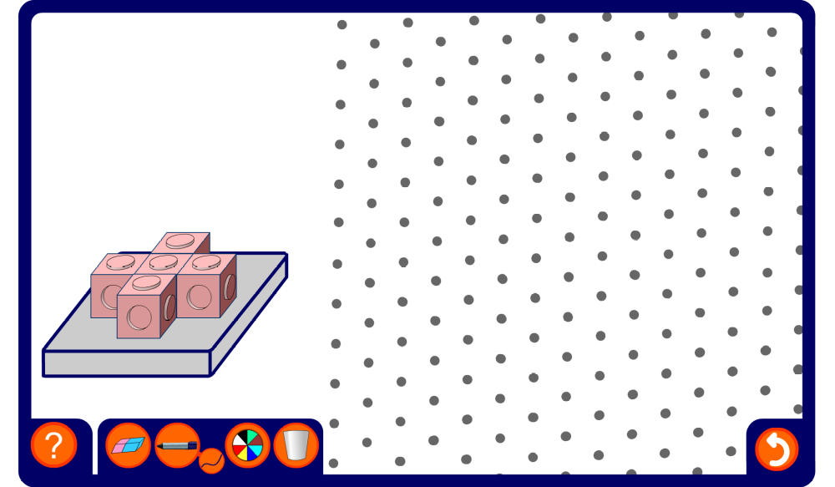
Drawing 3-D shapes on an isometric grid
Notes:
Use this activity to practise and to demonstrate isometric drawings of 3-dimensional shapes made from cubes.
Use the pen tool, set to draw straight lines, to draw the required shape on the grid.
As a more challenging exercise ask pupils to draw the given shape in different orientations of with extra cubes added in given positions.

