Slide 1
LO: Multiplying and Dividing Fractions

Slide 2

Denominators
do not
need to be the same.

Slide 3
Multiplying Fractions
Numerator x Numerator
Denominator x Denominator

Slide 4
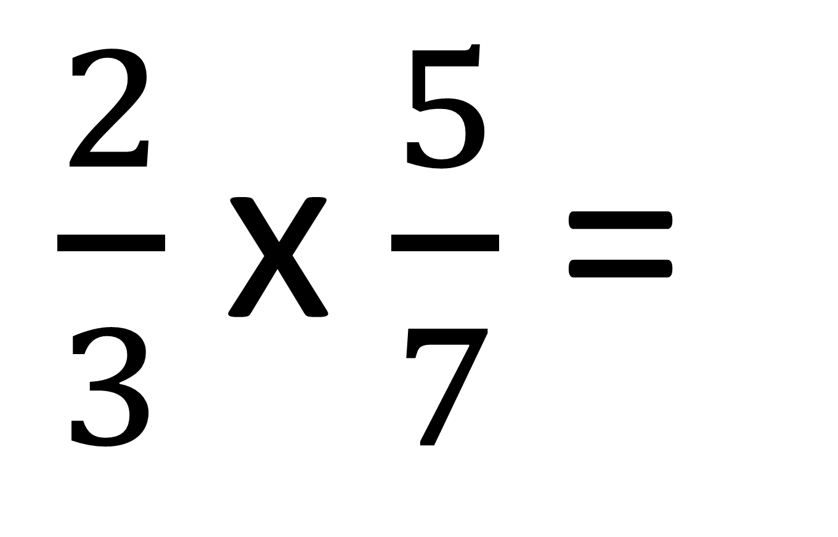
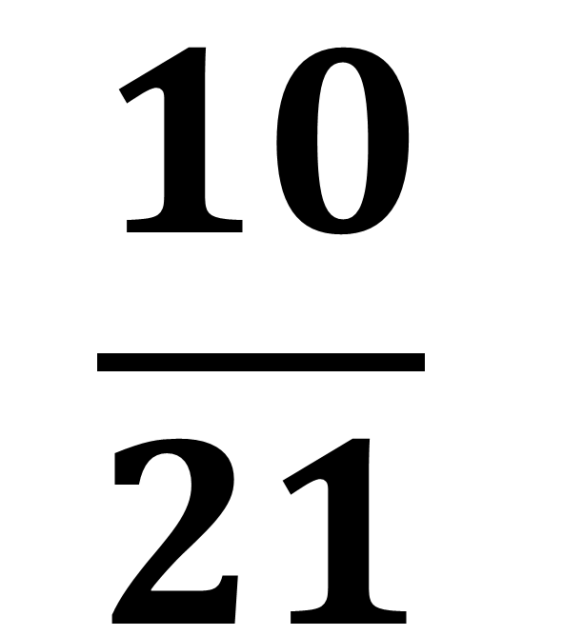
$\frac{2}{3}$ x $\frac{5}{7}$ =
$$\frac{10}{21}$$

Slide 5
Dividing Fractions
Flip the
dividing fraction
and multiply.

Slide 6
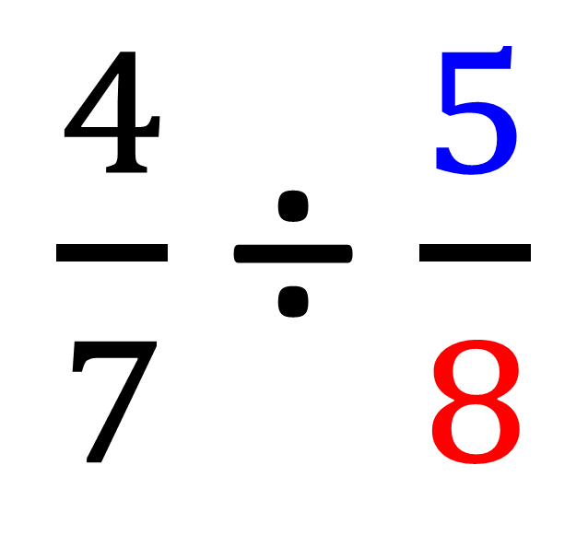
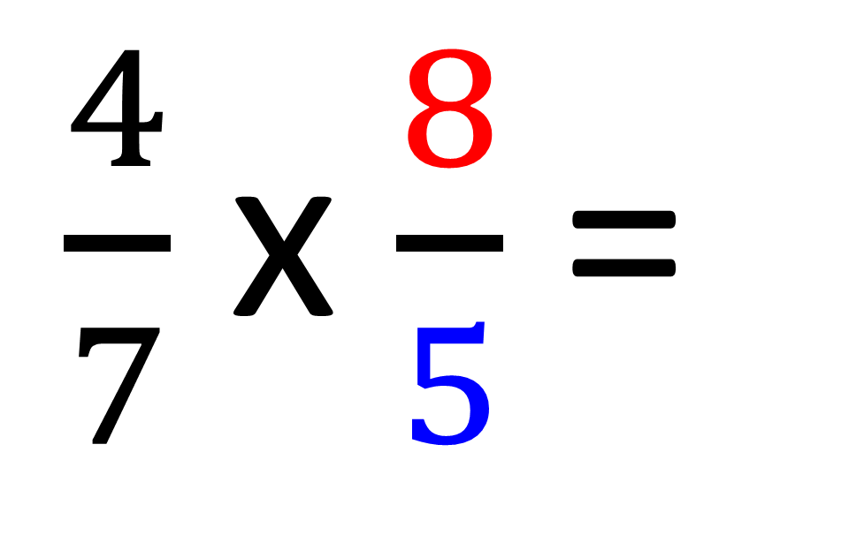
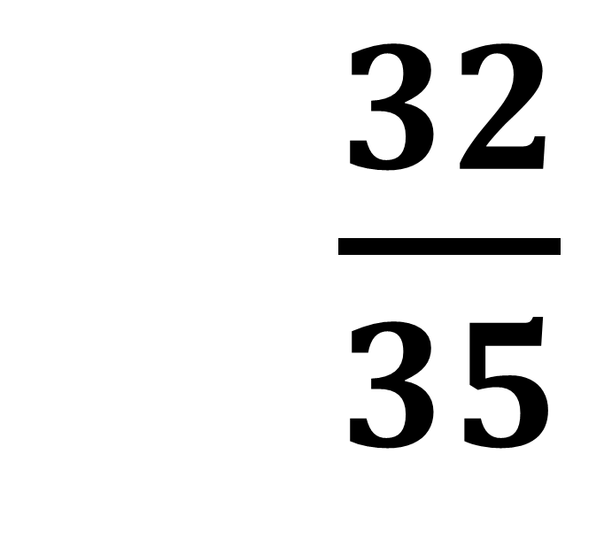
$\frac{4}{7}$ ÷ $\frac{5}{8}$
$\frac{4}{7}$ x $\frac{8}{5}$ =
= $\frac{32}{35}$

Slide 7
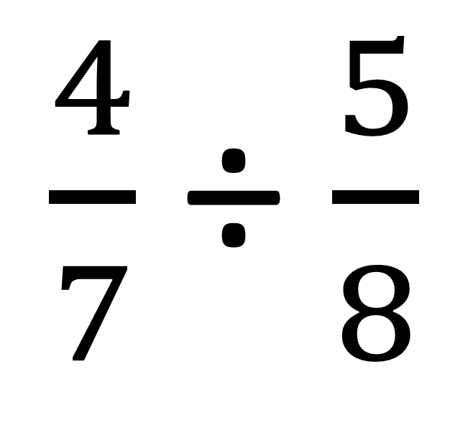
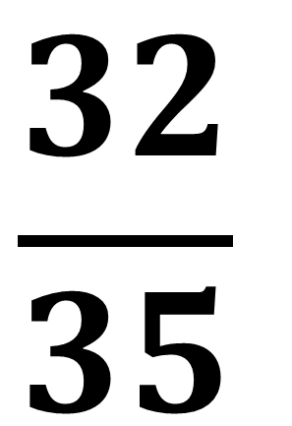
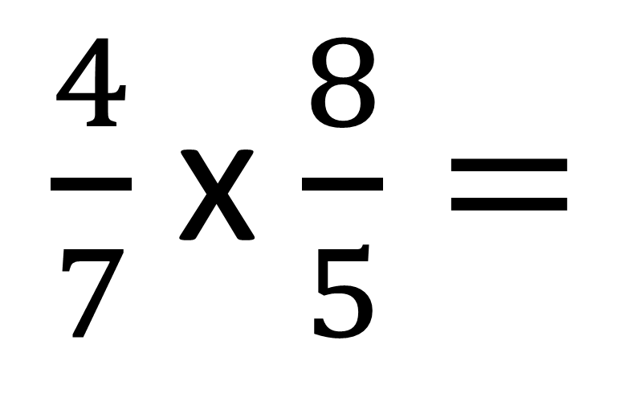
$\frac{4}{7}$ ÷ $\frac{5}{8}$
$\frac{4}{7}$ x $\frac{8}{5}=$
$$\frac{32}{35}$$

Slide 8
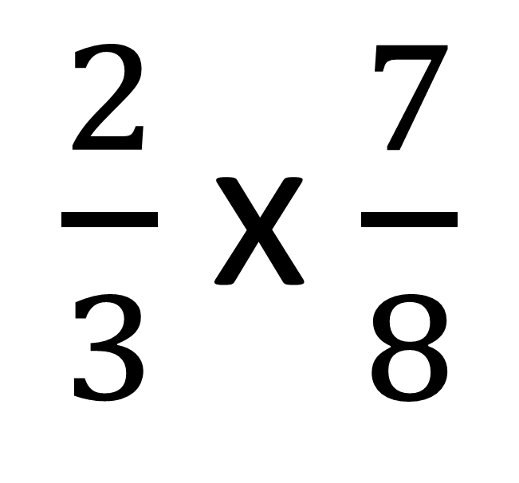
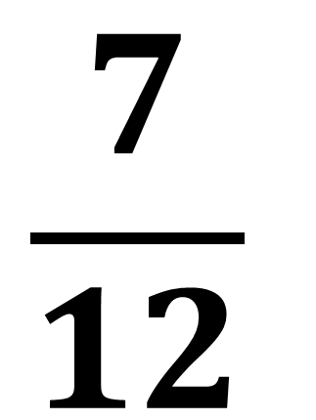
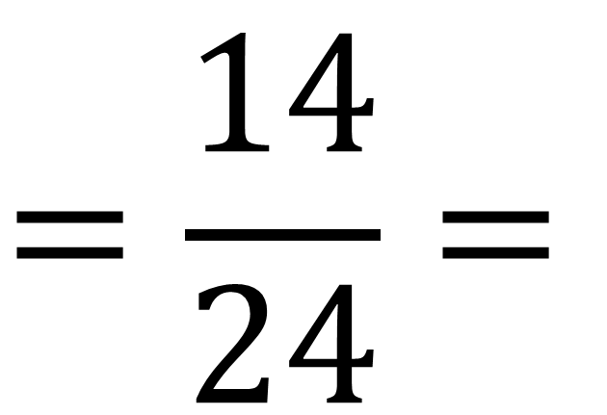
$\frac{2}{3}$ x $\frac{7}{8}$
$$=\frac{14}{24}=$$
$$\frac{7}{12}$$

Slide 9
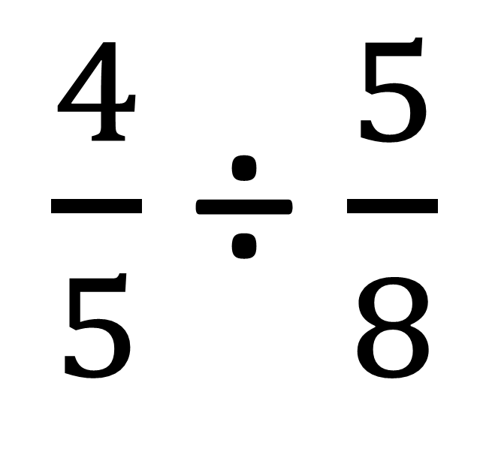
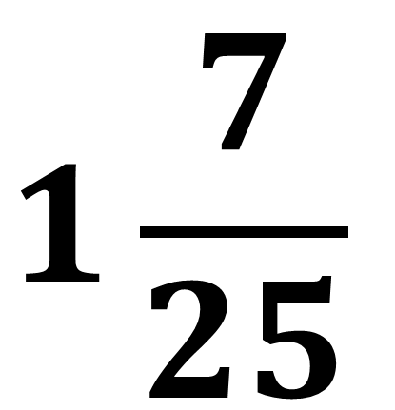
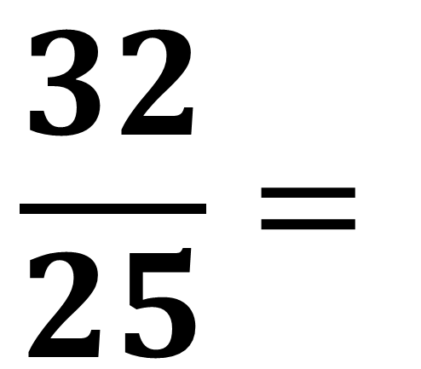
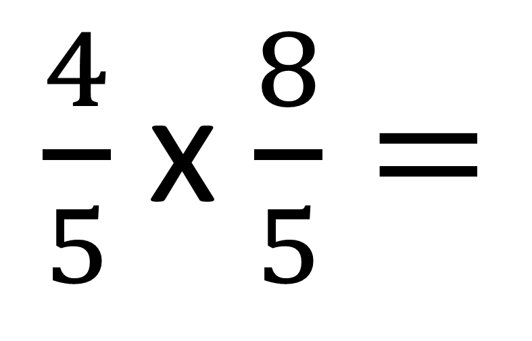
$\frac{4}{5}$ ÷ $\frac{5}{8}$
$\frac{4}{5}$ x $\frac{8}{5}=$
$$\frac{32}{25}=$$
$$1\frac{7}{25}$$

Slide 10
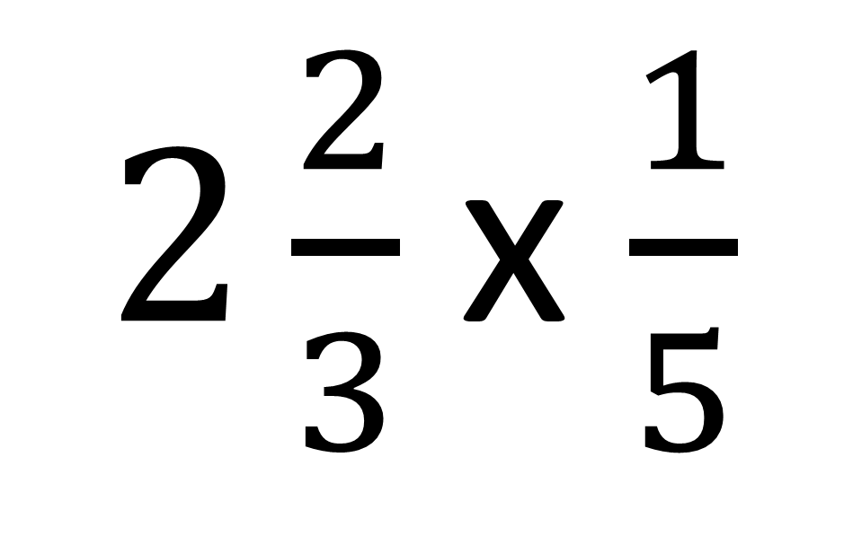
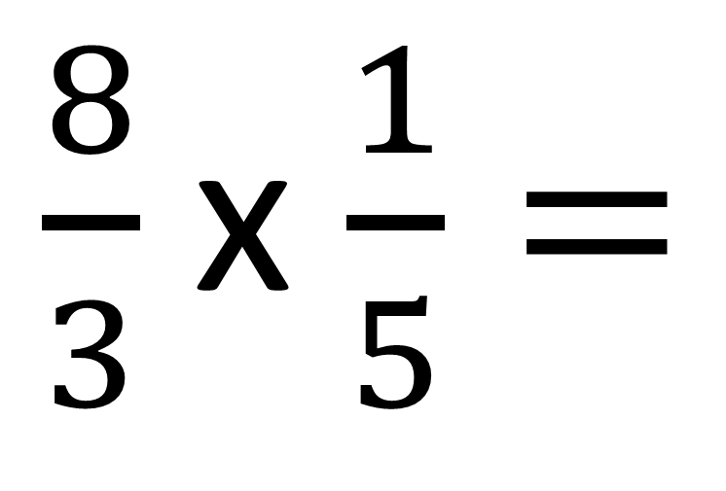
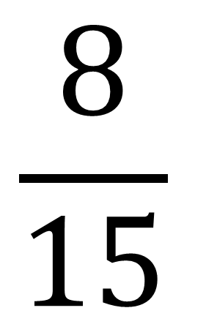
$2\frac{2}{3}$ x $\frac{1}{5}$
$\frac{8}{3}$ x $\frac{1}{5}=$
$$\frac{8}{15}$$

Slide 11
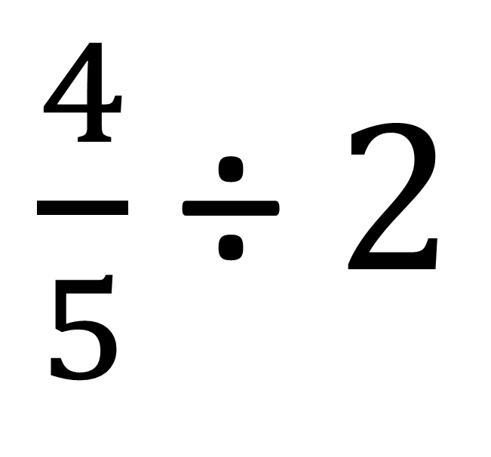
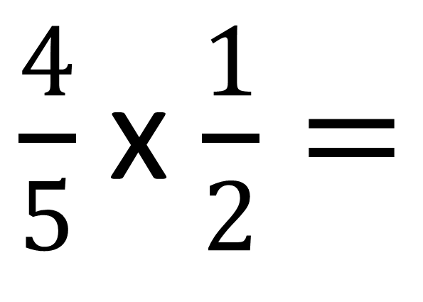
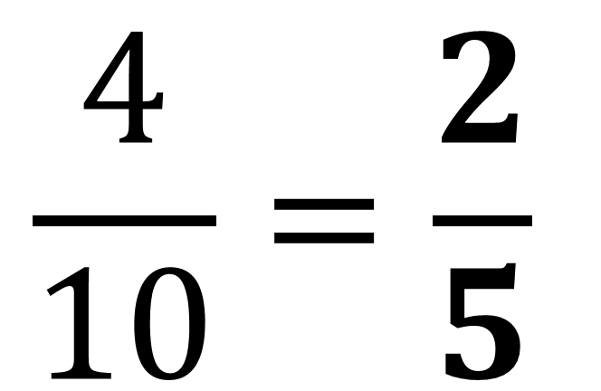
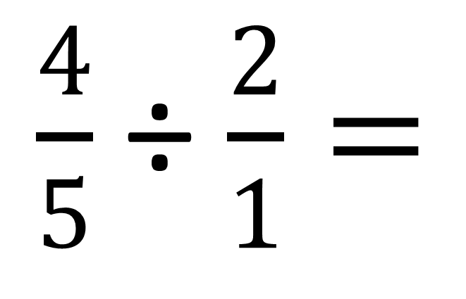
$\frac{4}{5}$ ÷ $2$
$$\frac{4}{10}=\frac{2}{5}$$
$\frac{4}{5}$ ÷ $\frac{2}{1}=$
$\frac{4}{5}$ x $\frac{1}{2}=$

Slide 12
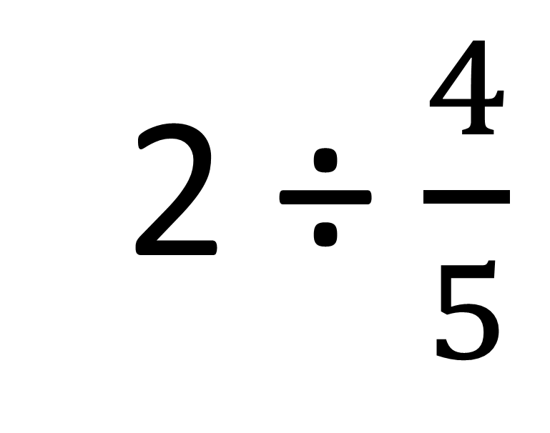
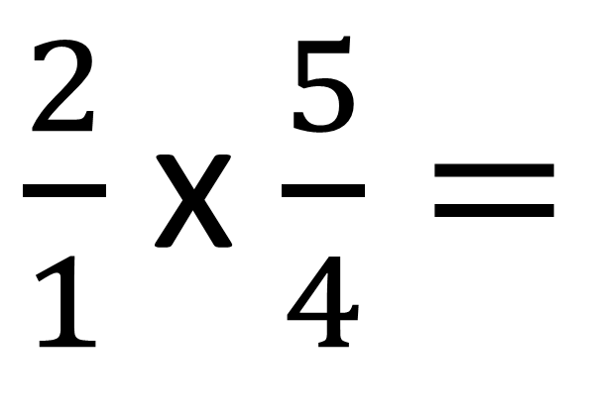
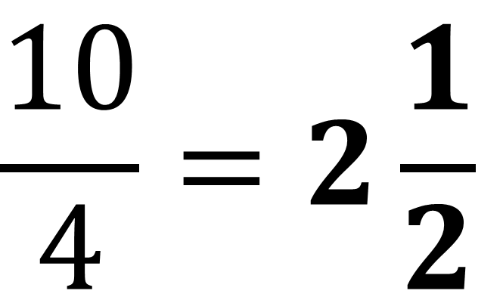
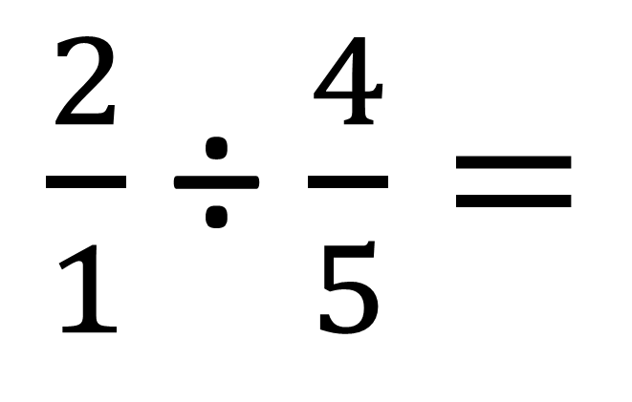
2 ÷ $\frac{4}{5}$
$$\frac{10}{4}=2\frac{1}{2}$$
$\frac{2}{1}$ ÷ $\frac{4}{5}=$
$\frac{2}{1}$ x $\frac{5}{4}=$

