Slide 1
LO: Exact Values
Using Trig Ratios

Slide 2

You calculator is broken.
However you still need to calculate angles
and lengths using trigonometry ratios!
But how?

Slide 3
Use the triangle and basic trigonometry to complete the table.
60°
Hint: Split the triangle in half
2
2
60°
60°
2
 | Sin | Cos | Tan
30°
60°

Slide 4







 | Sin | Cos | Tan
30°
60°
$$\frac{1}{2}$$
$$\frac{\sqrt{3}}{2}$$
$$\frac{1}{\sqrt{3}}$$
60˚
$$\frac{\sqrt{3}}{2}$$
$$\frac{1}{2}$$
$$\sqrt{3}$$
30˚
30˚
2
2
$$\sqrt{3}$$
60˚
60˚
1
2

Slide 5
Use the triangle and basic trigonometry to complete the table.
Hint: What type of triangle do you have?
45˚
 | Sin | Cos | Tan
45°

Slide 6
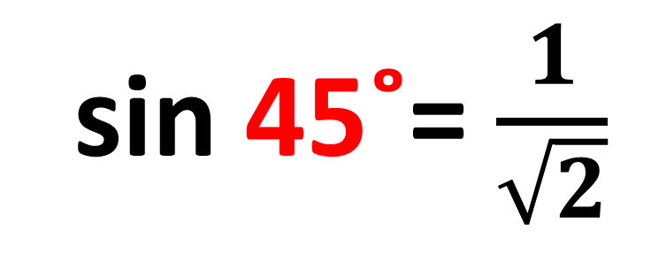

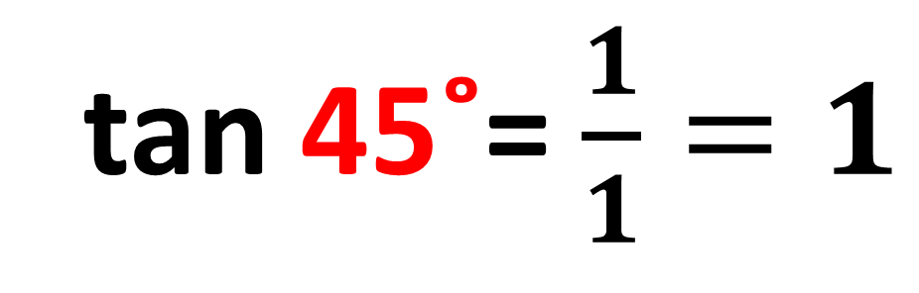
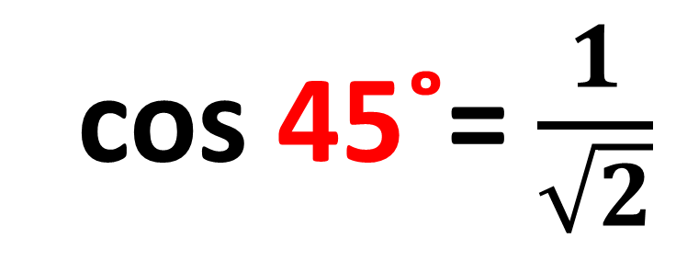
sin 45˚= $\frac{1}{\sqrt{2}}$
45˚
$$\sqrt{2}$$
cos 45˚= $\frac{1}{\sqrt{2}}$
1
45˚
tan 45˚= $\frac{1}{1}=1$
1

Slide 7

Sing a song about exact trig values!!!

Slide 8
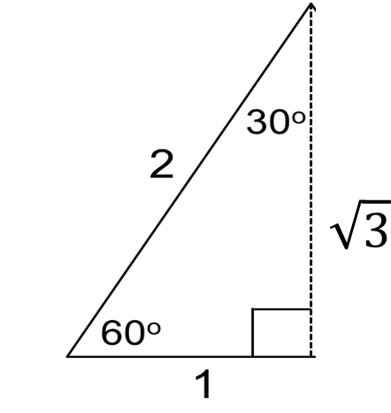
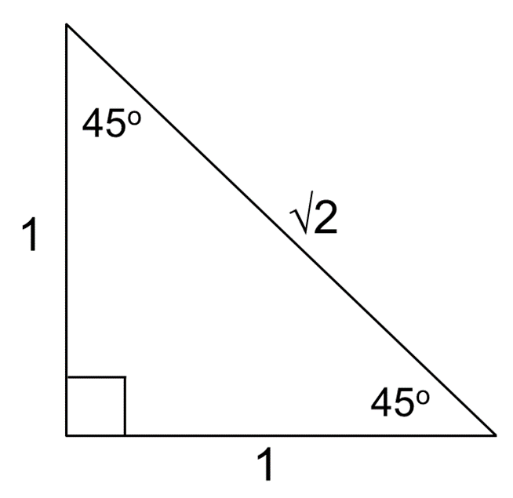








 | Sin | Cos | Tan
30°
60°
$$\frac{1}{2}$$
$$\frac{\sqrt{3}}{2}$$
$$\frac{1}{\sqrt{3}}$$
$$\frac{\sqrt{3}}{2}$$
$$\frac{1}{2}$$
$$\sqrt{3}$$
$$\frac{1}{\sqrt{2}}$$
$$\frac{1}{\sqrt{2}}$$
45°
1

