Slide 1
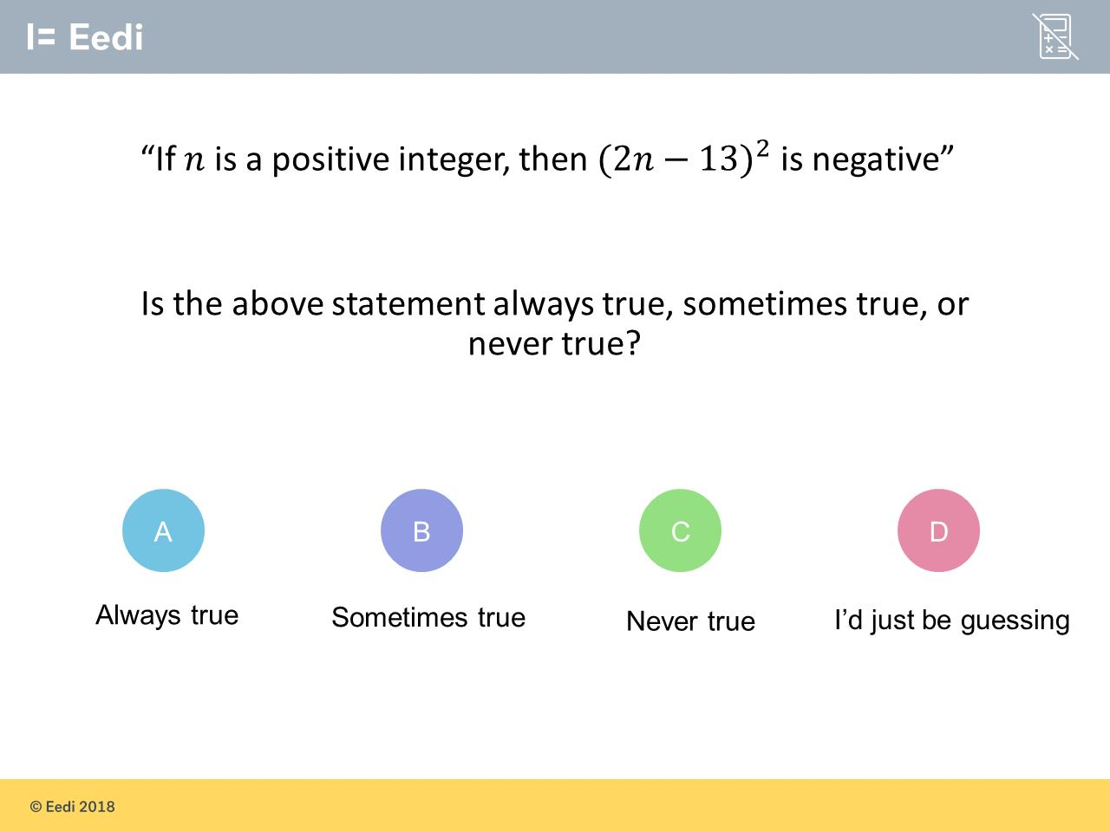
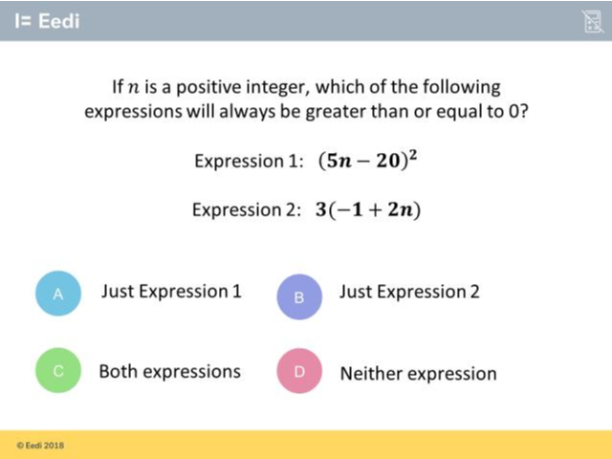
Worst answered question?
Most common wrong answer?

Slide 2
ANSWERS

Slide 3
Worst answered question?

Slide 4
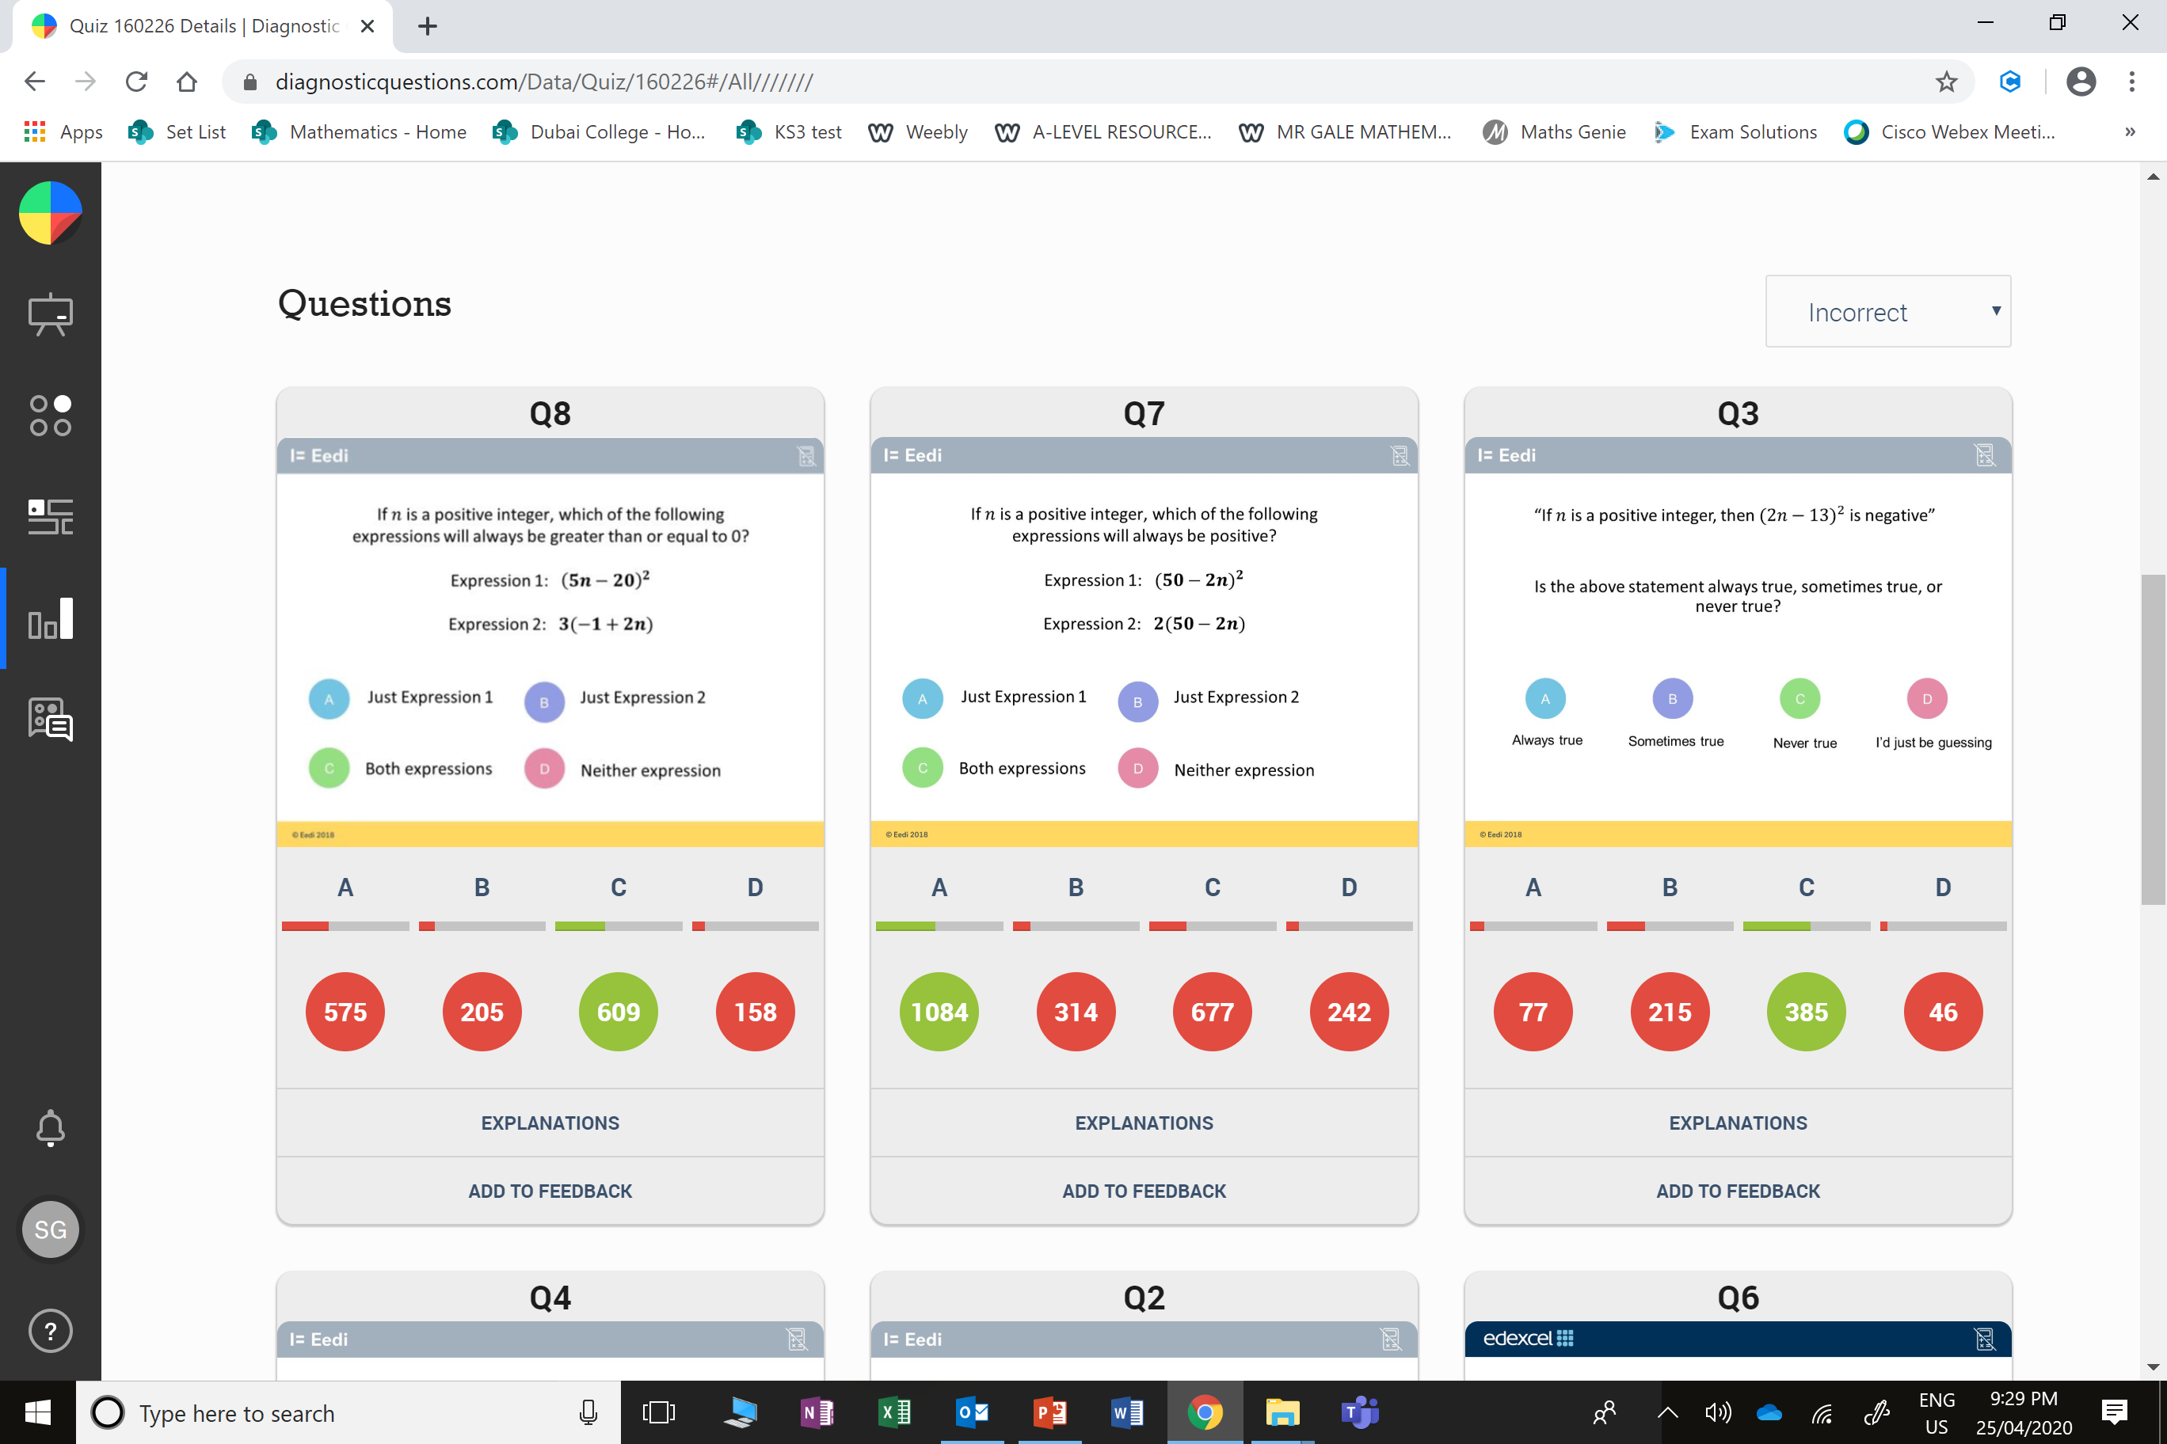
A
The student has not recognised that -1 + 2n is always positive.

Slide 5
B
The student may not know what happens when you square a negative number.

