Slide 1
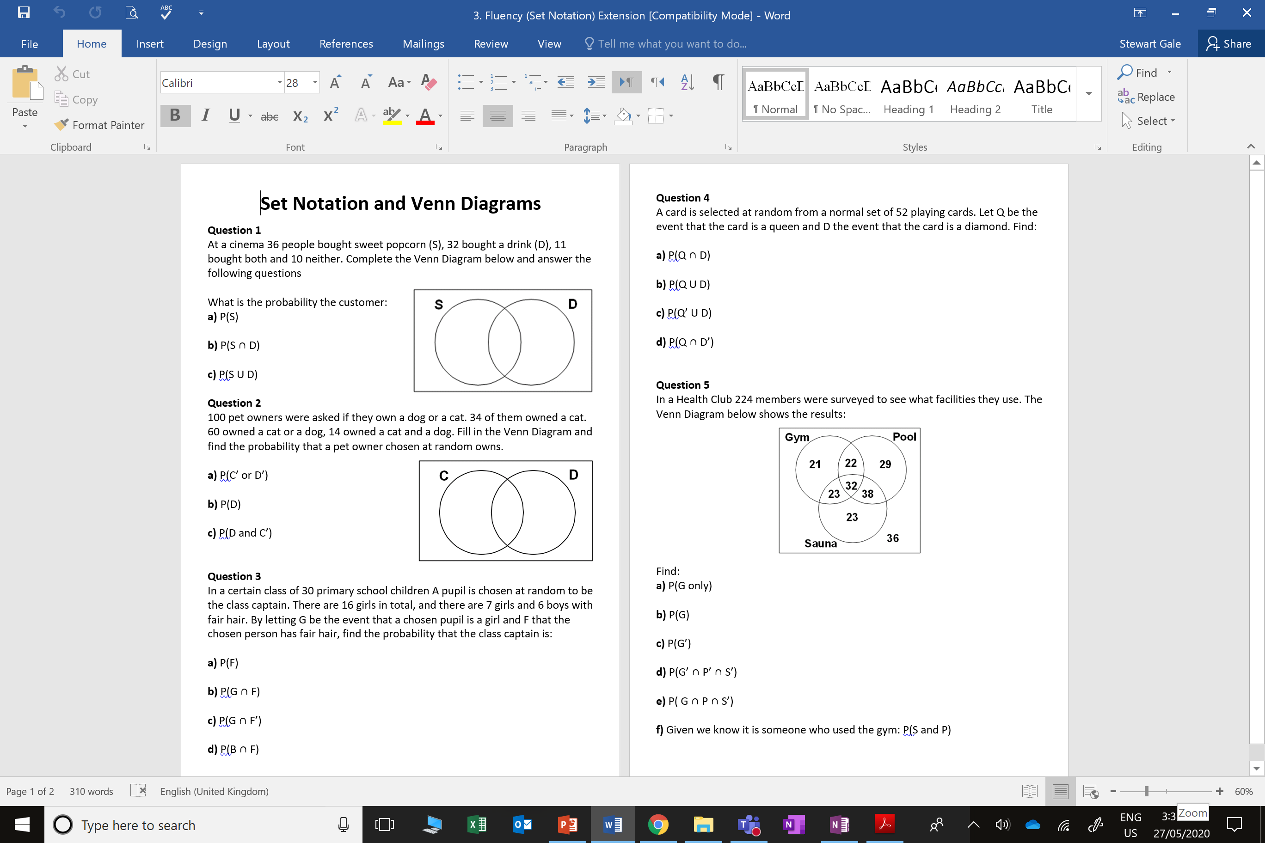

Slide 2
ANSWERS

Slide 3
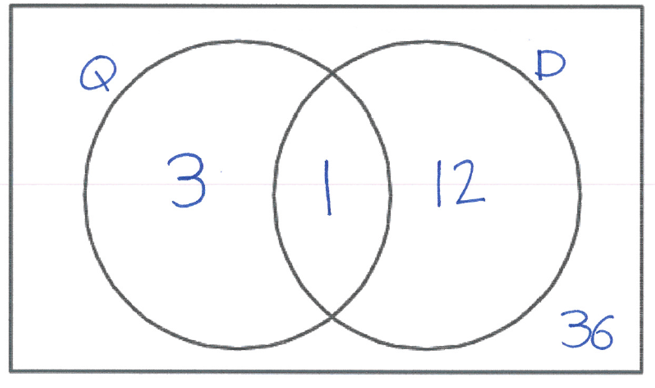
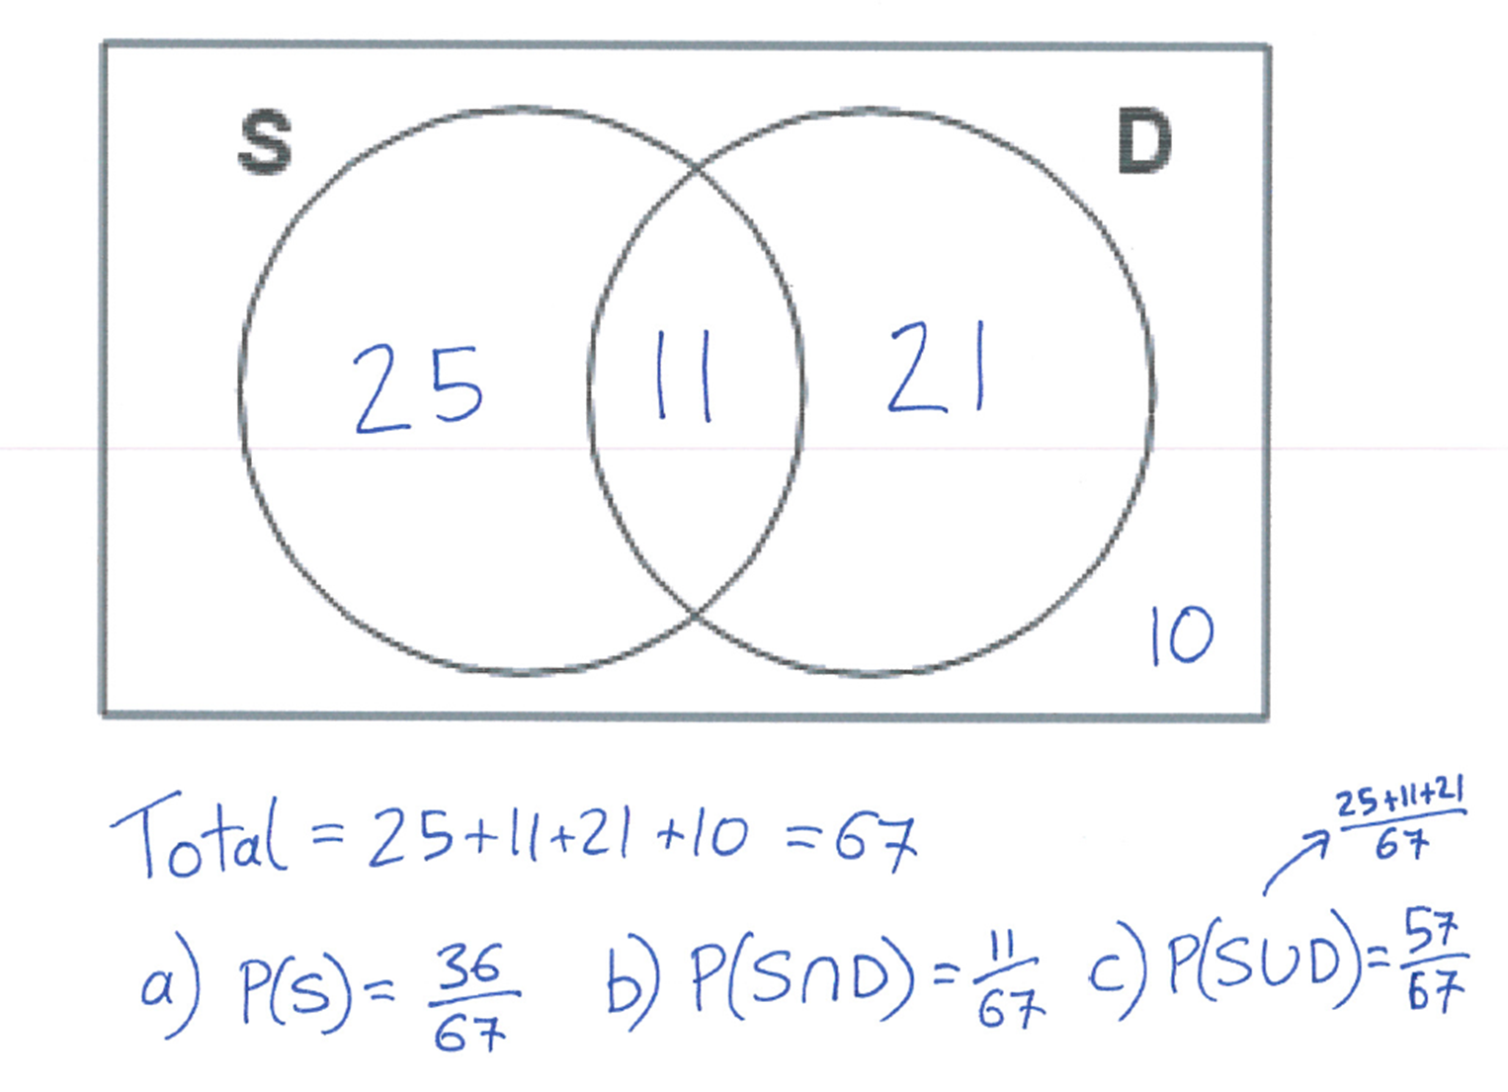
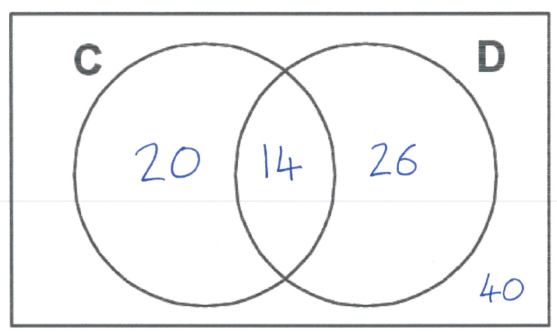
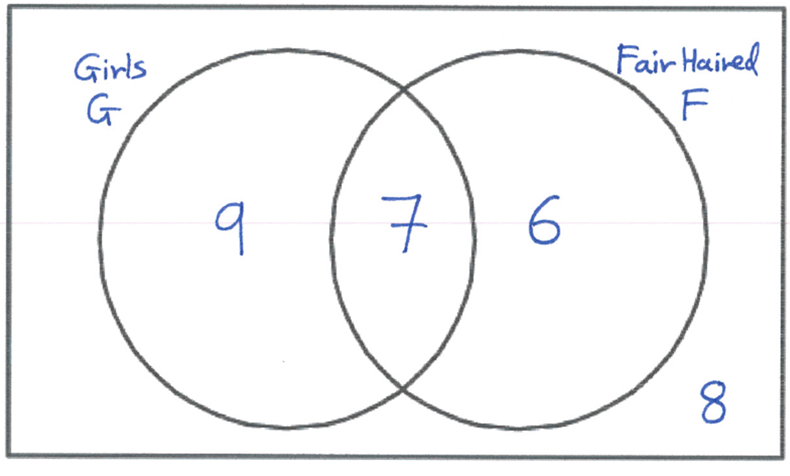




















$$\frac{1}{52}$$
$$\frac{16}{52}$$
$$\frac{36}{67}$$
$$\frac{49}{52}$$
$$\frac{3}{52}$$
$$\frac{11}{67}$$
$$\frac{57}{67}$$
$$\frac{86}{100}$$
$$\frac{40}{67}$$
$$\frac{26}{67}$$
$$\frac{21}{224}$$
$$\frac{98}{224}$$
$$\frac{126}{224}$$
$$\frac{13}{30}$$
$$\frac{36}{224}$$
$$\frac{7}{30}$$
$$\frac{22}{224}$$
$$\frac{9}{30}$$
$$\frac{6}{30}$$
$$\frac{32}{98}$$

