Slide 1
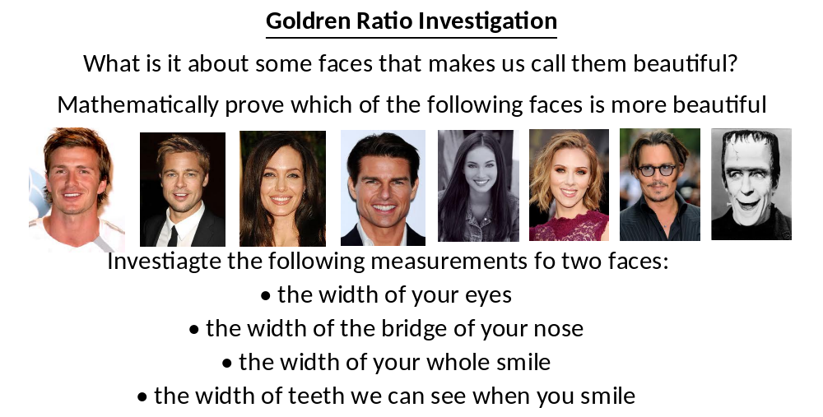
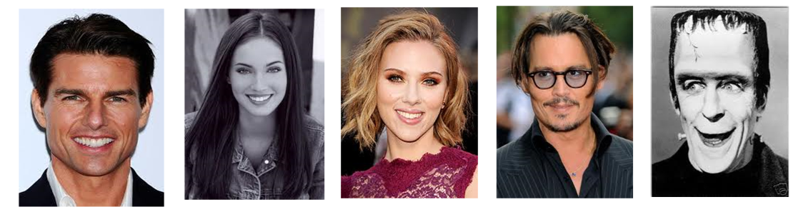

Slide 2
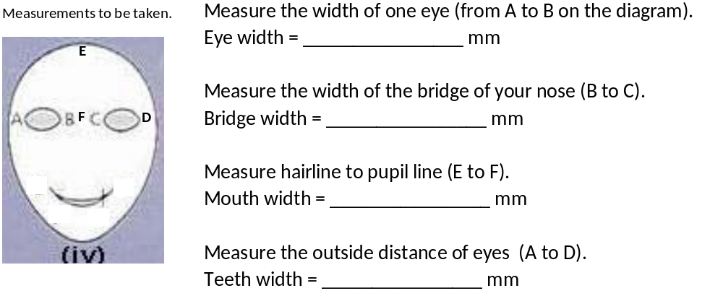

Slide 3
Name | Bridge width | Eye width | Ratio a ÷ b (1d.p.) | Outside distance of eyes | Hairline to pupil | Ratio d ÷ c (1d.p.) | Mean Average of both Ratios (1 d.p.) | Rank
 | (mm) | (mm) |  | (mm) | (mm)
 | a | b |  | d | c
Tom Curise
Megan Fox
Scarlett Johansson
Johnny Depp
Herman Moster

Slide 4
ANSWERS

Slide 5
Name | Bridge width | Eye width | Ratio a ÷ b (1d.p.) | Outside distance of eyes | Hairline to pupil | Ratio d ÷ c (1d.p.) | Mean Average of both Ratios (1 d.p.) | Rank
 | (mm) | (mm) |  | (mm) | (mm)
 | a | b |  | d | c
Tom Curise | 5 | 5 | 1 | 16 | 10 | 1.6 | 1.3 | 2rd
Megan Fox | 4 | 3 | 1.3 | 11 | 7 | 1.6 | 1.5 | 1nd
Scarlett Johansson | 4 | 4 | 1.0 | 13 | 9 | 1.4 | 1.2 | 3th
Johnny Depp | 3 | 3 | 1.0 | 12 | 10 | 1.2 | 1.1 | 4th
Herman Moster | 3 | 5 | 0.6 | 14 | 18 | 0.7 | 0.7 | 5th

