Slide 1
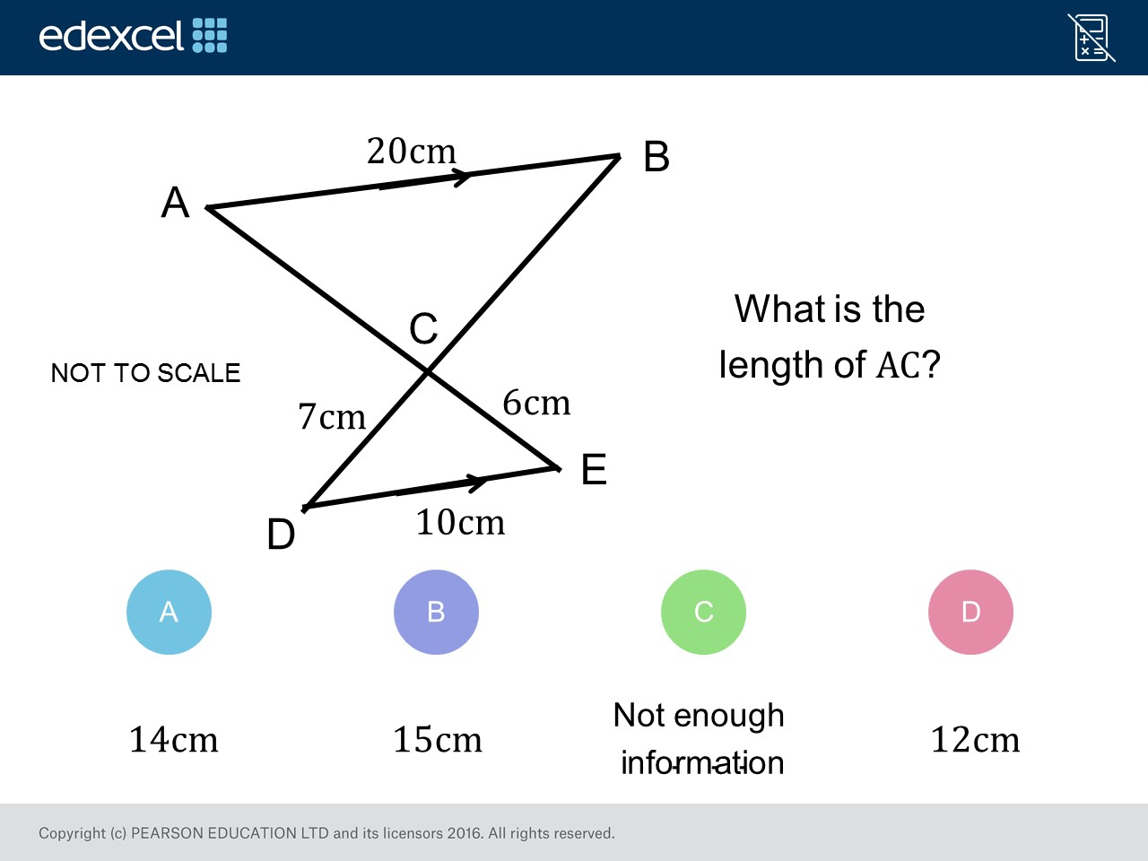
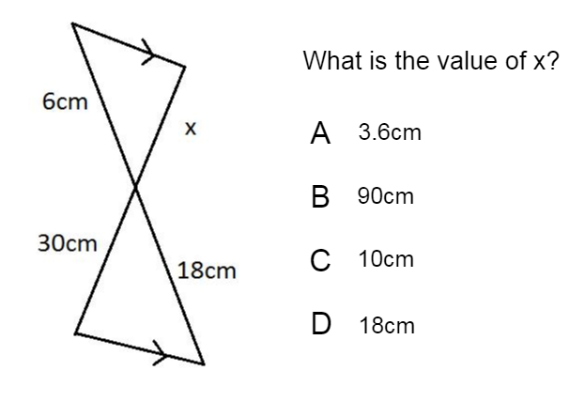
Worst answered question?
Most common wrong answer?

Slide 2
ANSWERS

Slide 3
Worst answered question?

Slide 4
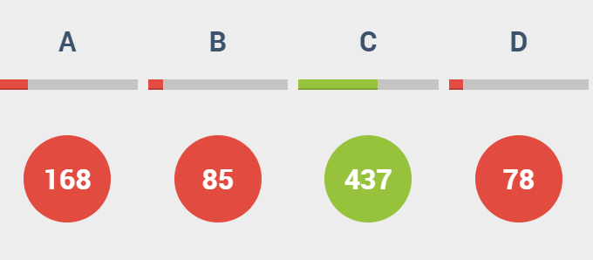
A
They used
30 and 18
to find the scale factor.

Slide 5
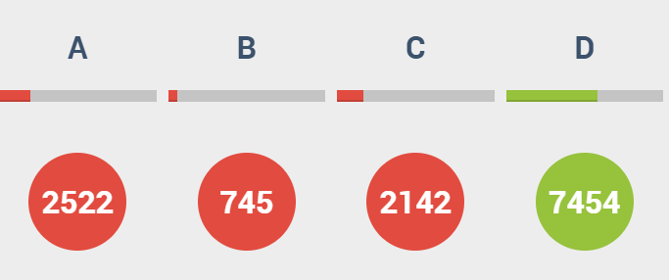
A
They multiplied the scale factor with 7cm instead of 6cm.

