Slide 1
Forces and Motions
Newtons 3rd Law
Chapter 10
(Part 5 of 9)

Slide 2
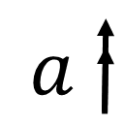
Newtons 3rd Law is very useful for questions that involve lifts and scale pans.
A
A
B
B
A lift will have a mass.
A scale-pan is light, and its mass is zero.

Slide 3
Newtons 3rd Law
For every action there is an
equal and opposite reaction.

Slide 4


The lift and the particles
may be moving
up or down together,
but the forces A and B
exert on each other
must be equal.
Why?
A
A
$$F$$
$$F$$
B
B
As they stay in contact.

Slide 5


If you want to find the force that B applies on A.
Find the force that A applies on B
because they will be equal (Newtons 3rd Law).
A
$$F$$
$$F$$
B

Slide 6


When you have objects stacked on top of each other,
you would typically resolve forces on the top object.
A
$$F$$
$$F$$
B
It’s too complicated to consider forces
on the bottom object in isolation.

Slide 7
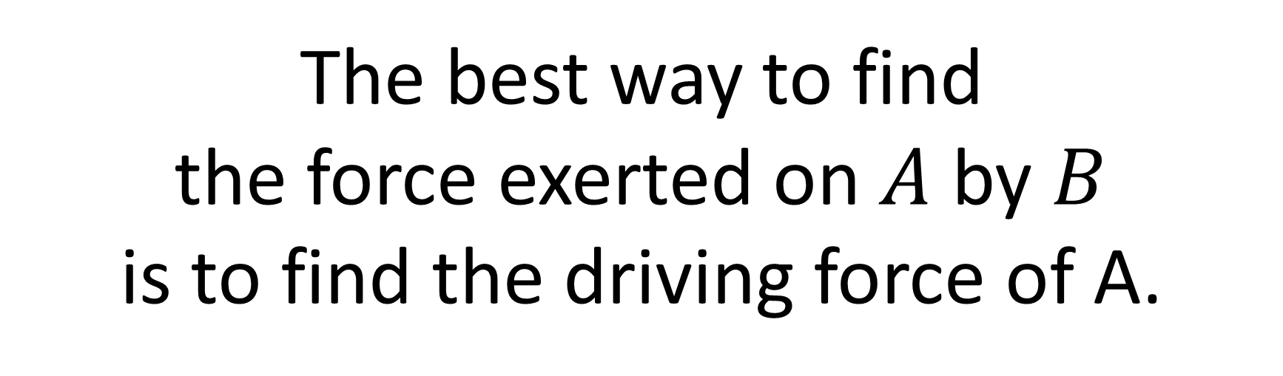



The best way to find
the force exerted on $A$ by $B$
is to find the driving force of A.
$$a$$
$$D$$
$$D$$
A
A
B
B

Slide 8
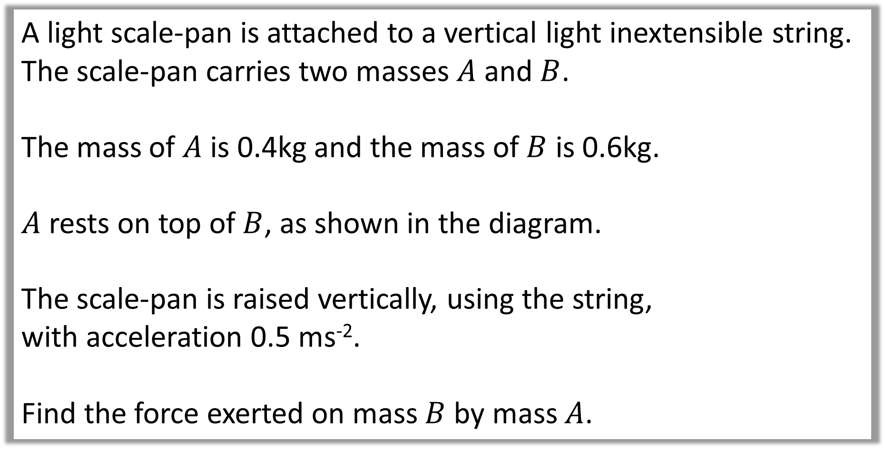
Question A
A light scale-pan is attached to a vertical light inextensible string. The scale-pan carries two masses $A$ and $B$.
The mass of $A$ is 0.4kg and the mass of $B$ is 0.6kg.
$A$ rests on top of $B$, as shown in the diagram.
The scale-pan is raised vertically, using the string,
with acceleration 0.5 ms⁻².
Find the force exerted on mass $B$ by mass $A$.

Slide 9

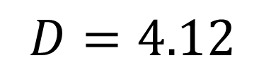
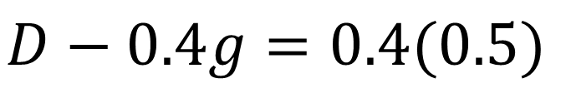
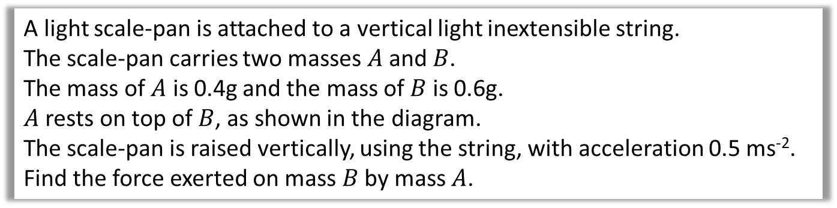


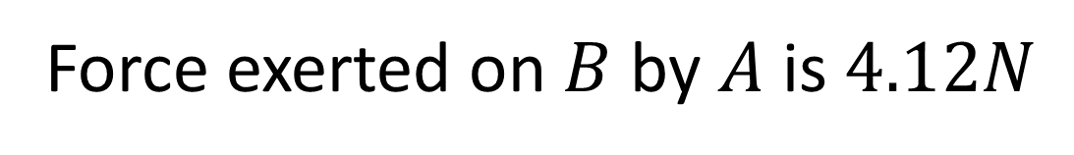

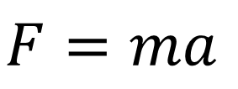
A light scale-pan is attached to a vertical light inextensible string.
The scale-pan carries two masses $A$ and $B$.
The mass of $A$ is 0.4g and the mass of $B$ is 0.6g.
$A$ rests on top of $B$, as shown in the diagram.
The scale-pan is raised vertically, using the string, with acceleration 0.5 ms⁻².
Find the force exerted on mass $B$ by mass $A$.
$$D$$
$$F=ma$$
0.4kg
$$D−0.4g=0.4(0.5)$$
0.4kg
$$D=4.12$$
$$a=0.5$$
0.6kg
$$0.4g$$
Force exerted on $B$ by $A$ is $4.12N$

Slide 10
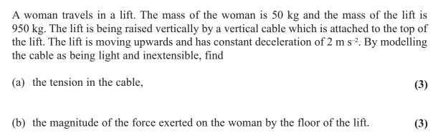
Question B

Slide 11
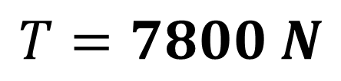
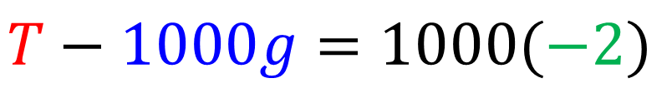

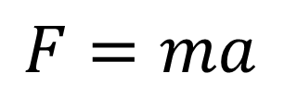
a.
T
$$F=ma$$
$$T−1000g=1000(−2)$$
$$a=−2$$
50kg
$T=7800 N$
950g
50g

Slide 12



b.
T
D
$$F=ma$$
$$a=−2$$
50kg
50
$$D−50g=50(−2)$$
$D=390 N$
50g
950g
50g
The force exerted on the women by the lift is $390 N$

