Slide 1
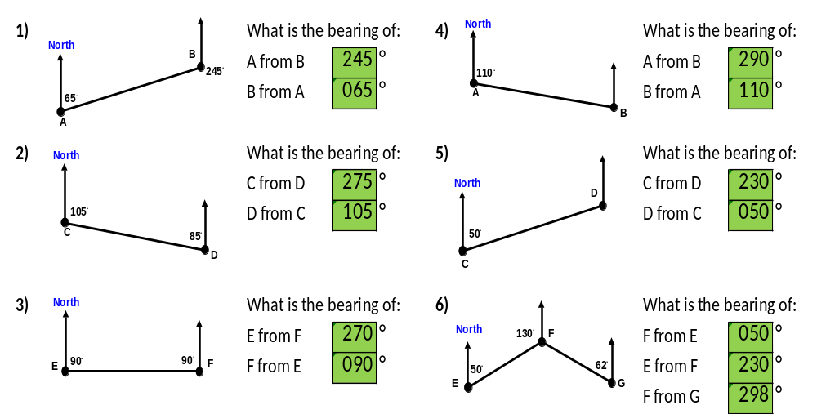
?
?
?
?
?
?
?
?
75
?
?
?
?
?

Slide 2
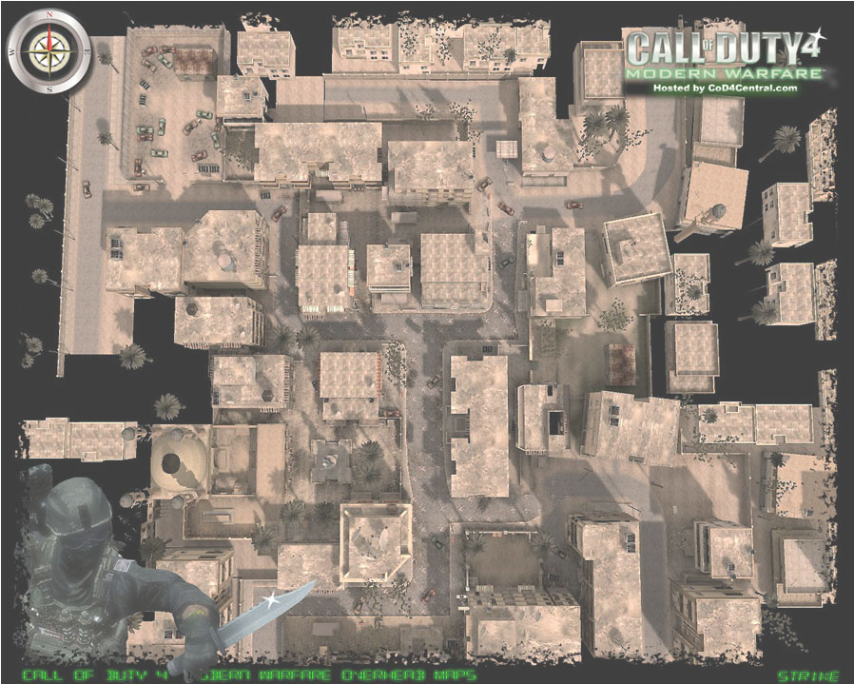

Locate 5 rooftop locactions
using the bearings given.
LOCATION | BEARING
MOSQUE | 010^{O}
MALL | 282^{O}
FIRE STATION | 050^{O}
THE FLATS | 210^{O}
THE APARTMENT BLOCK | 277^{O}
THE BAR | 155^{O}
THE HOSPTIAL | 350^{O}
THE SHOP | 076^{O}
THE OFFICES | 354^{O}
THE CAR PARK | 095^{O}
CAR
PARK
MILITARY
HQ
FLATS
BAR
POLICE
STATION
SHOP
OFFICES
MALL
MOSQUE
HOSPITAL
FIRE
STATION
APARTMENT
BLOCK
Notes:
ENEMY SNIPERS ARE BEDDED IN DEEP IN THE TOWN. INTEL HAVE UNCOMFIRMED SIGHTINGS FROM SEVERAL LOCATIONS AROUND THE TOWN. THERE ARE 5 SNIPERS IN THE TOWN, LOCATE THEM SO WE CAN ELIMINATE THE THREAT BEFORE OUR TROOPS MOVE IN.
INTEL HAS THESE BEARINGS OF THE SNIPERS. USE TRIANGULATION TO FIND WHERE THE SNIPERS ARE HIDING….

Slide 3
ANSWERS

Slide 4
?
?
?
285
?
75
?
?

Slide 5
?
?
?
?
?
?
?

Slide 6
CAR
PARK
MILITARY
HQ
5
4
FLATS
BAR
POLICE
STATION
SHOP
1
OFFICES
MALL
2
MOSQUE
HOSPITAL
FIRE
STATION
3
APARTMENT
BLOCK
Notes:
ENEMY SNIPERS ARE BEDDED IN DEEP IN THE TOWN. INTEL HAVE UNCOMFIRMED SIGHTINGS FROM SEVERAL LOCATIONS AROUND THE TOWN. THERE ARE 5 SNIPERS IN THE TOWN, LOCATE THEM SO WE CAN ELIMINATE THE THREAT BEFORE OUR TROOPS MOVE IN.
INTEL HAS THESE BEARINGS OF THE SNIPERS. USE TRIANGULATION TO FIND WHERE THE SNIPERS ARE HIDING….

