Slide 1
FM: Simultaneous Equations
(Linear and Non-Linear)

Slide 2
When solving simultaneous equations with Linear and Non-Linear equations,
always substitute the Linear
into the Non-Linear equation.

Slide 3
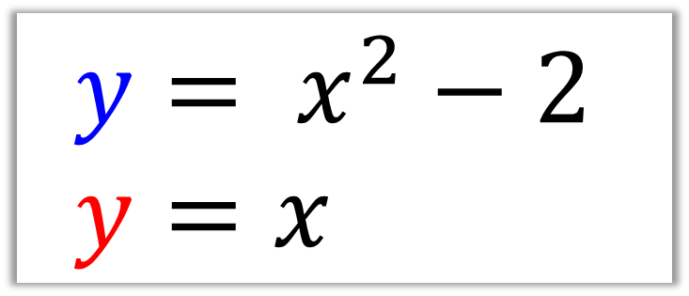
Solve the simultaneously equations.
$$y= x^{2}−2 \\ y=x$$
Step 1: Substitution
x² – 2 = x
Step 2: Rearrange (equal to zero)
x² – x – 2 = 0
Step 3: Solve by factorising
(x + 1)(x – 2) = 0
x = – 1 and x = 2
Step 4: Find the y values
y = – 1 and y = 2

Slide 4
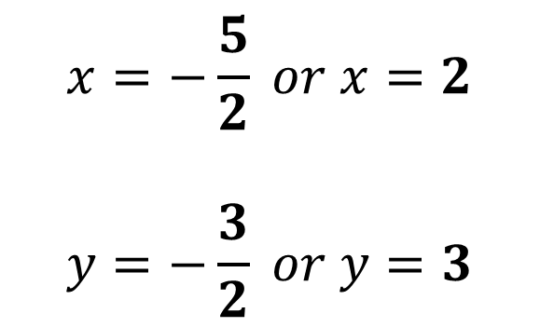
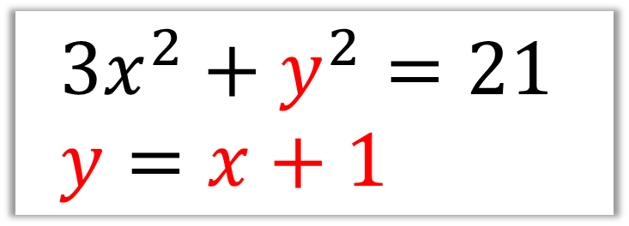
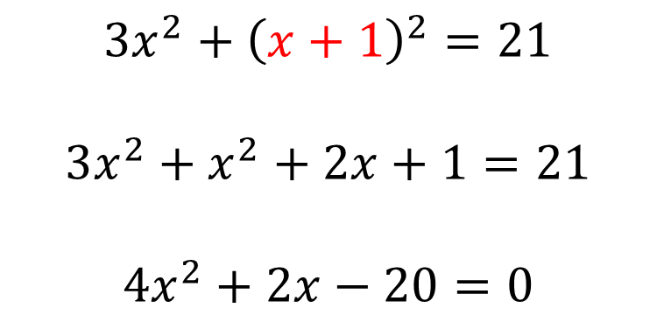
Solve the simultaneous equations:
$$3x^{2}+y^{2}=21 \\ y=x+1$$
$$3x^{2}+{\left(x+1\right)}^{2}=21$$
$$3x^{2}+x^{2}+2x+1=21$$
$$4x^{2}+2x−20=0$$
$$x=−\frac{5}{2} or x=2$$
$$y=−\frac{3}{2} or y=3$$

Slide 5
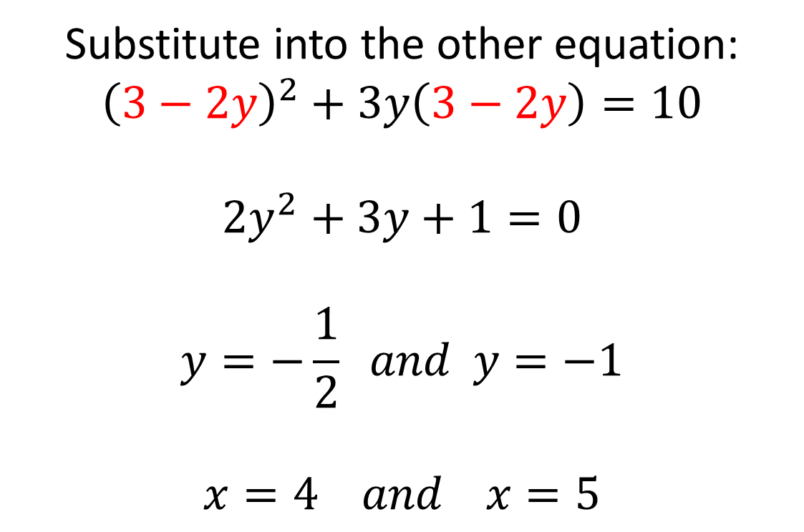
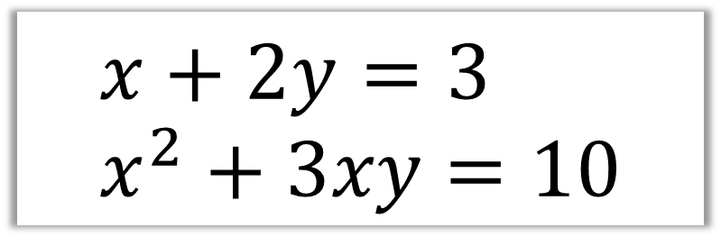
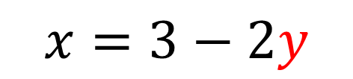
Solve the simultaneous equations:
$$x+2y=3 \\ x^{2}+3xy=10$$
$$x=3−2y$$
Substitute into the other equation:
$${\left(3−2y\right)}^{2}+3y\left(3−2y\right)=10$$
$$2y^{2}+3y+1=0$$
$$y=−\frac{1}{2} and y=−1$$
$$x=4 and x=5$$

