Slide 1
Functions and Graphs
Inverse Functions
Chapter 2
(Part 4 of 6)

Slide 2
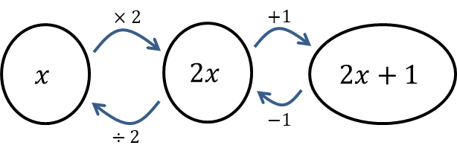
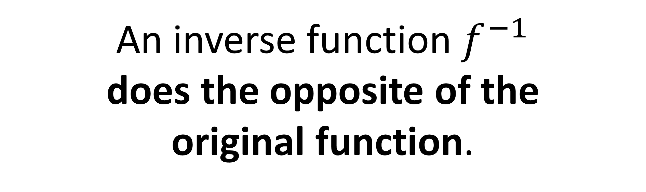
An inverse function $f^{−1}$
does the opposite of the
original function.

Slide 3

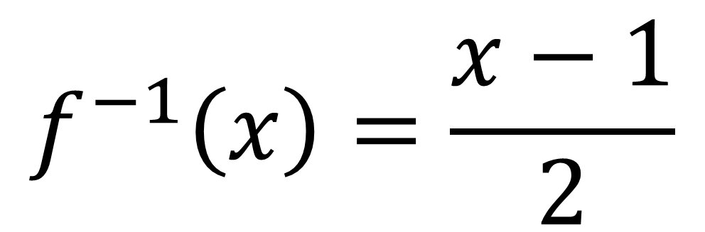
$$f\left(x\right)=2x+1$$
$$f^{−1}\left(x\right)=\frac{x−1}{2}$$

Slide 4
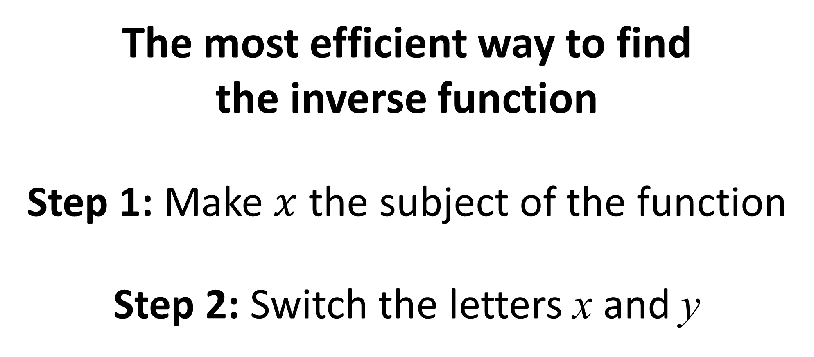
The most efficient way to find
the inverse function
Step 1: Make $x$ the subject of the function
Step 2: Switch the letters x and y

Slide 5

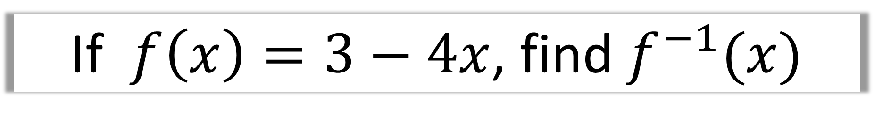
If $f\left(x\right)=3−4x$, find $f^{−1}(x)$
$$y=3−4x$$
$$4x=3−y$$
$$x=\frac{3−y}{4}$$
$$f^{−1}\left(x\right)=\frac{3−x}{4}$$

Slide 6
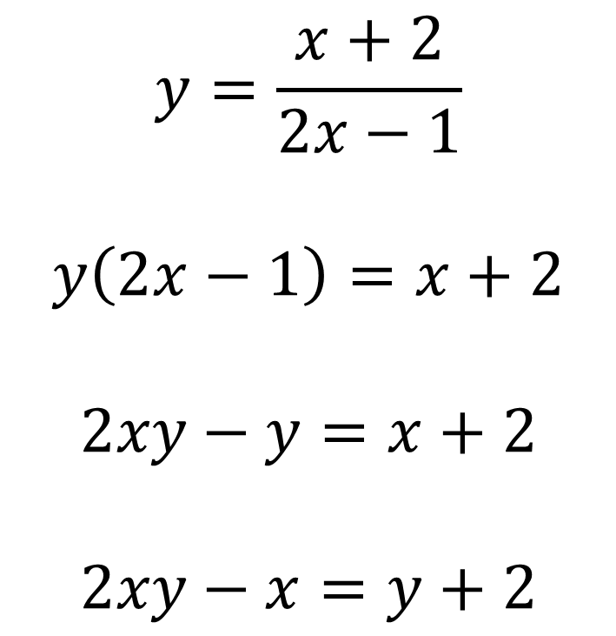
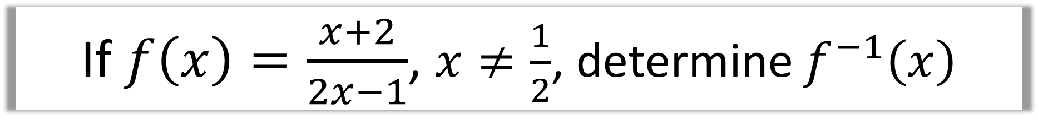
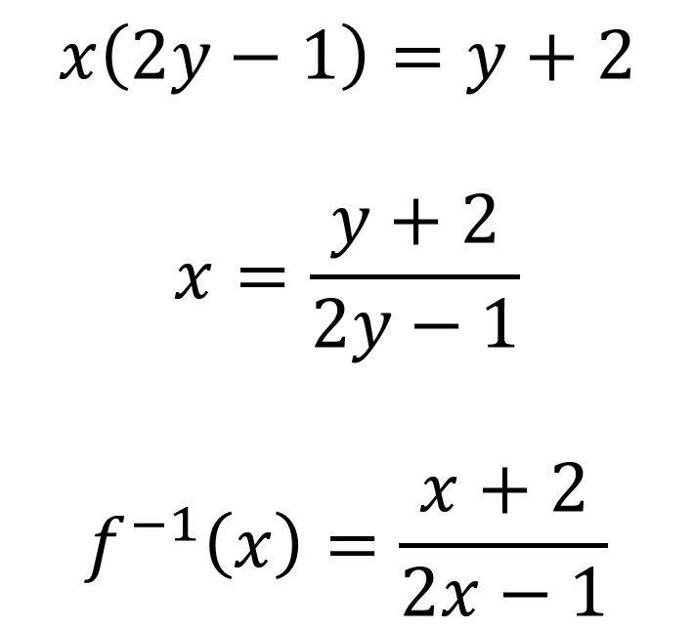
If $f\left(x\right)=\frac{x+2}{2x−1}$, $x≠\frac{1}{2}$, determine $f^{−1}\left(x\right)$
$$y=\frac{x+2}{2x−1}$$
$$y\left(2x−1\right)=x+2$$
$$2xy−y=x+2$$
$$2xy−x=y+2$$
$$x\left(2y−1\right)=y+2$$
$$x=\frac{y+2}{2y−1}$$
$$f^{−1}\left(x\right)=\frac{x+2}{2x−1}$$

Slide 7
To graph an inverse function,
you can reflect the original function
in the reflection line y = x

Slide 8
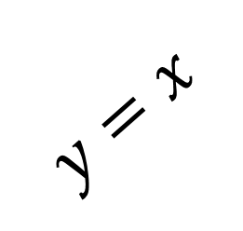
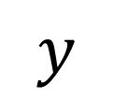

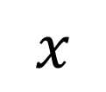

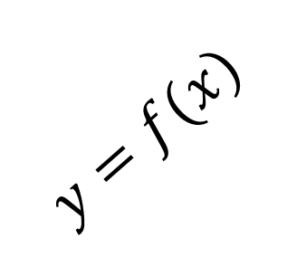
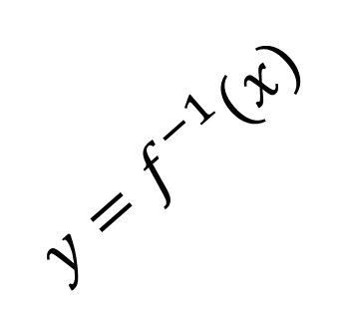
Graphing an inverse function.
$$y$$
$$y=f^{−1}(x)$$
$$y=f(x)$$
$$2$$
$$x$$
$$2$$
$$y=x$$

Slide 9
For a function
and the inverse function,
the domain and range switch

Slide 10

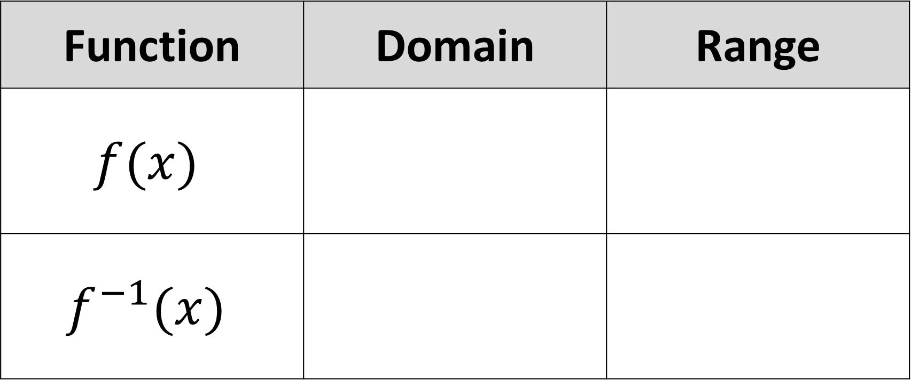



Note: domain and range switch
Function | Domain | Range
$$f(x)$$
$$f^{−1}(x)$$
$$x>1$$
$$y<2$$
$$x<2$$
$$y>1$$

Slide 11
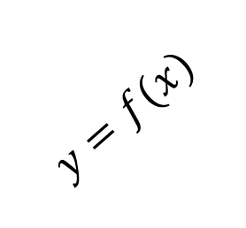
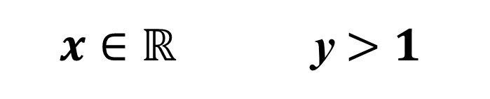

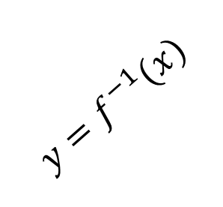

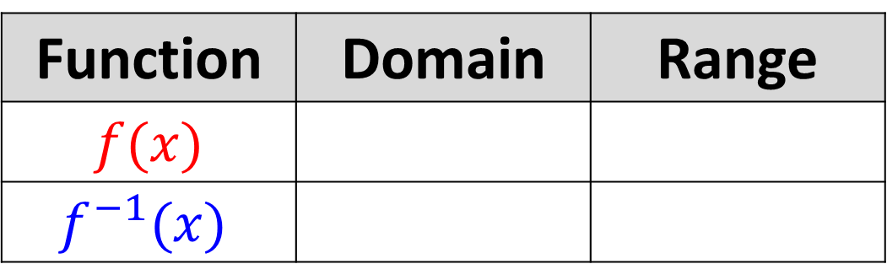



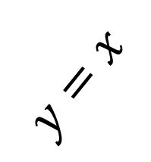


$$y$$
$$x=1$$
$$y=f^{−1}(x)$$
$$y=f(x)$$
Function | Domain | Range
$$f(x)$$
$$f^{−1}(x)$$
$$2$$
$$x>1$$ | y $∈ℝ$
$$y=1$$
$$x∈ℝ$$ | y $>1$
$$2$$
$$x$$
$$y=x$$

Slide 12
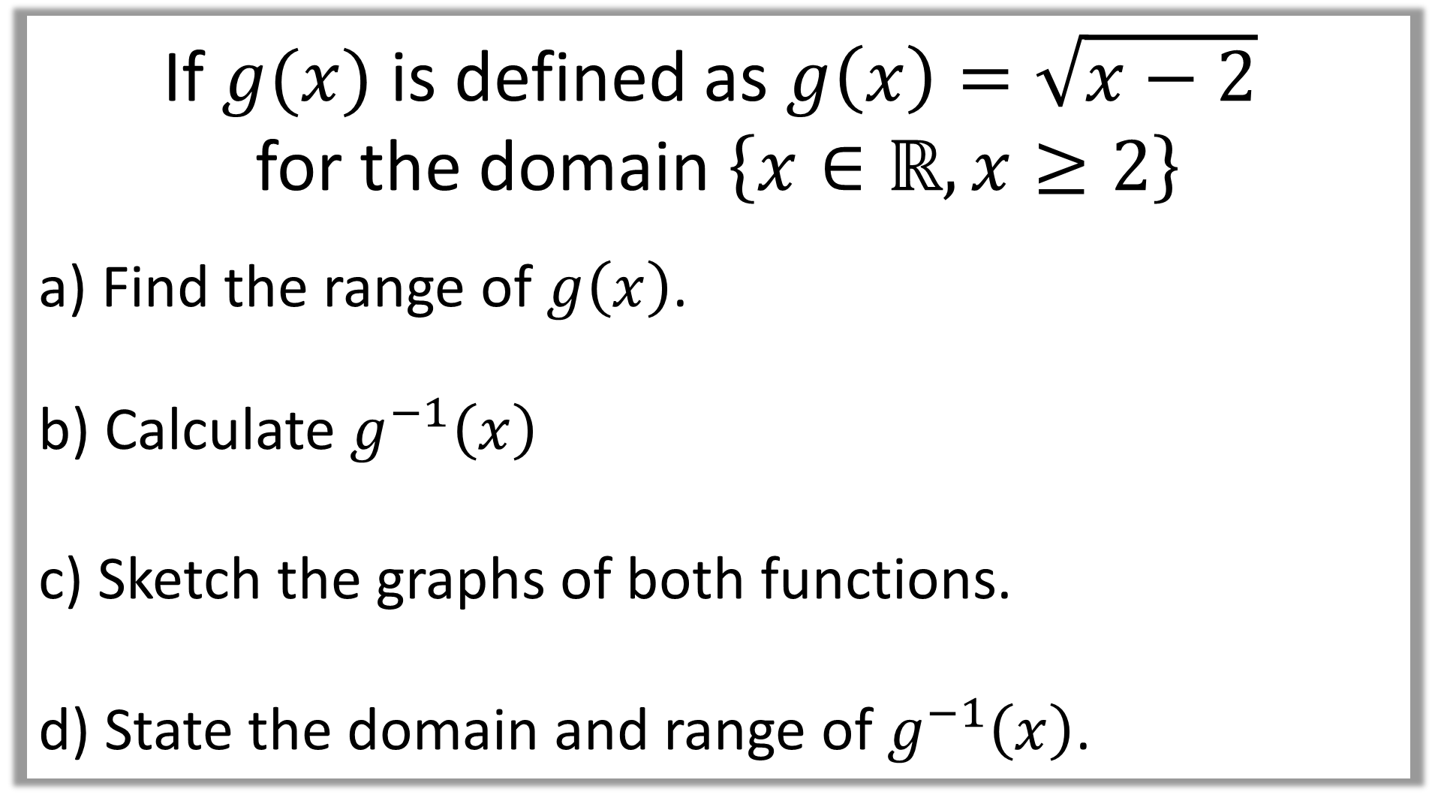
If $g(x)$ is defined as $g\left(x\right)=\sqrt{x−2}$
for the domain $\left\{x∈ℝ,x≥2\right\}$
a) Find the range of $g\left(x\right)$.
b) Calculate $g^{−1}\left(x\right)$
c) Sketch the graphs of both functions.
d) State the domain and range of $g^{−1}\left(x\right)$.

Slide 13
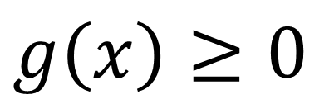
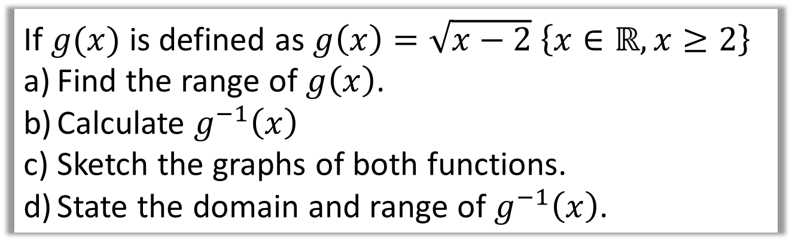
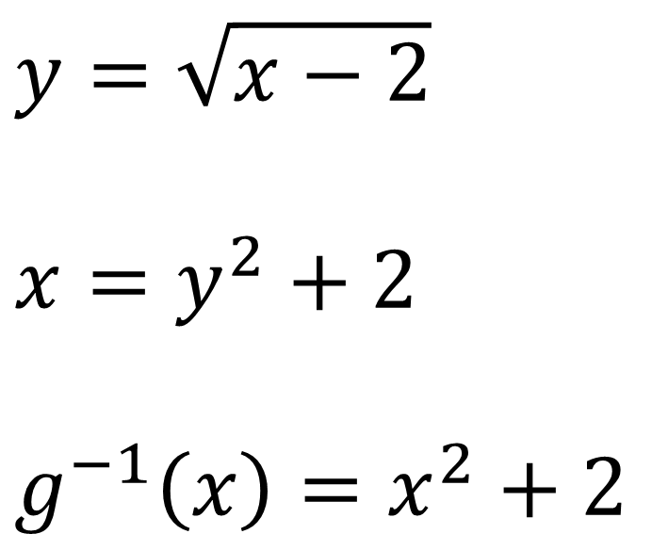
If $g(x)$ is defined as $g\left(x\right)=\sqrt{x−2} \left\{x∈ℝ,x≥2\right\}$
Find the range of $g\left(x\right)$.
Calculate $g^{−1}\left(x\right)$
Sketch the graphs of both functions.
State the domain and range of $g^{−1}\left(x\right)$.
a)
b)
$$y=\sqrt{x−2}$$
$$x=y^{2}+2$$
$$g^{−1}\left(x\right)=x^{2}+2$$
$$g\left(x\right)≥0$$

Slide 14



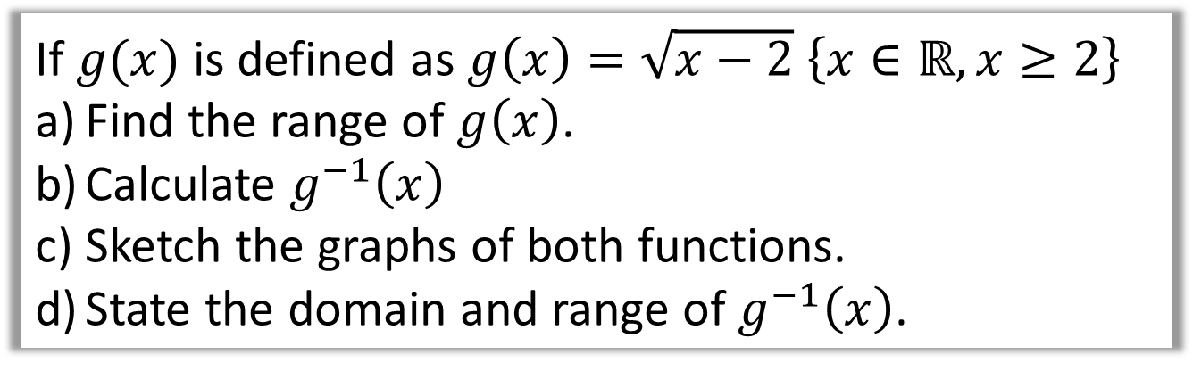


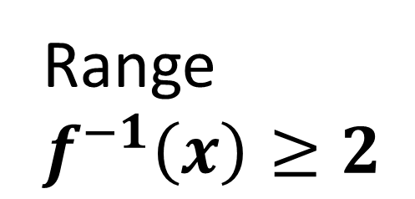

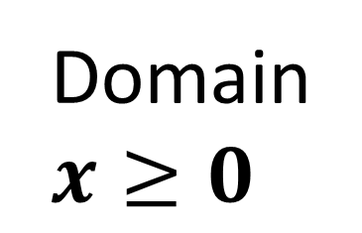
If $g(x)$ is defined as $g\left(x\right)=\sqrt{x−2} \left\{x∈ℝ,x≥2\right\}$
Find the range of $g\left(x\right)$.
Calculate $g^{−1}\left(x\right)$
Sketch the graphs of both functions.
State the domain and range of $g^{−1}\left(x\right)$.
$$y$$
d)
c)
Domain
$$x≥0$$
$$y=g^{−1}(x)$$
$$2$$
$$y=g(x)$$
Range
$$f^{−1}\left(x\right)≥2$$
$$x$$
$$2$$

Slide 15
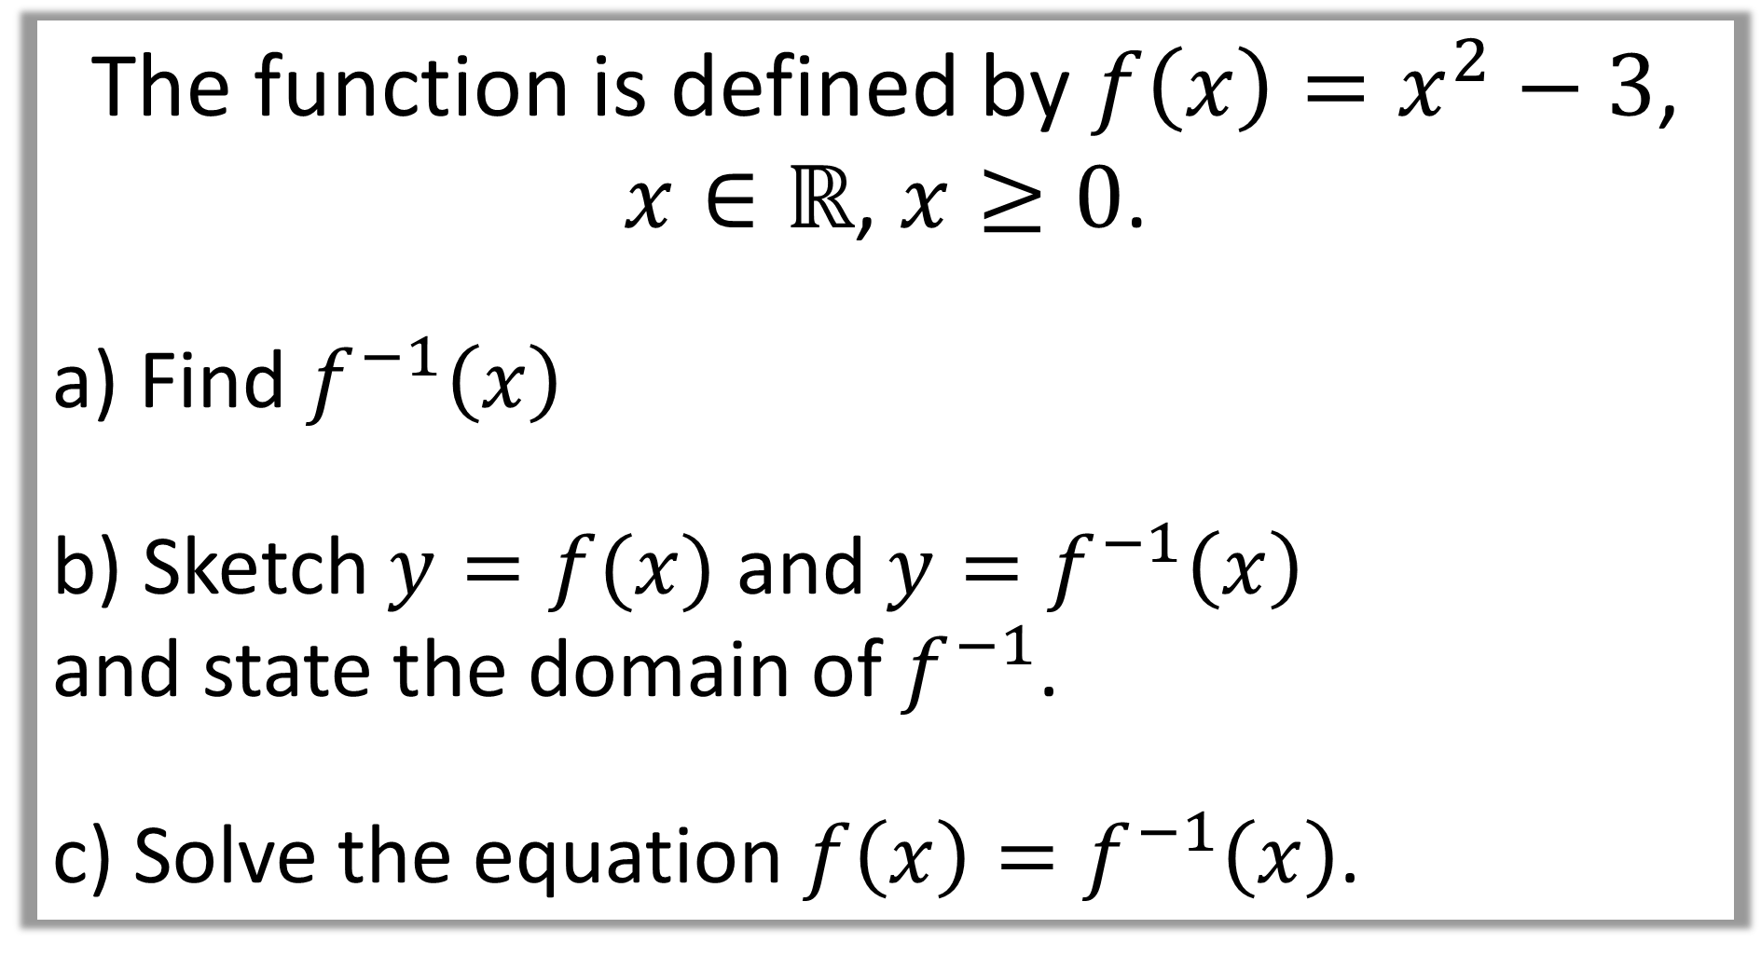
The function is defined by $f\left(x\right)=x^{2}−3$, $x∈ℝ$, $x≥0$.
a) Find $f^{−1}\left(x\right)$
b) Sketch $y=f(x)$ and $y=f^{−1}\left(x\right)$
and state the domain of $f^{−1}$.
c) Solve the equation $f\left(x\right)=f^{−1}\left(x\right)$.

Slide 16

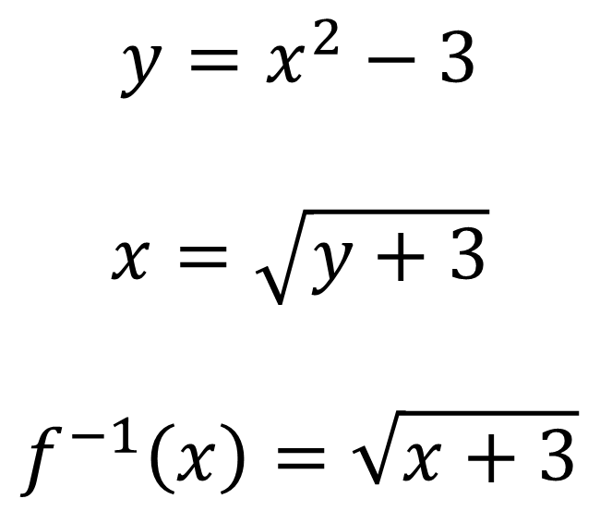

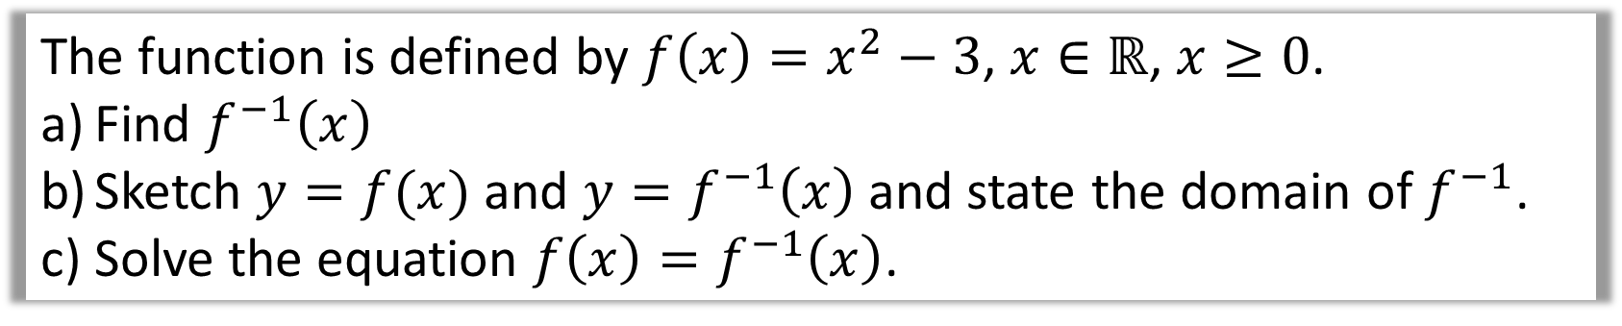





The function is defined by $f\left(x\right)=x^{2}−3$, $x∈ℝ$, $x≥0$.
Find $f^{−1}\left(x\right)$
Sketch $y=f(x)$ and $y=f^{−1}\left(x\right)$ and state the domain of $f^{−1}$.
Solve the equation $f\left(x\right)=f^{−1}\left(x\right)$.
$$y$$
a)
$$y=x^{2}−3$$
$$x=\sqrt{y+3}$$
$$f^{−1}\left(x\right)=\sqrt{x+3}$$
b)
$$y=f\left(x\right)$$
$$y=x$$
$$3$$
$$y=f^{−1}\left(x\right)$$
$$x$$
$$3$$

Slide 17
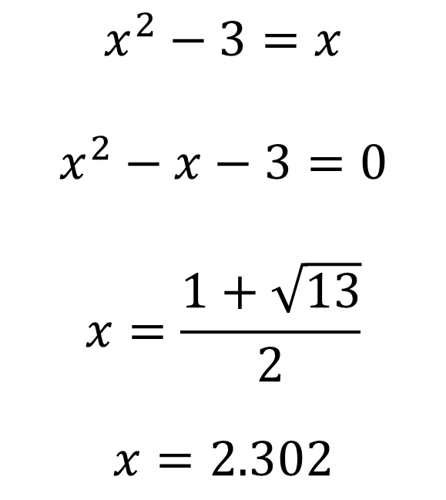

The function is defined by $f\left(x\right)=x^{2}−3$, $x∈ℝ$, $x≥0$.
Find $f^{−1}\left(x\right)$
Sketch $y=f(x)$ and $y=f^{−1}\left(x\right)$ and state the domain of $f^{−1}$.
Solve the equation $f\left(x\right)=f^{−1}\left(x\right)$.
c)
$$x^{2}−3=x$$
$$x^{2}−x−3=0$$
$$x=\frac{1+\sqrt{13}}{2}$$
$$x=2.302$$

Slide 18
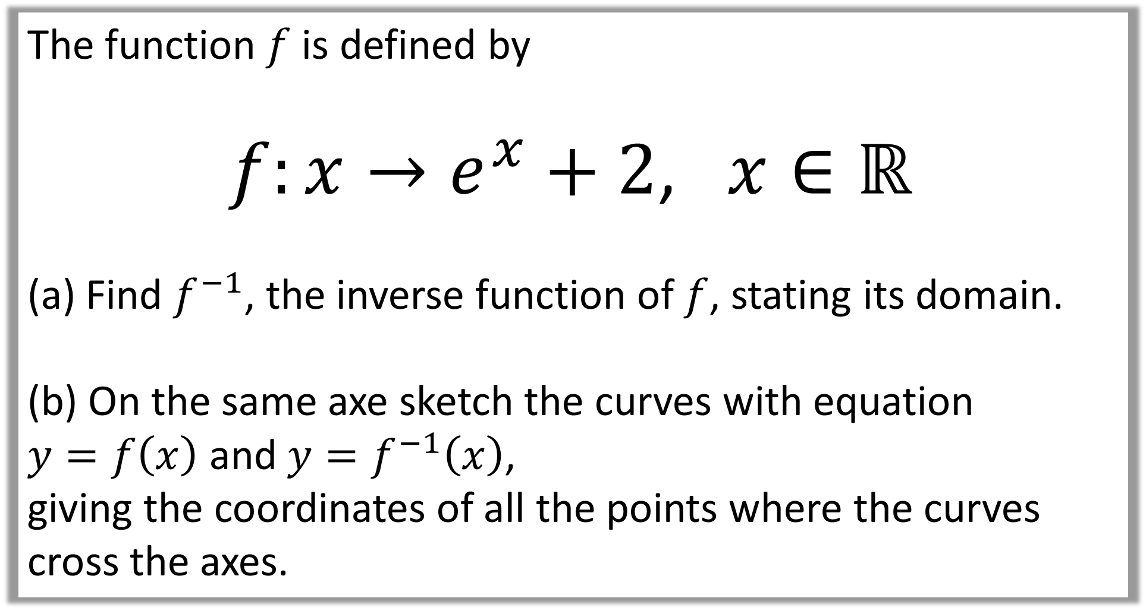
The function $f$ is defined by
$f:x→e^{x}+2$, $x∈ℝ$
(a) Find $f^{−1}$, the inverse function of $f$, stating its domain.
(b) On the same axe sketch the curves with equation
$y=f\left(x\right)$ and $y=f^{−1}\left(x\right)$,
giving the coordinates of all the points where the curves cross the axes.

Slide 19
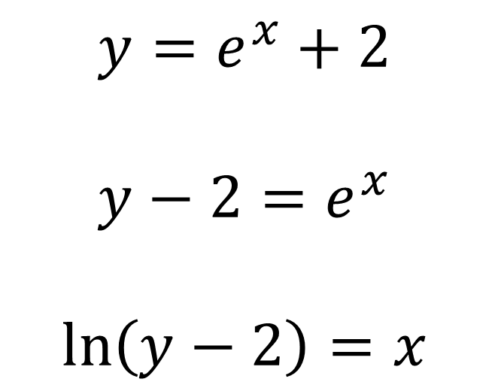
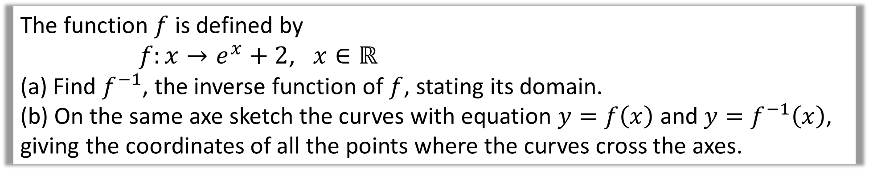

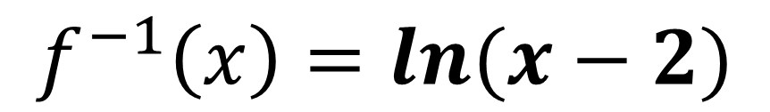
The function $f$ is defined by
$f:x→e^{x}+2$, $x∈ℝ$
(a) Find $f^{−1}$, the inverse function of $f$, stating its domain.
(b) On the same axe sketch the curves with equation $y=f\left(x\right)$ and $y=f^{−1}\left(x\right)$, giving the coordinates of all the points where the curves cross the axes.
a)
$$y=e^{x}+2$$
$$y−2=e^{x}$$
$$\ln\left(y−2\right)=x$$
$$f^{−1}\left(x\right)=ln(x−2)$$
Range $x>2$

Slide 20
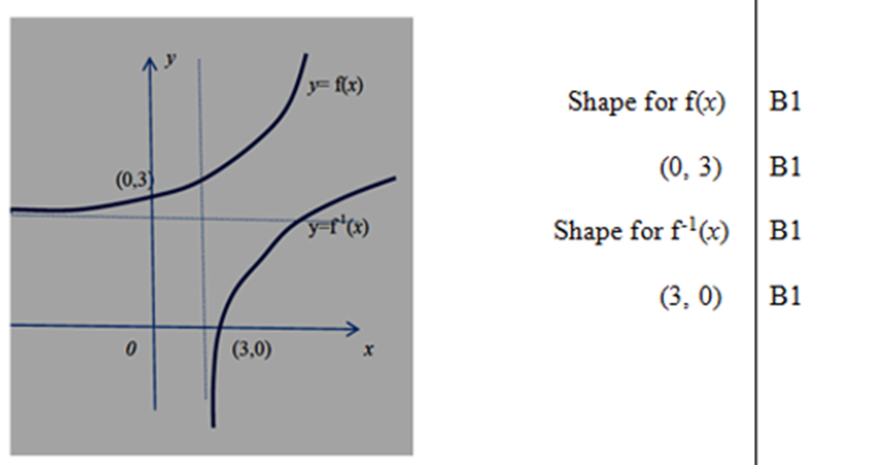
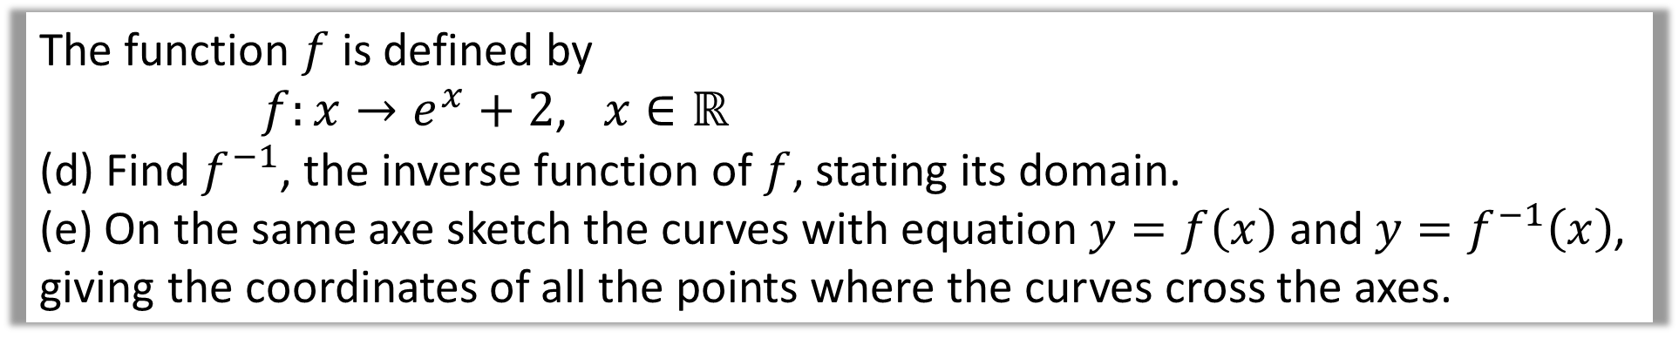
The function $f$ is defined by
$f:x→e^{x}+2$, $x∈ℝ$
(d) Find $f^{−1}$, the inverse function of $f$, stating its domain.
(e) On the same axe sketch the curves with equation $y=f\left(x\right)$ and $y=f^{−1}\left(x\right)$, giving the coordinates of all the points where the curves cross the axes.
b)

