Slide 1
LO: Cosine Rule
(Angles)

Slide 2
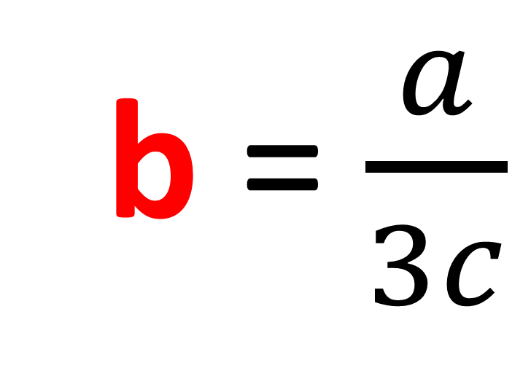
Make b the subject of the formula.
a = 3bc
b = $\frac{a}{3c}$

Slide 3
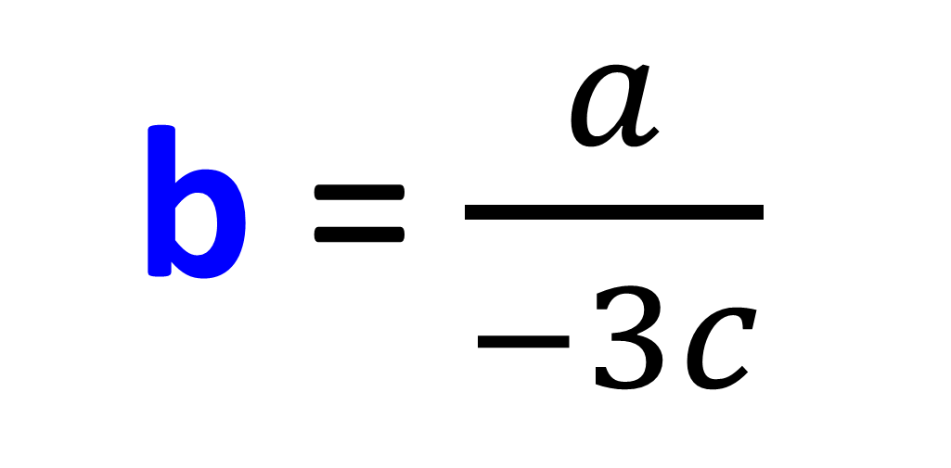
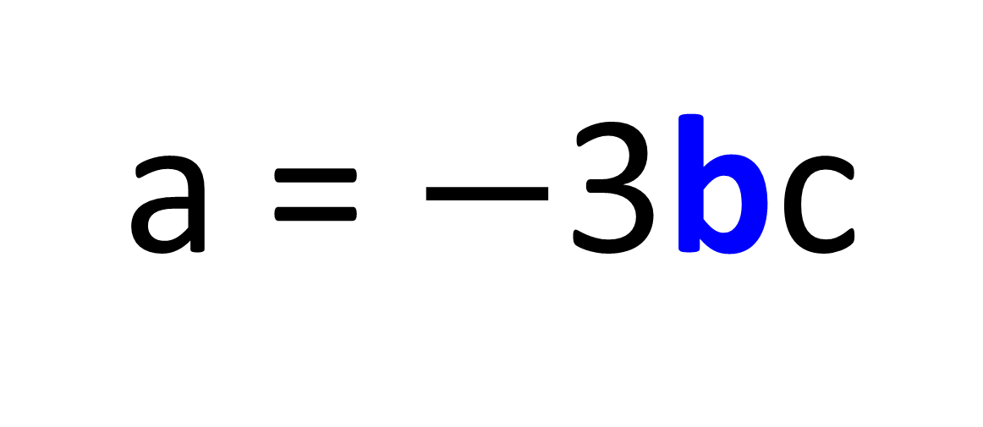
Make b the subject of the formula.
a = $−$3bc
b = $\frac{a}{−3c}$

Slide 4
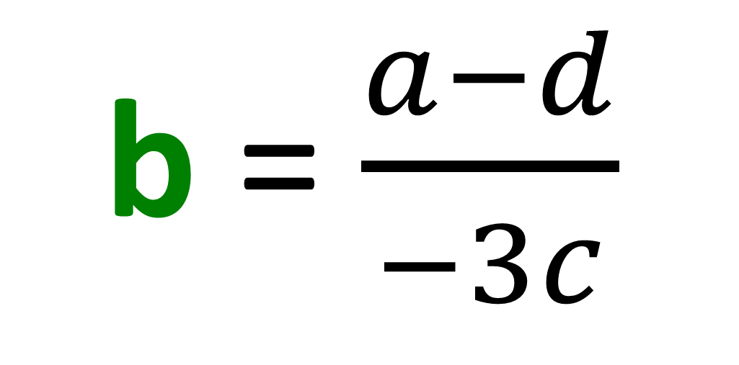
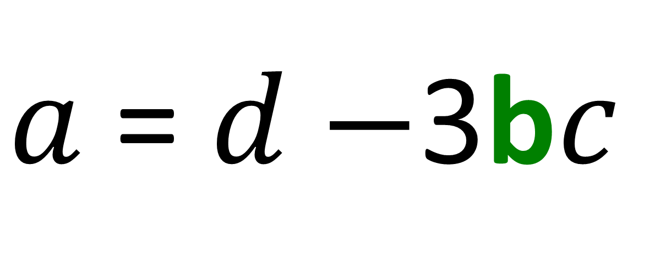
Make b the subject of the formula.
$a$ = $d−$3b$c$
b = $\frac{a−d}{−3c}$

Slide 5
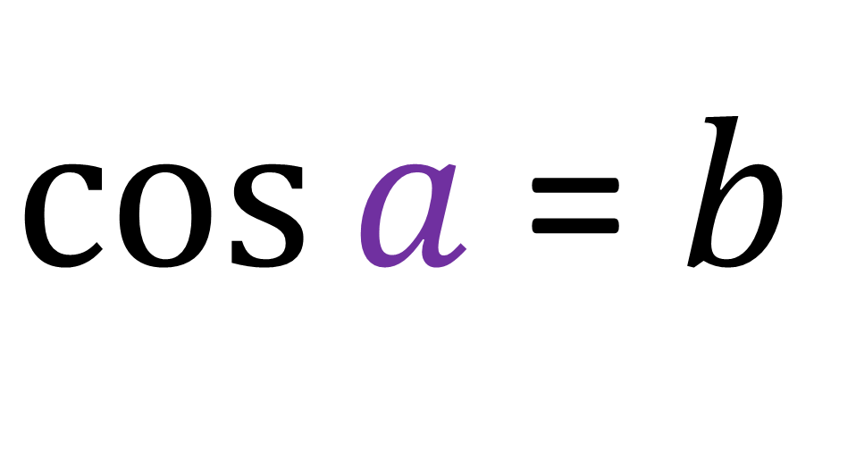

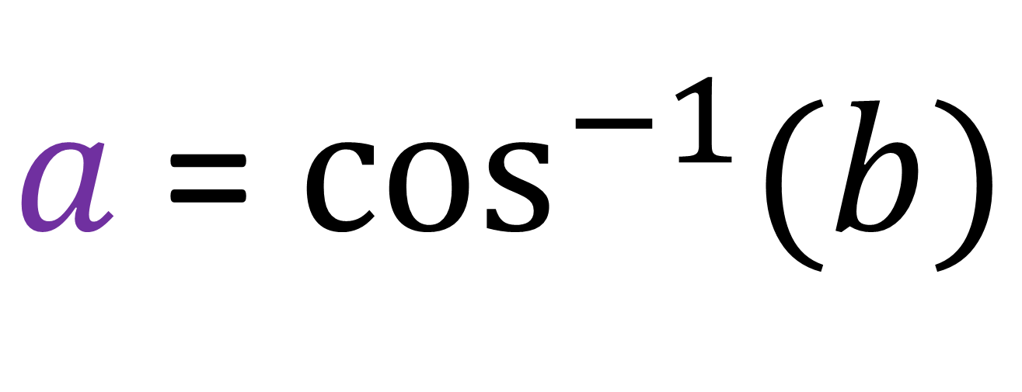
Make $a$ the subject of the formula.
$\cos{a}$ = $b$
$a$ = $\cos^{−1}{(b)}$

Slide 6
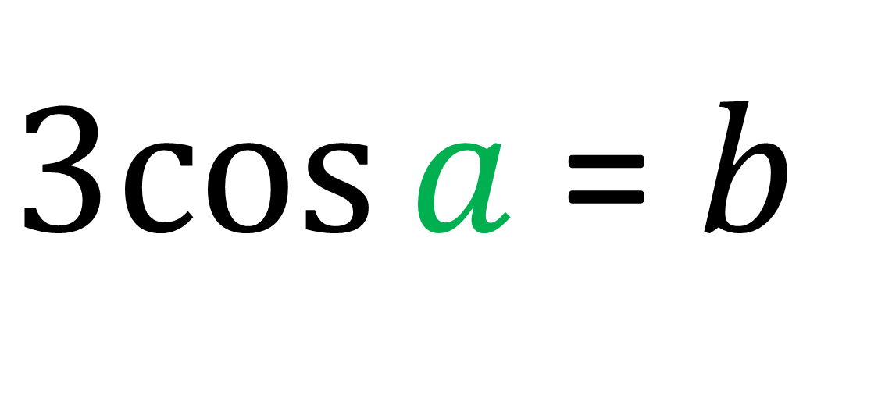

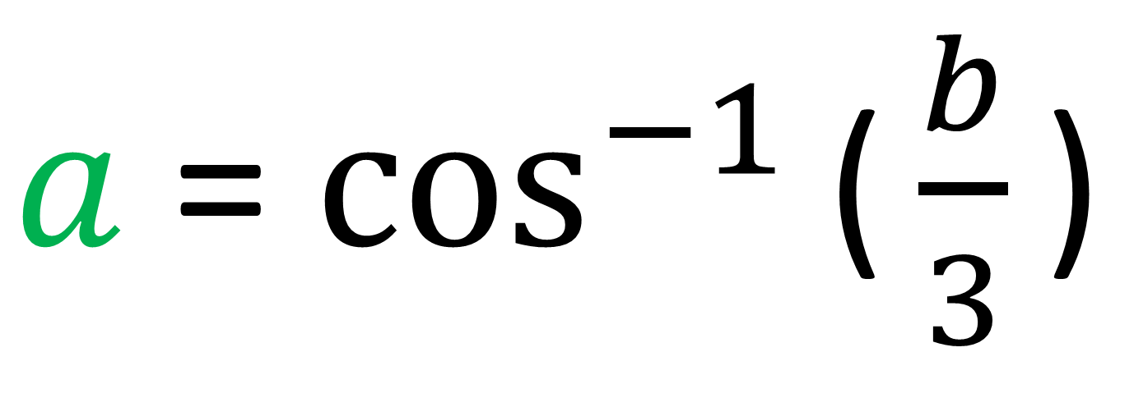
Make $a$ the subject of the formula.
$3cos{a}$ = $b$
$a$ = $\cos^{−1}{\text{(}\frac{b}{3}\text{)}}$

Slide 7
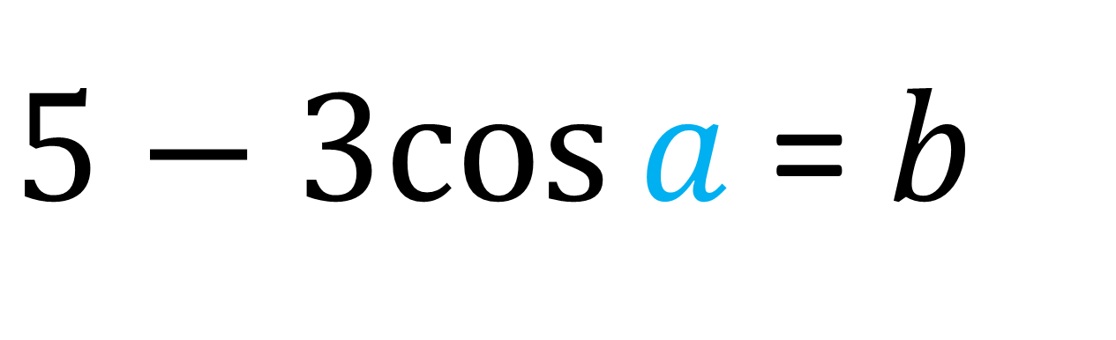

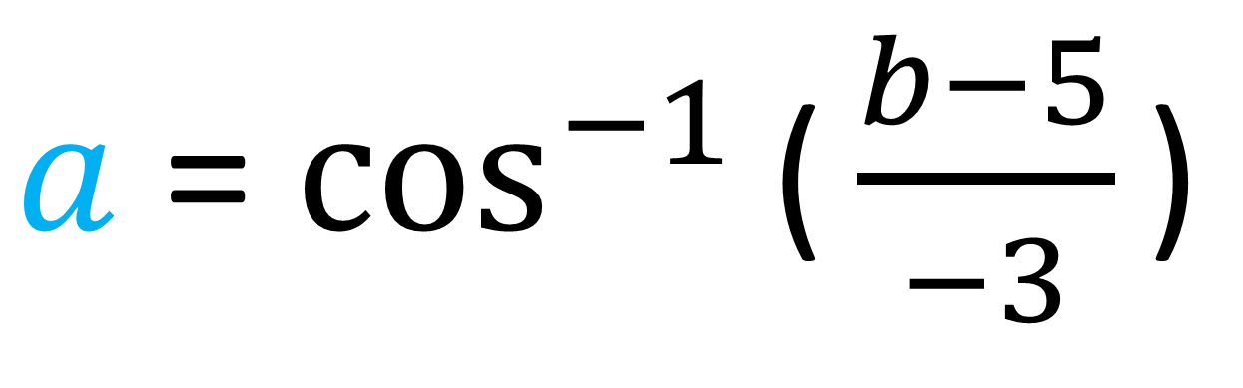
Make $a$ the subject of the formula.
$5−3cos{a}$ = $b$
$a$ = $\cos^{−1}{\text{(}\frac{b−5}{−3}\text{)}}$

Slide 8
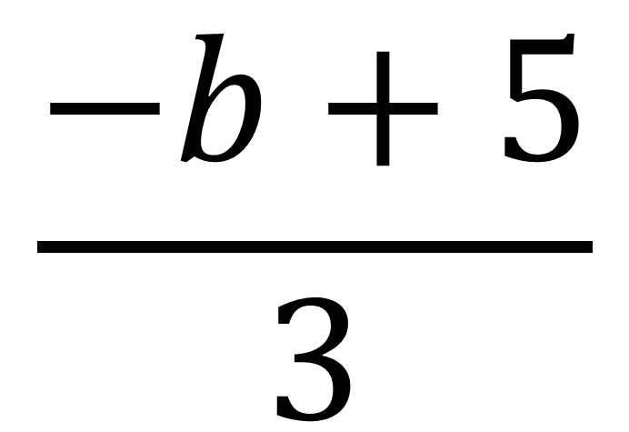
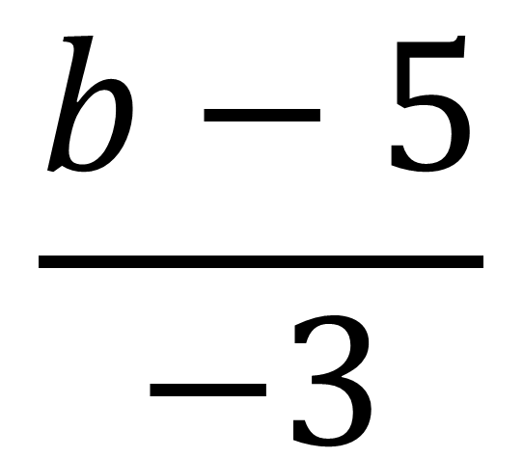
True or False
$$\frac{b−5}{−3}$$
$$\frac{−b+5}{3}$$
=
True

Slide 9
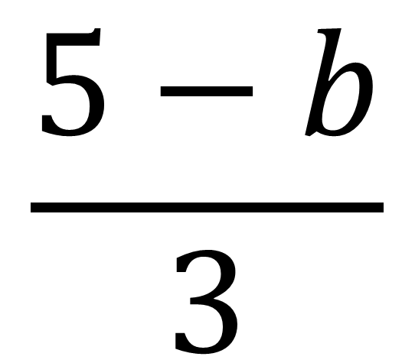
True or False
$$\frac{b−5}{−3}$$
$$\frac{5−b}{3}$$
=
True

Slide 10
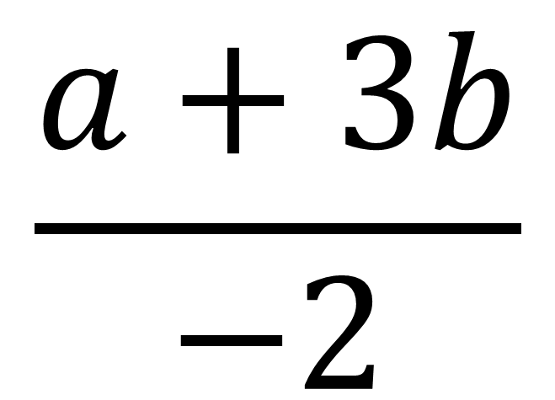
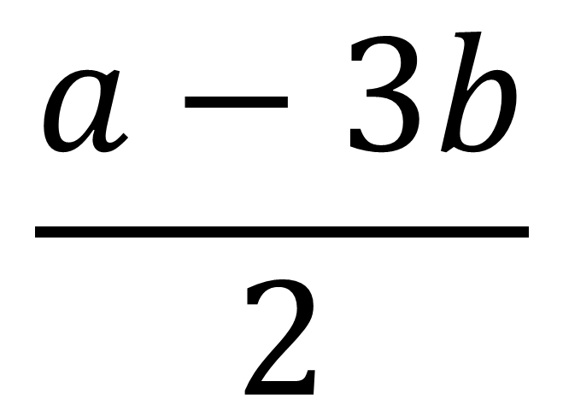
True or False
$$\frac{a−3b}{2}$$
$$\frac{a+3b}{−2}$$
=
False

Slide 11
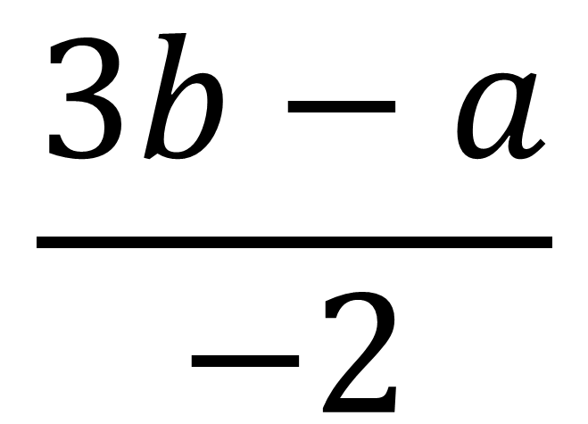
True or False
$$\frac{a−3b}{2}$$
$$\frac{3b−a}{−2}$$
=
True

Slide 12
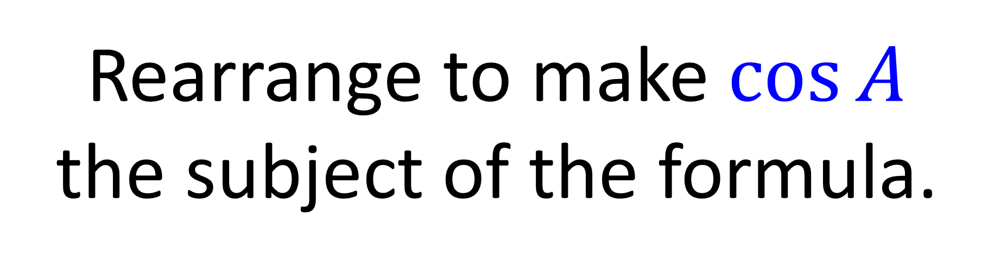
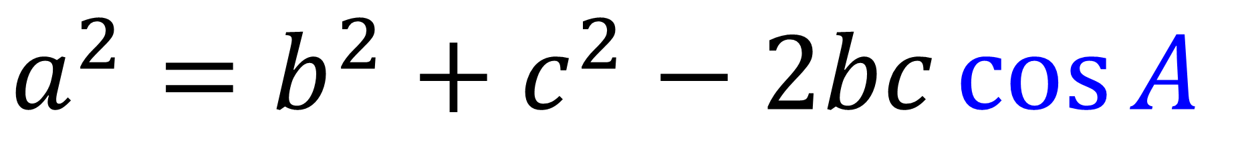
Rearrange to make $\cos{A}$
the subject of the formula.
$$a^{2}=b^{2}+c^{2}−2bc\cos{A}$$

Slide 13
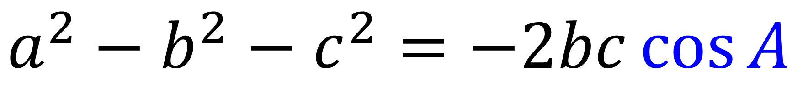
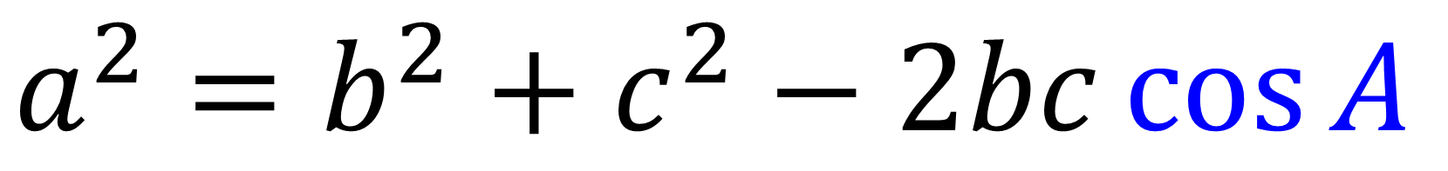
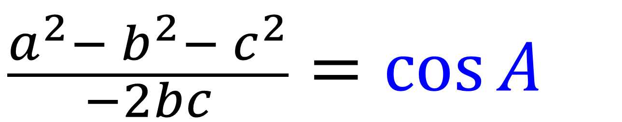
$$a^{2}=b^{2}+c^{2}−2bc\cos{A}$$
$$a^{2}{− b}^{2}− c^{2}=−2bc\cos{A}$$
$$\frac{a^{2}{− b}^{2}− c^{2}}{−2bc}=\cos{A}$$

Slide 14
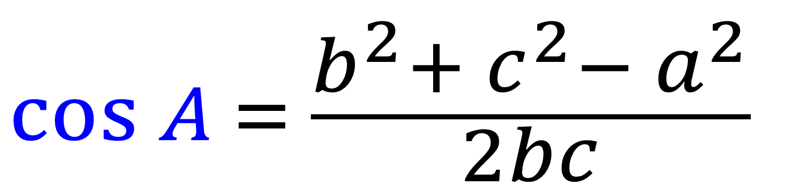
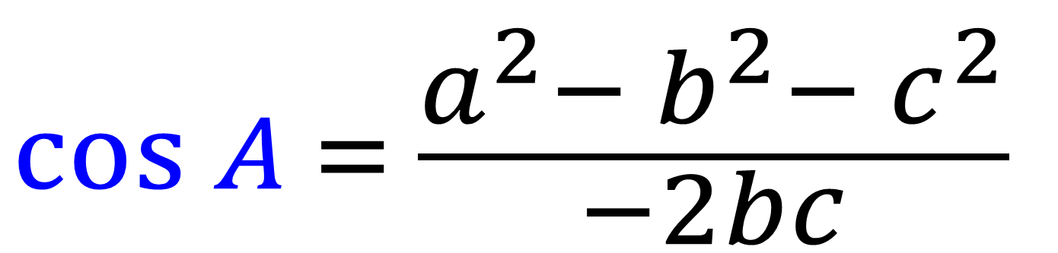
$$\cos{A} = \frac{a^{2}{− b}^{2}− c^{2}}{−2bc}$$
OR
$$\cos{A} = \frac{b^{2}{+ c}^{2}− a^{2}}{2bc}$$

Slide 15
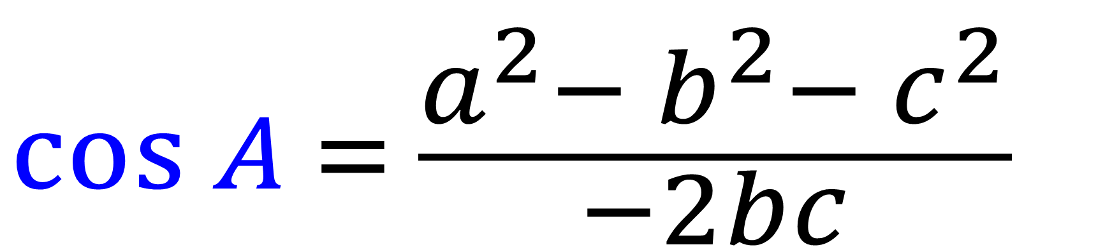
Cosine Rule
$$\cos{A} = \frac{a^{2}{− b}^{2}− c^{2}}{−2bc}$$

Slide 16
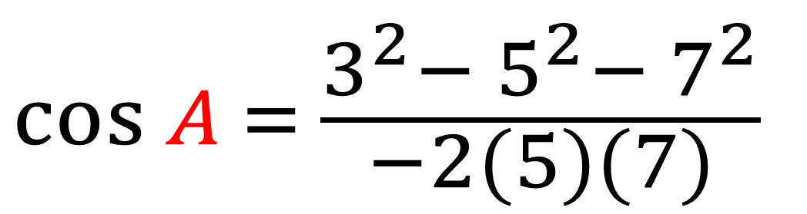
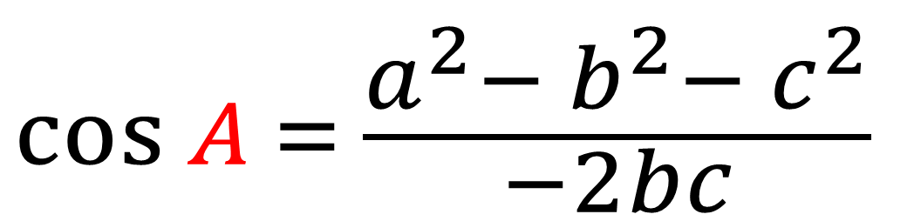
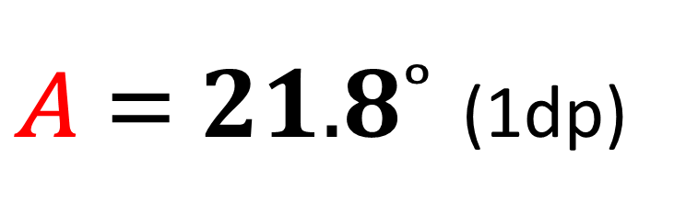
$$\cos{A} = \frac{a^{2}{− b}^{2}− c^{2}}{−2bc}$$
C
b
5cm
a
3cm
$$\cos{A} = \frac{3^{2}{− 5}^{2}− 7^{2}}{−2(5)(7)}$$
x
A
B
7cm
c
$A = 21.8˚$ (1dp)

Slide 17
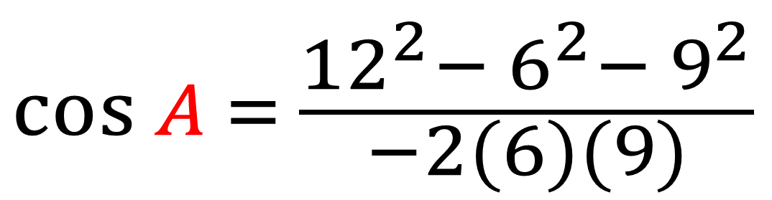
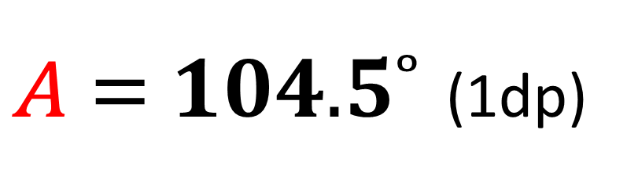
$$\cos{A} = \frac{a^{2}{− b}^{2}− c^{2}}{−2bc}$$
A
c
x
b
9cm
6cm
$$\cos{A} = \frac{{12}^{2}{− 6}^{2}− 9^{2}}{−2(6)(9)}$$
B
C
12cm
a
$A = 104.5˚$ (1dp)

Slide 18
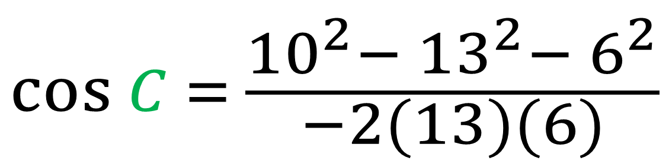
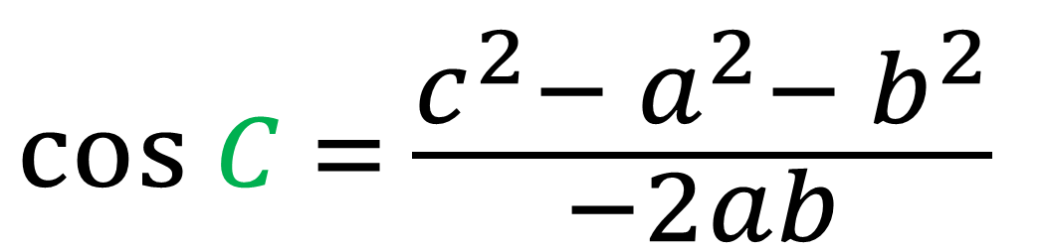
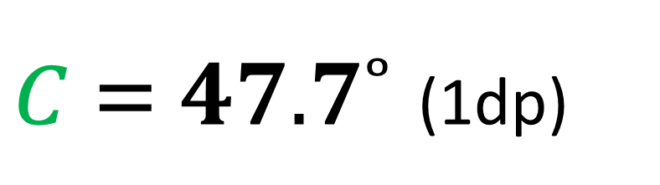
$$\cos{C} = \frac{c^{2}{− a}^{2}− b^{2}}{−2ab}$$
A
c
b
10cm
6cm
x
$$\cos{C} = \frac{{10}^{2}{− 13}^{2}− 6^{2}}{−2(13)(6)}$$
B
C
13cm
a
$C = 47.7˚$ (1dp)

