Slide 1

Junior Challenge 3
Silver

Slide 2
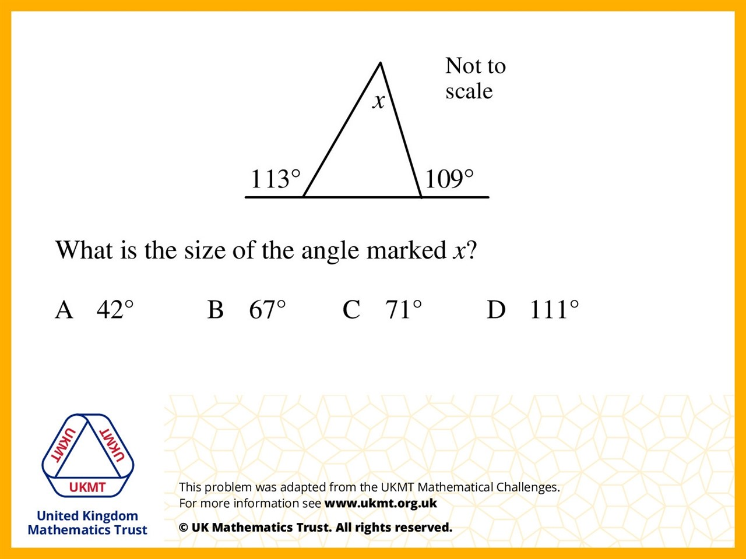
Q1.
180 – 133 = 67 and 180 – 109 = 71 and they are the 2 bottom angles so 180 – 67 – 71 = 42

Slide 3
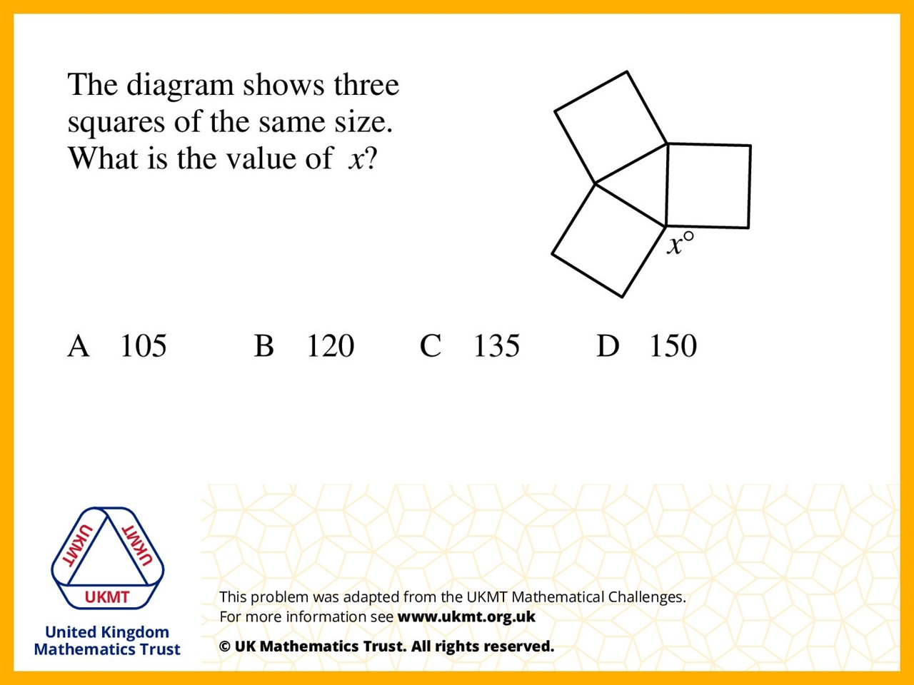
Q2.
90 + 90 + 60 = 240
360 – 240 = 120

Slide 4
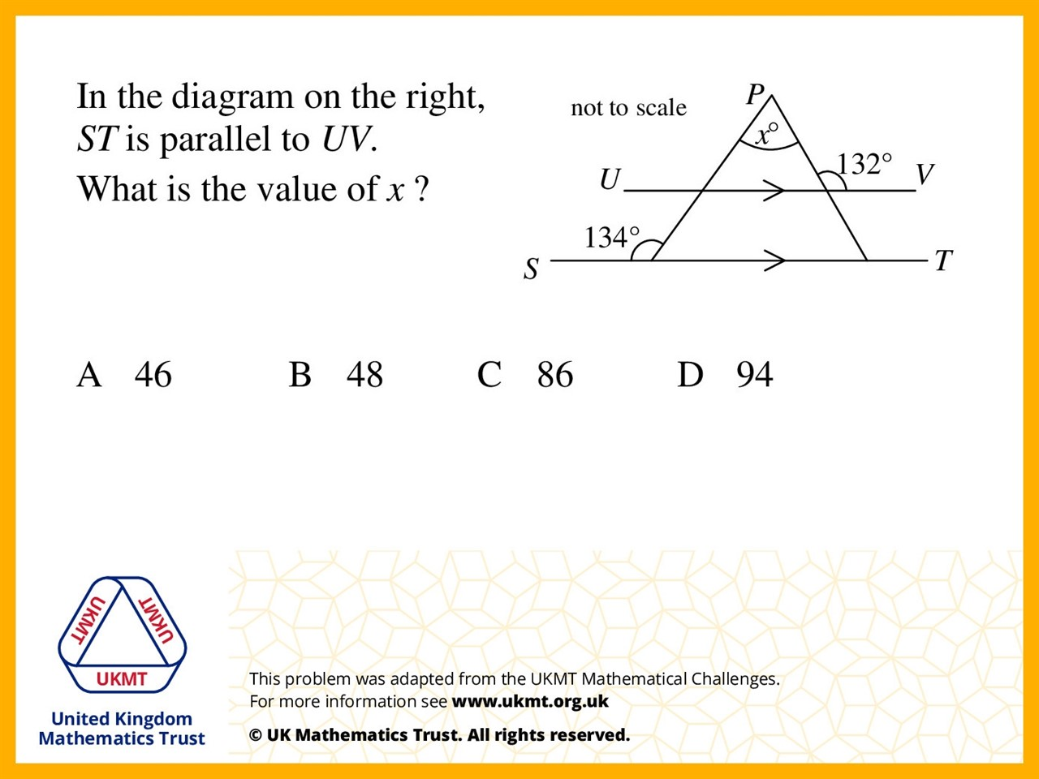
Q3.
180 –134 = 46
180 – 132 = 48
46 + 48 = 94
180 – 94 = 86

Slide 5
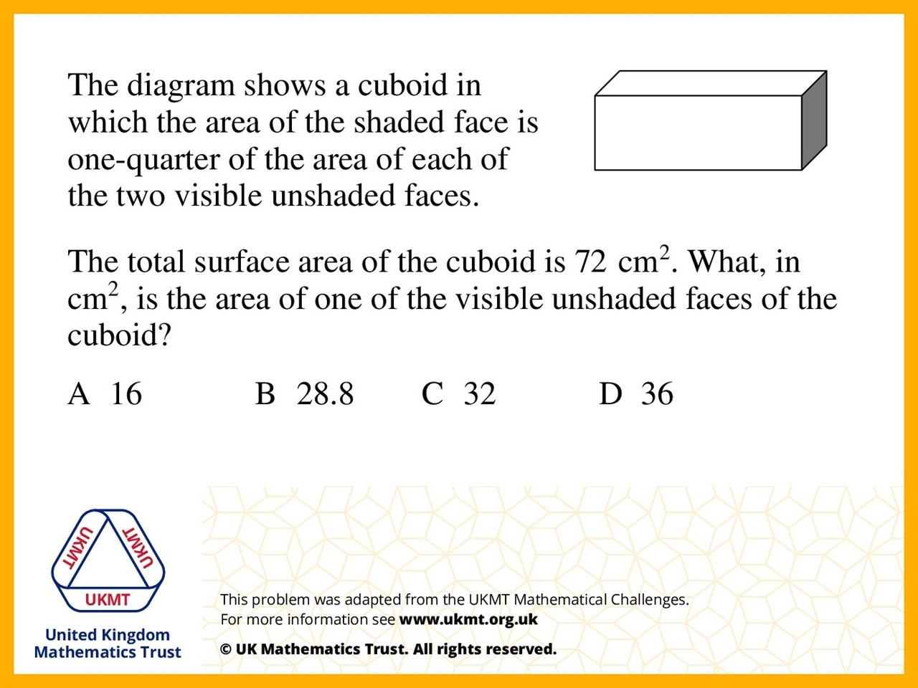
Q4.
Shaded area = x
Unshaded area = 4x.
Total surface area is 18x = 72
which means that x = 4.
So the unshaded area is 4 x 4 = 16.

Slide 6
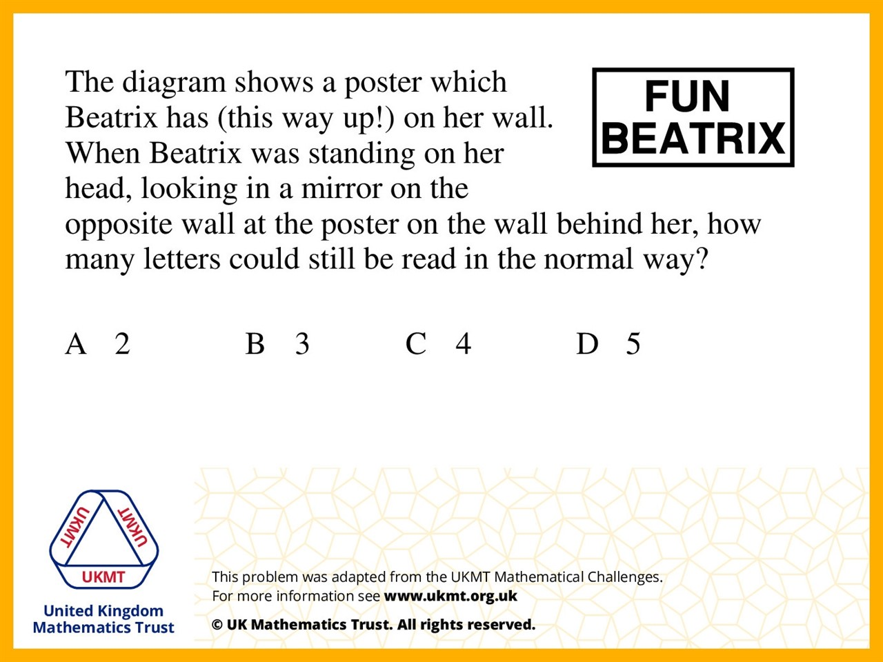
Q5.
The letters X, I, E and B can
still be read the write way around

