Slide 1
Correlation and Regression
Correlation
Chapter 5
(Part 1 of 2)

Slide 2
Correlation
Correlation gives the
strength and type
of the relationship
between two variables.

Slide 3
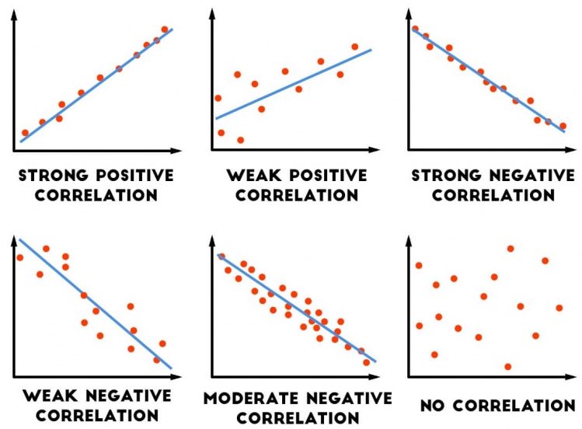

Slide 4
Beware there is a difference between..
being asked for the correlation
and
to describe the relationship.

Slide 5
Correlation
Positive, Negative or No Correlation.
Also state the strength.
Describe
Worded description in the context
of the problem.

Slide 6
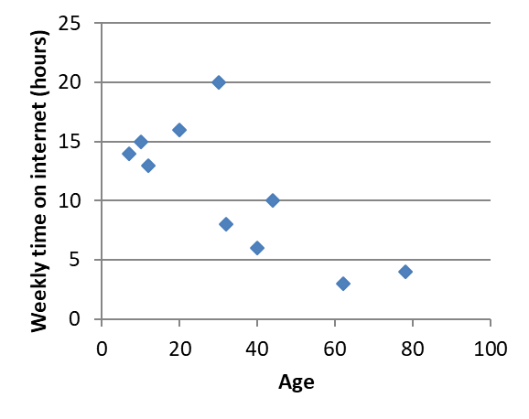
Correlation:
Moderate Negative

Slide 7
Describe:
As you increase with age you spend less time on the internet

Slide 8
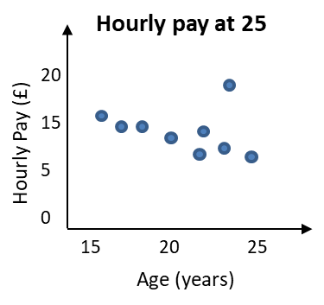
Correlation
Strong Negative
Correlation
Describe
As age increases, the hour pay tends to decrease.

