Slide 1
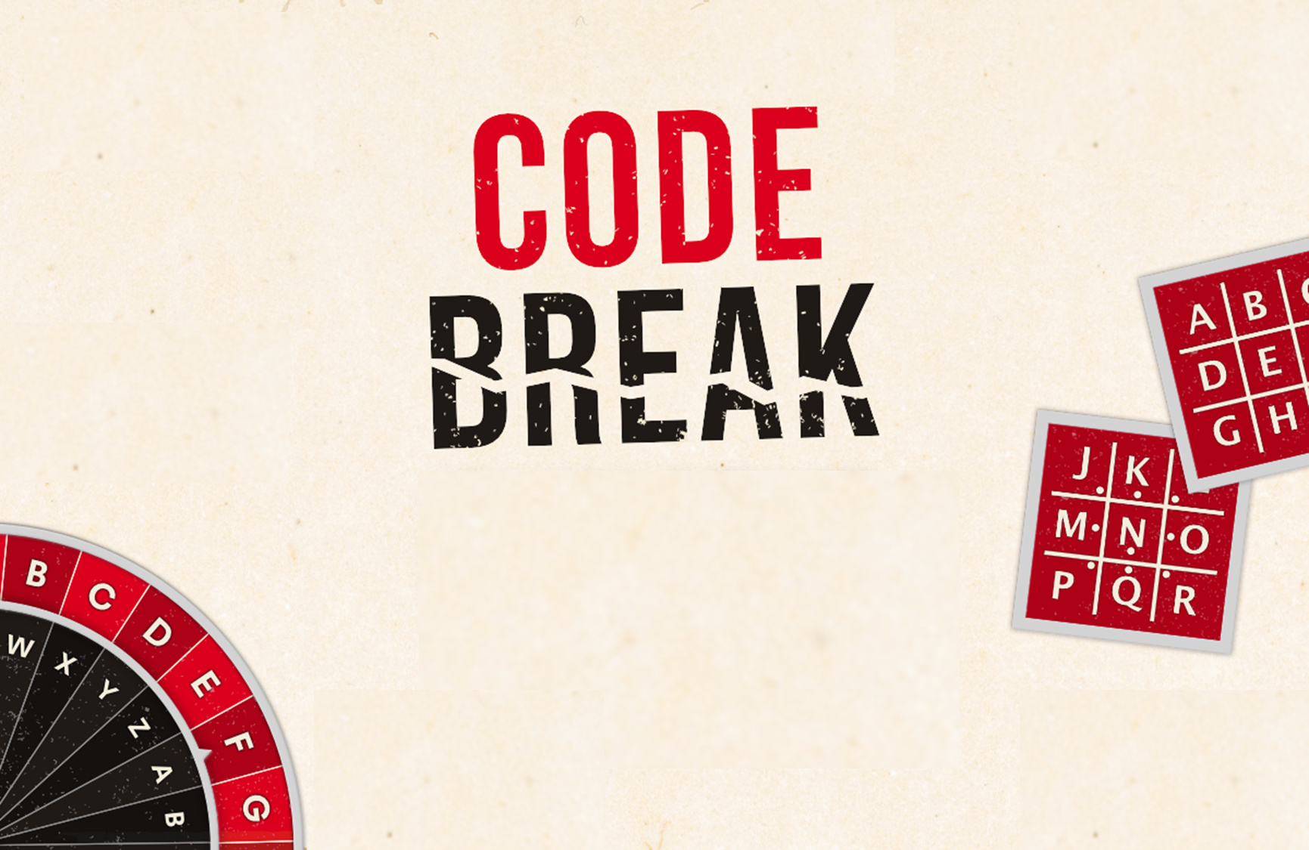
ANSWERS

Slide 2
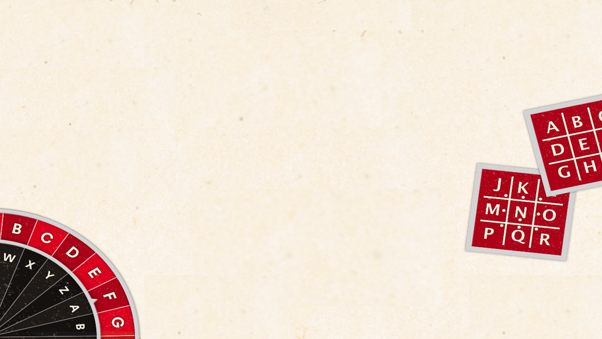
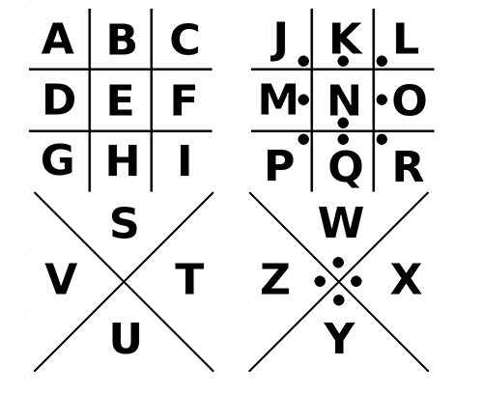
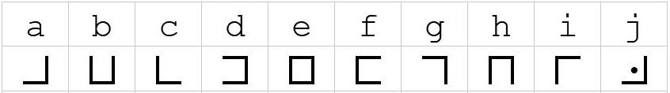
Pigpen Codes

Slide 3
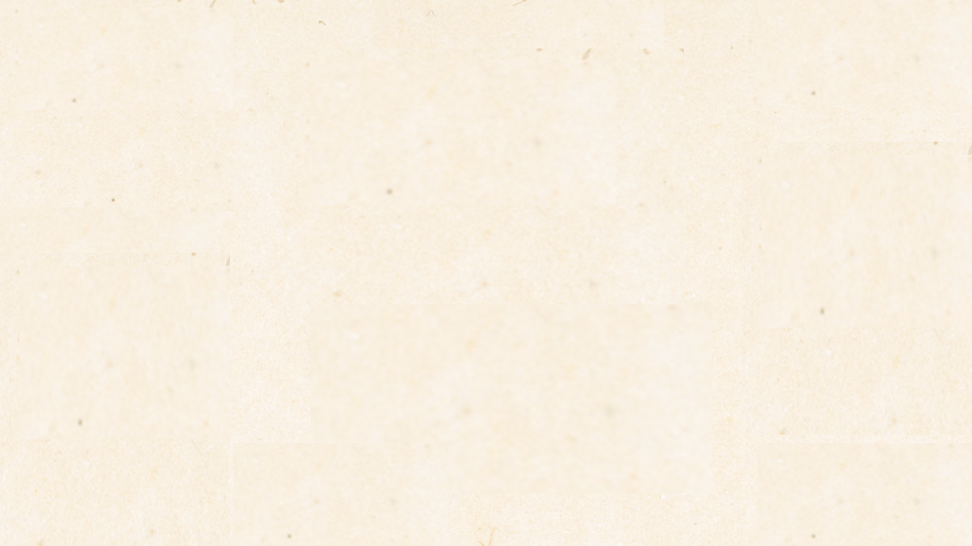


Pigpen Codes - BREAK THE CODE
1)
Mathematics
2)
I went for a walk

Slide 4
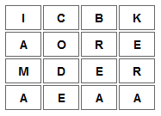
Transposition Ciphers
A transposition means that the letters of the code are simply rearranged into a different order using a grid.
ICBKAOREMDERAEAA
(using a 4 by 4 grid)
I am a Codebreaker

Slide 5


Transposition Ciphers - BREAK THE CODE
THIS IS A MORE DIFFICULT CODE BREAKING TEST
WHAT IS FOUR SQUARED PLUS EIGHT SQUARED?
80

Slide 6
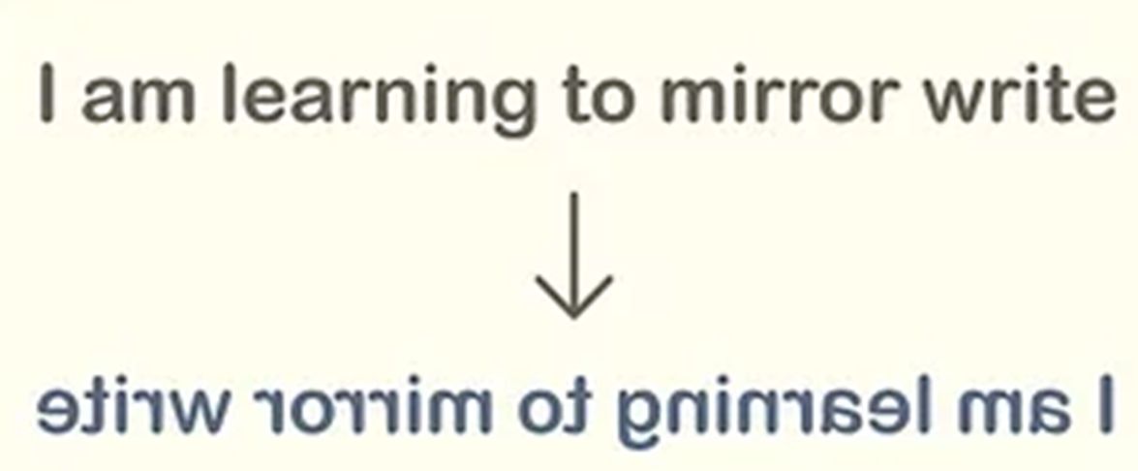
Backward/Mirror Writing

Slide 7
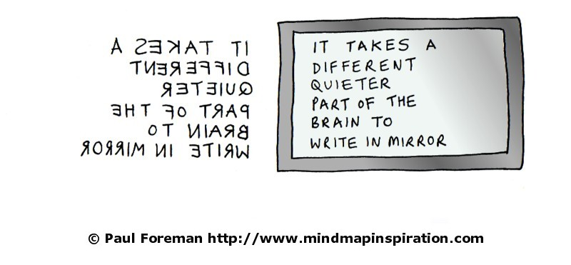
Mirror Writing - BREAK THE CODE

Slide 8
Letter Swapping
wInetttoehwsmiimgnoplo
(Pairs of letters are swapped)
I went to the swimming pool

Slide 9
Letter Swapping - BREAK THE CODE
1) oycuna erda htsi
Groups of 2
You can read this
2) lumpitcilitano
Groups of 3
Multiplication

Slide 10
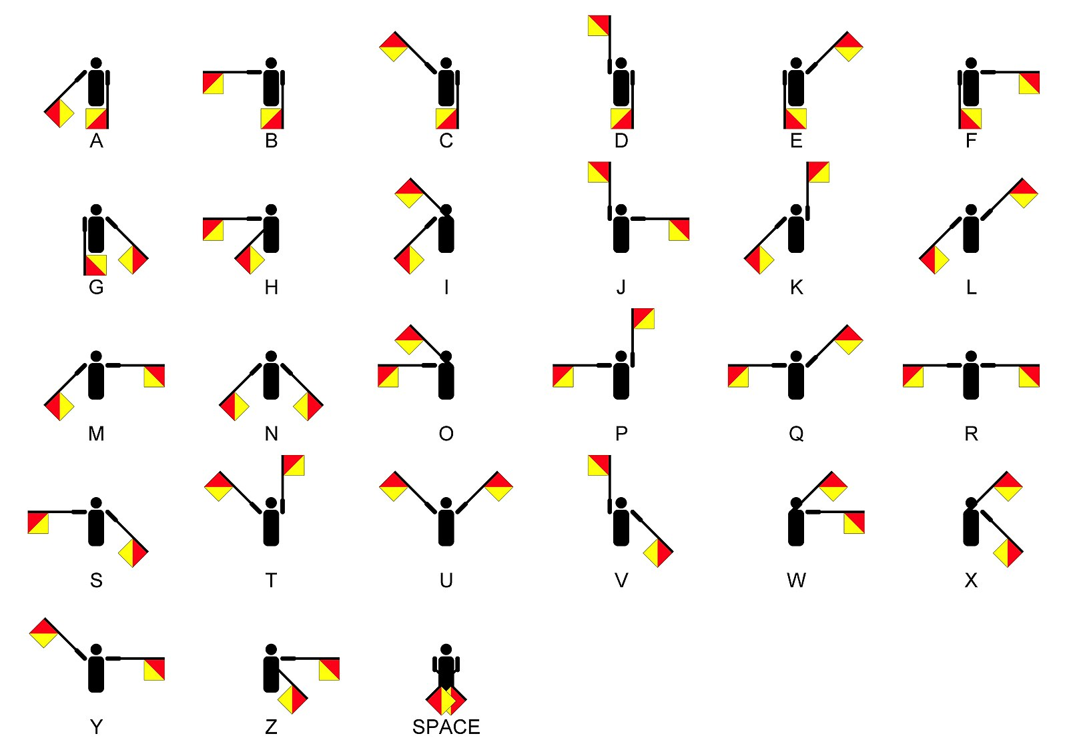
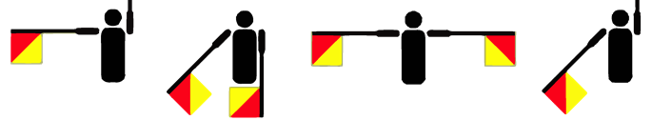
Semaphore Codes
P A R K

Slide 11
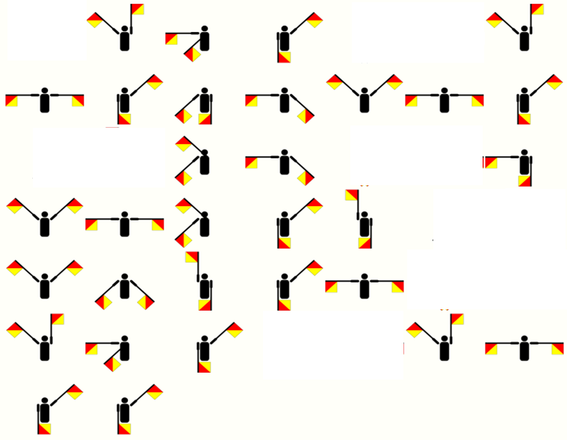
Semaphore Codes - BREAK THE CODE
The treasure is buried under the tree.

Slide 12


Caesar Shifts
The alphabet is shift into a new position.
Below is a shift of Right 3.
ARYXF ZLIIBDB
DUBAI COLLEGE

Slide 13
Caesar Shifts - BREAK THE CODE
1) ZLKDOXQRIXQFLKP VLR EXSB ZOXZHBA QEB ZXBPXO PEFCQ ZLAB
Alphabet | A | B | C | D | E | F | G | H | I | J | K | L | M | N | O | P | Q | R | S | T | U | V | W | X | Y | Z
Cipher | X | Y | Z | A | B | C | D | E | F | G | H | I | J | K | L | M | N | O | P | Q | R | S | T | U | V | W
CONGRATULATIONS YOU HAVE CRACKED THE CAESAR SHIFT CODE
2) DOHA PZ AOL MPMAO AYPHUNBSHY UBTILY
Alphabet | A | B | C | D | E | F | G | H | I | J | K | L | M | N | O | P | Q | R | S | T | U | V | W | X | Y | Z
Cipher | H | I | J | K | L | M | N | O | P | Q | R | S | T | U | V | W | X | Y | Z | A | B | C | D | E | F | G
WHAT IS THE FIFTH TRIANGULAR NUMBER?
15

Slide 14
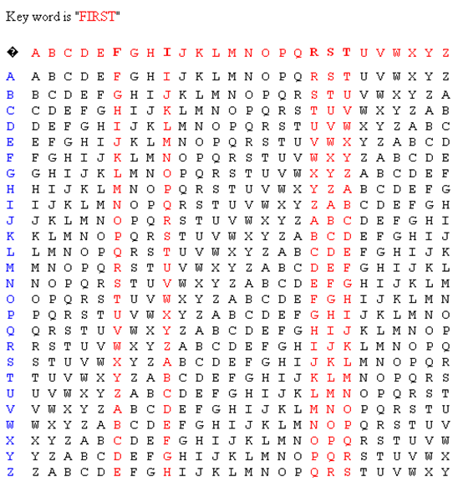
Vigenère Encryption
Key word is FIRST
First letter = use column F
Second letter = use column I
Third letter = use column R
Fourth letter = use column S
Fifth letter = use column T
Sixth letter = use column F
Seven letter = use column I
and so on.
Look down the column for you coded letter then look across the row to the blue column to get the uncoded letter.
BPF
WHO

Slide 15
Vigenère Encryption - BREAK THE CODE
TOPTS ZYLLU ANWZA ZAWHQ
How many second is a day?
86400

Slide 16
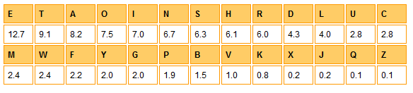
Frequency Analysis
Concentrate on short words first.
A question begins with a word like why or what.
Look for coded letters which repeats.
Think about what letter is used most in the English language.
Looking at the % probably of each letter being in a word.

Slide 17
Frequency Analysis - BREAK THE CODE
GITW JAJ XRH PIQW AXHR HEK RCCATK; EK YRIUJKJ HEK YBO IH HEK TRUXKU. EK PKXH HR HEK IAUZRUH.
EK HROOKJ EAO YUAKC TIOK AX HEK HUIOE.
EK QRRWKJ IH I FIZ RC HEK PRUQJ, YRBSEH I HATWKH HR ZIUAO, IXJ XKNKU QRRWKJ YITW.
Alphabet | A | B | C | D | E | F | G | H | I | J | K | L | M | N | O | P | Q | R | S | T | U | V | W | X | Y | Z
Cipher | I | Y | T | J | K | C | S | E | A | G | W | Q | F | X | R | Z |  | U | O | H |  | N | P
Jack did not walk into the office; he boarded the bus at the corner.
He went to the airport. He tossed his brief case in the trash.
He looked at a map of the world, bought a ticket to Paris, and never looked back.

