Slide 1

Senior Challenge 1
BRONZE

Slide 2
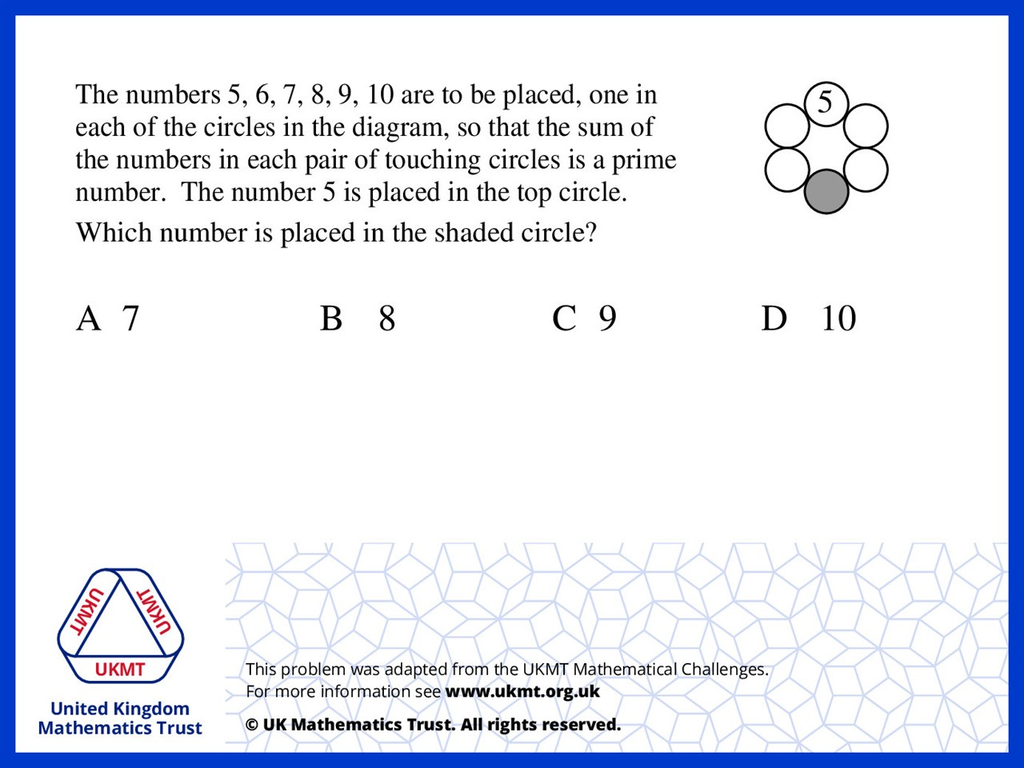
Q1.
Starting from 5 going to the right: 5,8,9,10,7,6

Slide 3
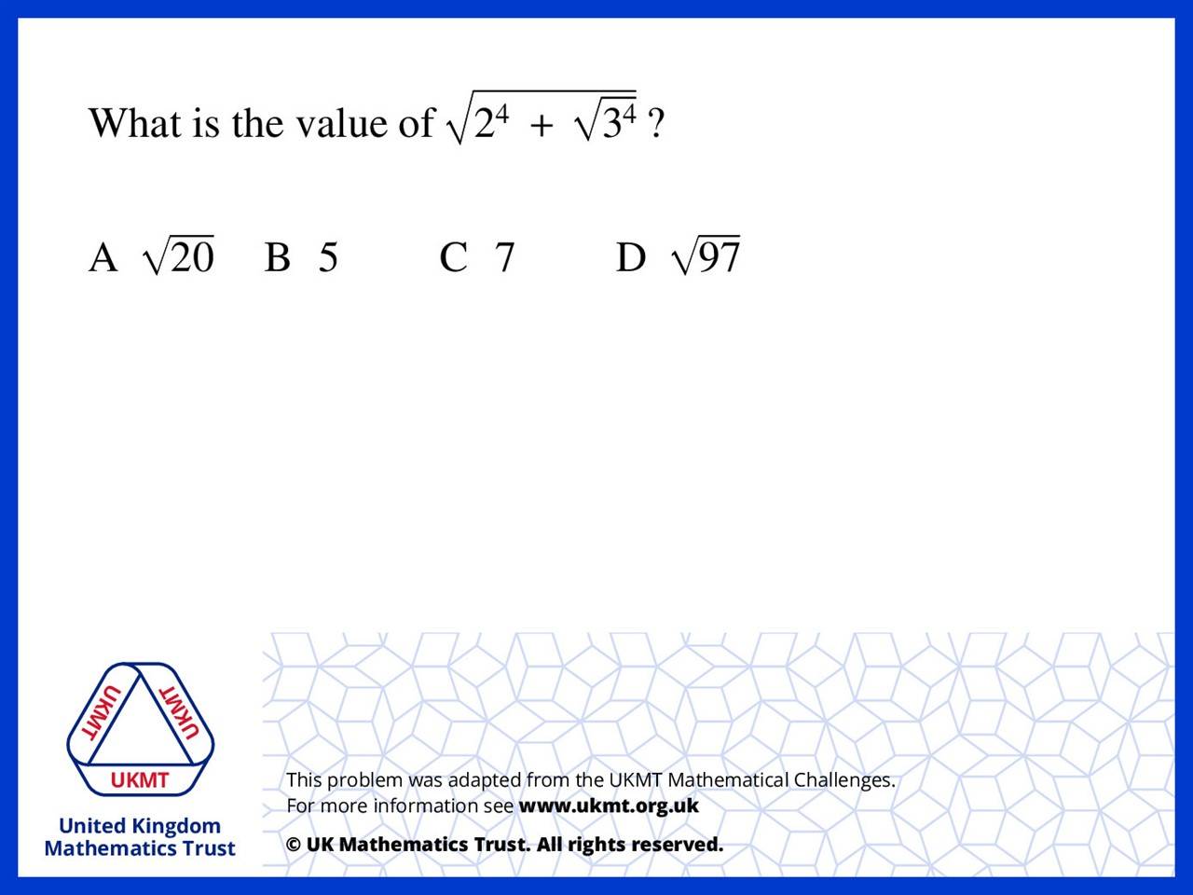

Q2.
$3^{4}$ = 81
$\sqrt{81}$= 9
$2^{4}$ = 16
16 + 9 = 25
$\sqrt{25}$= 25

Slide 4
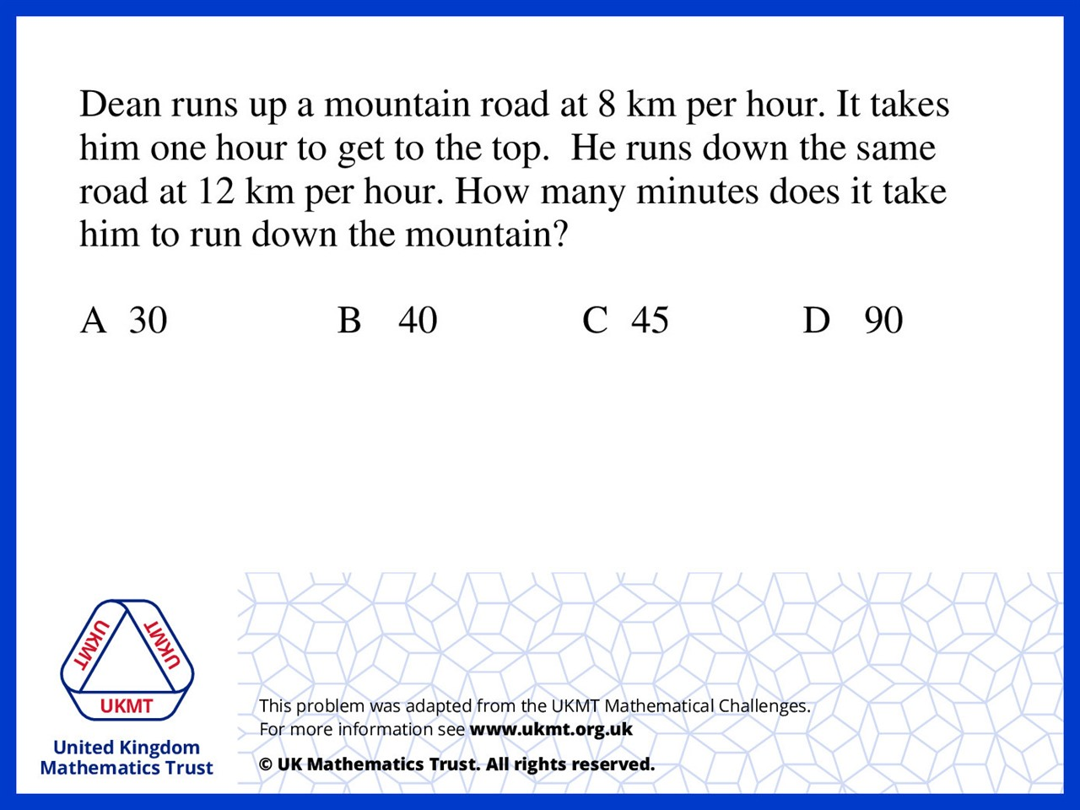
Q3.
The distance of the road was 8 x 60 = 480
480 ÷ 12 = 40 minutes

Slide 5
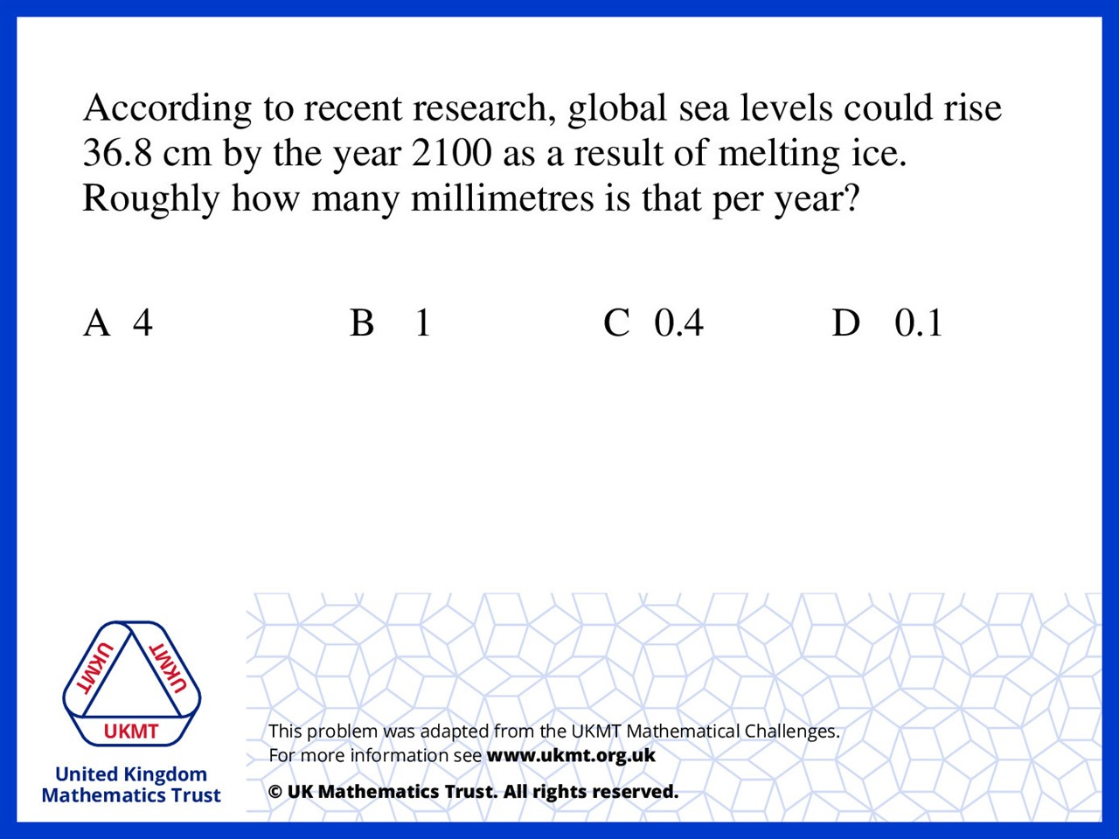
Q4.
36.8cm is approximately 400mm
400 ÷ 100 = 4

Slide 6
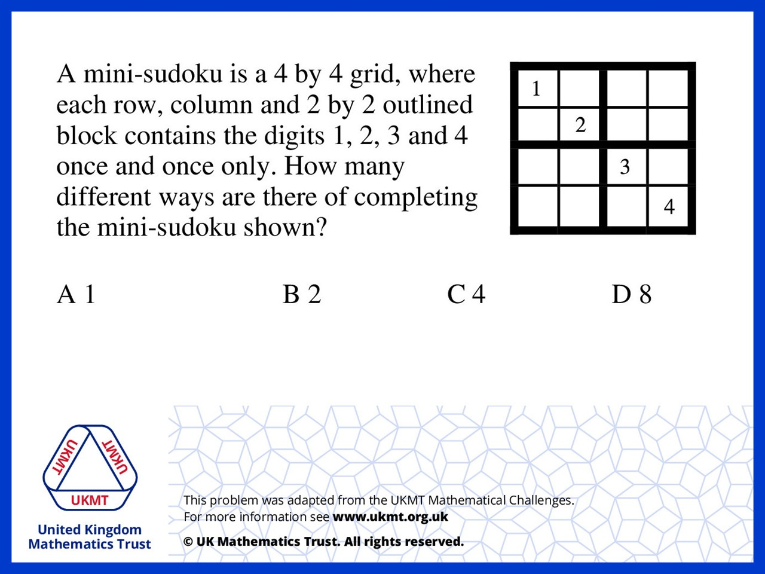
Q5.
In the top left 2 by 2 square there is only two ways to arrange 3 and 4.

