Slide 1
Differentiation
Product Rule
Chapter 9
(Part 4 of 10)

Slide 2
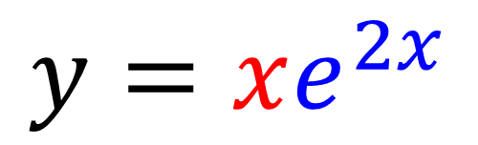
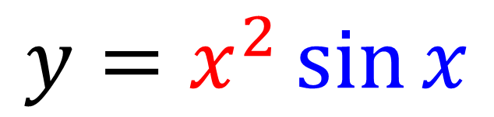
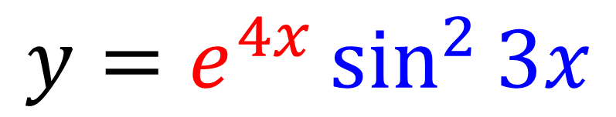
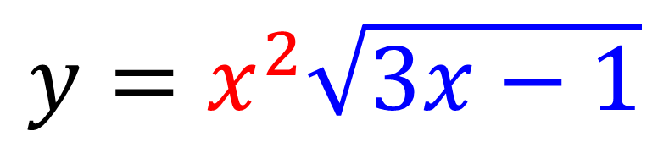
The product rule is used when
you have a product of two functions.
$$y=x^{2}\sin{x}$$
$$y=xe^{2x}$$
$$y=x^{2}\sqrt{3x−1}$$
$$y=e^{4x}\sin^{2}{3x}$$

Slide 3
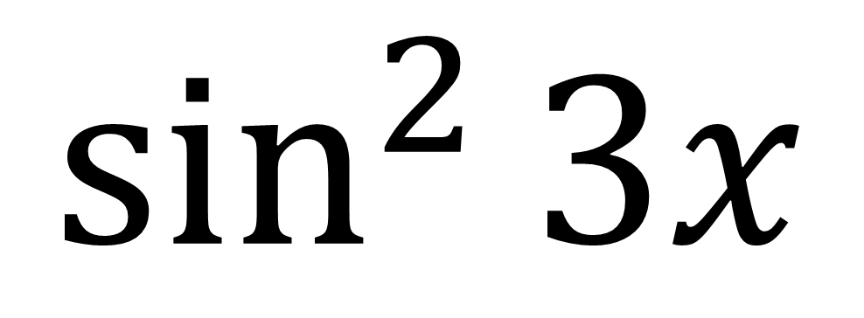
Product or Chain Rule?
$$\sin^{2}{3x}$$
Chain Rule

Slide 4
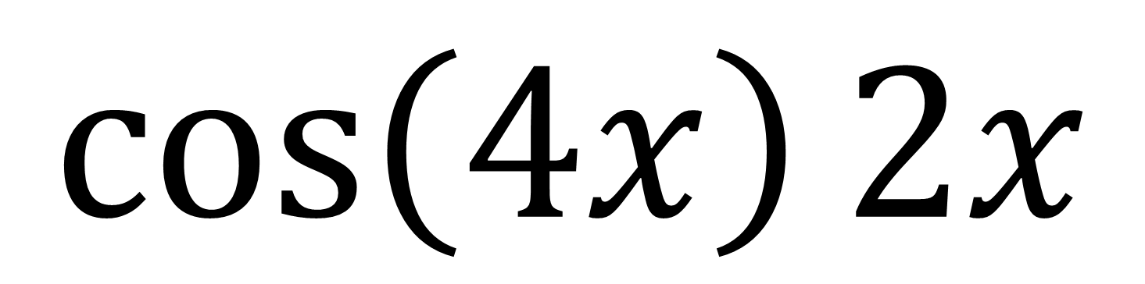
Product or Chain Rule?
$$\cos\left(4x\right)2x$$
Product Rule

Slide 5
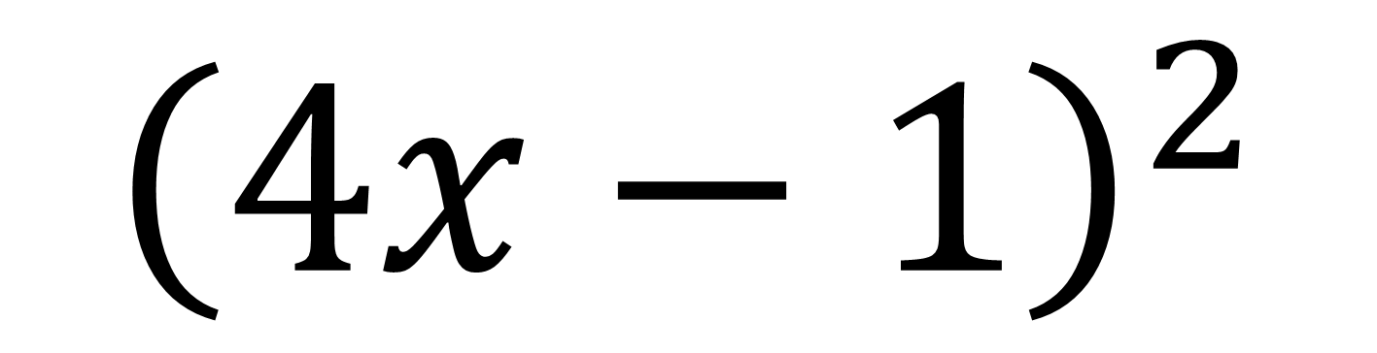
Product or Chain Rule?
$${\left(4x−1\right)}^{2}$$
Chain Rule

Slide 6
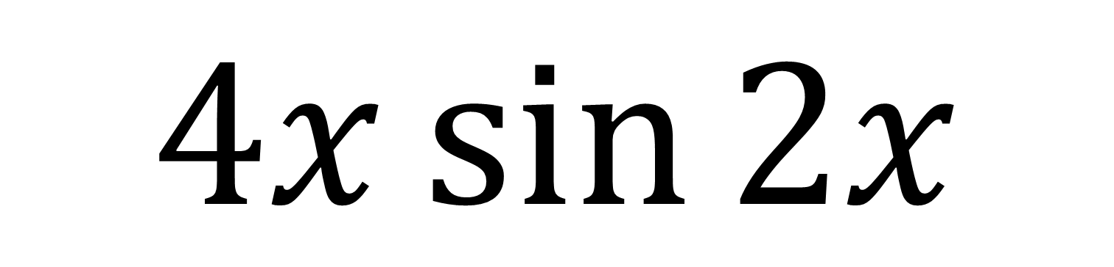
Product or Chain Rule?
$$4x\sin{2x}$$
Product Rule

Slide 7
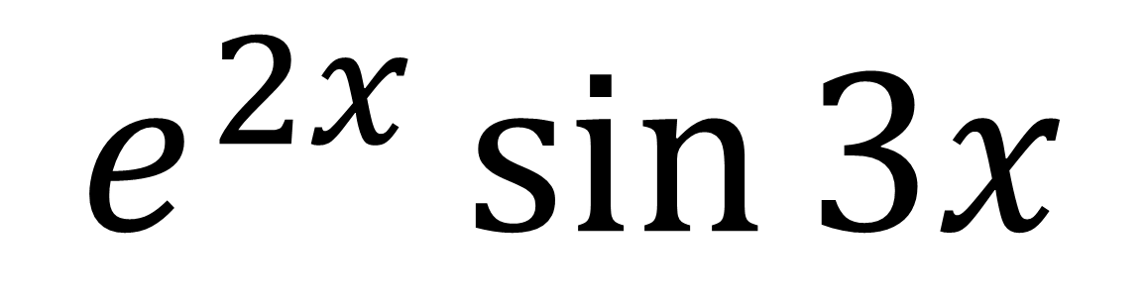
Product or Chain Rule?
$$e^{2x}\sin{3x}$$
Product Rule

Slide 8
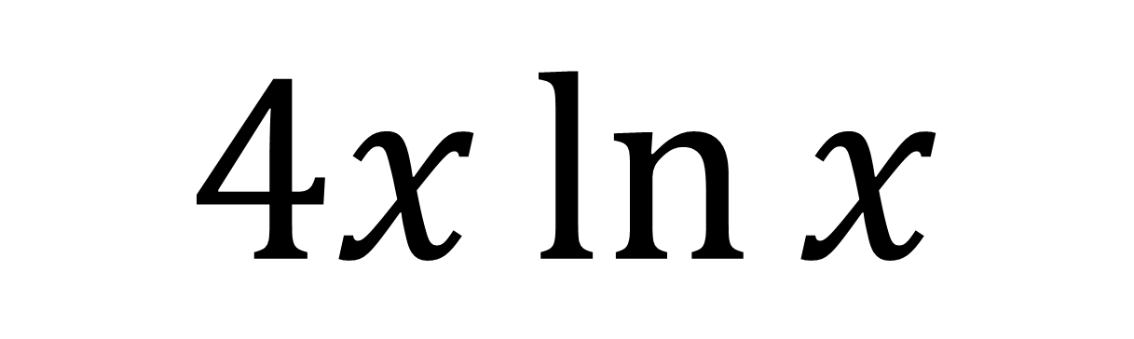
Product or Chain Rule?
$$4x\ln{x}$$
Product Rule

Slide 9
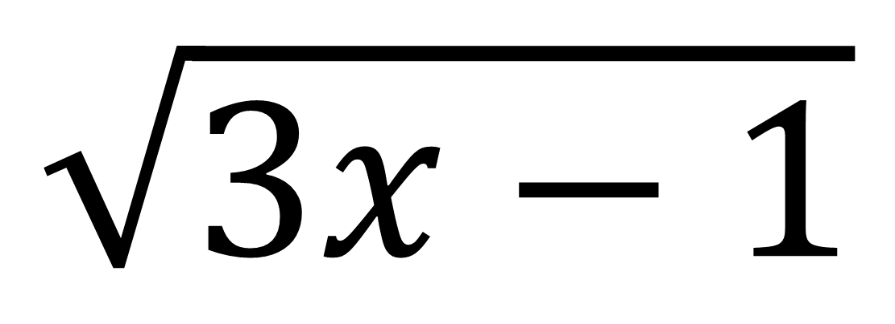
Product or Chain Rule?
$$\sqrt{3x−1}$$
Chain Rule

Slide 10
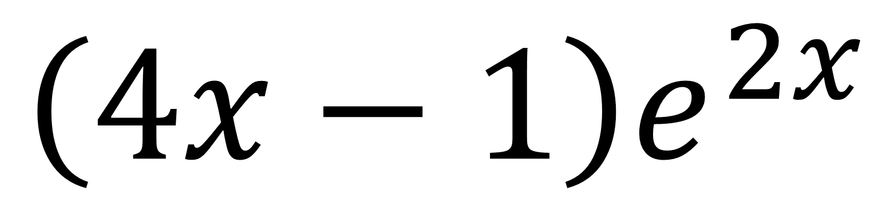
Product or Chain Rule?
$$\left(4x−1\right)e^{2x}$$
Product Rule

Slide 11
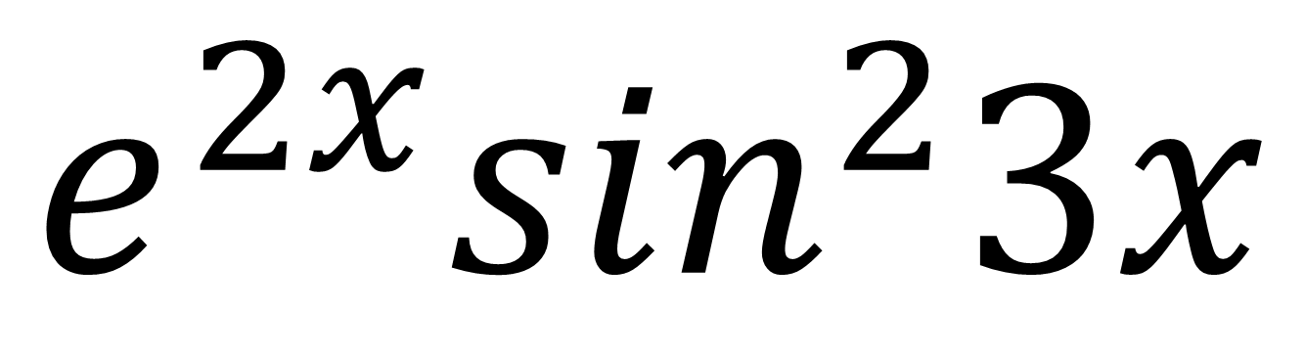
Product or Chain Rule?
$$e^{2x}\sin^{2}3x$$
Product and Chain Rule

Slide 12
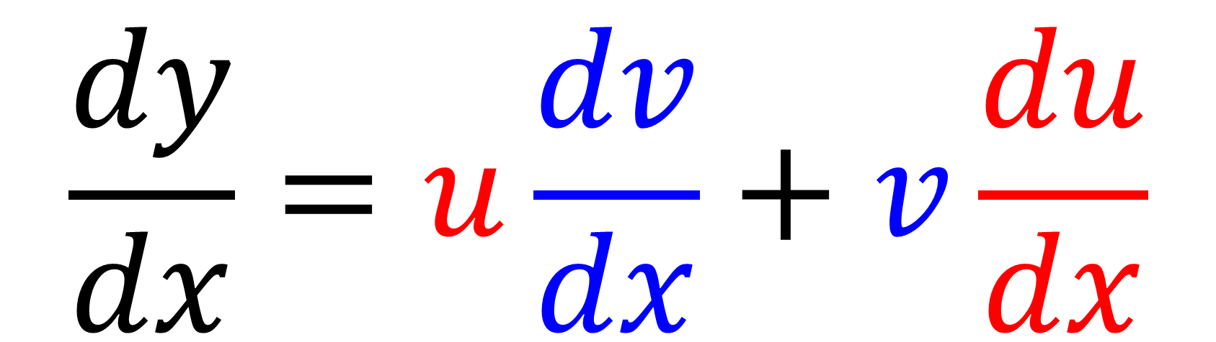

The Product Rule
If $y=uv$ then
$$\frac{dy}{dx}=u\frac{dv}{dx}+v\frac{du}{dx}$$

Slide 13
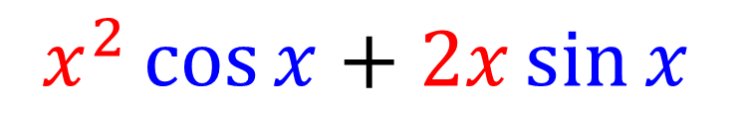

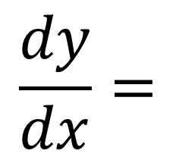
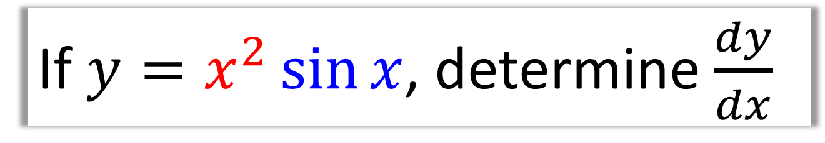


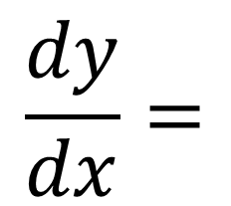
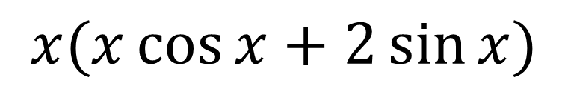
If $y=x^{2}\sin{x}$, determine $\frac{dy}{dx}$
(Factorise your answer)
$$x^{2}$$ | $$sin x$$
$$2x$$ | $$\cos{x}$$
$$2x$$
$$\cos{x}$$
$$\frac{dy}{dx}=$$
Multiply opposite
corners and add
$$x^{2}\cos{x}+2x\sin{x}$$
$$\frac{dy}{dx}=$$
Factorise
$$x(x\cos{x}+2\sin{x)}$$

Slide 14

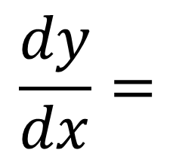
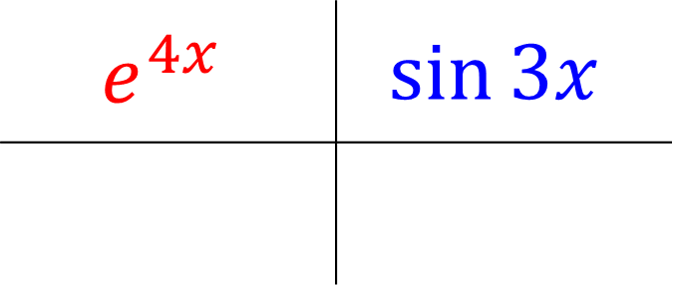
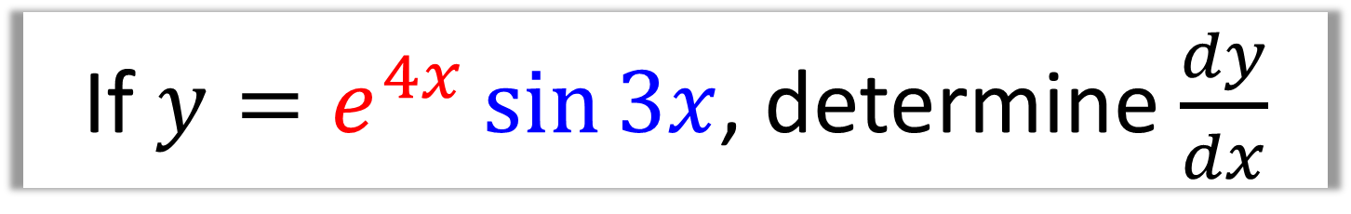
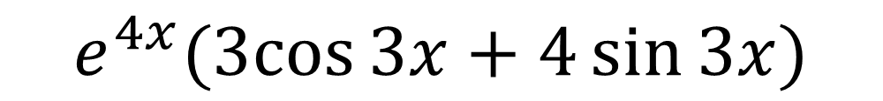
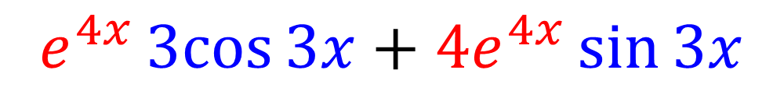
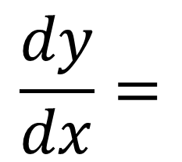

If $y=e^{4x}\sin{3x}$, determine $\frac{dy}{dx}$
(Factorise your answer)
$$e^{4x}$$ | $$\sin{3x}$$
$$2x$$ | $$\cos{x}$$
$${4e}^{4x}$$
$$3cos{3x}$$
$$\frac{dy}{dx}=$$
$$e^{4x}3cos{3x}+{4e}^{4x}\sin{3x}$$
$$\frac{dy}{dx}=$$
$$e^{4x}(3cos{3x}+4\sin{3x)}$$

Slide 15
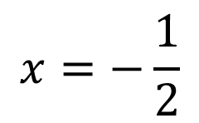
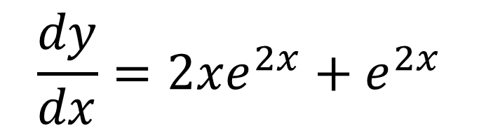


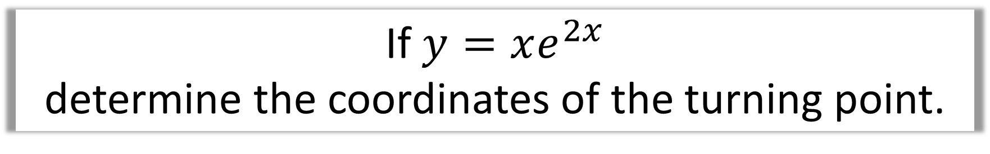
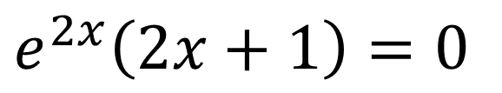


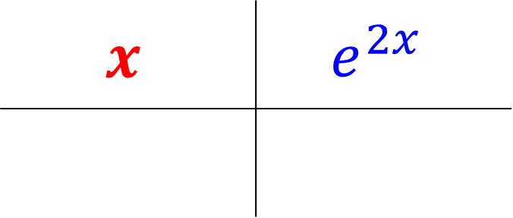
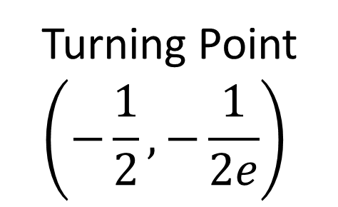
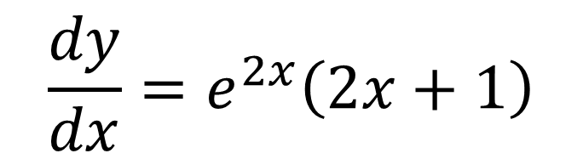
If $y=xe^{2x}$
determine the coordinates of the turning point.
$$x$$ | $$e^{2x}$$
$$2x$$ | $$\cos{x}$$
$$e^{2x}\left(2x+1\right)=0$$
$$1$$
$$2e^{2x}$$
$e^{2x}≠0$
$$x=−\frac{1}{2}$$
$$\frac{dy}{dx}=2xe^{2x}+e^{2x}$$
$$2x+1=0$$
Turning Point
$$\left(−\frac{1}{2},−\frac{1}{2e}\right)$$
$$\frac{dy}{dx}=e^{2x}\left(2x+1\right)$$

Slide 16

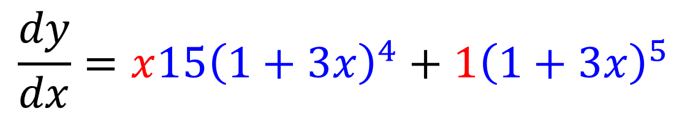
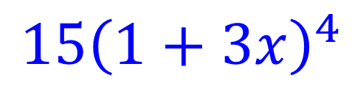
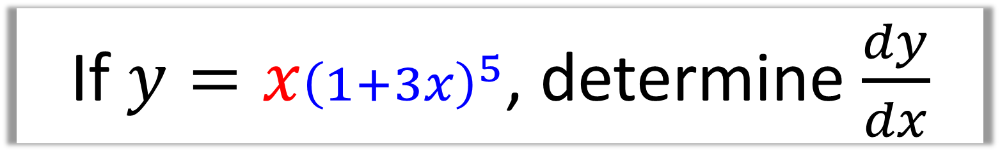
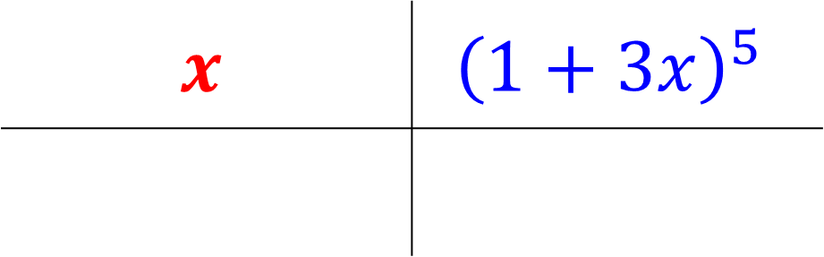
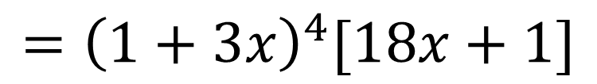
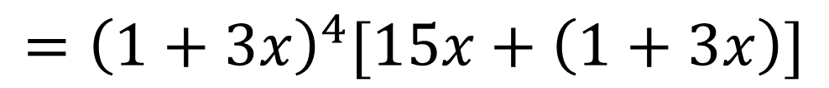
If $y=x{\left(1+3x\right)}^{5}$, determine $\frac{dy}{dx}$
(Factorise your answer)
$$x$$ | $${\left(1+3x\right)}^{5}$$
$$2x$$ | $$\cos{x}$$
$$1$$
$${15\left(1+3x\right)}^{4}$$
$$\frac{dy}{dx}=x{15\left(1+3x\right)}^{4}+1{\left(1+3x\right)}^{5}$$
$$={\left(1+3x\right)}^{4}[15x+\left(1+3x\right)]$$
$$={\left(1+3x\right)}^{4}[18x+1]$$

Slide 17
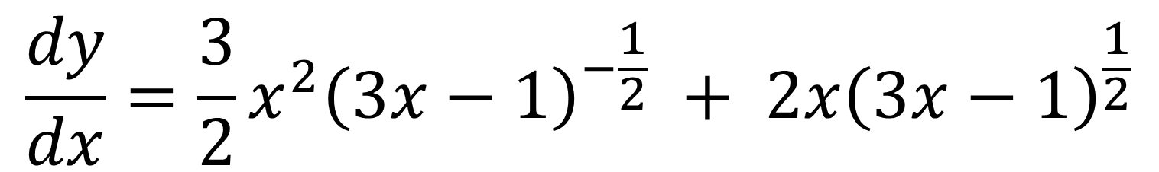
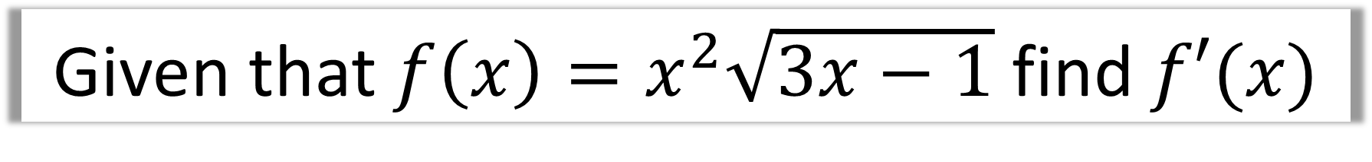



Given that $f\left(x\right)=x^{2}\sqrt{3x−1}$ find $f′(x)$
(No need to factorise your final answer)
$$x^{2}$$ | $${\left(3x−1\right)}^{\frac{1}{2}}$$
$$2x$$ | $$\cos{x}$$
$$\frac{3}{2}{\left(3x−1\right)}^{−\frac{1}{2}}$$
$$2x$$
$$\frac{dy}{dx}=\frac{3}{2}x^{2}{\left(3x−1\right)}^{−\frac{1}{2}} + 2x{\left(3x−1\right)}^{\frac{1}{2}}$$

Slide 18
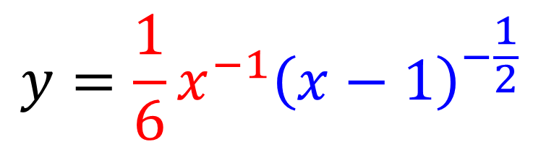





$y=\frac{1}{6x\sqrt{x−1}}$ $find \frac{dy}{dx}$
$$y=\frac{1}{6}x^{−1}{\left(x−1\right)}^{−\frac{1}{2}}$$
(No need to factorise your final answer)
$$\frac{1}{6}x^{−1}$$ | $${\left(x−1\right)}^{−\frac{1}{2}}$$
$$2x$$ | $$\cos{x}$$
$$−\frac{1}{6}x^{−2}$$
$$−\frac{1}{2}{\left(x−1\right)}^{−\frac{3}{2}}$$
$$\frac{dy}{dx}=−\frac{1}{6}x^{−2}{\left(x−1\right)}^{−\frac{1}{2}} + −\frac{1}{12}x^{−1}{\left(x−1\right)}^{−\frac{3}{2}}$$

Slide 19







If $y=e^{4x}\sin^{2}{3x}$
show that $\frac{dy}{dx}=e^{4x}\sin{3x}\left(A\cos{3x}+B\sin{3x}\right)$
where $A$ and $B$ are constants to be determined.
$$e^{4x}$$ | $${\left(\sin{3x}\right)}^{2}$$
$$2x$$ | $$\cos{x}$$
$$4e^{4x}$$
$$6\sin{3x}\cos{3x}$$
$$\frac{dy}{dx}=6e^{4x}\sin{3x}\cos{3x}+4e^{4x}{\left(\sin{3x}\right)}^{2}$$
Factorise out
$$e^{4x}\sin{3x}$$
$$\frac{dy}{dx}=e^{4x}\sin{3x}\left(6\cos{3x}+4\sin{3x}\right)$$

Slide 20


Slide 21


Slide 22


