Slide 1
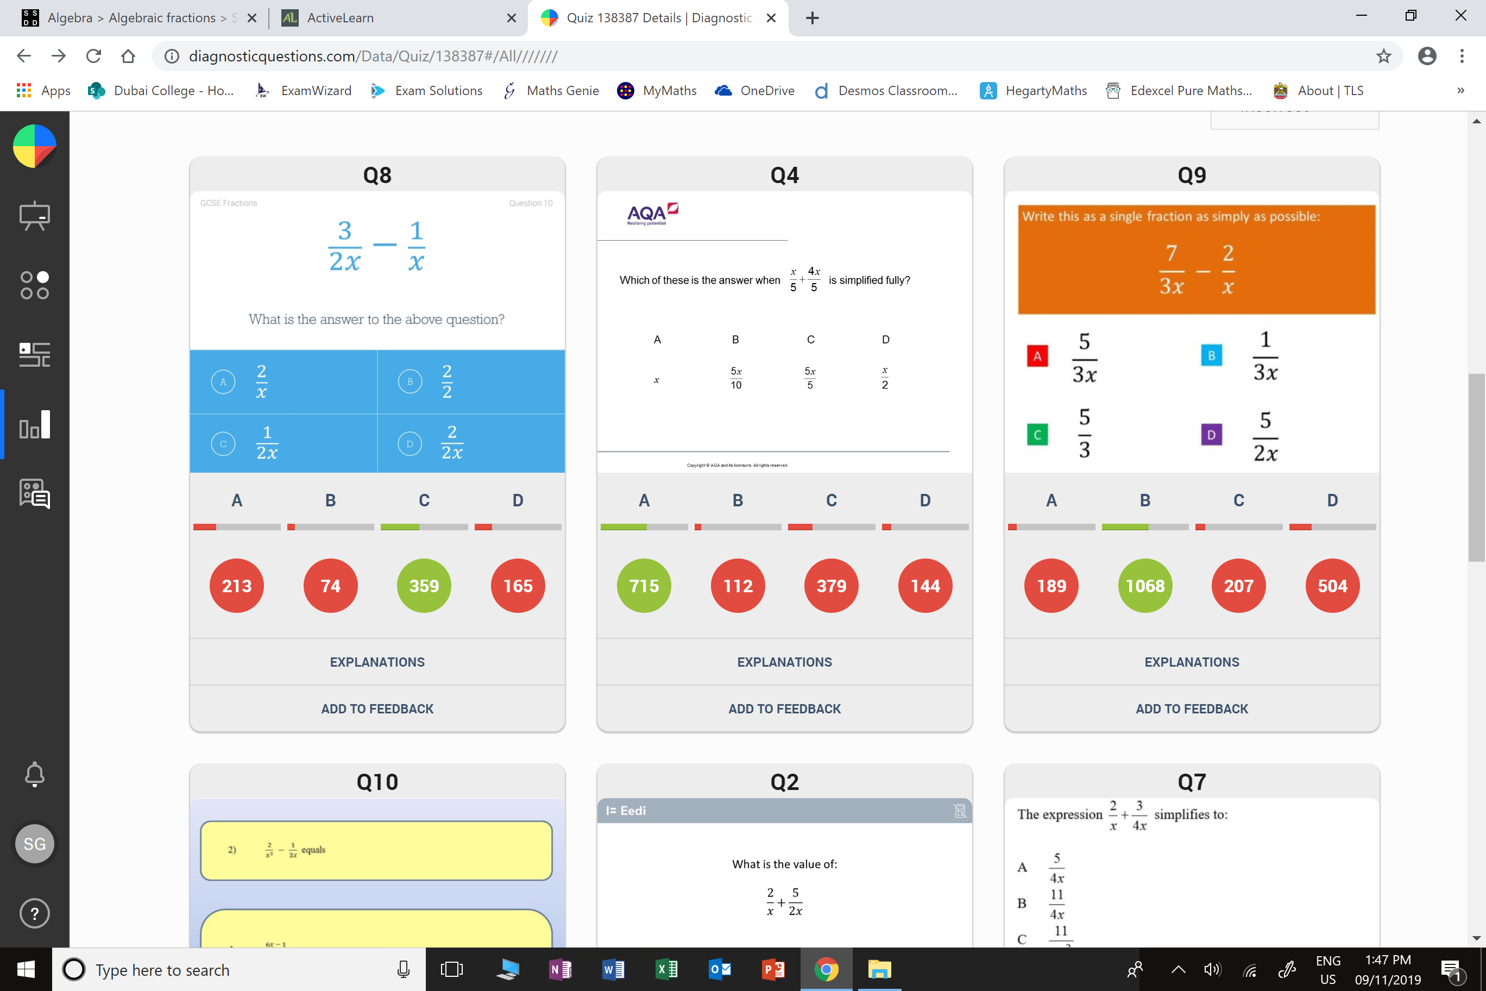
Which question had the lowest percentage of
correct answers?
For each question, what was the most common
wrong answer?

Slide 2
ANSWERS

Slide 3
Which question had the lowest percentage of
correct answers?
For each question, what was the most common
wrong answer?

Slide 4
A
Students do subtraction without a
common denominator.

Slide 5
C
Students answered correctly but
forgot to simplify.

