Slide 1

Diagnostic Assessment .Delta 2
Unit 2
Writing and Simplifying Expressions
Algebraic Indices
Substitution
Expanding Brackets
Factorising
Writing and Solving Equations

Slide 2
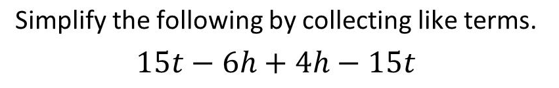
Question 1 – Simplifying Expressions

Slide 3
Answer 1 – Simplifying Expressions
CORRECT ANSWER | CORRECT EXPLANATION
–2h | We have 15t - 15t = 0 and -6h + 4h = -2h. Putting them together gives -2h.
COMMON MISTAKES | WHAT MIGHT BE YOUR MISTAKE
1t – 2h | The student may have calculated the coefficient of t correctly, but has not understood the significance of 0.
0 – 2h | The student has calculated the answer correctly, but has left 0 in the answer. This is not the convention.
0t – 2h | The student has calculated the answer correctly, but has left 0 in the answer. This is not the convention.

Slide 4
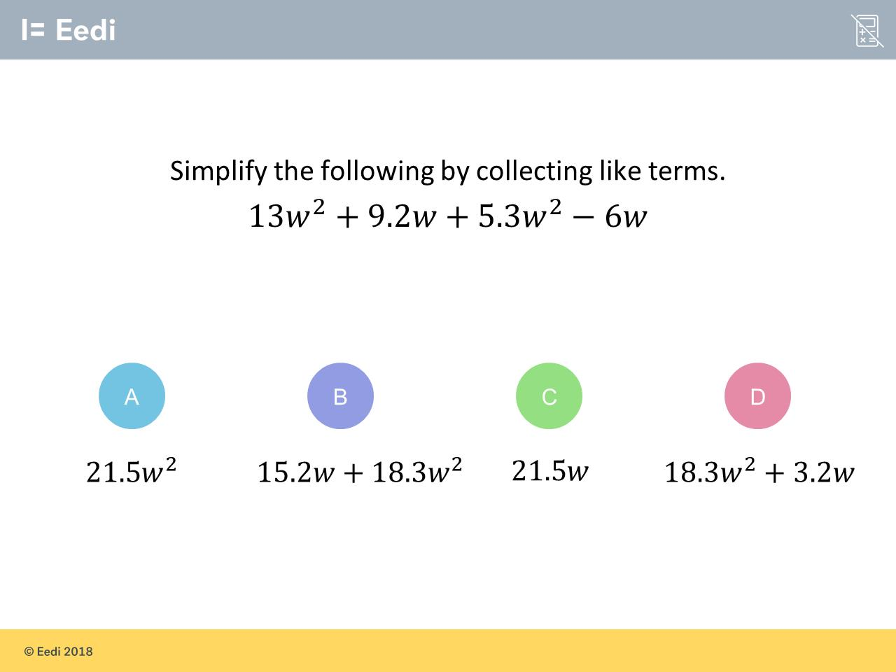
Question 2 – Simplifying Expression

Slide 5
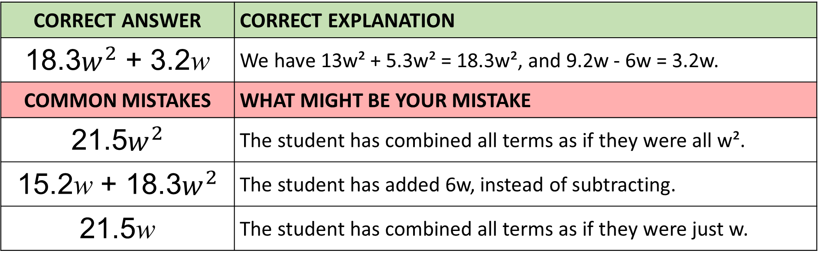
Answer 2 – Simplifying Expressions
CORRECT ANSWER | CORRECT EXPLANATION
18.3$w^{2}$ + 3.2w | We have 13w² + 5.3w² = 18.3w², and 9.2w - 6w = 3.2w.
COMMON MISTAKES | WHAT MIGHT BE YOUR MISTAKE
21.5$w^{2}$ | The student has combined all terms as if they were all w².
15.2w + 18.3$w^{2}$ | The student has added 6w, instead of subtracting.
21.5w | The student has combined all terms as if they were just w.

Slide 6
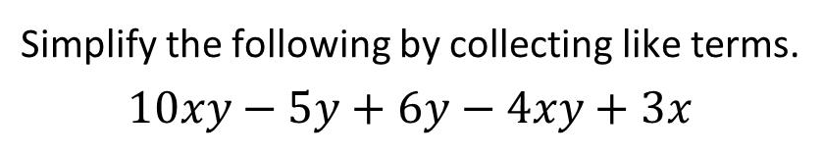
Question 3 – Simplifying Expressions

Slide 7
Answer 3 – Simplifying Expressions
CORRECT ANSWER | CORRECT EXPLANATION
6xy + y + 3x | We have 10xy - 4xy = 6xy, -5y +6y = y and 3x by itself. Combining them all gives the answer.
COMMON MISTAKES | WHAT MIGHT BE YOUR MISTAKE
10xy | The student may have collected all terms as if they were all xy.
6xy + y | The student has missed the 3x.
9x + y | The student has combined 10xy - 4xy + 3x as if they all were multiples of x.

Slide 8
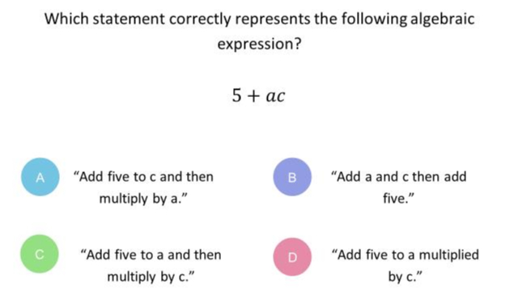
Question 4 – Writing Expressions

Slide 9
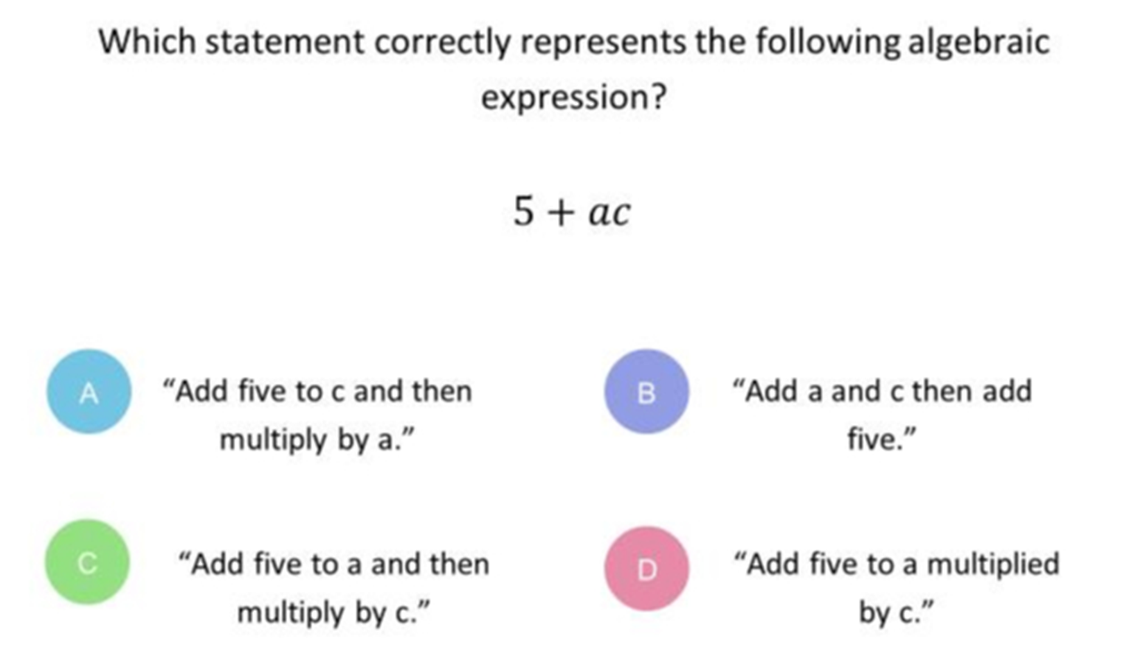
Answer 4 – Writing Expressions
CORRECT ANSWER | CORRECT EXPLANATION
D | ac means "a multiplied by c". We also need to remember the correct order of operations, so we must do this multiplication first. So, we add 5 to a multiplied by c.
COMMON MISTAKES | WHAT MIGHT BE YOUR MISTAKE
A | You just need to remember the order of operations: multiplications come before additions.
B | ac actually means a x c rather than a + c.
C | You just need to remember the order of operations: multiplications come before additions. You'll be ready next time!

Slide 10
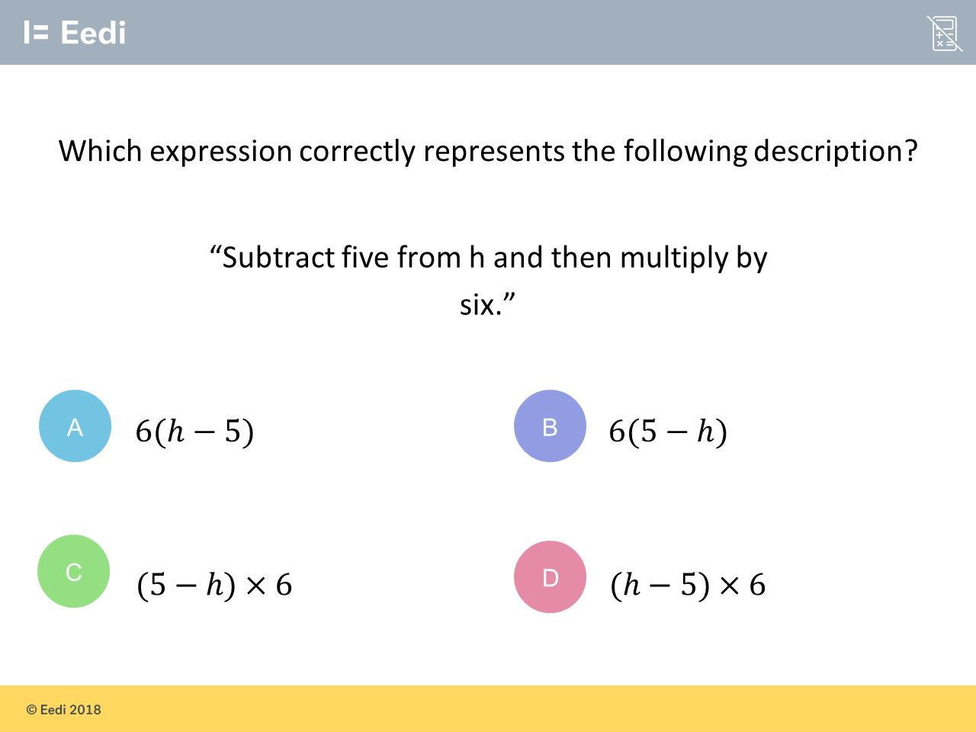
Question 5 – Writing Expressions

Slide 11
Answer 5 – Writing Expressions
CORRECT ANSWER | CORRECT EXPLANATION
A | We subtract 5 from h first, to get h - 5, and then multiply the entire thing by 6 i.e. 6( h - 5 )
COMMON MISTAKES | WHAT MIGHT BE YOUR MISTAKE
B | 'subtract five from h' means h - 5, not 5 - h
C | 'Subtract five from h' means h - 5, rather than 5 - h. Also, the conventions for multiplying by 6 are that we should have the 6 at the front, and we do not need the multiplication sign.
D | Your answer is actually correct in that this is what the description means. But the way we indicate multiplication in algebraic expressions means that the 6 goes at the front and we do not need the multiplication sign.

Slide 12
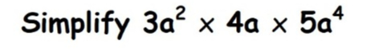
Question 6 – Algebraic Indices

Slide 13
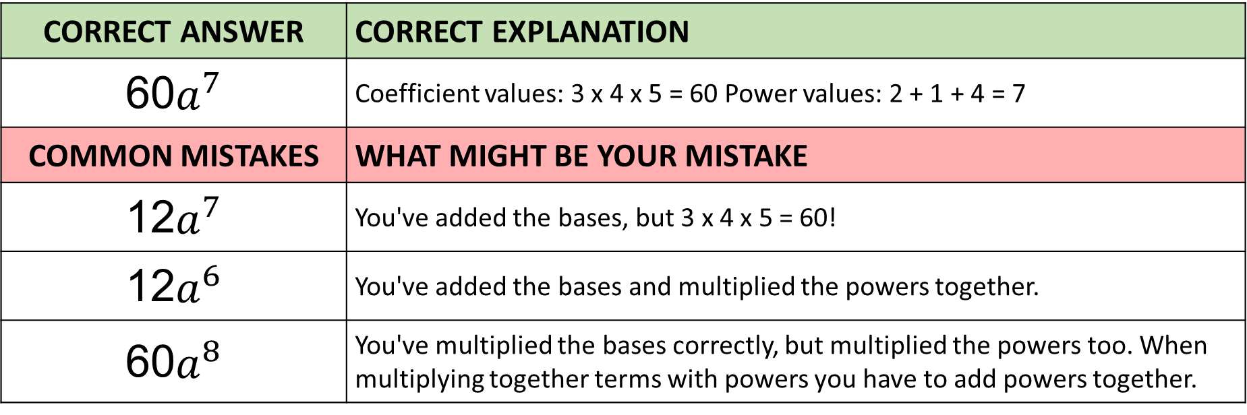
Answer 6 – Algebraic Indices
CORRECT ANSWER | CORRECT EXPLANATION
60$a^{7}$ | Coefficient values: 3 x 4 x 5 = 60 Power values: 2 + 1 + 4 = 7
COMMON MISTAKES | WHAT MIGHT BE YOUR MISTAKE
12$a^{7}$ | You've added the bases, but 3 x 4 x 5 = 60!
12$a^{6}$ | You've added the bases and multiplied the powers together.
60$a^{8}$ | You've multiplied the bases correctly, but multiplied the powers too. When multiplying together terms with powers you have to add powers together.

Slide 14
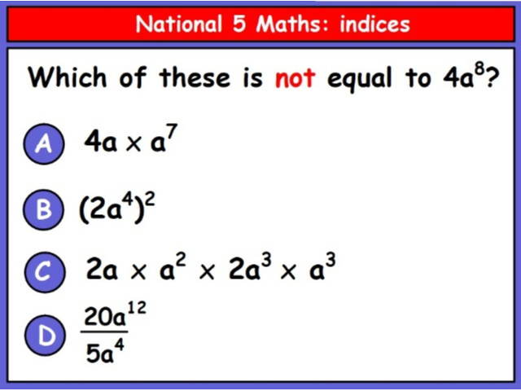
Question 7 – Algebraic Indices

Slide 15
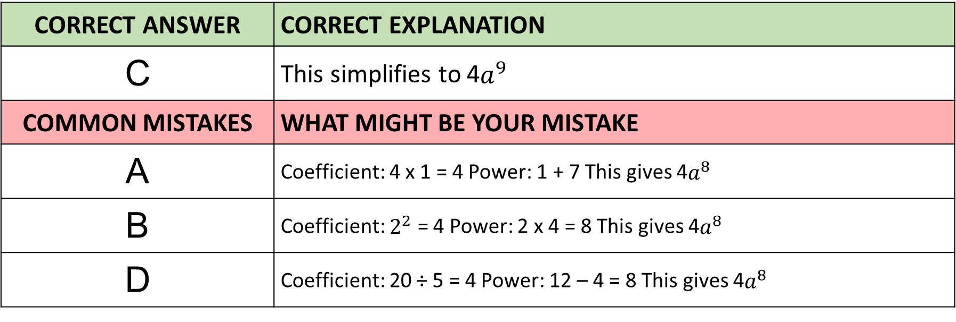
Answer 7 – Algebraic Indices
CORRECT ANSWER | CORRECT EXPLANATION
C | This simplifies to 4$a^{9}$
COMMON MISTAKES | WHAT MIGHT BE YOUR MISTAKE
A | Coefficient: 4 x 1 = 4 Power: 1 + 7 This gives 4$a^{8}$
B | Coefficient: $2^{2}$ = 4 Power: 2 x 4 = 8 This gives 4$a^{8}$
D | Coefficient: 20 ÷ 5 = 4 Power: 12 – 4 = 8 This gives 4$a^{8}$

Slide 16
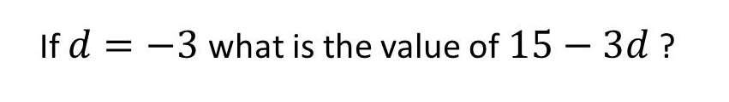
Question 8 – Substitution

Slide 17
Answer 8 – Substitution
CORRECT ANSWER | CORRECT EXPLANATION
24 | 15 - 3 × -3 = 15 + 9 = 24.
COMMON MISTAKES | WHAT MIGHT BE YOUR MISTAKE
-18 | The student has put the digits together and found 15 - 33.
6 | The student has not recognised that two negatives make a positive.
9 | The student has subtracted 3 and then subtracted 3 again.

Slide 18
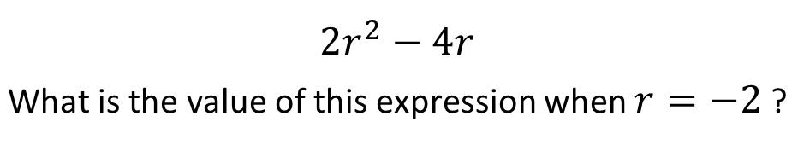
Question 9 – Substitution

Slide 19
Answer 9 – Substitution
CORRECT ANSWER | CORRECT EXPLANATION
16 | We have 2 × (-2)² - 4×( -2) = 2 × 4 + 8 = 16.
COMMON MISTAKES | WHAT MIGHT BE YOUR MISTAKE
-34 | The student has calculated the first term correctly, then subtracted 42.
-16 | The student has found the number of people who ordered nothing.
0 | The student has subtracted 8, rather than adding.

Slide 20
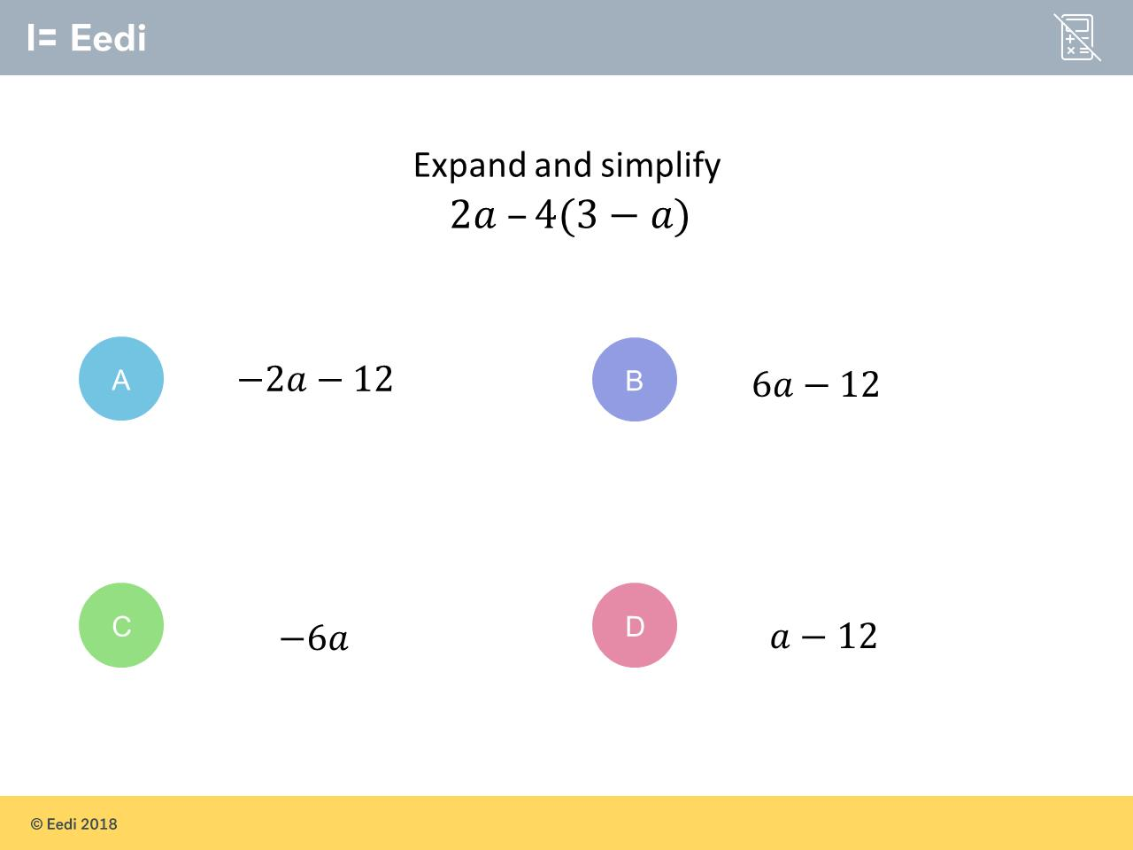
Question 10 – Expanding Brackets

Slide 21
Answer 10 – Expanding Brackets
CORRECT ANSWER | CORRECT EXPLANATION
6a – 12 | We have 2a - 4(3-a) = 2a -12 +4a = 6a - 12.
COMMON MISTAKES | WHAT MIGHT BE YOUR MISTAKE
–2a – 12 | The student has not recognised that the a term is a double negative.
–6a | The student may believe that 3 - a = 2a.
a – 12 | The student has not multiplied -a by 4.

Slide 22
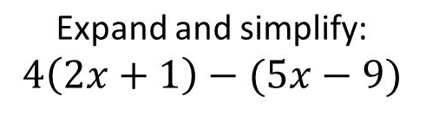
Question 11 – Expanding Brackets

Slide 23
Answer 11 – Expanding Brackets
CORRECT ANSWER | CORRECT EXPLANATION
3x + 13 | Expanding gives 8x + 4 - 5x + 9 = 3x + 13.
COMMON MISTAKES | WHAT MIGHT BE YOUR MISTAKE
3x – 5 | The student has not recognised that the 9 is a double negative i.e. - -9 = 9.
13x – 5 | The student has added the x terms and has not recognised 9 as a double negative.
13x + 13 | The student has added the x terms.

Slide 24
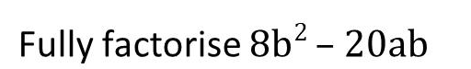
Question 12 – Factorising

Slide 25
Answer 12 – Factorising
CORRECT ANSWER | CORRECT EXPLANATION
4b(2b – 5a) | The HCF of 8b² and -20ab is 4b, so we can take this out as a factor.
COMMON MISTAKES | WHAT MIGHT BE YOUR MISTAKE
4(b – 5ab) | The student has not factorised the letters
b(8b – 20a) | The student has only take out a factor of b. We can factorise the numbers also.
2b(4b – 10a) | The student has factorised, but not fully. We can take out another factor of 2.

Slide 26
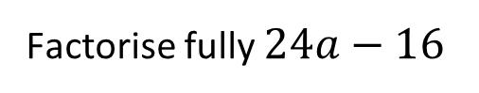
Question 13 – Factorising

Slide 27
Answer 13 – Factorising
CORRECT ANSWER | CORRECT EXPLANATION
8(3a – 2) | The HCF of 24 and 16 is 8, so we can take out a factor of 8. This gives 8(3a - 2).
COMMON MISTAKES | WHAT MIGHT BE YOUR MISTAKE
12(2a – 4) | The student may have tried to remove the biggest factor, but has not recognised that 12 × -4 does not equal -16.
4(6a – 4) | The student has not factorised fully. They can still take out a factor of 2.
6(4a – 3) | The student has not recognised that 6 is not a factor of 16.

Slide 28
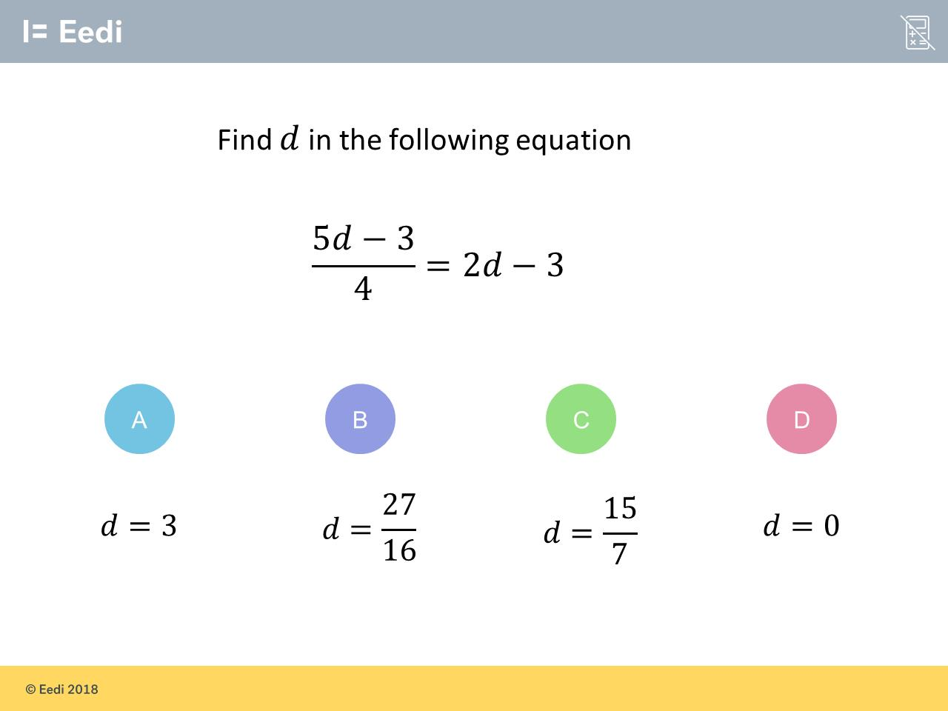
Question 14 – Solving Equations

Slide 29
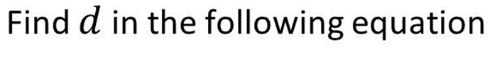
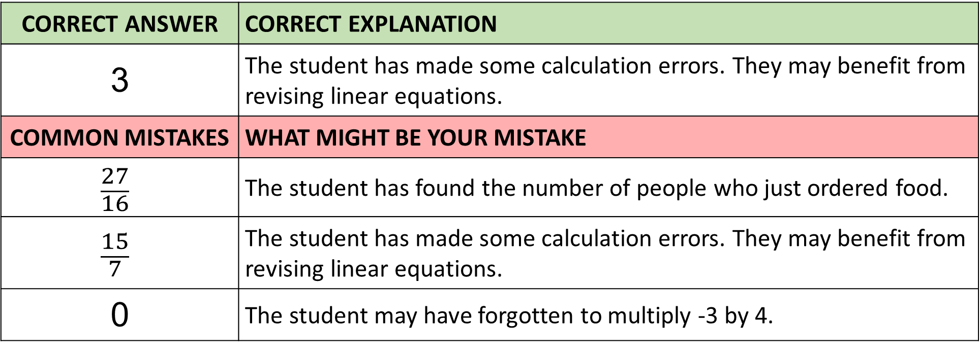
Answer 14 – Solving Equations
CORRECT ANSWER | CORRECT EXPLANATION
3 | The student has made some calculation errors. They may benefit from revising linear equations.
COMMON MISTAKES | WHAT MIGHT BE YOUR MISTAKE
$$\frac{27}{16}$$ | The student has found the number of people who just ordered food.
$$\frac{15}{7}$$ | The student has made some calculation errors. They may benefit from revising linear equations.
0 | The student may have forgotten to multiply -3 by 4.

Slide 30
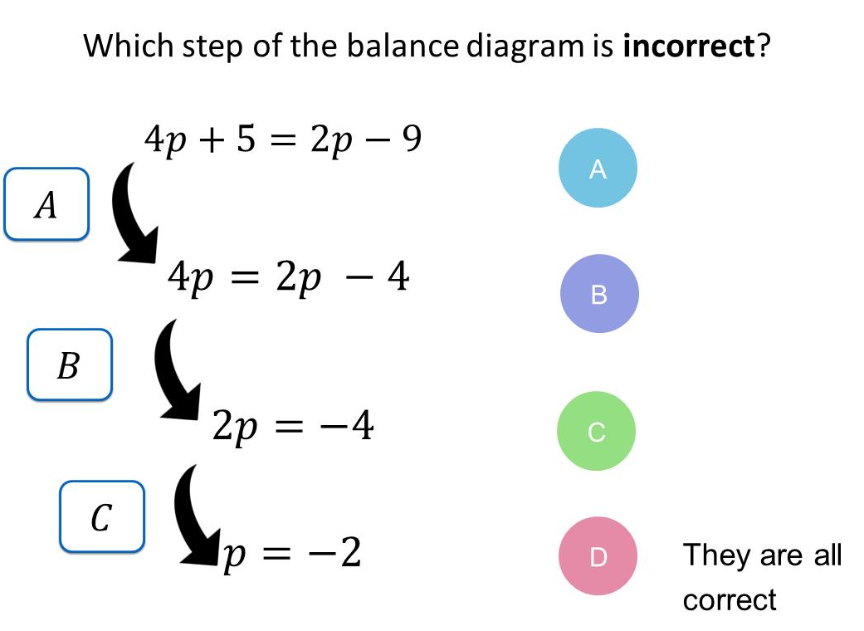
Question 15 – Solving Equations

Slide 31
Answer 15 – Solving Equations
CORRECT ANSWER | CORRECT EXPLANATION
A | Here we have added 5, rather than subtracting 5.
COMMON MISTAKES | WHAT MIGHT BE YOUR MISTAKE
B | The student has picked a correct step.
C | The student has picked a correct step.
D | The student has not noticed that A is incorrect.

Slide 32
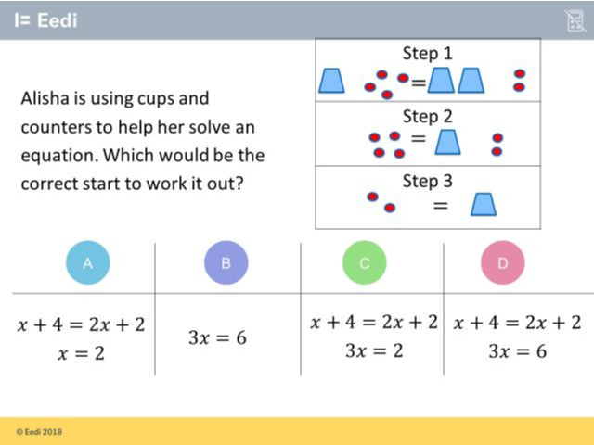
Question 16 – Writing Equations

Slide 33
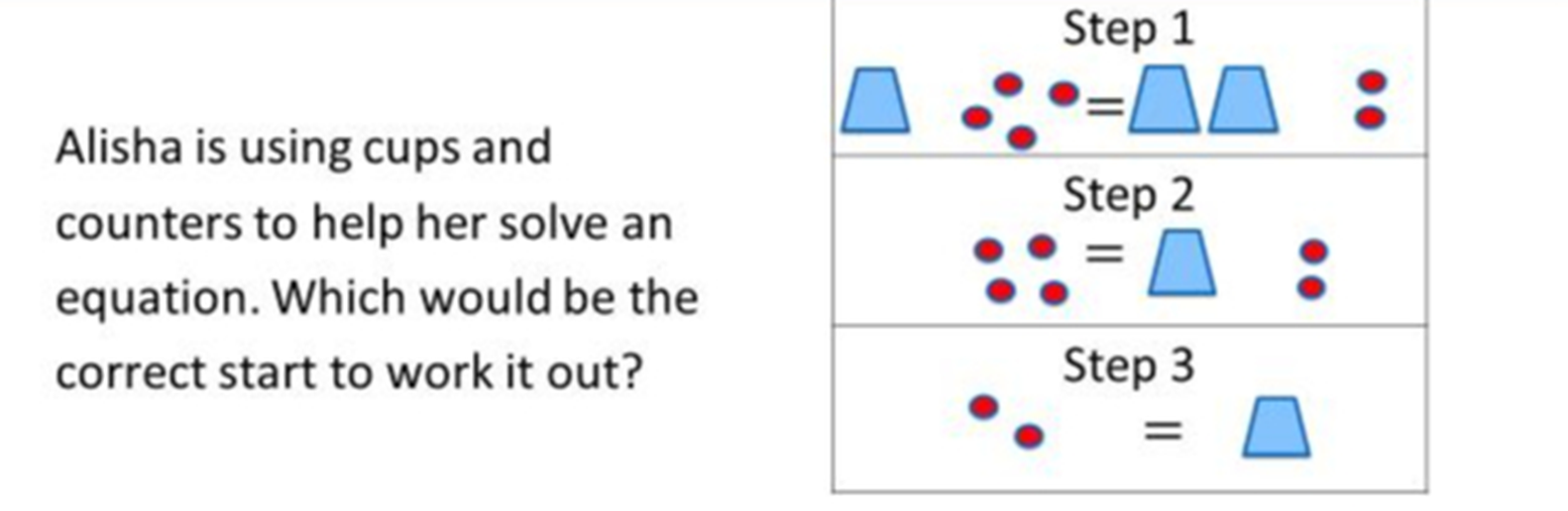
Answer 16 – Writing Equations
CORRECT ANSWER | CORRECT EXPLANATION
A | If x is a cup, and a counter is a number, then the equation in Step 1 is x + 4 = 2x + 2. The equation in Step 3 is then x = 2.
COMMON MISTAKES | WHAT MIGHT BE YOUR MISTAKE
B | The student has not used the inverse operations when trying to solve the equation.
C | The student has added x, rather than subtracting.
D | The student has not used the inverse operations when trying to solve the equation.

