Slide 1
FM: Mid Points and Ratios

Slide 2
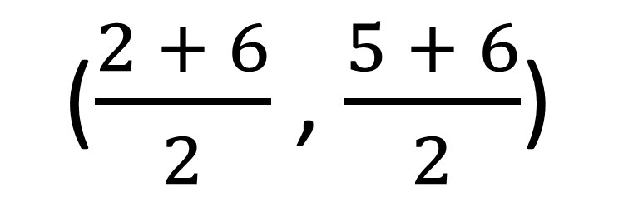

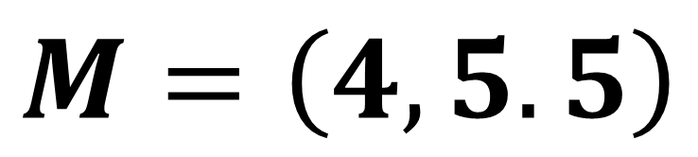
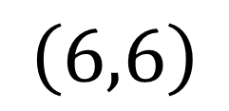
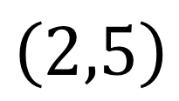
Mid points
$$\left(6,6\right)$$
$$M$$
$\left(2,5\right)$
Just find mean of $x$ values and mean of $y$ values.
($\frac{2 + 6}{2}$ , $\frac{5 + 6}{2}$)
$$M=\left(4, 5.5\right)$$

Slide 3
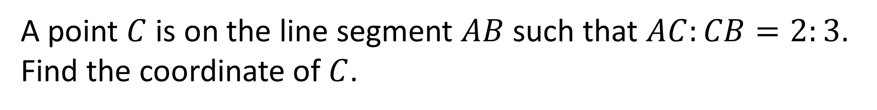

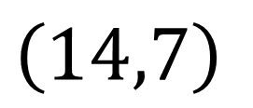
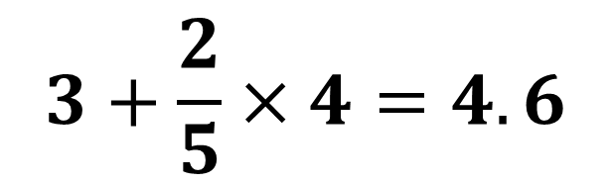

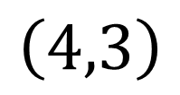
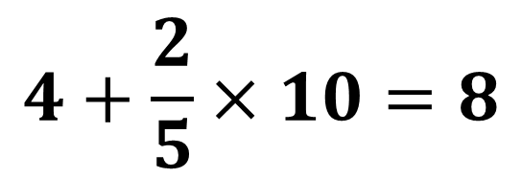
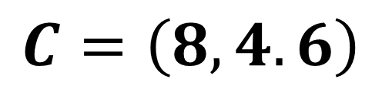
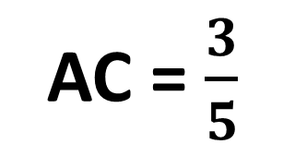

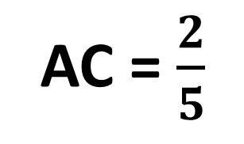
Raitos
AC = $\frac{2}{5}$
$$B$$
$\left(14,7\right)$
$$C$$
AC = $\frac{3}{5}$
$$\left(4,3\right)$$
$$A$$
A point $C$ is on the line segment $AB$ such that $AC:CB=2:3$.
Find the coordinate of $C$.
$$4+\frac{2}{5}×10=8$$
$$C=\left(8, 4.6\right)$$
$$3+\frac{2}{5}×4=4.6$$

Slide 4
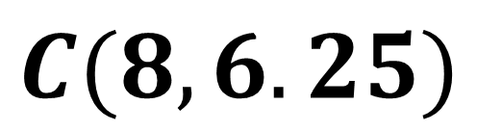
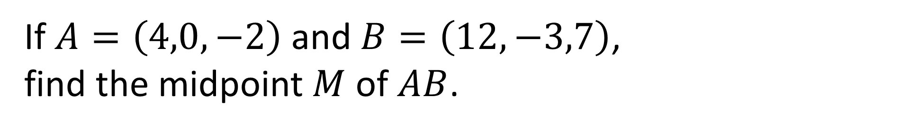
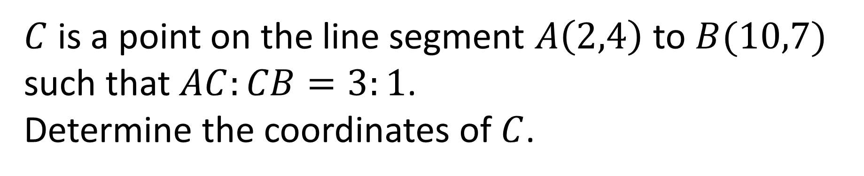
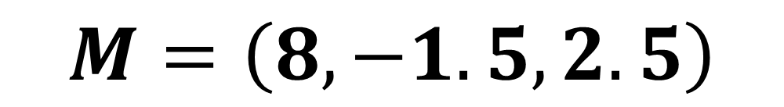
If $A=\left(4,0,−2\right)$ and $B=\left(12,−3,7\right)$,
find the midpoint $M$ of $AB$.
$$M=\left(8, −1.5, 2.5\right)$$
$C$ is a point on the line segment $A\left(2,4\right)$ to $B(10,7)$ such that $AC:CB=3:1$.
Determine the coordinates of $C$.
$$C(8,6.25)$$

Slide 5
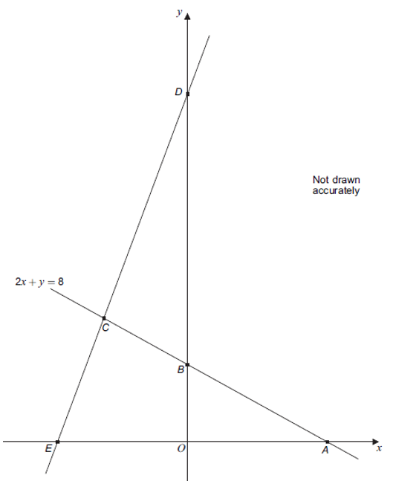
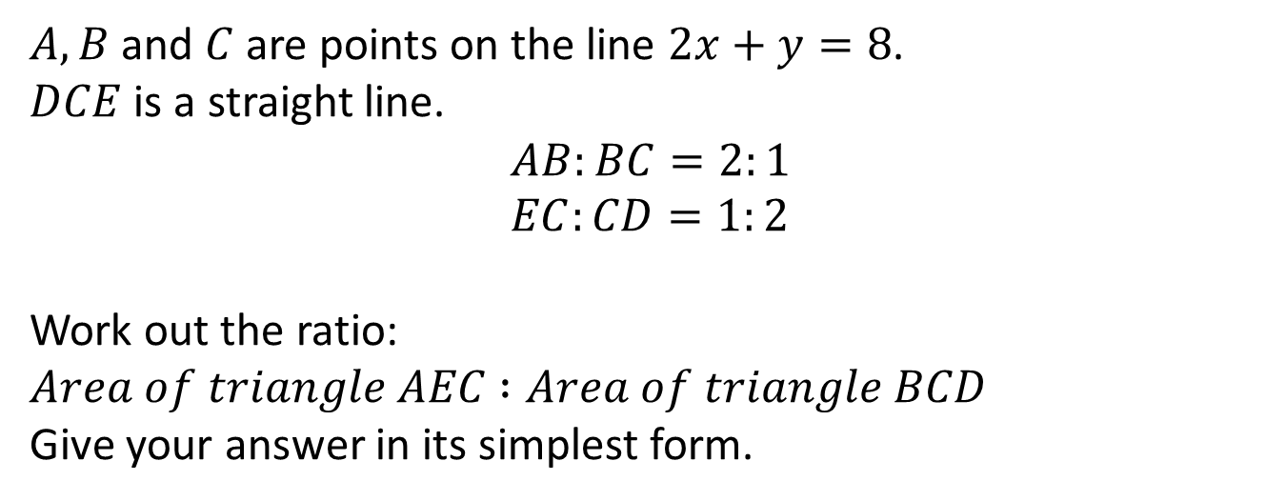
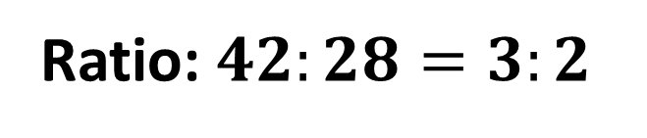
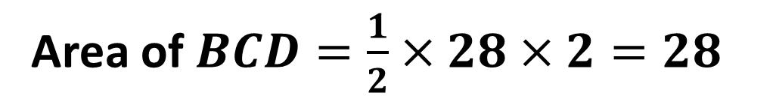
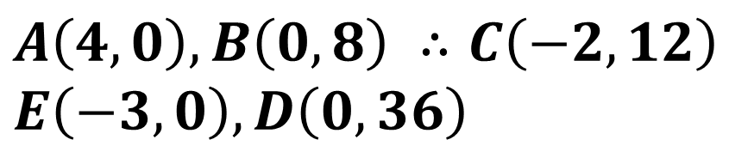
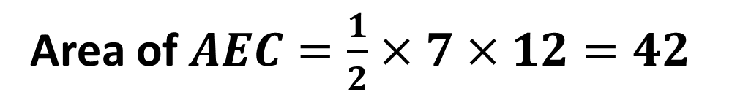
(On provided sheet)
$A, B$ and $C$ are points on the line $2x+y=8$.
$DCE$ is a straight line.
$$AB:BC=2:1 \\ EC:CD=1:2$$
Work out the ratio:
$Area of triangle AEC$ $:Area of triangle BCD$
Give your answer in its simplest form.
$$A\left(4,0\right), B\left(0,8\right) ∴C\left(−2,12\right)$$
$$E\left(−3,0\right), D\left(0,36\right)$$
Area of $AEC=\frac{1}{2}×7×12=42$
Area of $BCD=\frac{1}{2}×28×2=28$
Ratio: $42:28=3:2$

