Slide 1
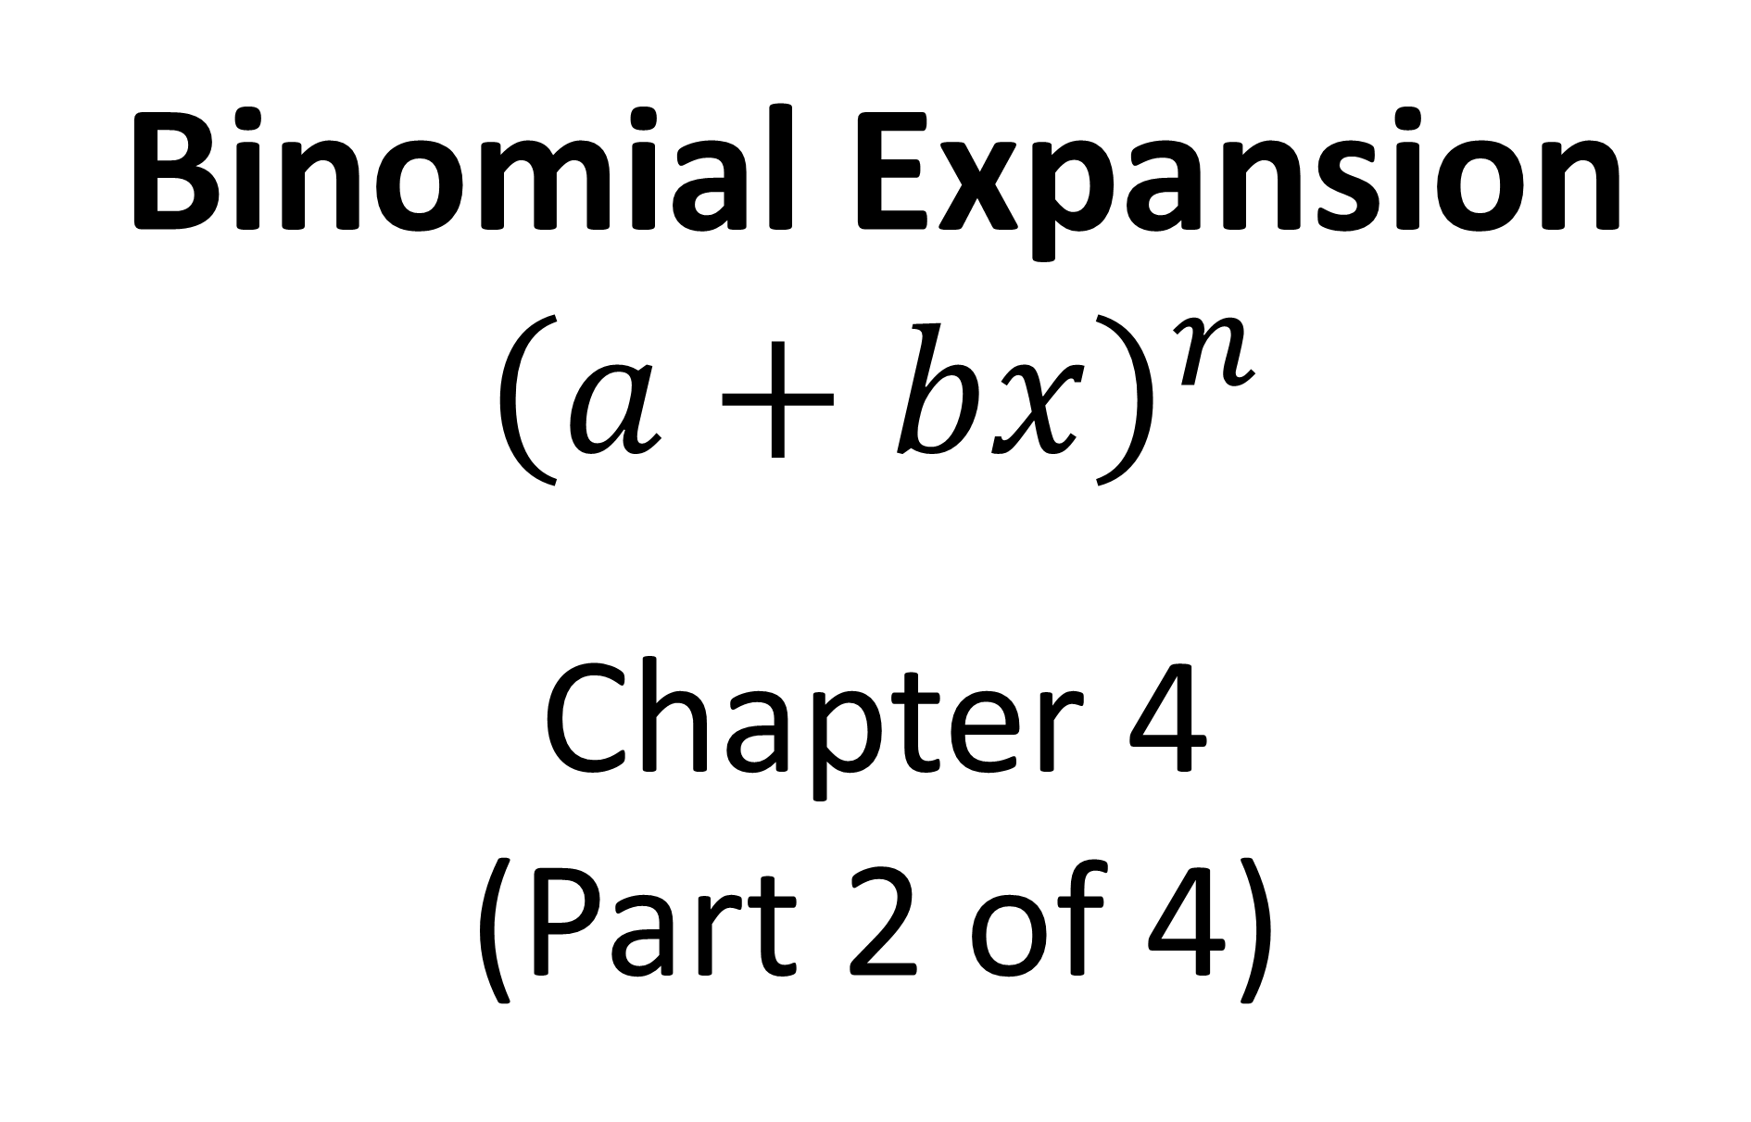
Binomial Expansion
$${\left(a+bx\right)}^{n}$$
Chapter 4
(Part 2 of 4)

Slide 2
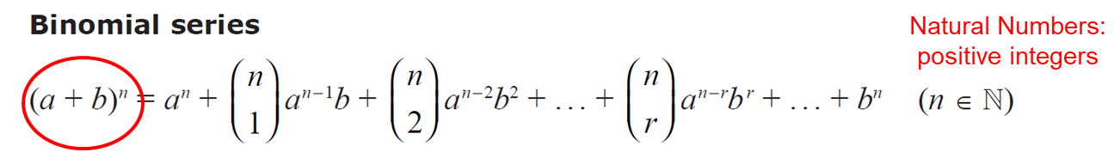


Which expansion would you use for ${\left(4+x\right)}^{\frac{1}{2}}$ ?
(1 + x)^{n}

Slide 3

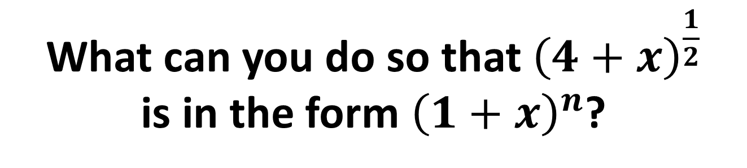
$${\left(4+x\right)}^{\frac{1}{2}}$$
To use this expansion, you need
the constant inside the bracket to be a 1.
What can you do so that ${\left(4+x\right)}^{\frac{1}{2}}$
is in the form${\left(1+x\right)}^{n}$?
Factorise out 4.

Slide 4
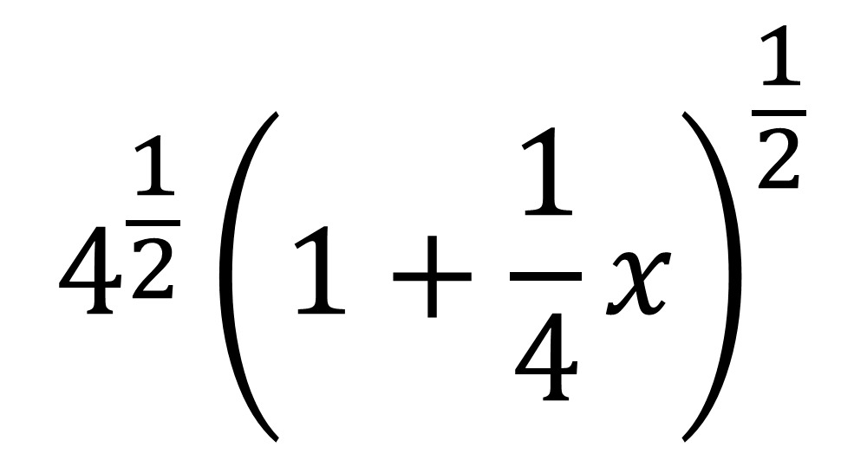
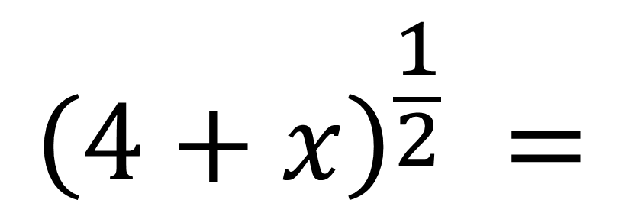
What do you do if you are factorising out a number of a bracket that has a power?
$$4^{\frac{1}{2}}{\left(1+\frac{1}{4}x\right)}^{\frac{1}{2}}$$
$${\left(4+x\right)}^{\frac{1}{2}} =$$

Slide 5
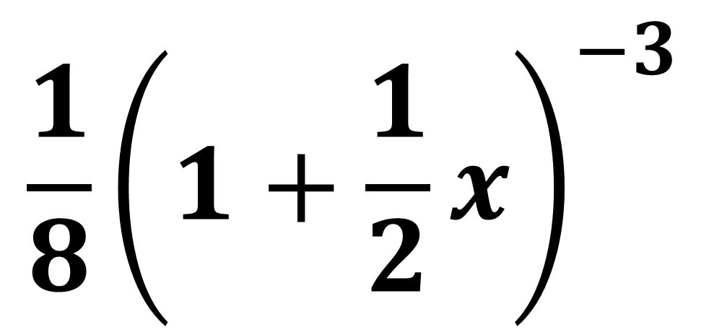

Write in the form (1 + x)^{n}
$$\frac{1}{8}{\left(1+\frac{1}{2}x\right)}^{−3}$$
$${\left(2+x\right)}^{−3}=$$

Slide 6
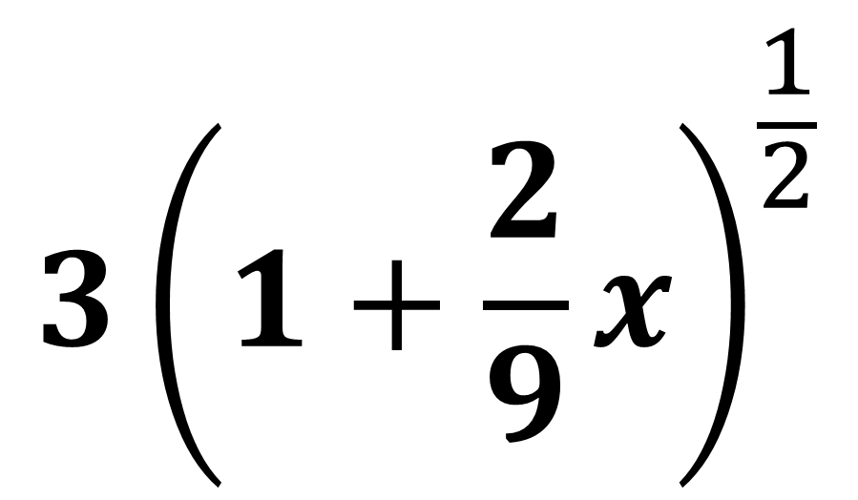
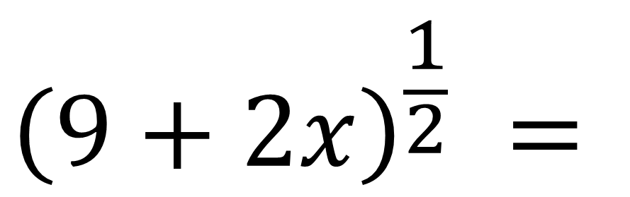
Write in the form (1 + x)^{n}
$$3{\left(1+\frac{2}{9}x\right)}^{\frac{1}{2}}$$
$${\left(9+2x\right)}^{\frac{1}{2}} =$$

Slide 7
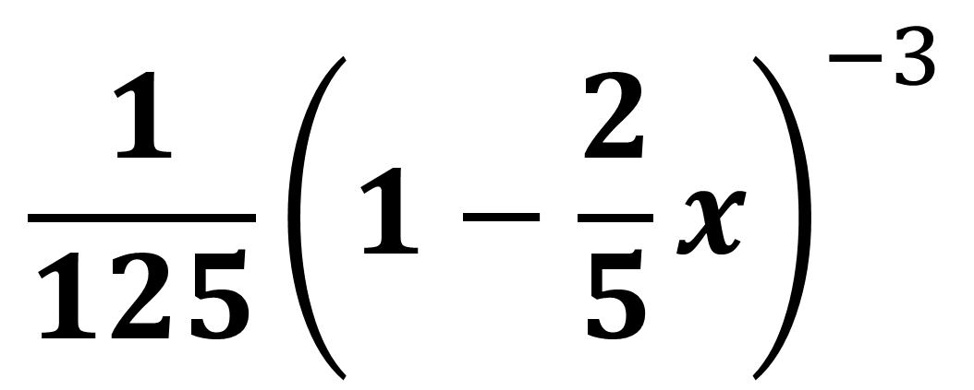

Write in the form (1 + x)^{n}
$$\frac{1}{125}{\left(1−\frac{2}{5}x\right)}^{−3}$$
$${\left(5−2x\right)}^{−3}=$$

Slide 8
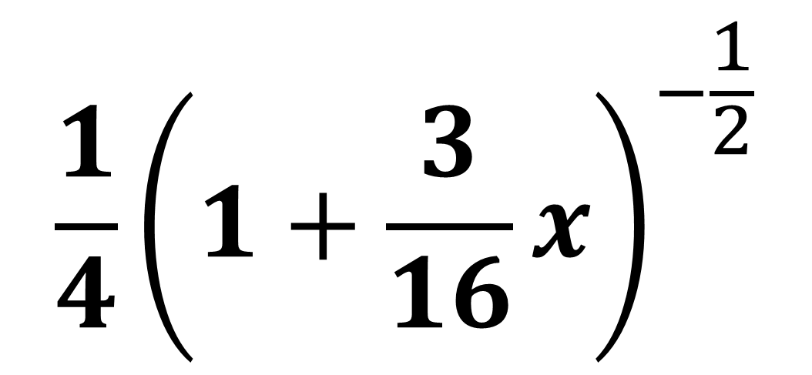
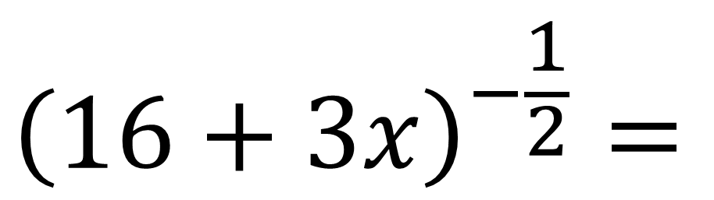
Write in the form (1 + x)^{n}
$$\frac{1}{4}{\left(1+\frac{3}{16}x\right)}^{−\frac{1}{2}}$$
$${\left(16+3x\right)}^{−\frac{1}{2}}=$$

Slide 9
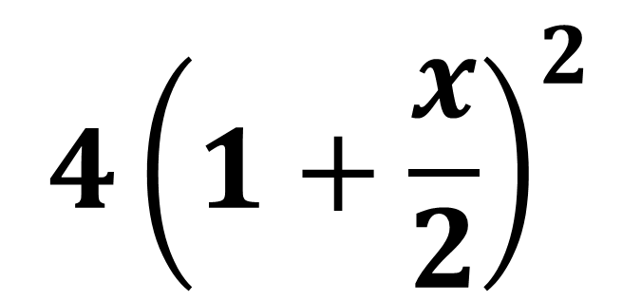
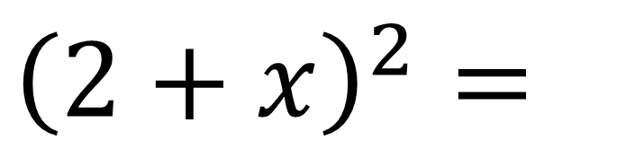
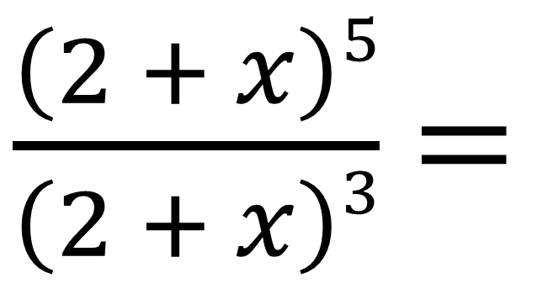
Write in the form (1 + x)^{n}
$\frac{\left(2 + x\right)5}{\left(2 + x\right)3}$ $=$
$${4\left(1+\frac{x}{2}\right)}^{2}$$
$${\left(2+x\right)}^{2}=$$

Slide 10
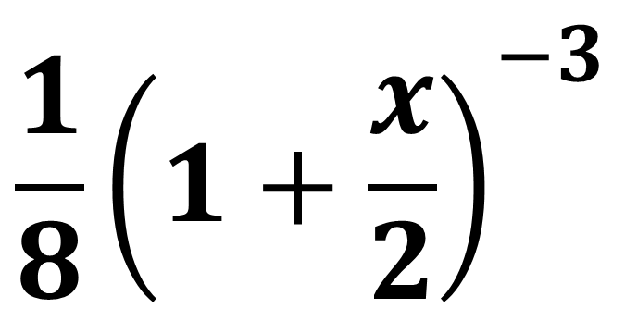
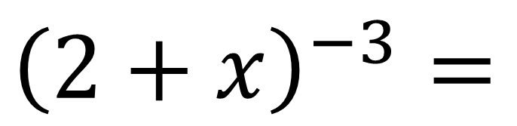
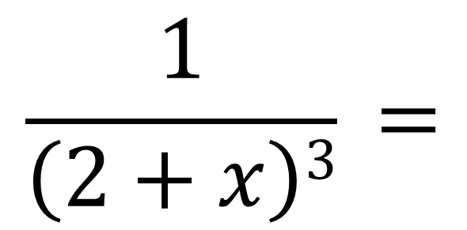
Write in the form (1 + x)^{n}
$$\frac{1}{\left(2+x\right)3} =$$
$${\frac{1}{8}\left(1+\frac{x}{2}\right)}^{−3}$$
$${\left(2+x\right)}^{−3}=$$

Slide 11
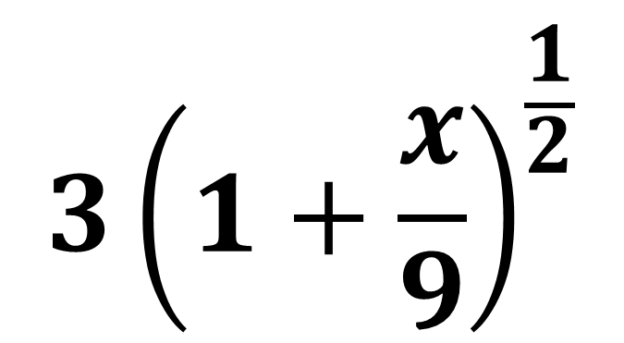
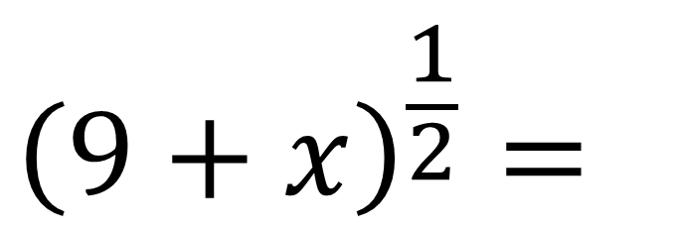
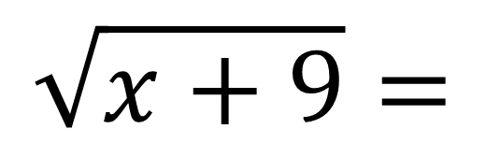
Write in the form (1 + x)^{n}
$${3\left(1+\frac{x}{9}\right)}^{\frac{1}{2}}$$
$${\left(9+x\right)}^{\frac{1}{2}}=$$
$$\sqrt{x+9}=$$

Slide 12
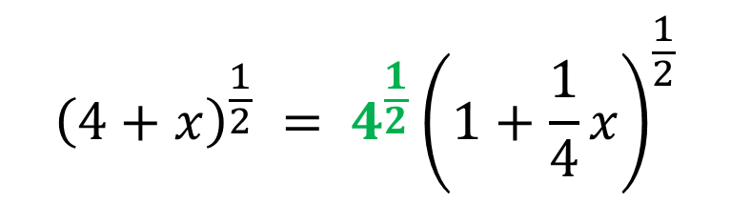
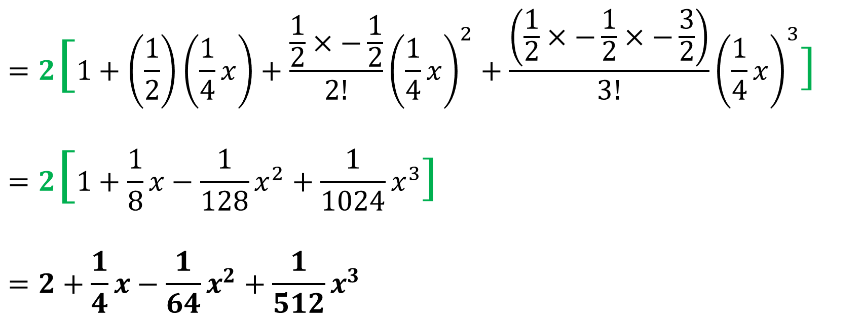
Find first four terms in the binomial expansion of ${\left(4+x\right)}^{\frac{1}{2}}$
$${\left(4+x\right)}^{\frac{1}{2}} = 4^{\frac{1}{2}}{\left(1+\frac{1}{4}x\right)}^{\frac{1}{2}}$$
$${\left(1+x\right)}^{n}=1+n\left(x\right)+\frac{n(n−1)}{1 \text{x} 2}{\left(x\right)}^{2}+\frac{n\left(n−1\right)…(n−r+1)}{1 \text{x} 2 \text{x} …\text{x} r}{\left(x\right)}^{2}$$
$$=2[1+\left(\frac{1}{2}\right)\left(\frac{1}{4}x\right)+\frac{\frac{1}{2}×−\frac{1}{2}}{2!}{\left(\frac{1}{4}x\right)}^{2}+\frac{\left(\frac{1}{2}×−\frac{1}{2}×−\frac{3}{2}\right)}{3!}{\left(\frac{1}{4}x\right)}^{3}]$$
$$=2[1+\frac{1}{8}x−\frac{1}{128}x^{2}+\frac{1}{1024}x^{3}]$$
$$=2+\frac{1}{4}x−\frac{1}{64}x^{2}+\frac{1}{512}x^{3}$$

Slide 13
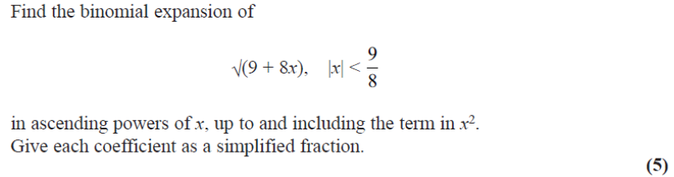
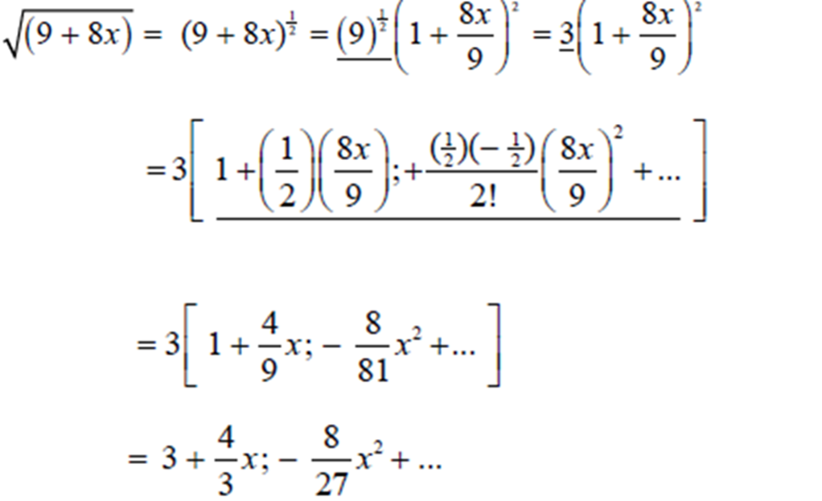
$${\left(1+x\right)}^{n}=1+n\left(x\right)+\frac{n(n−1)}{1 \text{x} 2}{\left(x\right)}^{2}+\frac{n\left(n−1\right)…(n−r+1)}{1 \text{x} 2 \text{x} …\text{x} r}{\left(x\right)}^{2}$$

Slide 14
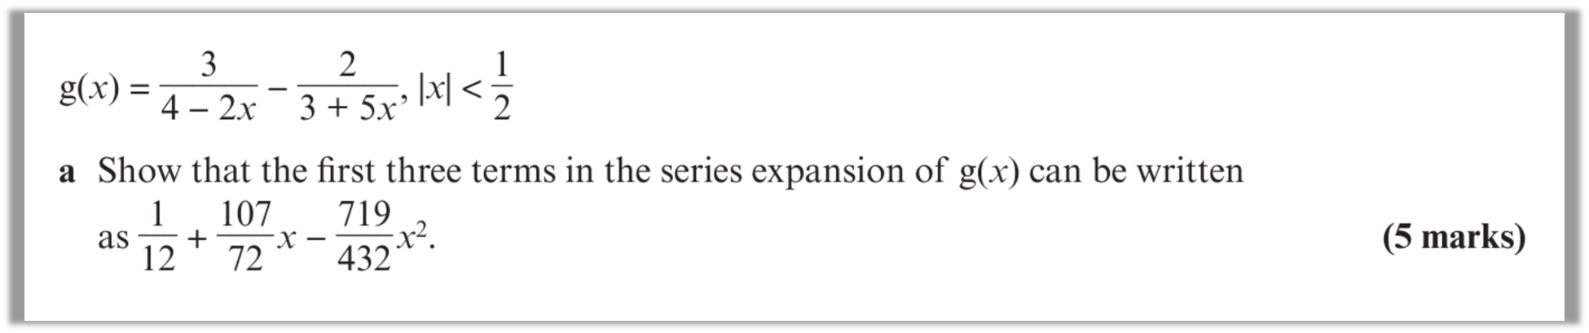
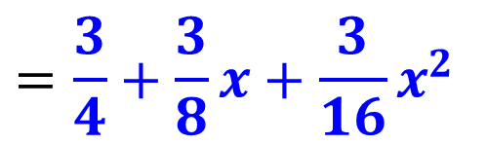
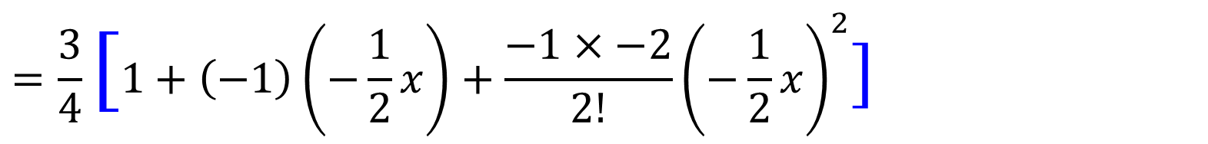
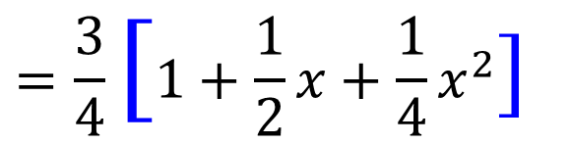

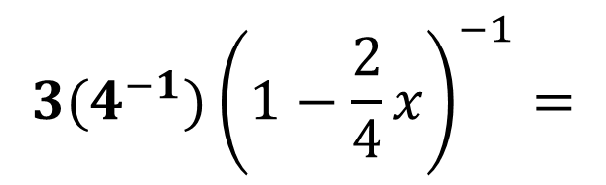
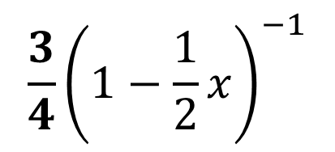
$${3(4}^{−1}){\left(1−\frac{2}{4}x\right)}^{−1}=$$
$$\frac{3}{4}{\left(1−\frac{1}{2}x\right)}^{−1}$$
$${3\left(4−2x\right)}^{−1} =$$
$$=\frac{3}{4}[1+\left(−1\right)\left(−\frac{1}{2}x\right)+\frac{−1×−2}{2!}{\left(−\frac{1}{2}x\right)}^{2}]$$
$$=\frac{3}{4}[1+\frac{1}{2}x+\frac{1}{4}x^{2}]$$
$$=\frac{3}{4}+\frac{3}{8}x+\frac{3}{16}x^{2}$$

Slide 15
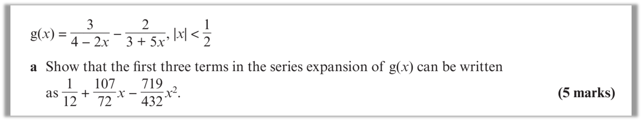
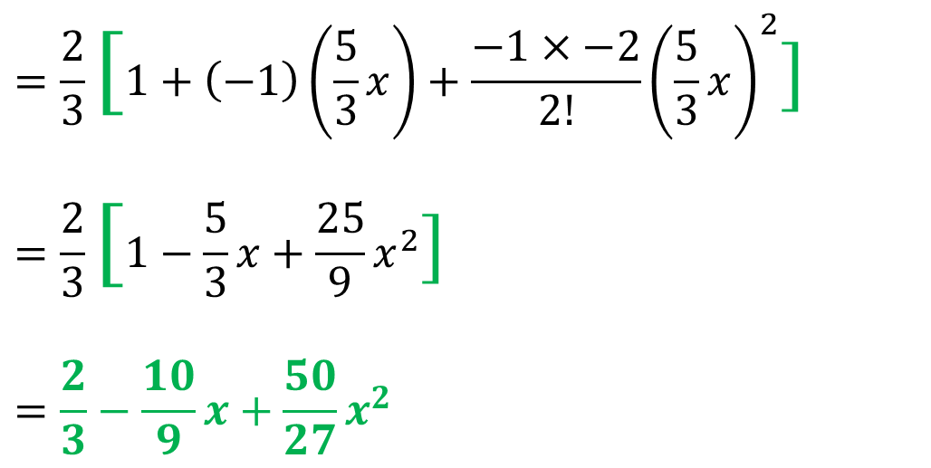

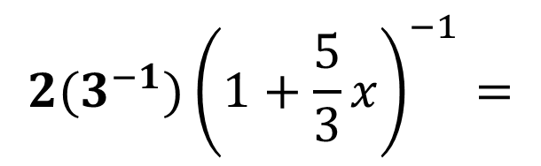
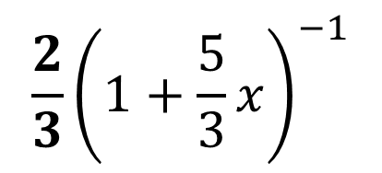
$${2(3}^{−1}){\left(1+\frac{5}{3}x\right)}^{−1}=$$
$$\frac{2}{3}{\left(1+\frac{5}{3}x\right)}^{−1}$$
$${2\left(3+5x\right)}^{−1} =$$
$$=\frac{2}{3}[1+\left(−1\right)\left(\frac{5}{3}x\right)+\frac{−1×−2}{2!}{\left(\frac{5}{3}x\right)}^{2}]$$
$$=\frac{2}{3}[1−\frac{5}{3}x+\frac{25}{9}x^{2}]$$
$$=\frac{2}{3}−\frac{10}{9}x+\frac{50}{27}x^{2}$$

Slide 16
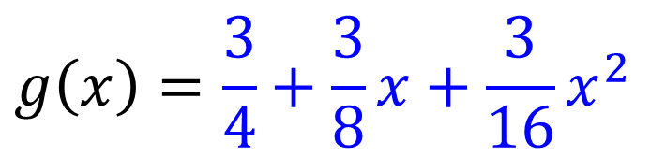
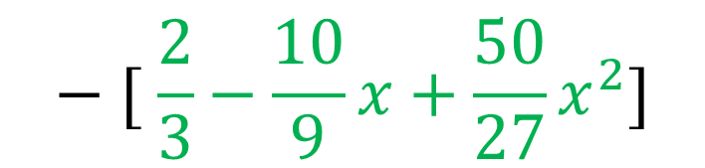
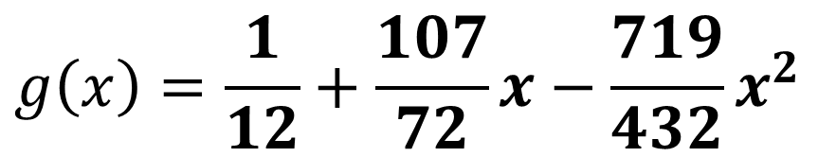

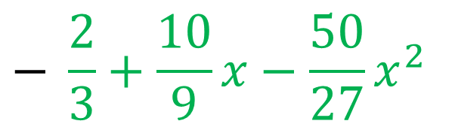
$$g\left(x\right)=\frac{3}{4}+\frac{3}{8}x+\frac{3}{16}x^{2}$$
$$− [ \frac{2}{3}−\frac{10}{9}x+\frac{50}{27}x^{2}]$$
$$g\left(x\right)=\frac{3}{4}+\frac{3}{8}x+\frac{3}{16}x^{2}$$
$$− \frac{2}{3}+\frac{10}{9}x−\frac{50}{27}x^{2}$$
$$g\left(x\right)=\frac{1}{12}+\frac{107}{72}x−\frac{719}{432}x^{2}$$

