Slide 1
Equations and Inequalities
Set Notation
Chapter 3
(Part 3 of 3)

Slide 2
Set Notation
A set is a collection of values such that:
- The order of values does not matter.
- There are no duplicates.

Slide 3

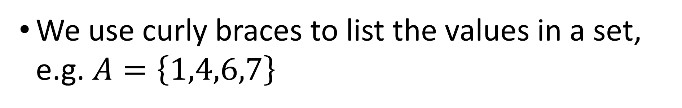
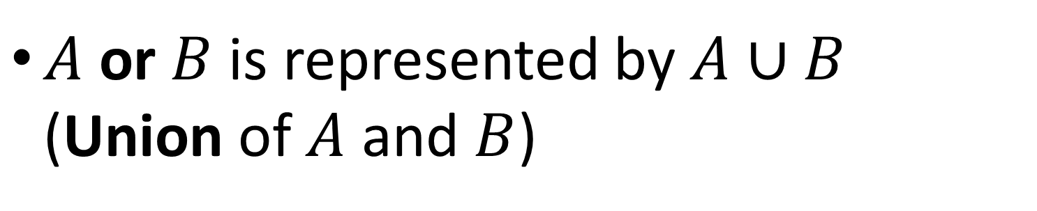
Things to know:
We use curly braces to list the values in a set, e.g. $A=\left\{1,4,6,7\right\}$
$A$ and $B$ is represented by $A∩B$ (Intersection of $A$ and $B)$
$A$ or $B$is represented by $A∪B$ (Union of $A$ and $B$)

Slide 4
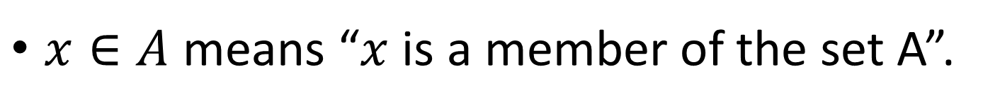
$ℕ \text{is} \text{the} \text{set} \text{of} \text{natural} \text{numbers}\text{ (}\text{all} \text{positive} \text{integers}\text{)}$
$ℤ \text{is} \text{the} \text{set} \text{of} \text{all} \text{integers}\text{ (}\text{including} \text{negative} \text{numbers} \text{and}\text{ 0) }$
$ℝ$ is the set of all real numbers (including all possible decimals)
$x∈A$ means “$x$ is a member of the set A”.

Slide 5
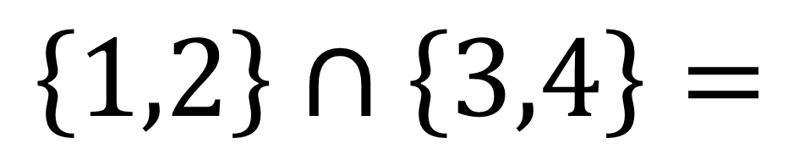
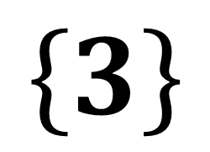
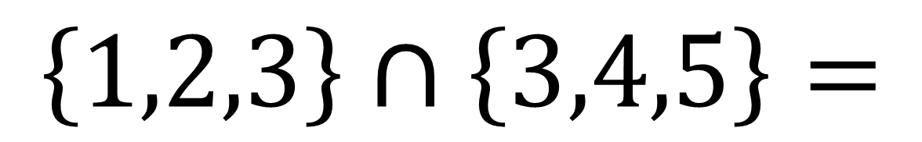

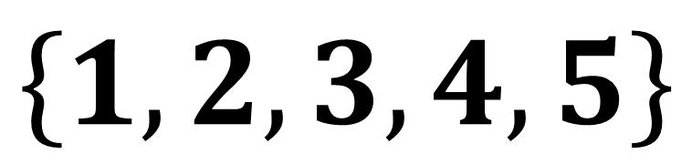
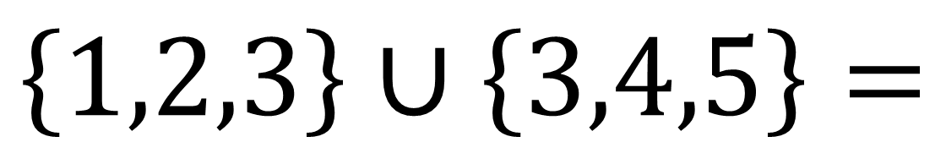
$$\left\{1,2,3\right\}∩\left\{3,4,5\right\}=$$
$$\left\{3\right\}$$
$$\left\{1,2,3\right\}∪\left\{3,4,5\right\}=$$
$$\left\{1,2,3,4,5\right\}$$
$$\left\{1,2\right\}∩\left\{3,4\right\}=$$
$$∅$$

Slide 6
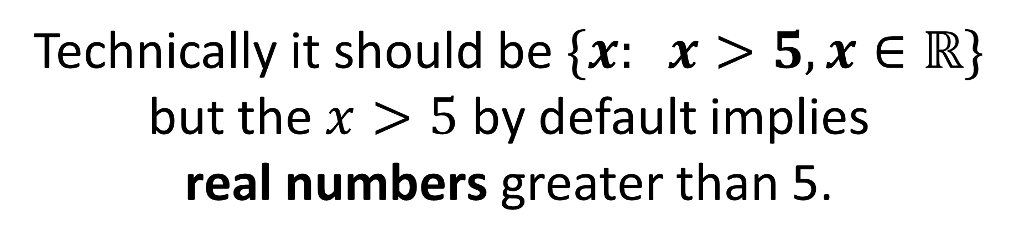
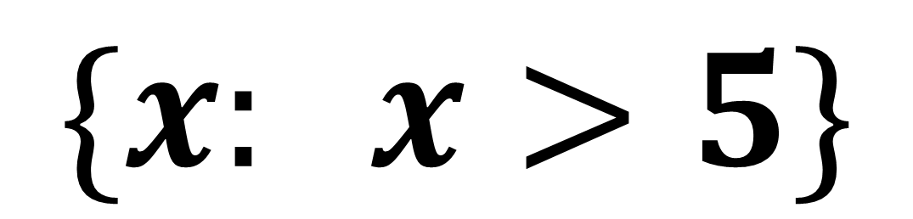
All (real) numbers greater than 5.
$$\{x: x>5\}$$
Technically it should be $\{x: x>5,x∈ℝ\}$
but the $x>5$ by default implies
real numbers greater than 5.

Slide 7
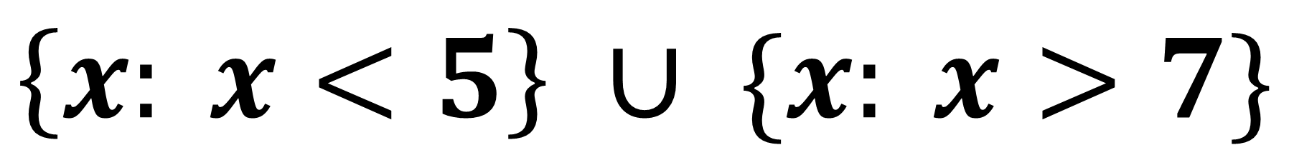
All (real) numbers less than 5 or greater than 7.
$$\left\{x: x<5\right\} ∪ \{x: x>7\}$$

Slide 8
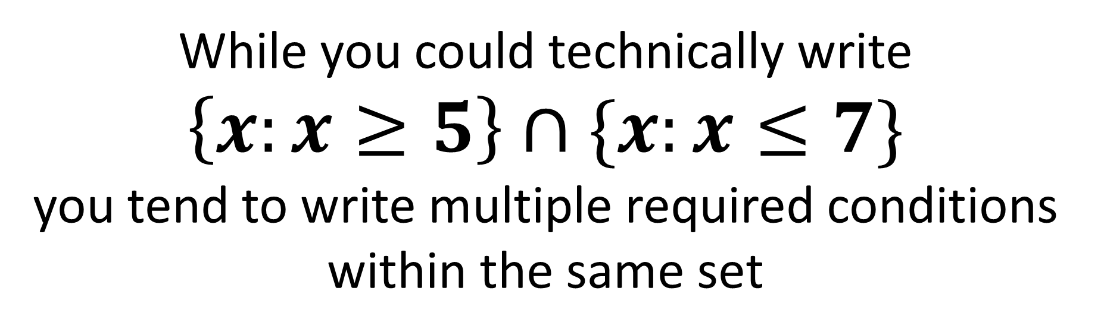
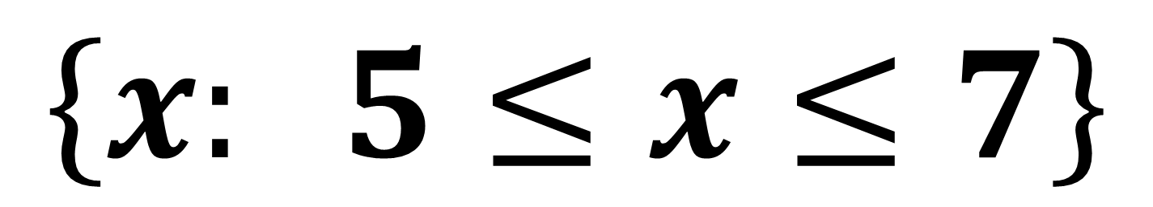
All (real) numbers between 5 and 7 inclusive.
$$\left\{x: 5≤x≤7\right\}$$
While you could technically write
$\left\{x:x≥5\right\}∩\{x:x≤7\}$
you tend to write multiple required conditions within the same set

Slide 9
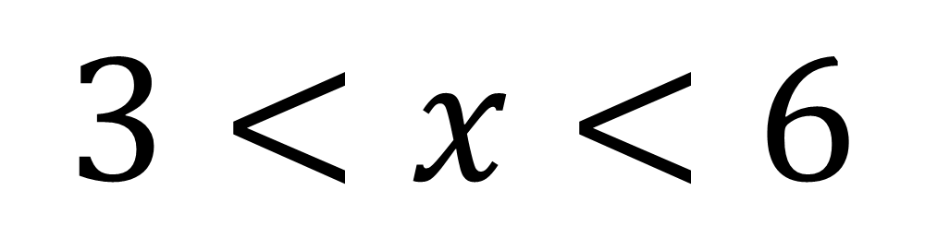
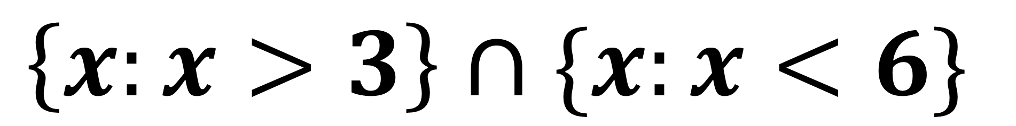
$$3<x<6$$
Write using set notation.
$$\left\{x:x>3\right\}∩\{x:x<6\}$$

Slide 10
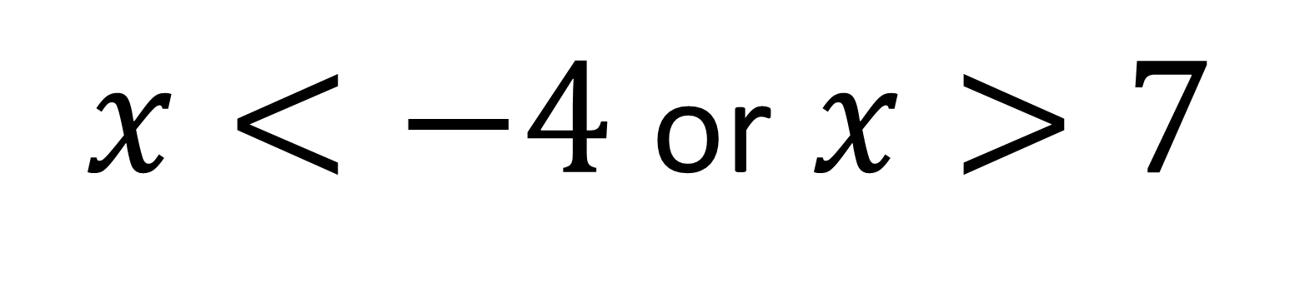
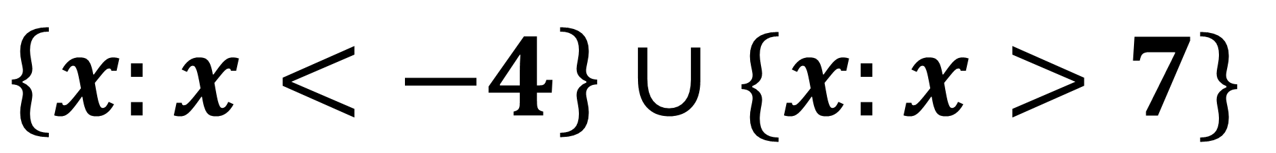
$x<−4$ or $x>7$
Write using set notation.
$$\left\{x:x<−4\right\}∪\{x:x>7\}$$

Slide 11
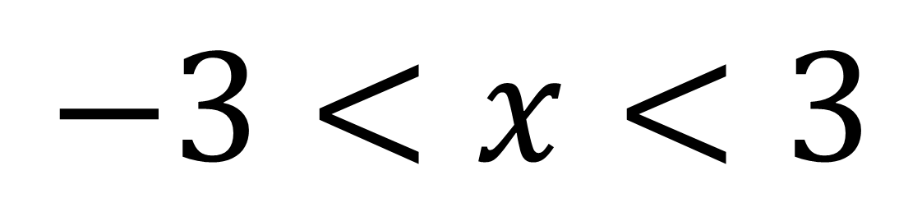
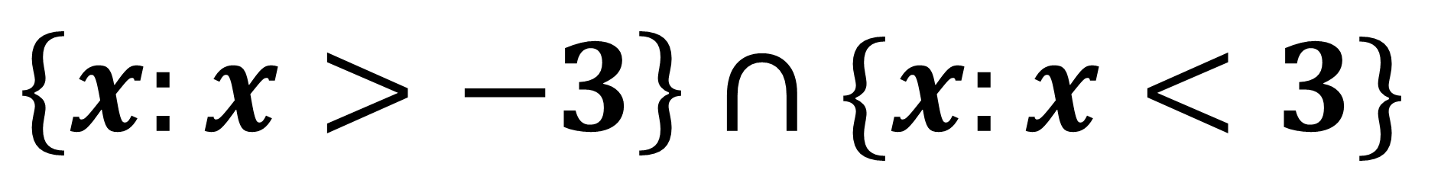
$$−3<x<3$$
Write using set notation.
$$\left\{x:x>−3\right\}∩\{x:x<3\}$$

Slide 12
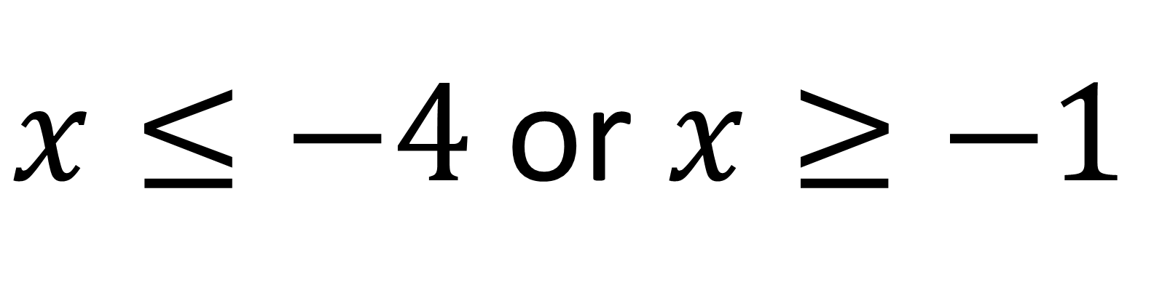
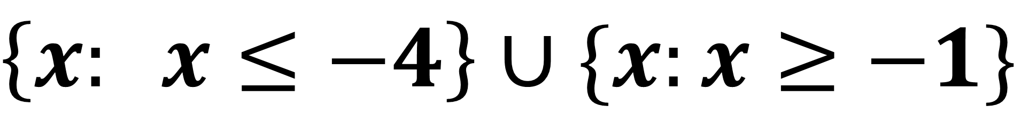
$x≤−4$ or $x≥−1$
Write using set notation.
$$\left\{x: x≤−4\right\}∪\{x:x≥−1\}$$

