Slide 1
LO: Speed-Time Graphs

Slide 2
What does the graph show about
the motion of an object?
It is moving at constant speed
Speed
(m/s)
Time (s)

Slide 3
What does the graph show about
the motion of an object?
It is moving at constant acceleration
Speed
(m/s)
Time (s)

Slide 4
What does the graph show about
the motion of an object?
It is moving at constant deceleration
Speed
(m/s)
Time (s)

Slide 5
Describe the journey of the object?
Speed
(m/s)
Time (s)

Slide 6
There are two main things that we can calculate from the graph.
Distance Travelled
Acceleration/Deceleration

Slide 7
Distance Travelled
= Area Under the Graph
Speed
(m/s)
Time (s)

Slide 8
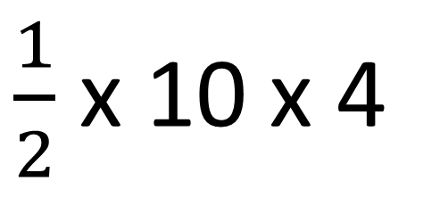
What is the distance travelled by the object?
10
$\frac{1}{2}$ x 10 x 4
Speed
(m/s)
= 20m
Time (s)
4

Slide 9
Acceleration/Deceleration = Gradient
Speed
(m/s)
Time (s)

Slide 10

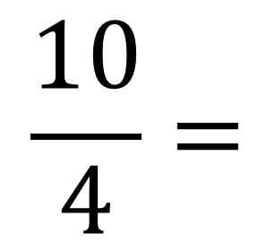
What is the acceleration
of the object?
10
Speed
(m/s)
$$\frac{10}{4}=$$
$2.5$m/s/s
Time (s)
4

Slide 11
What is the total distance travelled by the object?
20
Total Distance = 180m
Speed
(m/s)
120
40
20
Time (s)
4
10
12

Slide 12
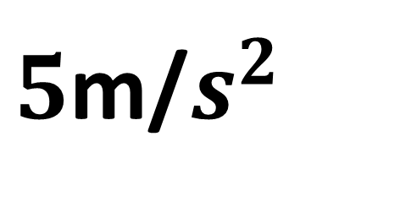
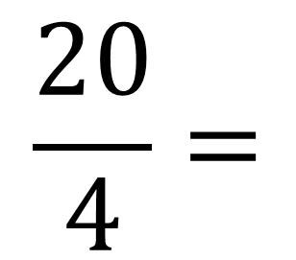
What was the acceleration of the object?
$$\frac{20}{4}=$$
20
$5$m/$s^{2}$
Speed
(m/s)
Time (s)
4
10
12

Slide 13
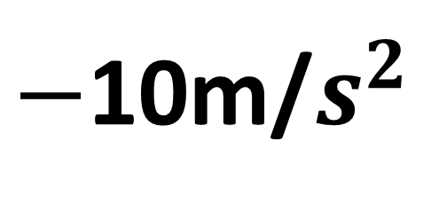
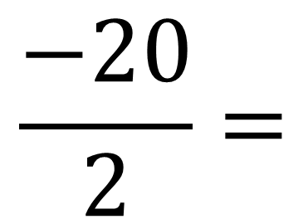
What was the deceleration of the object?
$$\frac{−20}{2}=$$
20
$−$10m/$s^{2}$
Speed
(m/s)
Time (s)
4
10
12

