Slide 1
LO: Area
of a Circle

Slide 2
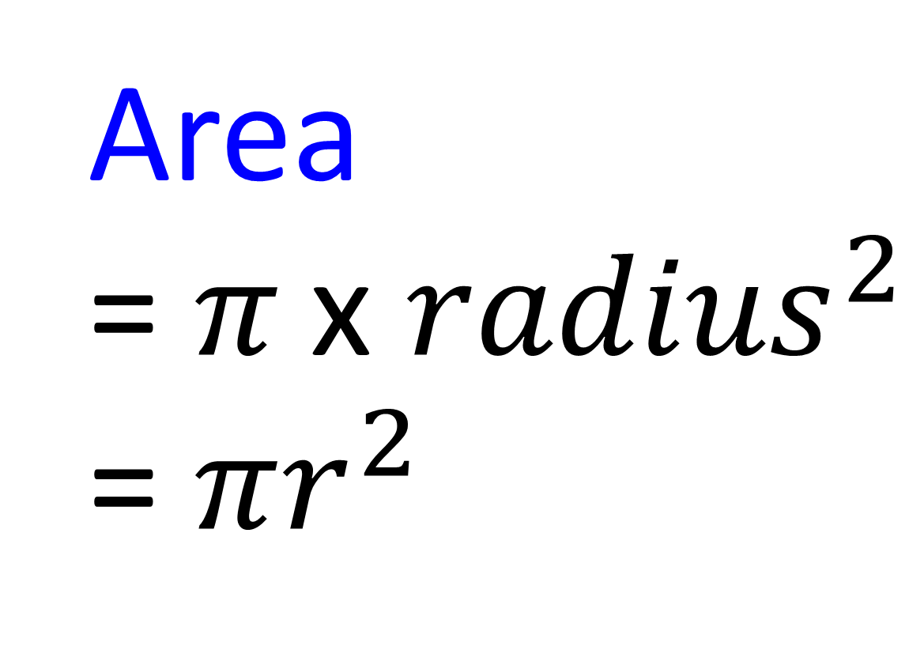
What is the formula for area?
Area
= $π \text{x} {radius}^{2}$
= $πr^{2}$

Slide 3
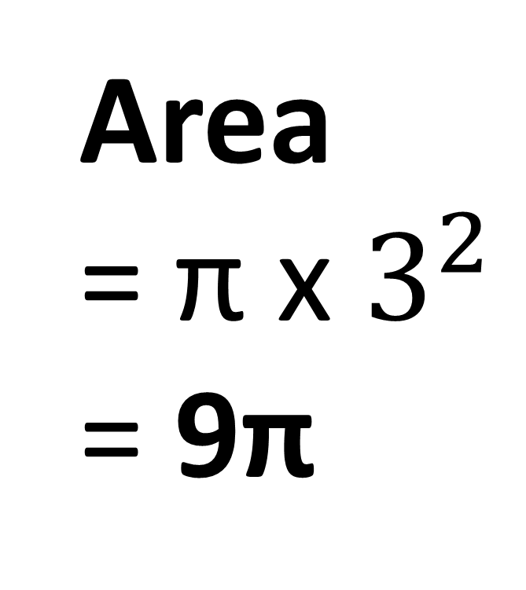
Find the Area of the circle.
Give your answer in terms of π
Area
= π x $3^{2}$
= 9π
6cm

Slide 4
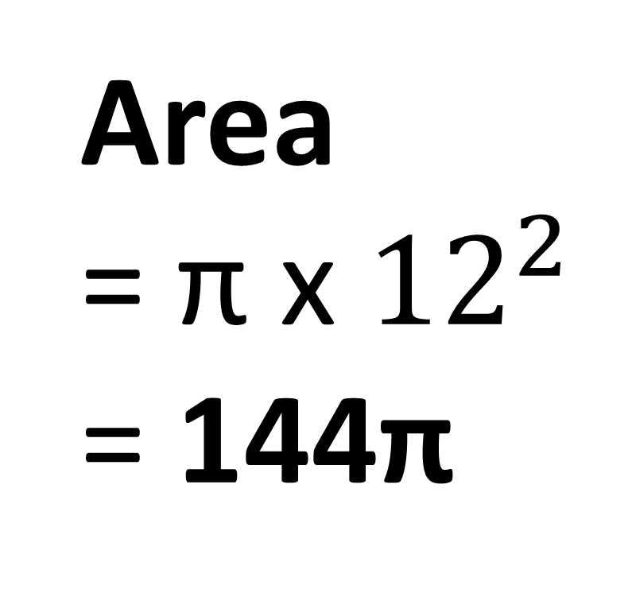
Find the Area of the circle.
Give your answer in terms of π
Area
= π x ${12}^{2}$
= 144π
12m

Slide 5
Semi-Circles

Slide 6
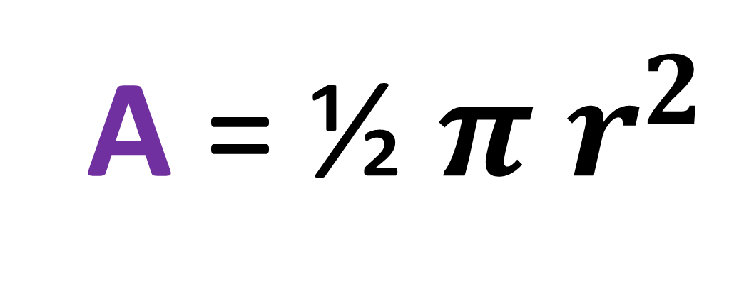
Write a formula for
the area of a semi-circle?
A = ½ $π r^{2}$

Slide 7
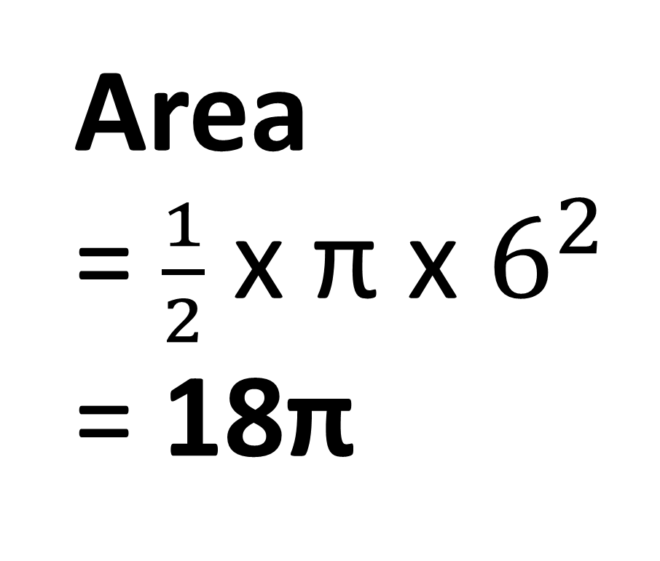
Find the Area of the semi-circle.
Give your answer in terms of π
Area
= $\frac{1}{2}$ x π x $6^{2}$
= 18π
12cm

Slide 8
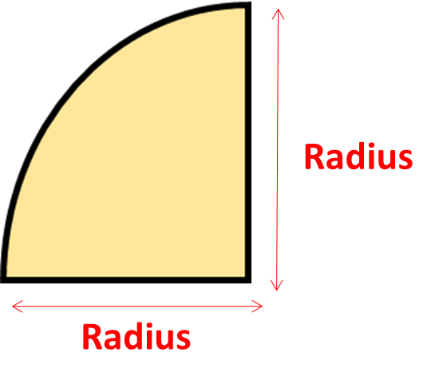
Quarter-Circles

Slide 9
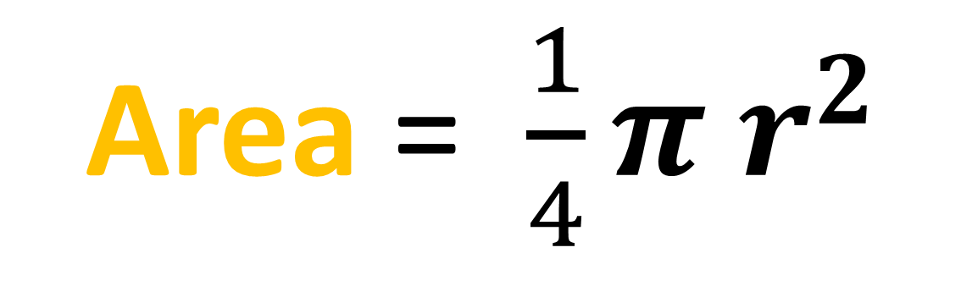
Write a formula for the area
of a quarter circle?
Area = $\frac{1}{4}π r^{2}$
Radius

Slide 10
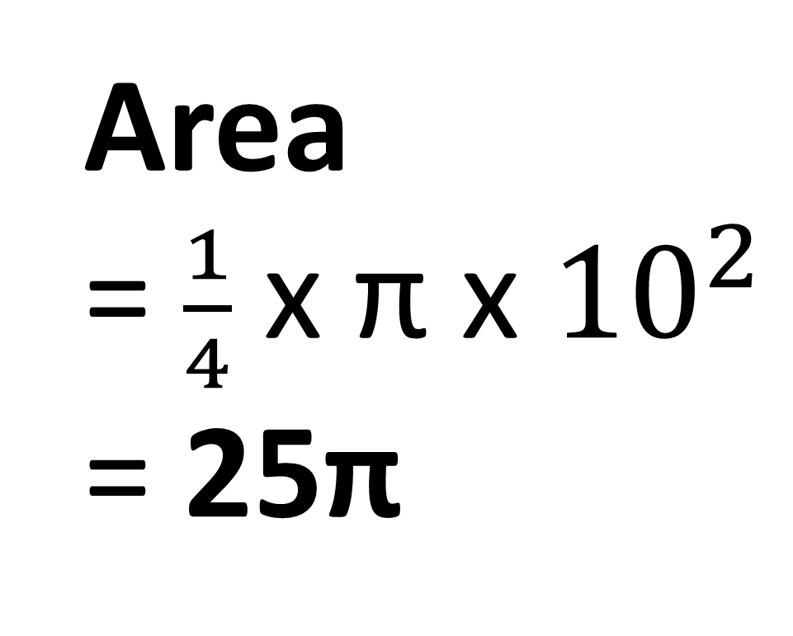
Find the Area of the quarter-circle.
Give your answer in terms of π
Area
= $\frac{1}{4}$ x π x ${10}^{2}$
= 25π
10 mm

Slide 11
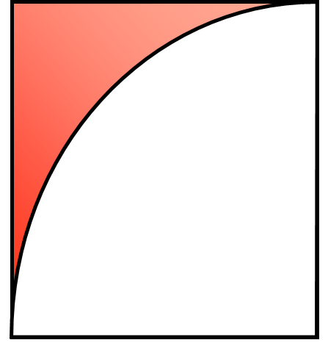
Is this a rectangle or square?
Radius
Radius
Square

Slide 12
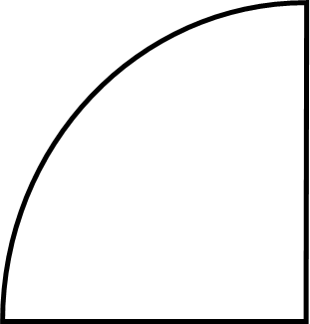
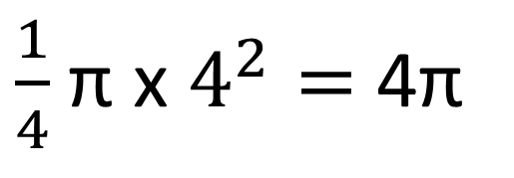
What is the area of the red shading?
4cm
4 x 4 = 16
4cm
$\frac{1}{4}$π x $4^{2}=$ 4π
4cm
4cm
Shading = 16 – 4π
= 3.4 (1 dp)

Slide 13
What is the area of the red shading?
4cm
16π
2cm
4π
Shading = 12π

Slide 14
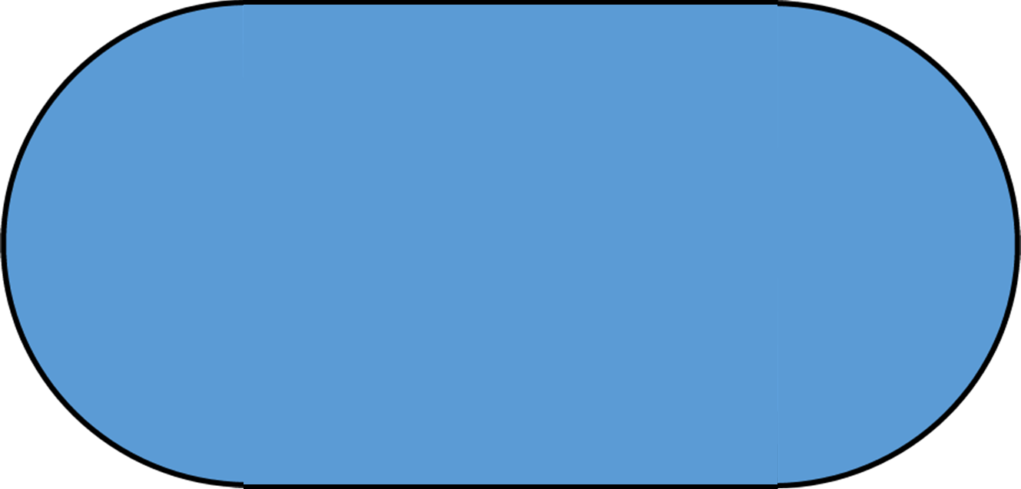
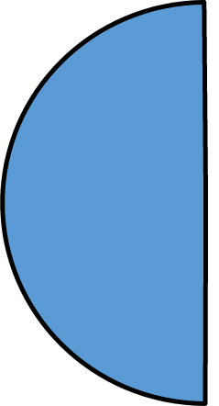
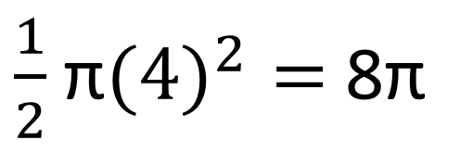
What is the area of the shape?
6cm
$\frac{1}{2}$π$({4)}^{2}=$ 8π
4cm
4cm
8 x 6 = 48
Area = 16π + 48

