Slide 1
Exponentials and Logs
Introduction
Chapter 14
(Part 1 of 9)

Slide 2

Exponentials
$$a^{x}$$
x is the exponent
a is the base value

Slide 3
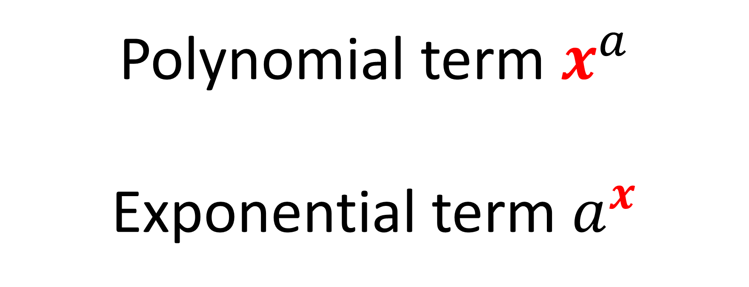
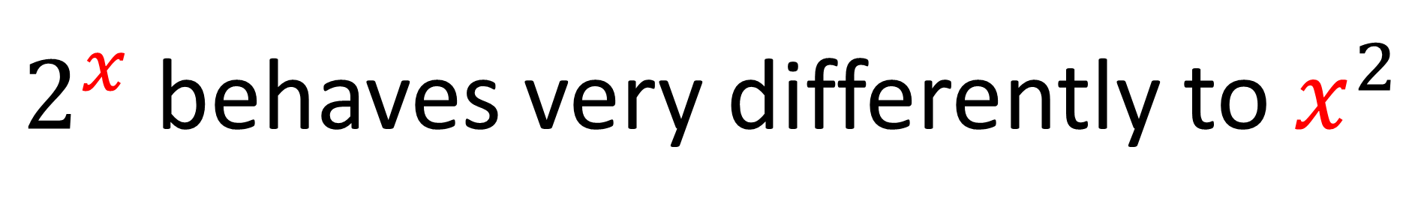
Polynomial term $x^{a}$
Exponential term $a^{x}$
$2^{x}$ behaves very differently to $x^{2}$

Slide 4

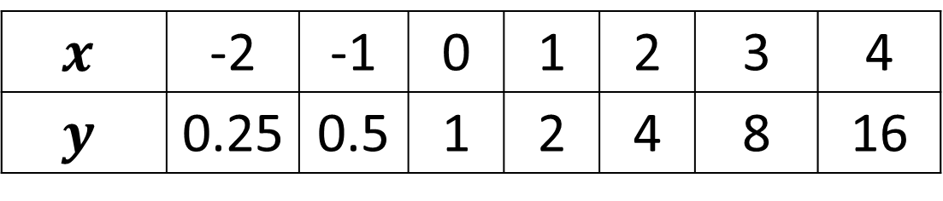
$$x$$ | -2 | -1 | 0 | 1 | 2 | 3 | 4
$$y$$ | 0.25 | 0.5 | 1 | 2 | 4 | 8 | 16
20
16
12
8
4
-4
$$y=2^{x}$$
-2 -1 1 2 3 4 5 6 7
Notes:
Get students to sketch axes and tables in their books.

Slide 5
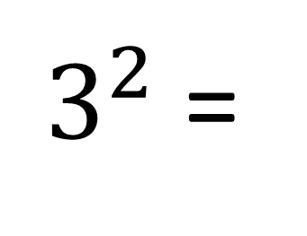
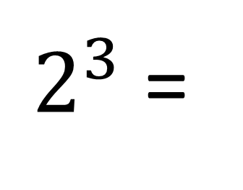
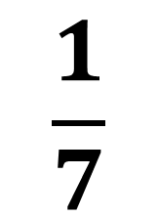
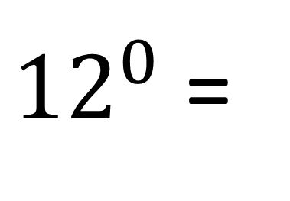
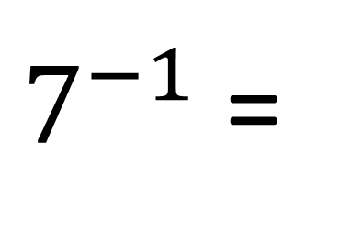
These are examples of exponentials.
$2^{3}$ =
8
$3^{2}$ =
9
$$\frac{1}{7}$$
$7^{−1}$ =
${12}^{0}$ =
1

Slide 6
Exponential Equation
y = a^{x}

Slide 7
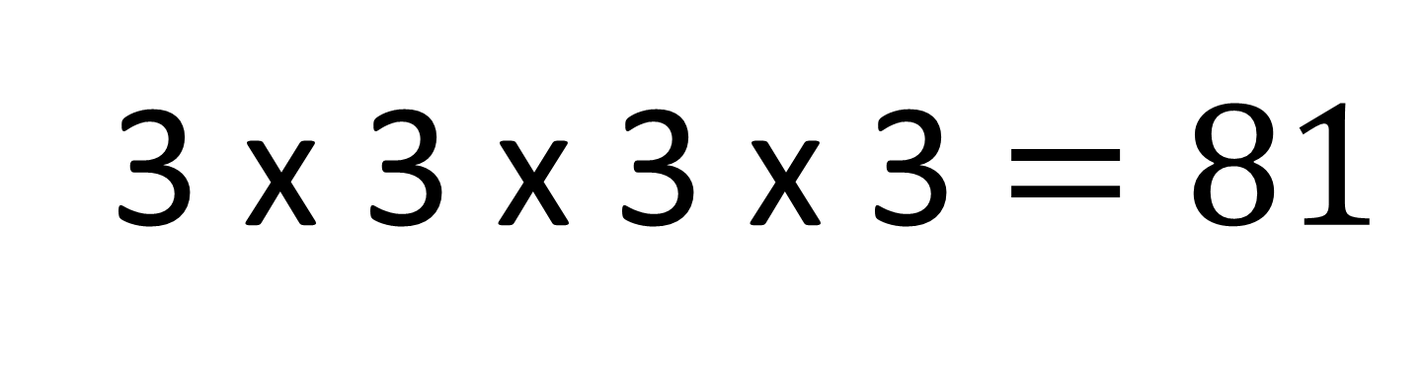
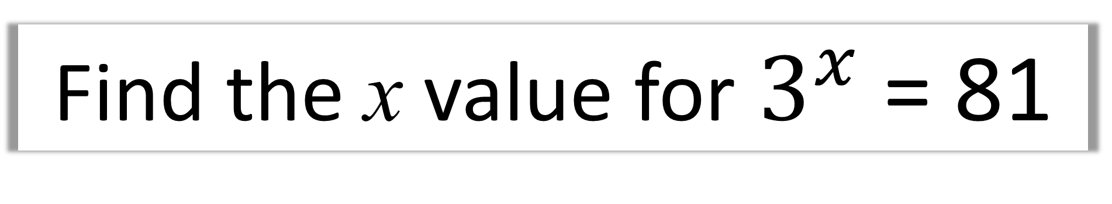
Find the x value for $3^{x}$ = 81
3 x 3 x 3 x 3 $=81$
x = 4

Slide 8
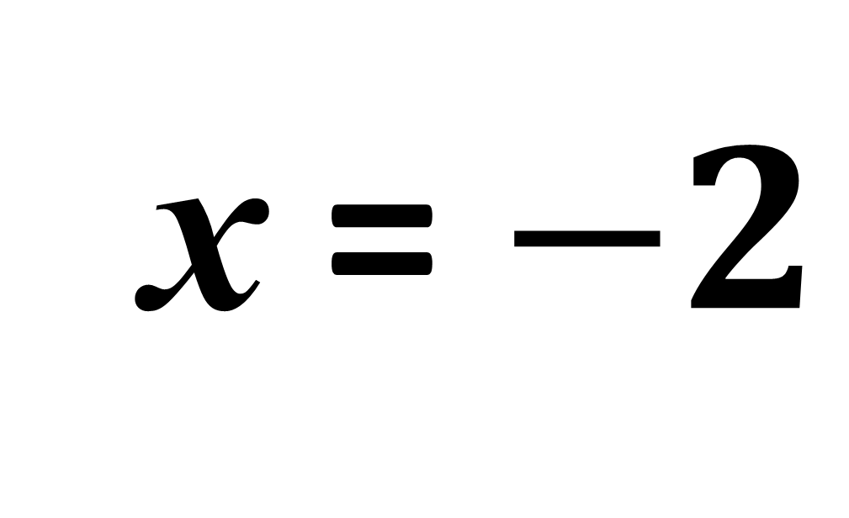
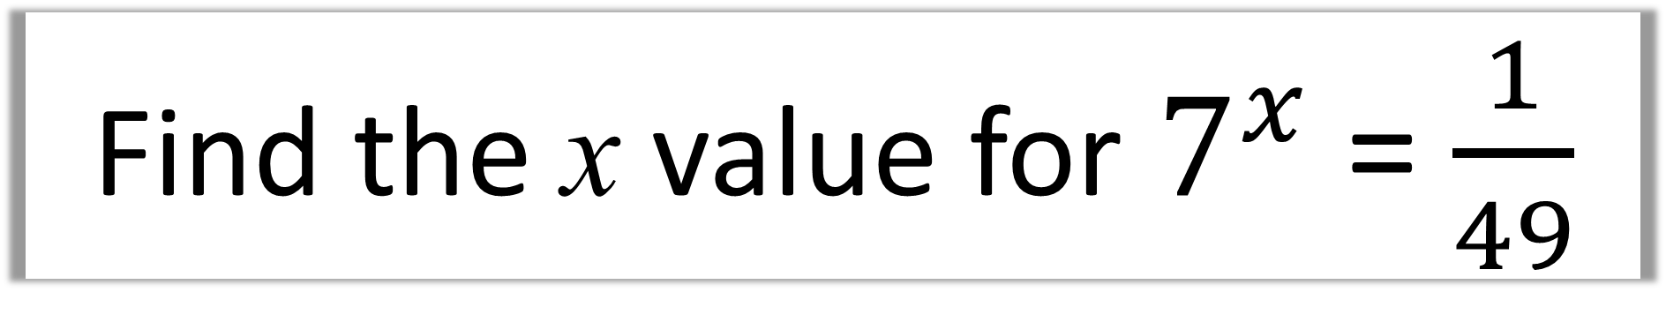
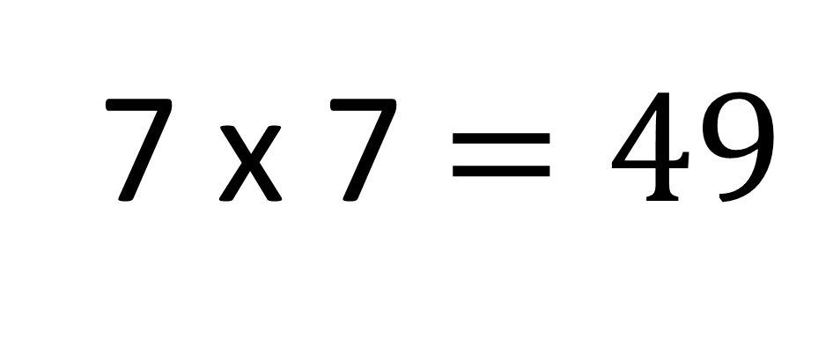
Find the x value for $7^{x}$ = $\frac{1}{49}$
7 x 7 $=49$
x = $−2$

Slide 9
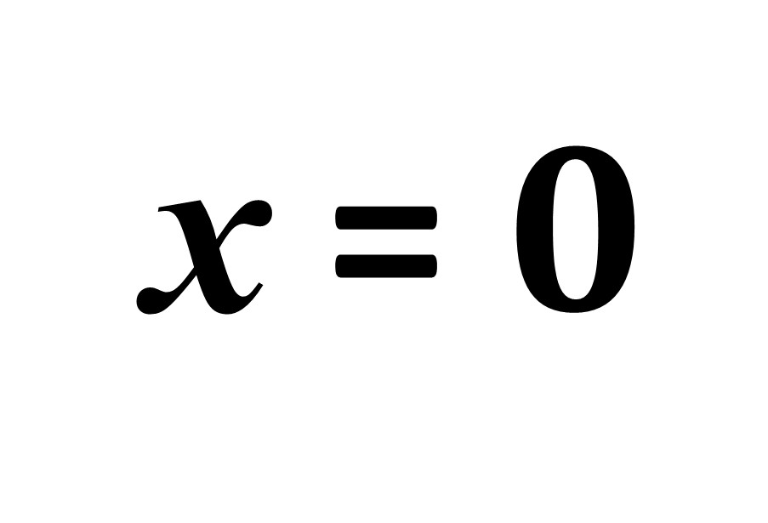
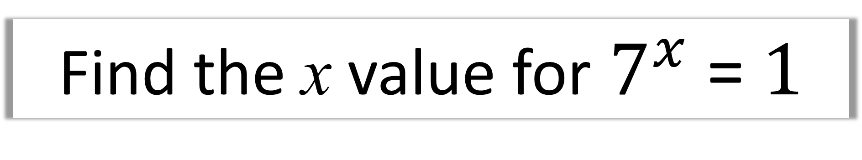
Find the x value for $7^{x}$ = $1$
x = $0$

Slide 10
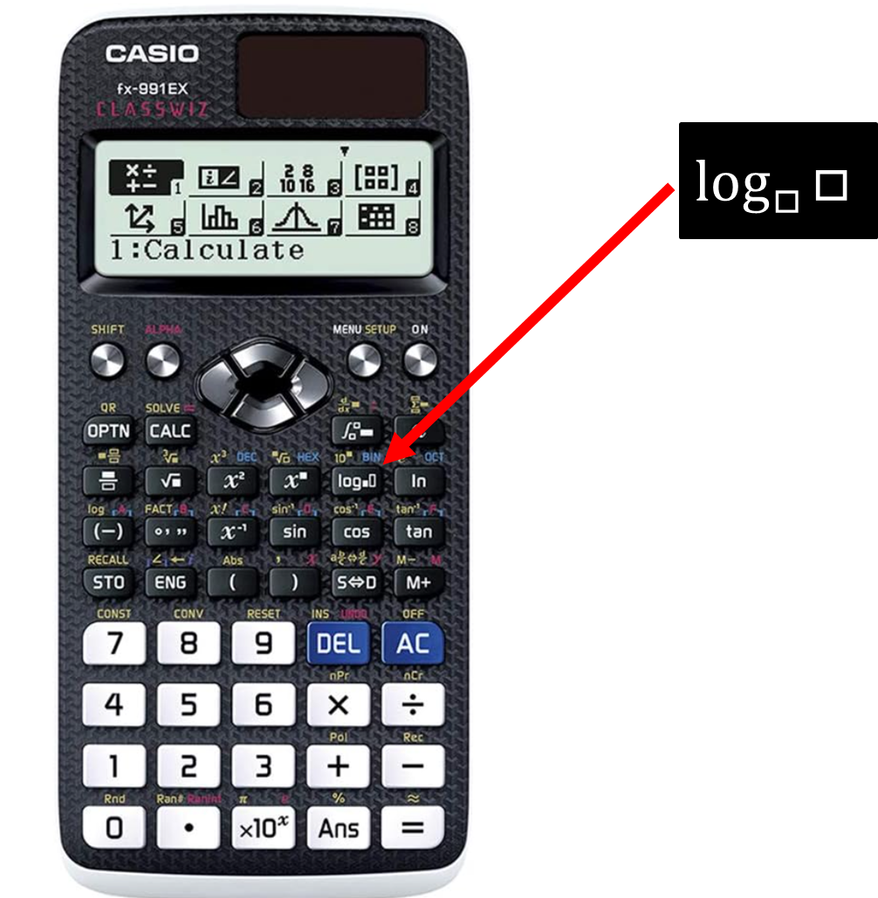
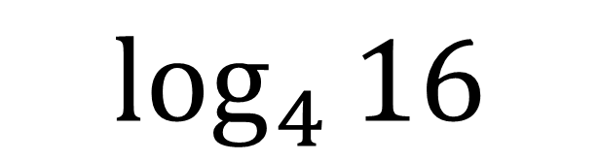
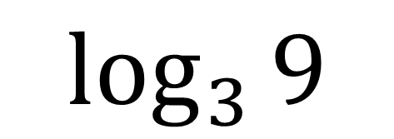
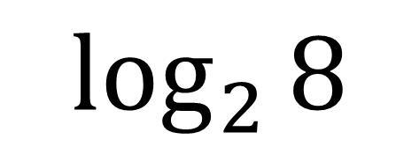
Logarithms
$$\log_{3}{9}$$
$$\log_{4}{16}$$
$$\log_{2}{8}$$
Logarithms, provide an inverse to
exponential functions.

Slide 11
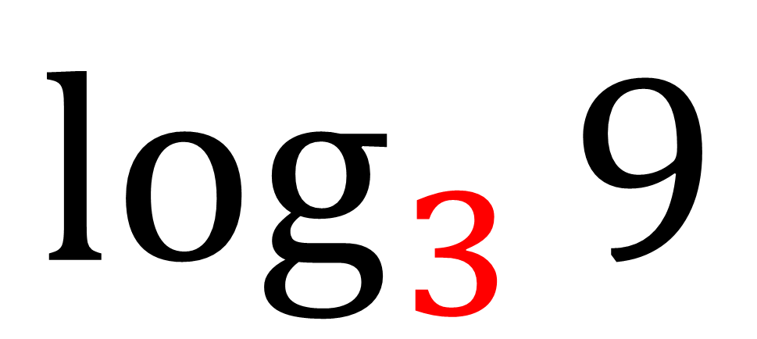
Logarithms
$$\log_{3}{9}$$
Log 9 in the base of 3

Slide 12
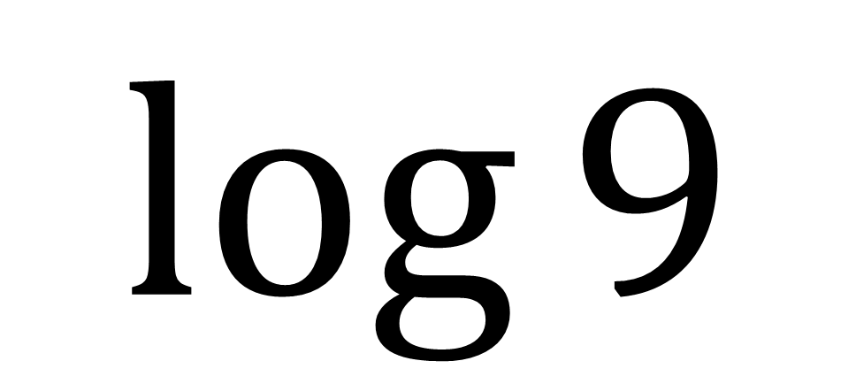
$$\log{9}$$
If no base value given,
then you assume it is base of 10

Slide 13
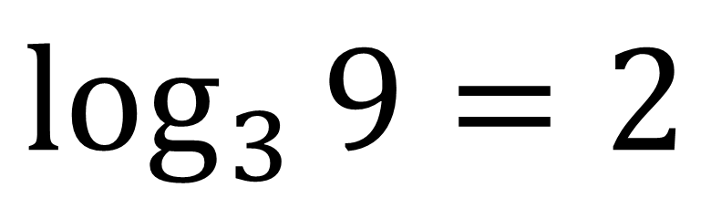
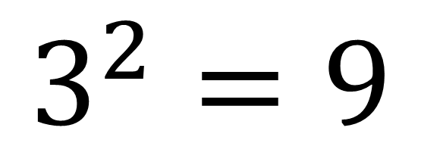
Exponential Equations
Logarithms can be used to
solve exponential equations
$$3^{2}=9$$
$$\log_{3}{9}=2$$

Slide 14
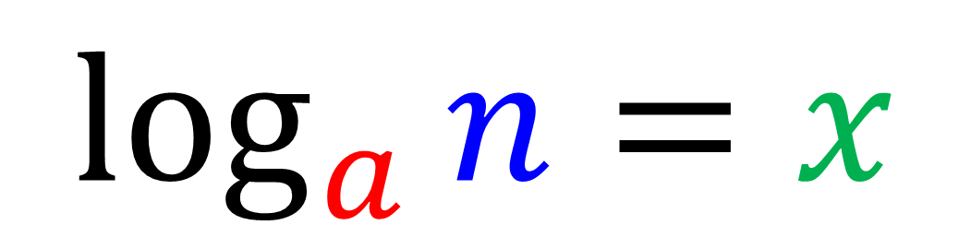
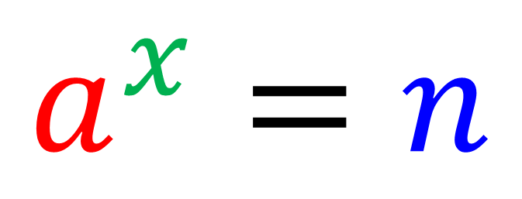
Interchanging between exponential and log form
$$a^{x}=n$$
$$\log_{a}{n}=x$$

Slide 15
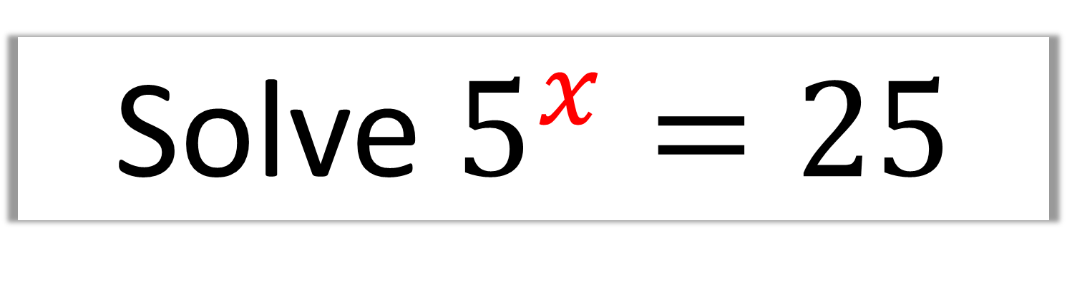
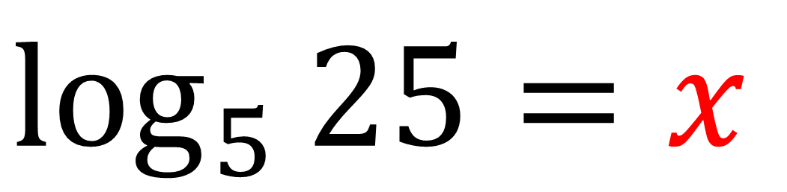
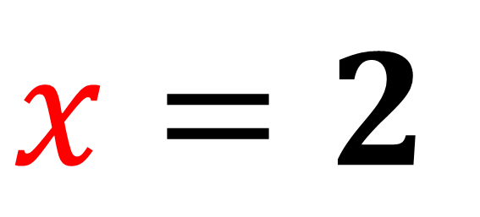
Solve $5^{x}=25$
$$\log_{5}{25}=x$$
$$x=2$$
Think: “5 to the power of what gives you 25?”

Slide 16
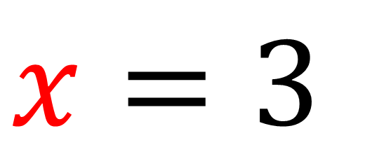
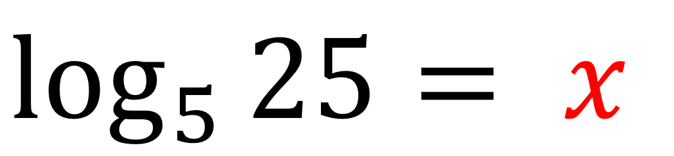
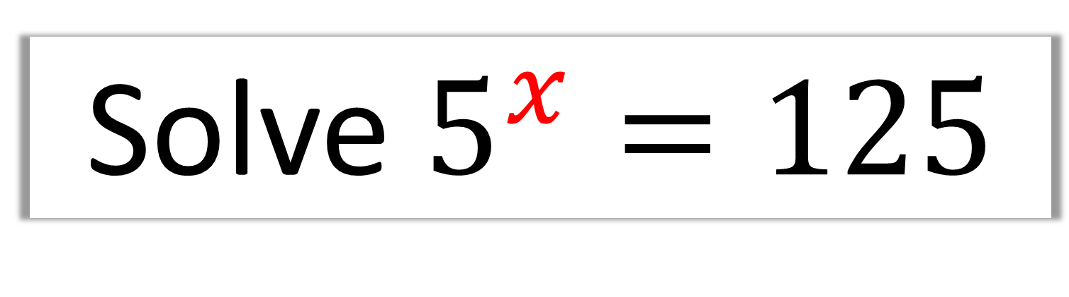
Solve $5^{x}=125$
$$\log_{5}{25}= x$$
$$x=3$$

Slide 17
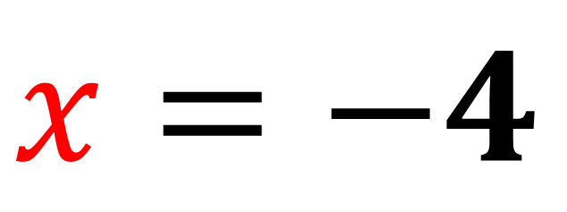
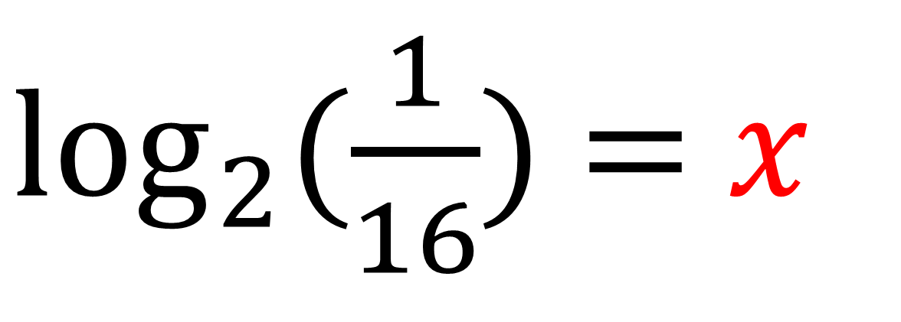
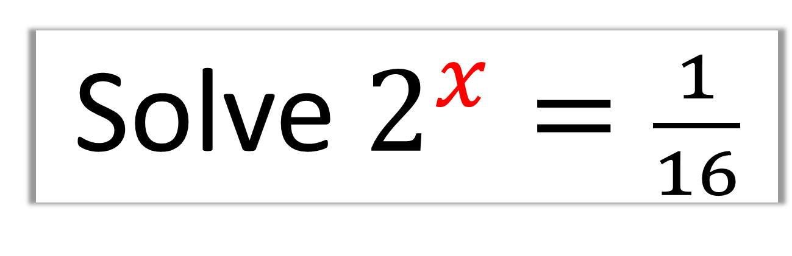
Solve $2^{x}=\frac{1}{16}$
$\log_{2}{(\frac{1}{16})}$ $=$ 𝑥
$$x=−4$$

Slide 18
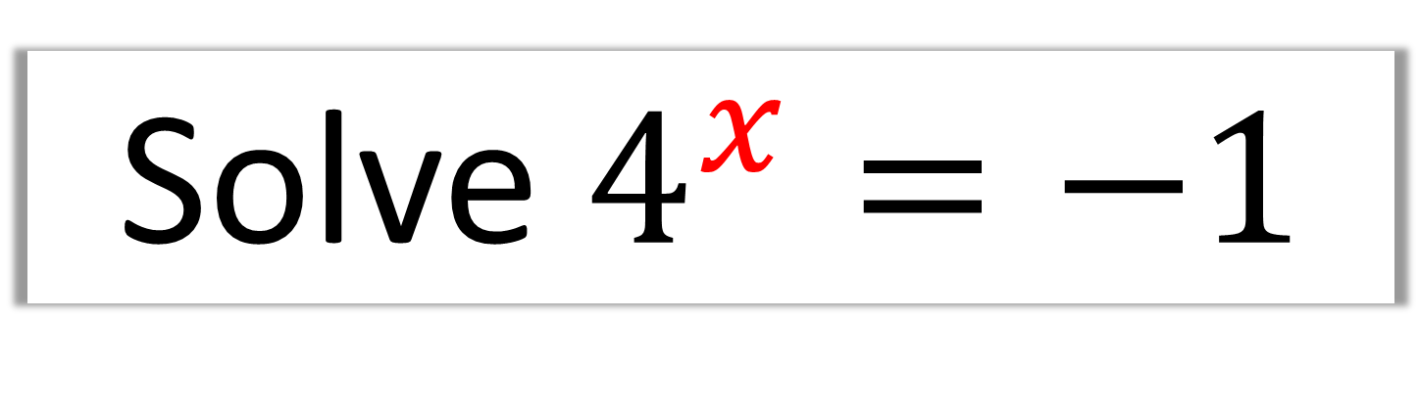
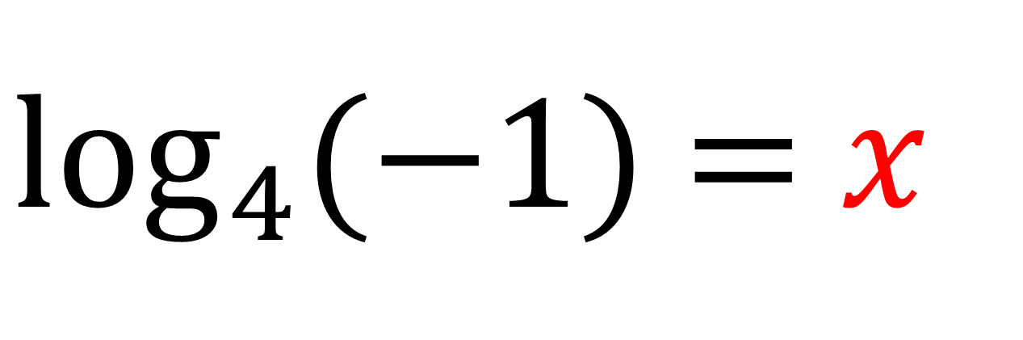
Solve $4^{x}=−1$
$\log_{4}{(−1)}$ $=$ 𝑥
You cannot log negatives!

Slide 19
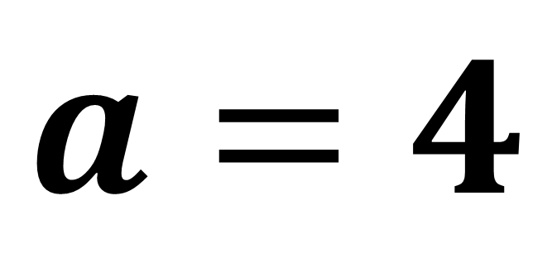
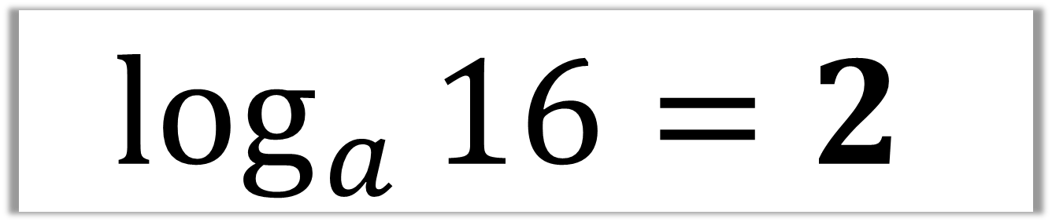
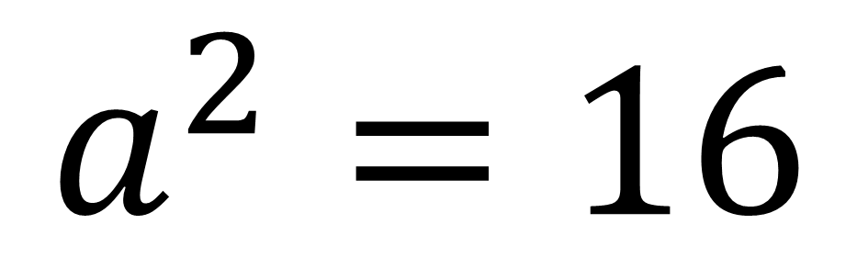
$$\log_{a}{16}=2$$
$$a^{2}=16$$
$$a=4$$

Slide 20
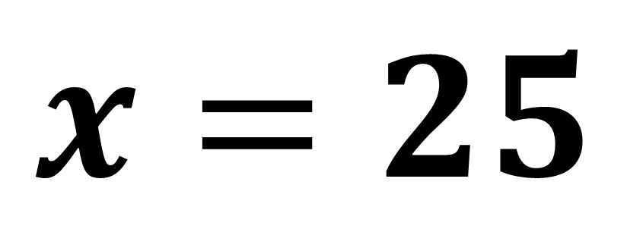
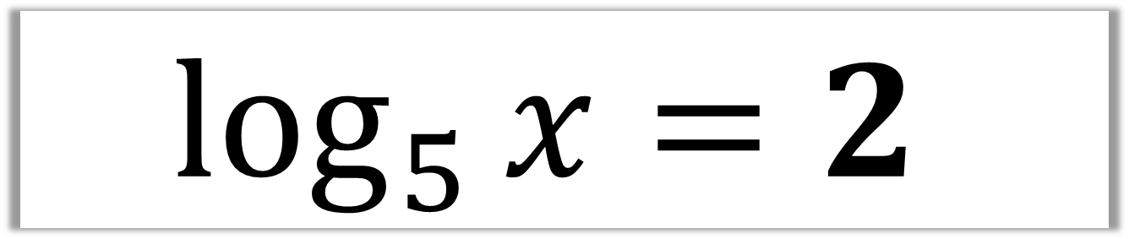
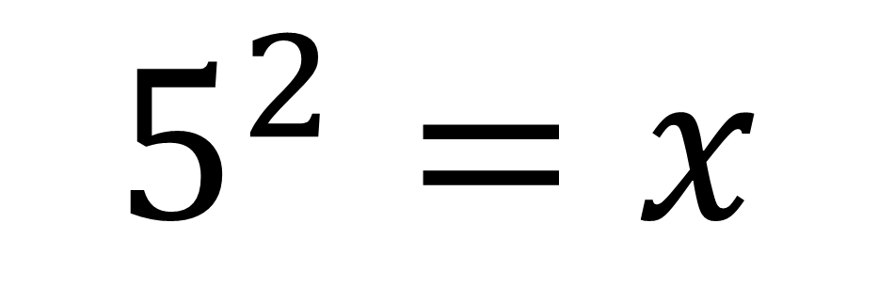
$$\log_{5}{x}=2$$
$$5^{2}=x$$
$$x=25$$

Slide 21
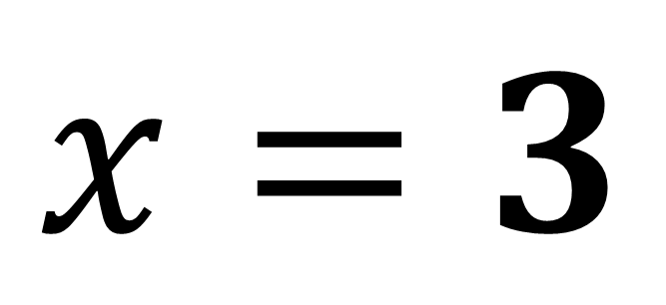

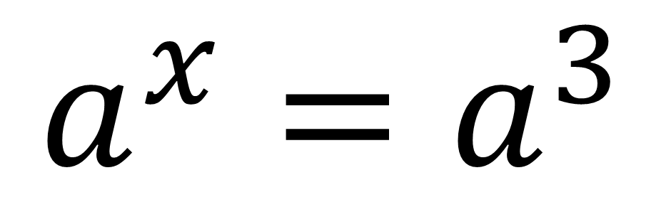
$$\log_{a}\left(a^{x}\right)=3$$
$$a^{x}=a^{3}$$
$$x=3$$

Slide 22
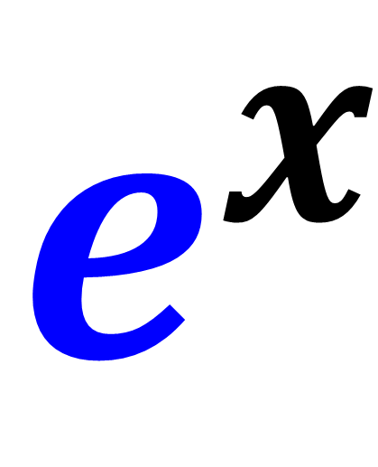
A Special Exponential
$$e^{x}$$
e ≈ 2.71821….
e is an irrational number and never ends.

Slide 23
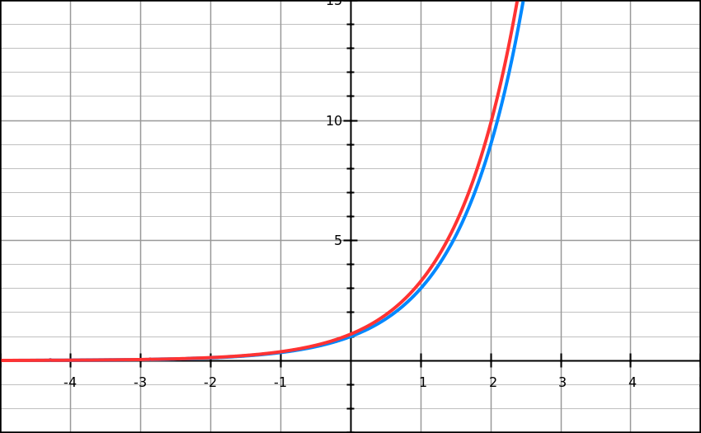
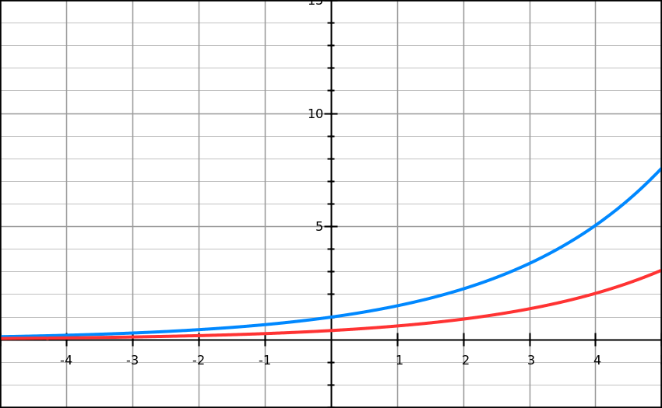
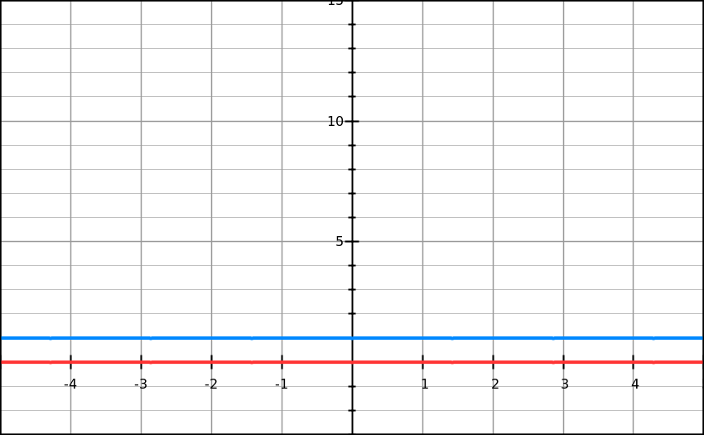
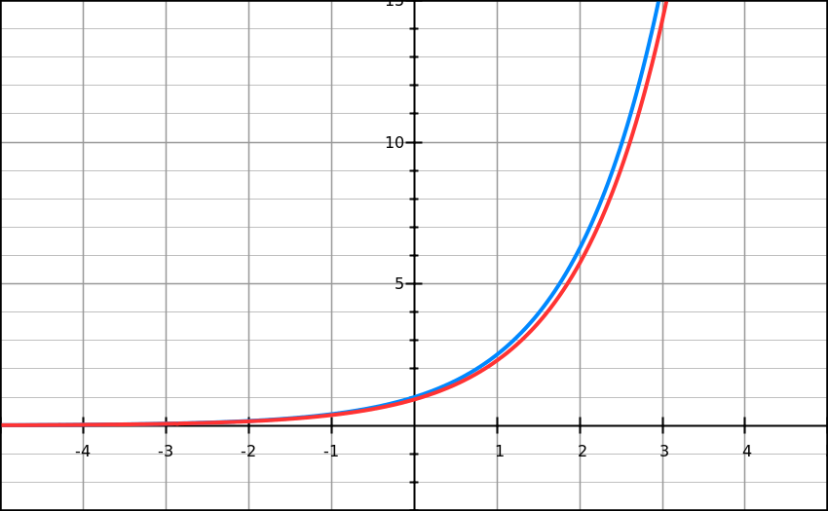












$y=e^{x}$
Click
Function
Gradient
$$y=1^{x}$$
$$\frac{dy}{dx}=0$$
>
$$y={1.5}^{x}$$
$$\frac{dy}{dx}=0.41×{1.5}^{x}$$
>
$$y=2^{x}$$
$$\frac{dy}{dx}=0.69×2^{x}$$
>
$$y={2.5}^{x}$$
$$\frac{dy}{dx}=0.92×{2.5}^{x}$$
>
$$y=3^{x}$$
$$\frac{dy}{dx}=1.10×3^{x}$$
>
Compare each exponential function against its respective gradient function. What do you notice?

Slide 24


$y=e^{x}$
$y={2.5}^{x}$ and $y=3^{x}$
is very similar to their respective gradient functions.
So is there a base between 2.5 and 3 where
the function is equal to its gradient function.
This value is 2.71828………..
𝑒 = 2.71828… is known as Euler’s Number.

Slide 25
e^{x} is special because
of the graph it produces.
It is used to model real situations
such as population growth
and radioactive decay.

