Slide 1
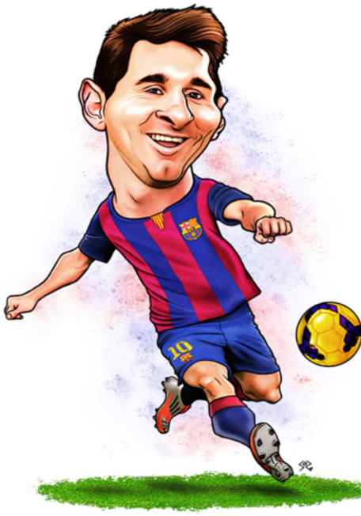
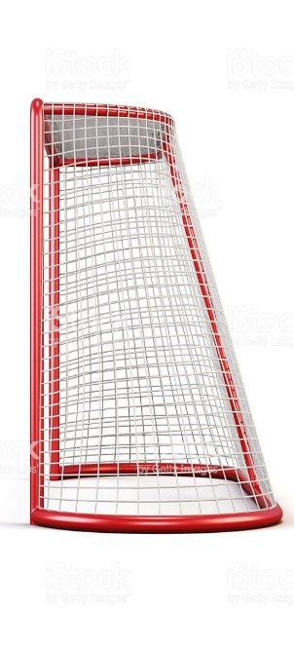
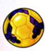
What is the area of the triangle?
The ball leaves Messi foot
at 10˚ from the ground.
80°
2.5 m
10˚
25 m
10 metres
Will he score?

Slide 2
ANSWERS

Slide 3
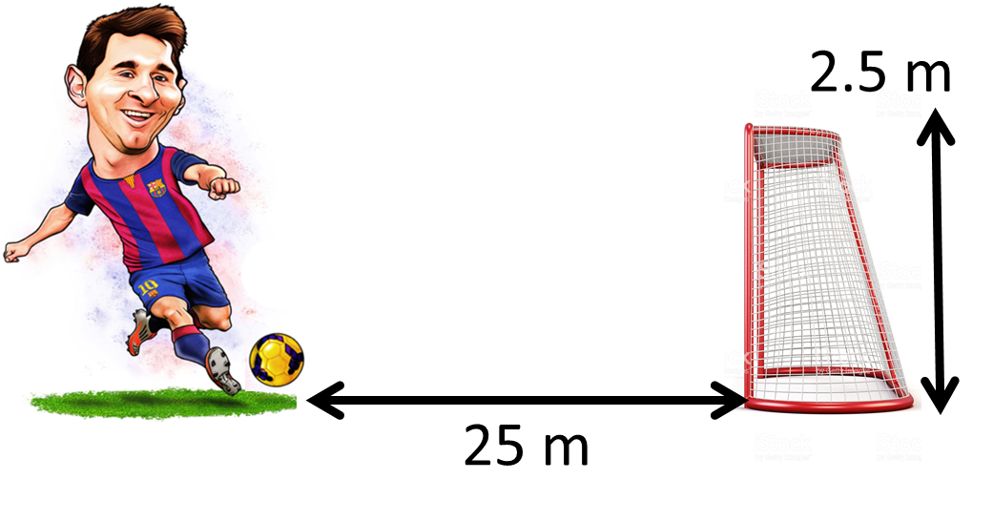
tan (10) x 25
= 4.4
He misses!

Slide 4
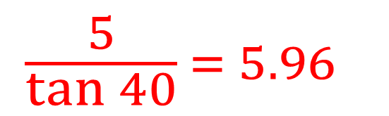
What is the area of the triangle?
80°
40˚
$$\frac{5}{\tan{40}} = 5.96$$
5m
10 metres

