Slide 1
Sequences and Series
Recurrence Relations
Chapter 3
(Part 7 of 8)

Slide 2
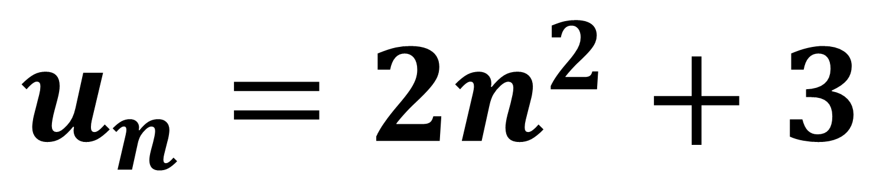
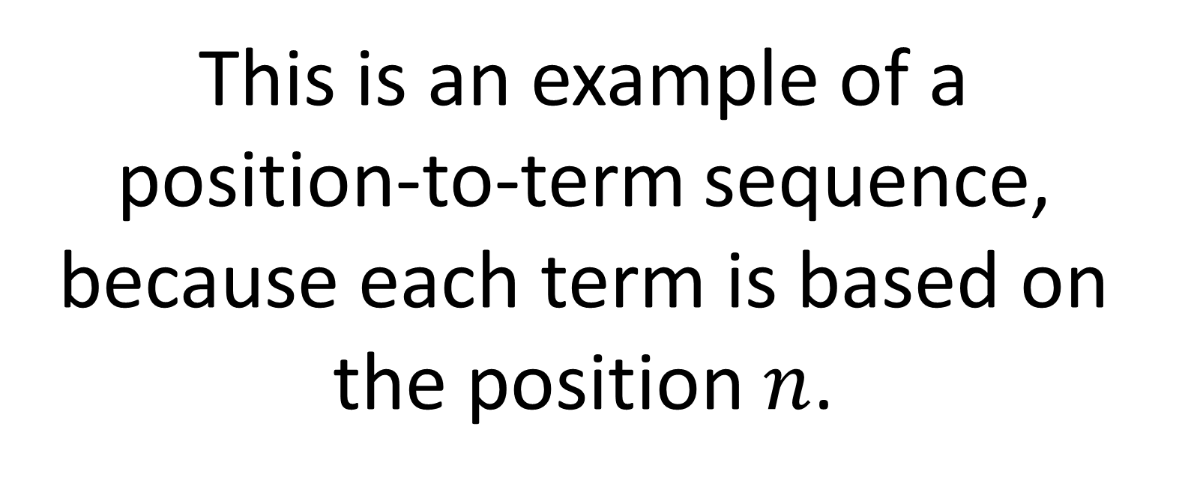
$$u_{n}=2n^{2}+3$$
This is an example of a
position-to-term sequence,
because each term is based on
the position $n$.

Slide 3
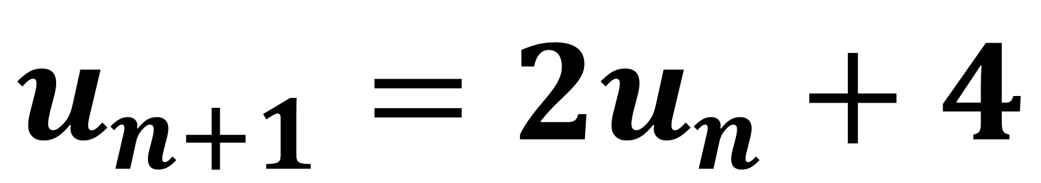
$$u_{n+1}=2u_{n}+4$$
This is an example of a
term-to-term sequence,
because each term is based on
the previous term.

Slide 4
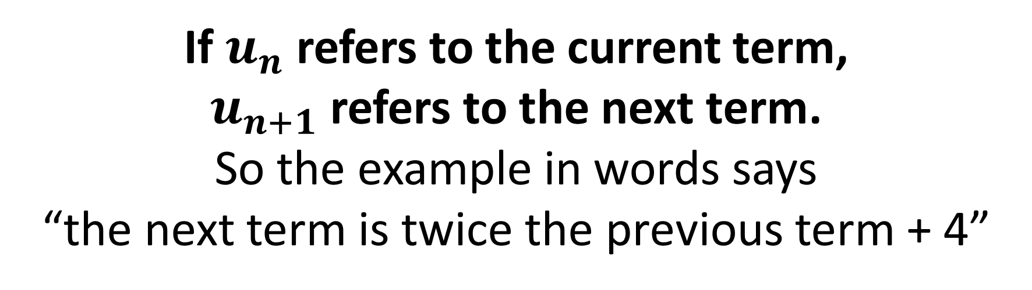
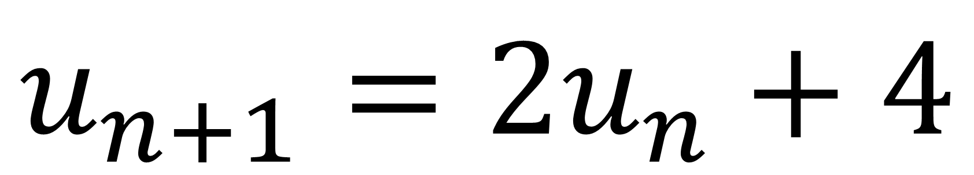
Recurrence Formula
$$u_{n+1}=2u_{n}+4$$
If $u_{n}$ refers to the current term,
$u_{n+1}$ refers to the next term.
So the example in words says
“the next term is twice the previous term + 4”

Slide 5
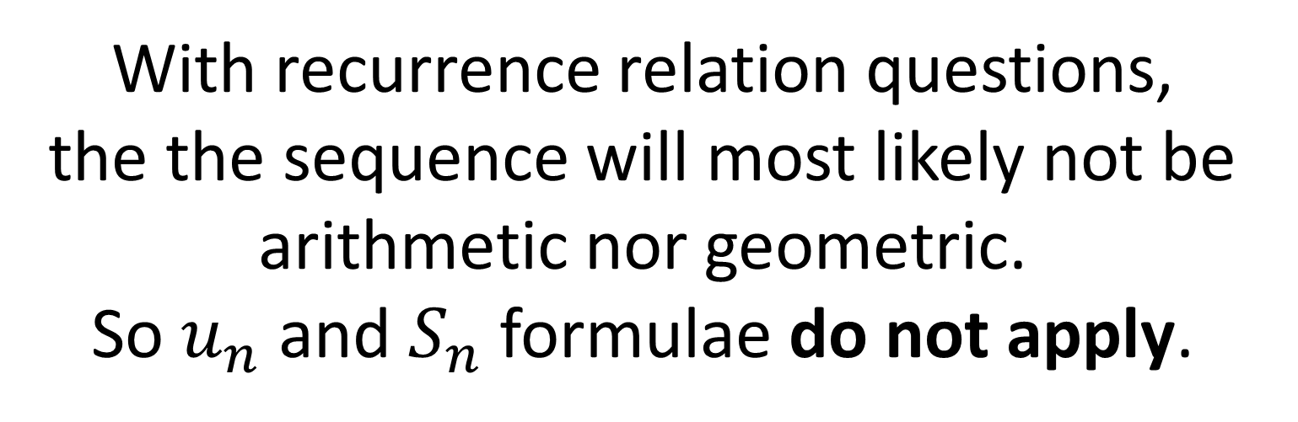
Recurrence Formula
$$u_{n+1}=2u_{n}+4$$
With recurrence relation questions,
the the sequence will most likely not be
arithmetic nor geometric.
So $u_{n}$ and $S_{n}$ formulae do not apply.

Slide 6
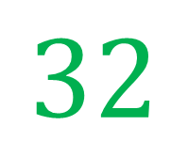
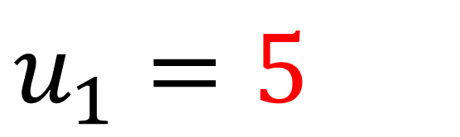
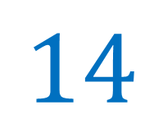
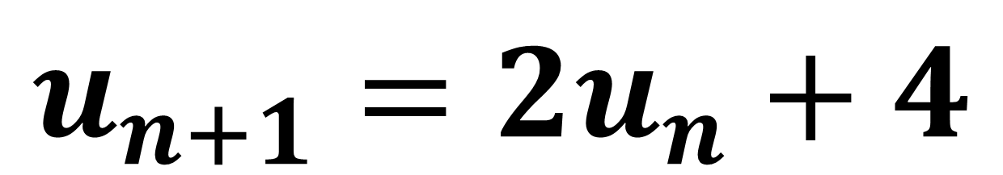
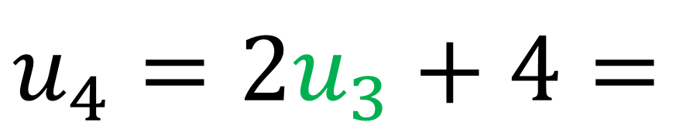
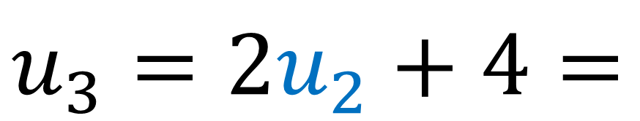
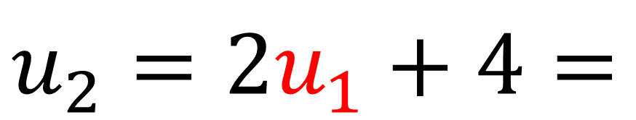
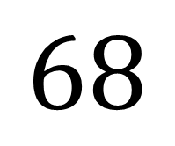
$$u_{n+1}=2u_{n}+4$$
$$u_{1}=5$$
$$u_{2}=2u_{1}+4=$$
$$14$$
$$u_{3}=2u_{2}+4=$$
$$32$$
$$u_{4}=2u_{3}+4=$$
$$68$$

Slide 7
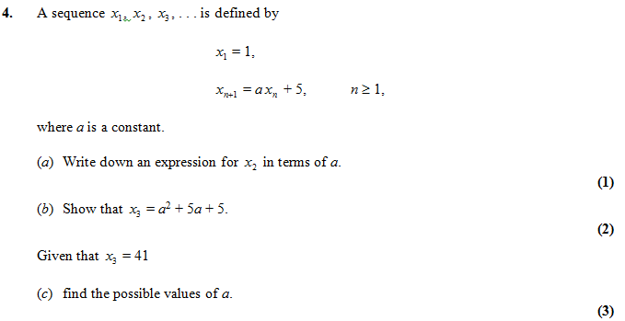





$$x_{2}=a+5$$
$$x_{3}=a\left(a+5\right)+5=a^{2}+5a+5$$
$$a^{2}+5a+5=41$$
$$a^{2}+5a−36=0$$
$$a=−9 or 4$$

Slide 8
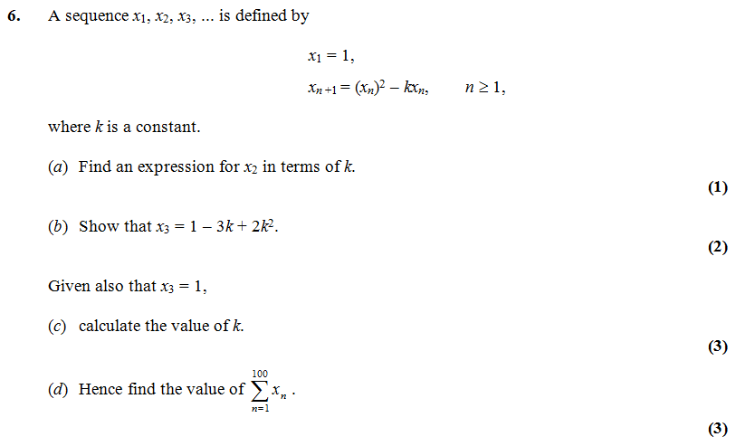

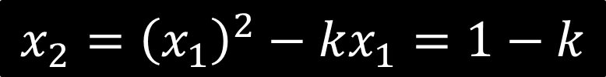

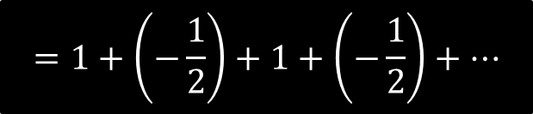


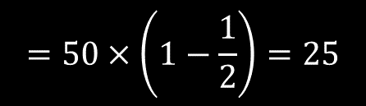
$$x_{2}={\left(x_{1}\right)}^{2}−kx_{1}=1−k$$
$$x_{3}={\left(x_{2}\right)}^{2}−kx_{2}$$
$$={\left(1−k\right)}^{2}−k\left(1−k\right)$$
$$=1−3k+2k^{2}$$
$$k=\frac{3}{2}$$
$$=1+\left(−\frac{1}{2}\right)+1+\left(−\frac{1}{2}\right)+…$$
$$=50×\left(1−\frac{1}{2}\right)=25$$

Slide 9
Increasing, decreasing and periodic sequences
A sequence is increasing if the terms are always increasing.
A sequence is decreasing if the terms are always decreasing.
A sequence is periodic if the terms repeat in a cycle.

Slide 10
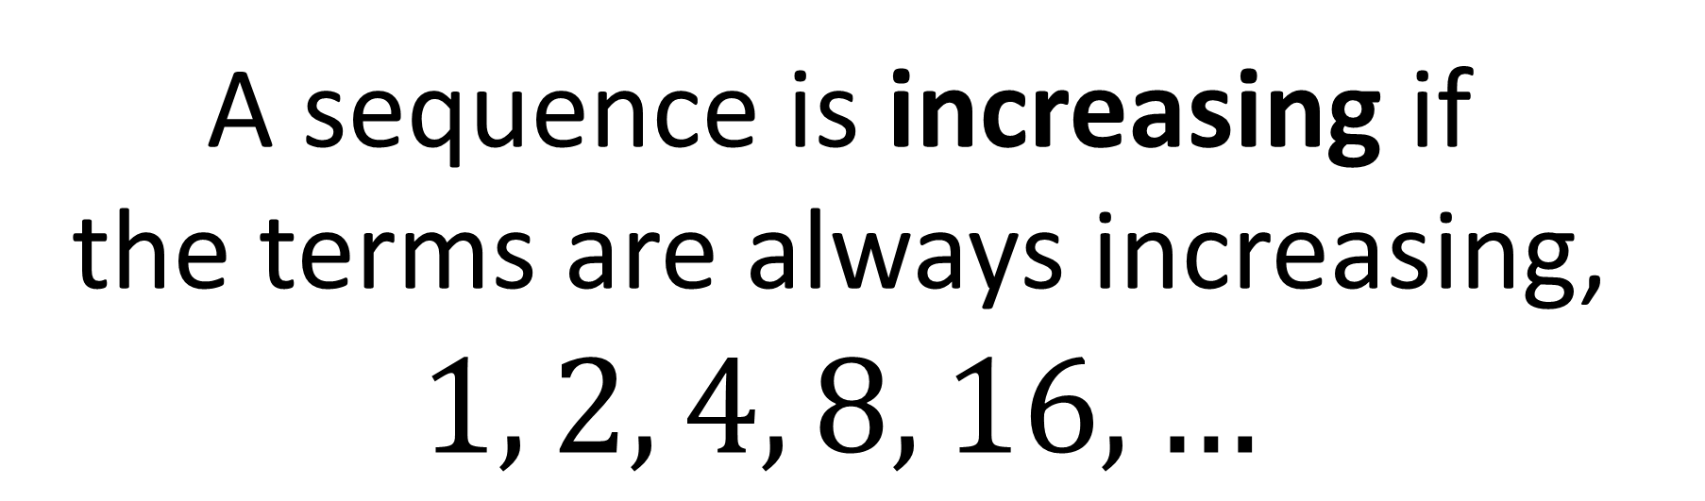
Increasing Sequences
A sequence is increasing if
the terms are always increasing,
$$1, 2, 4, 8, 16, …$$

Slide 11
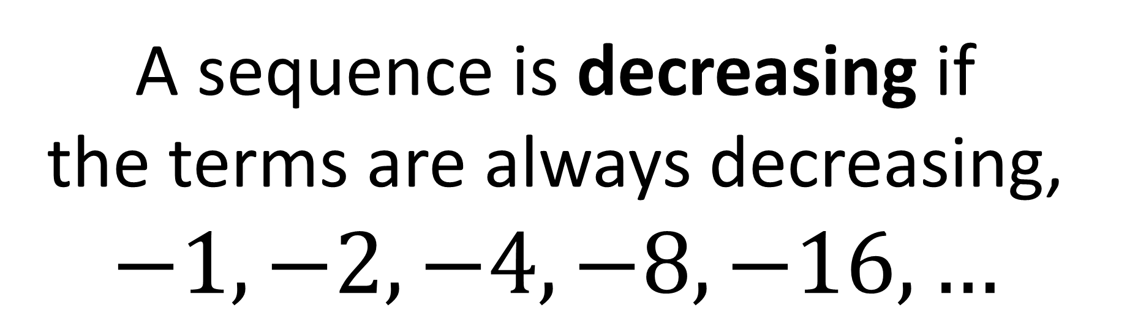
Decreasing Sequences
A sequence is decreasing if
the terms are always decreasing,
$$−1, −2, −4, −8, −16, …$$

Slide 12
Periodic Sequences
2, 3, 0, 2, 3, 0, 2, 3, 0, 2,…
it has order 3
(repeats every 3 terms)

Slide 13
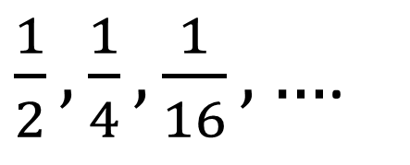
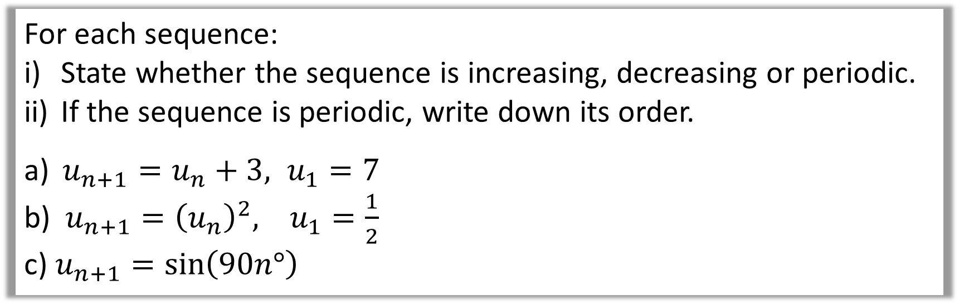
For each sequence:
State whether the sequence is increasing, decreasing or periodic.
If the sequence is periodic, write down its order.
$u_{n+1}=u_{n}+3, u_{1}=7$
b)$u_{n+1}={\left(u_{n}\right)}^{2}, u_{1}=\frac{1}{2}$.
c) $u_{n+1}=\sin\left(90n°\right)$
7, 10, 13, ….
Increasing
a)
$\frac{1}{2},\frac{1}{4},\frac{1}{16},…$.
Decreasing
b)
c)
1, 0, -1, 0, 1, 0, …
Periodic, order 4.

