Slide 1
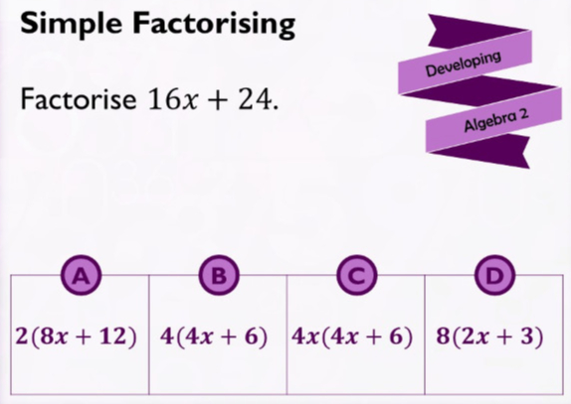
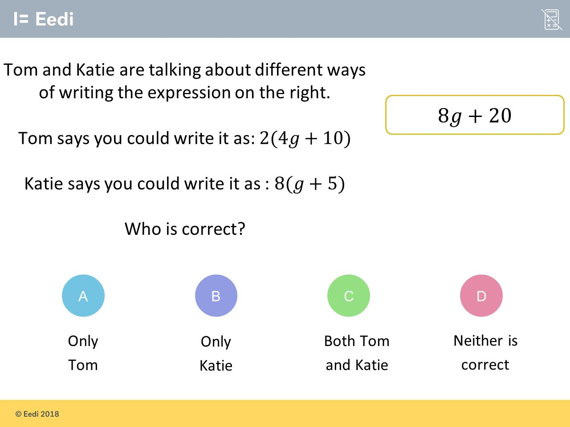
Worst answered question?
Most common wrong answer?

Slide 2
ANSWERS

Slide 3
Worst answered question?

Slide 4
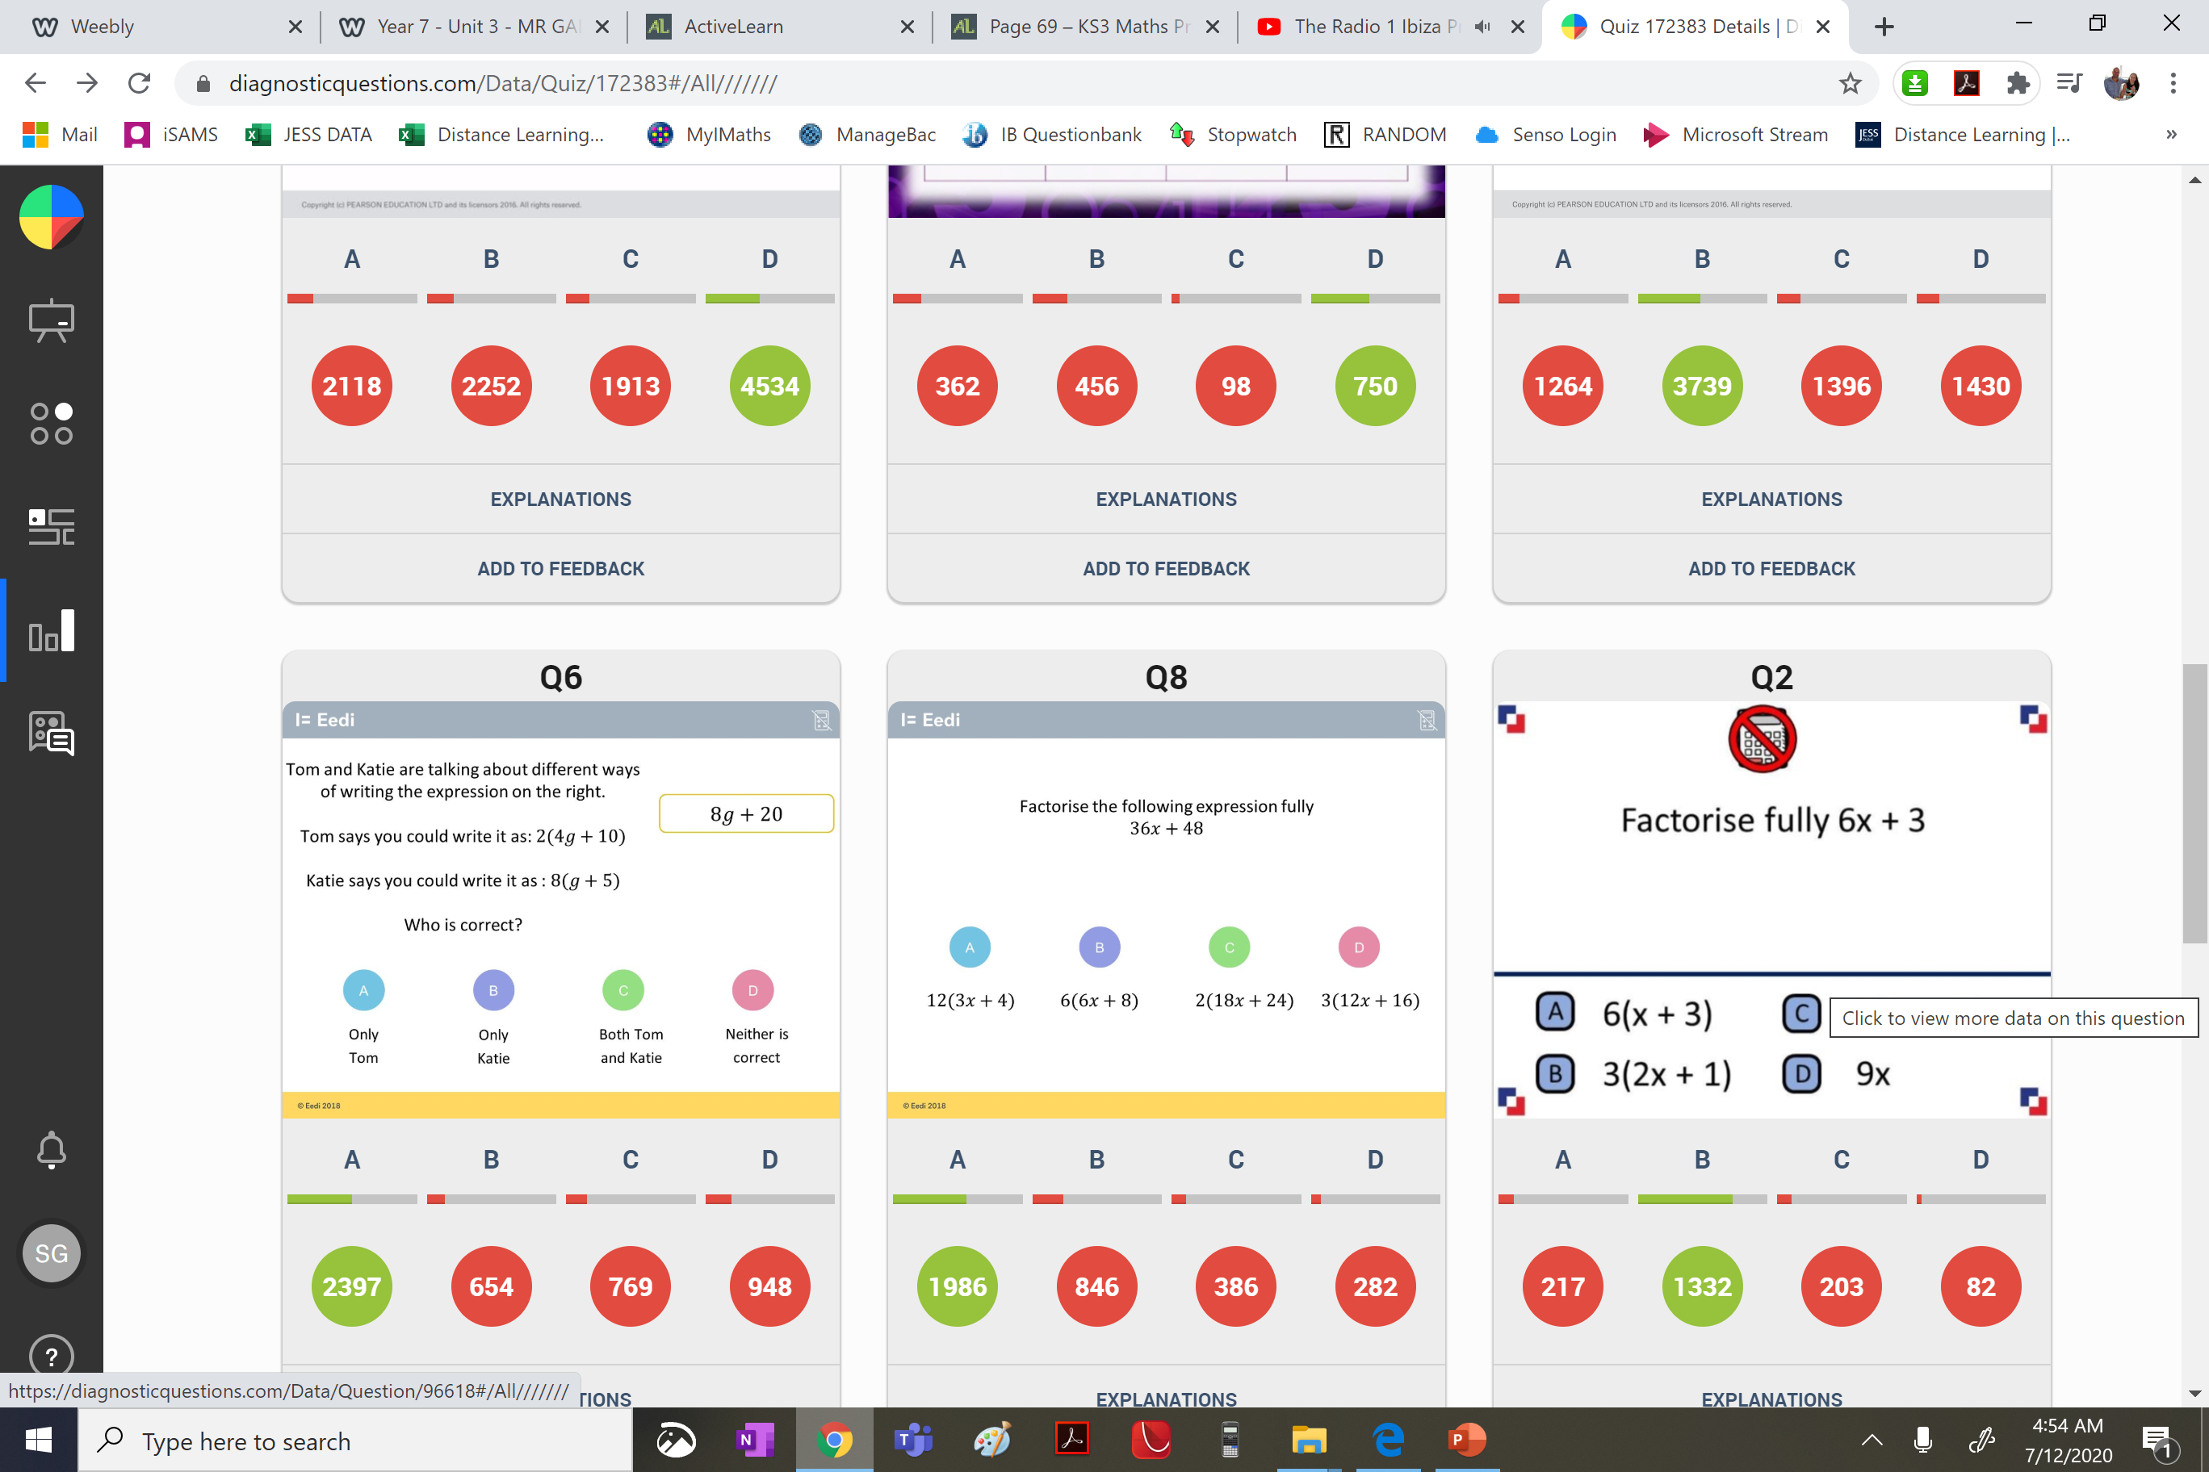
A
They did not take out the HCF
just a
common factor.

Slide 5
B
The student did not recognize that the questions does not say factorise just rewrite.

