Slide 1

Diagnostic Assessment .Delta 3
Unit 7
Distance Time Graphs
Compound Measures
Bounds
Calculating Bounds

Slide 2
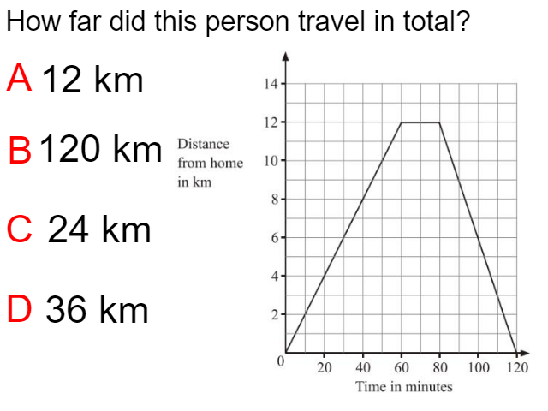
Question 2 – Distance Time Graphs
How far was travelled in total?

Slide 3
Answer 2 – Distance Time Graphs
How far was
travelled in total?
CORRECT ANSWER | CORRECT EXPLANATION
24 km | 12km away form home and 12k back to home give a total of 24km
COMMON MISTAKES | WHAT MIGHT BE YOUR MISTAKE
12 km | The student only did the distance away from the home
120 km | The student give the total time of the journey.
0 km | The student gave the distance from home at the end not the total distance.

Slide 4
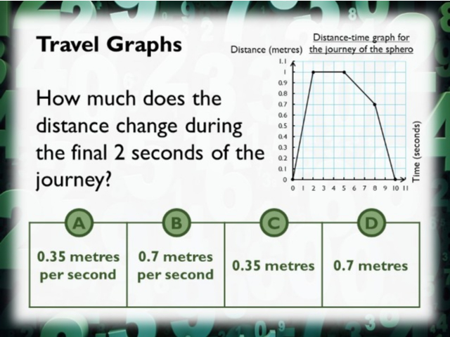
Question 1 – Distance Time Graphs

Slide 5
Answer 1 – Distance Time Graphs
CORRECT ANSWER | CORRECT EXPLANATION
0.7 m | In the last 2 seconds it goes from 0.7 to 0.
COMMON MISTAKES | WHAT MIGHT BE YOUR MISTAKE
0.35 m | The student gave the distance traveled in the last second.
0.35 m/s | The student gave the answer as a speed instead of a distance.
10 | The student gave the total time of the journey.

Slide 6
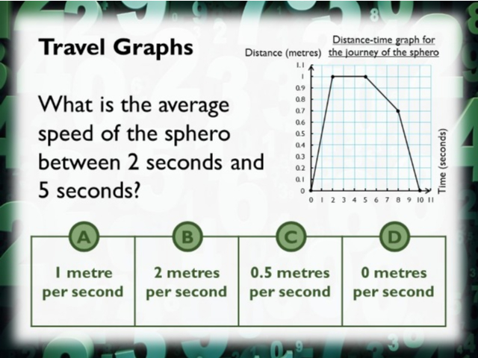
Question 3 – Distance Time Graphs

Slide 7
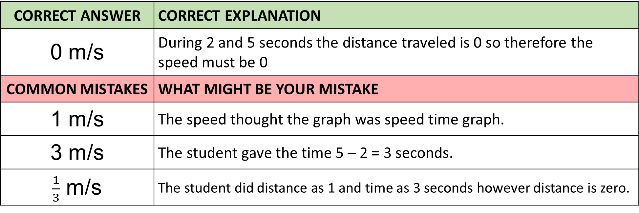
Answer 3 – Distance Time Graphs
CORRECT ANSWER | CORRECT EXPLANATION
0 m/s | During 2 and 5 seconds the distance traveled is 0 so therefore the speed must be 0
COMMON MISTAKES | WHAT MIGHT BE YOUR MISTAKE
1 m/s | The speed thought the graph was speed time graph.
3 m/s | The student gave the time 5 – 2 = 3 seconds.
$\frac{1}{3}$ m/s | The student did distance as 1 and time as 3 seconds however distance is zero.

Slide 8
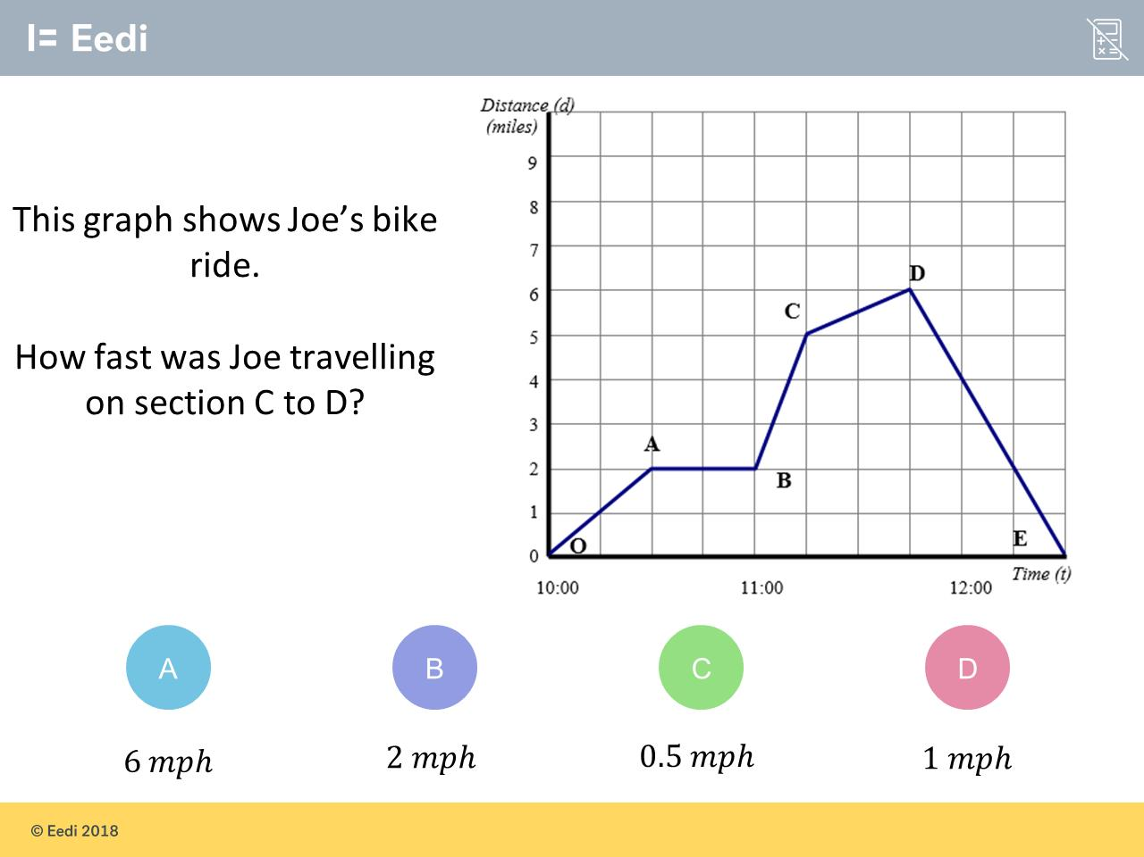
Question 4 – Distance Time Graphs

Slide 9
Answer 4 – Distance Time Graphs
CORRECT ANSWER | CORRECT EXPLANATION
2 mph | The gradient of the graph between C and D is 1mile/0.5 hours = 2 mph.
COMMON MISTAKES | WHAT MIGHT BE YOUR MISTAKE
6 mph | The student may have read the miles at D.
0.5 mph | The student has divided the wrong way around.
1 mph | The student may have misread the scale of the x axis.

Slide 10
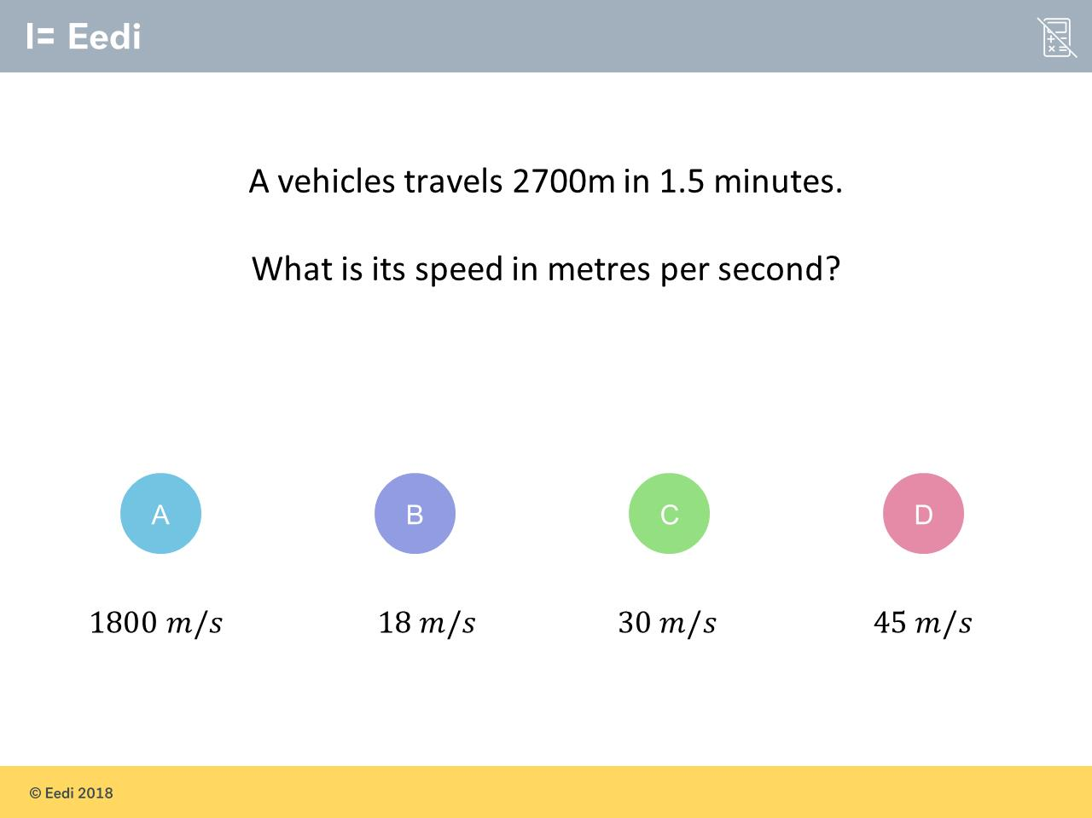
Question 5 – Compound Measures

Slide 11
Answer 5 – Compound Measures
CORRECT ANSWER | CORRECT EXPLANATION
30 m/s | We have 1.5 minutes = 90 seconds, so we have 2700/90 = 30 m/s.
COMMON MISTAKES | WHAT MIGHT BE YOUR MISTAKE
1800 m/s | The student has not changed the minutes to seconds before dividing.
18 m/s | The student may believe that there are 100 seconds in a minute.
45 m/s | The student has divided by 60 seconds, rather than 90 seconds.

Slide 12
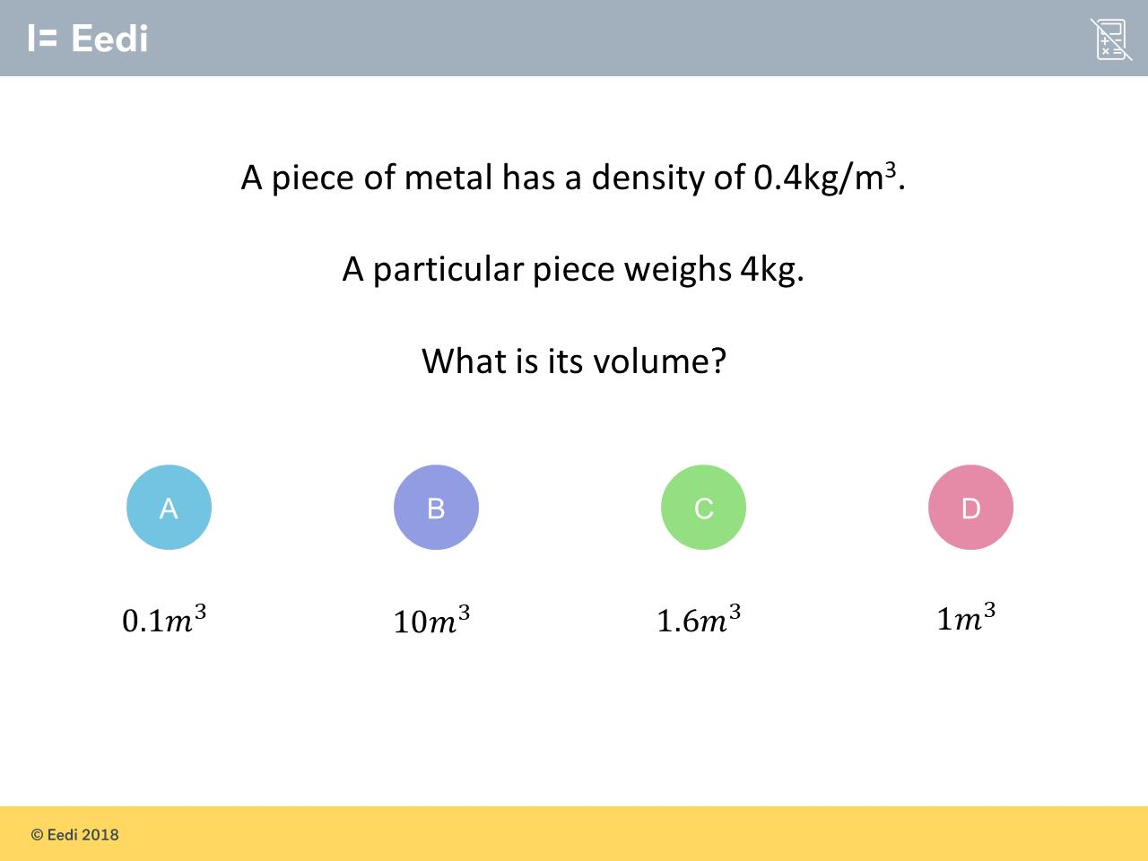
Question 6 – Compound Measures

Slide 13
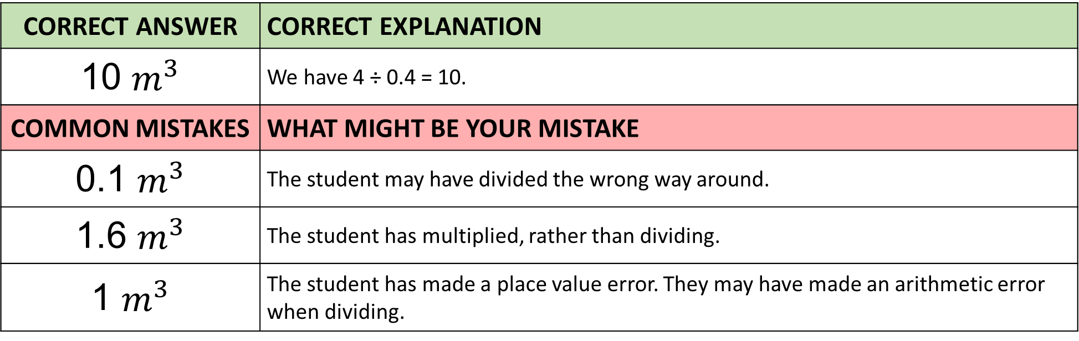
Answer 6 – Compound Measures
CORRECT ANSWER | CORRECT EXPLANATION
10 $m^{3}$ | We have 4 ÷ 0.4 = 10.
COMMON MISTAKES | WHAT MIGHT BE YOUR MISTAKE
0.1 $m^{3}$ | The student may have divided the wrong way around.
1.6 $m^{3}$ | The student has multiplied, rather than dividing.
1 $m^{3}$ | The student has made a place value error. They may have made an arithmetic error when dividing.

Slide 14
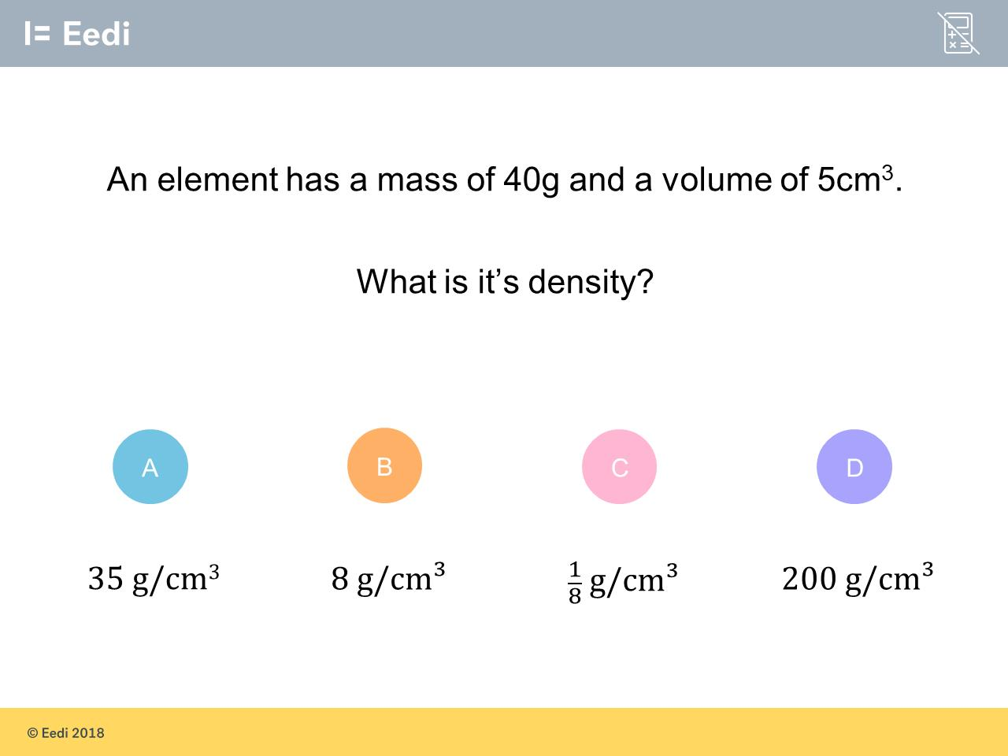
Question 7 – Compound Measures

Slide 15
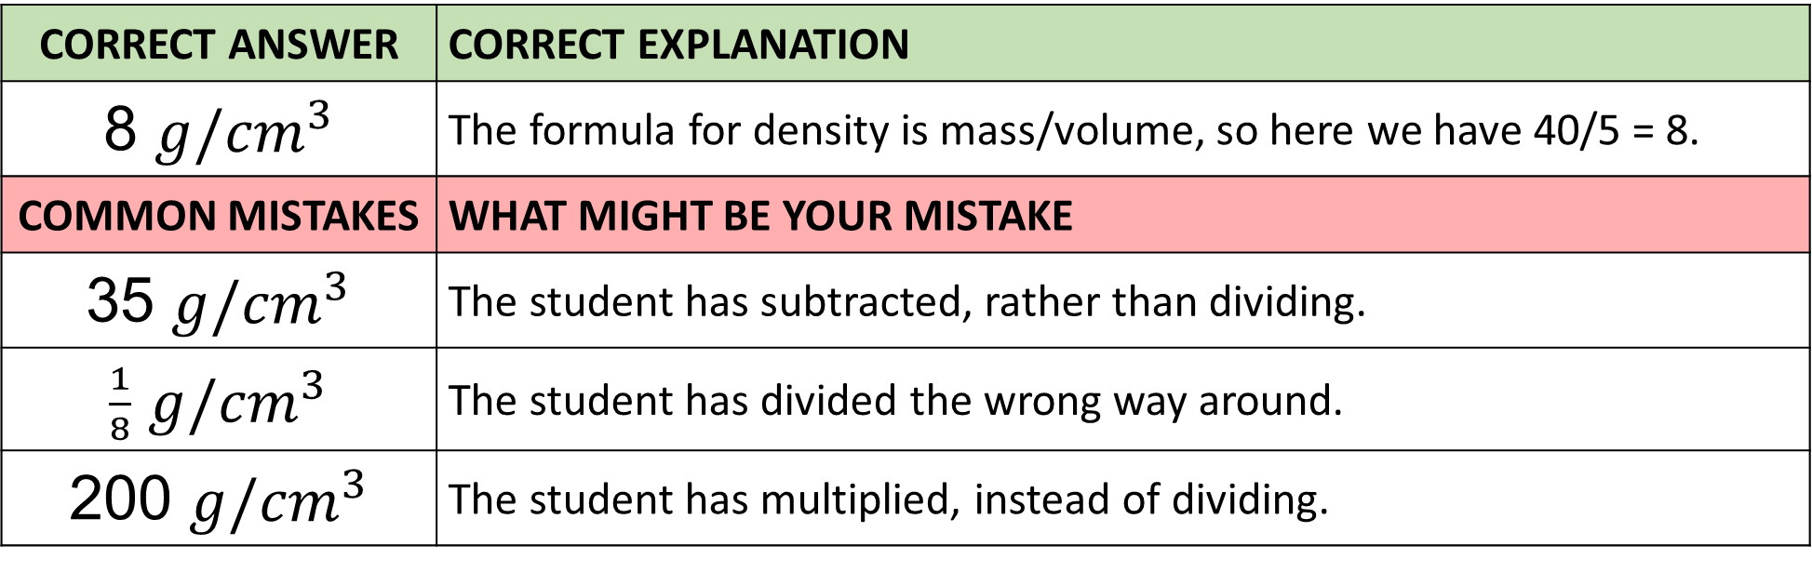
Answer 7 – Compound Measures
CORRECT ANSWER | CORRECT EXPLANATION
8 ${g/cm}^{3}$ | The formula for density is mass/volume, so here we have 40/5 = 8.
COMMON MISTAKES | WHAT MIGHT BE YOUR MISTAKE
35 ${g/cm}^{3}$ | The student has subtracted, rather than dividing.
$\frac{1}{8}$ ${g/cm}^{3}$ | The student has divided the wrong way around.
200 ${g/cm}^{3}$ | The student has multiplied, instead of dividing.

Slide 16
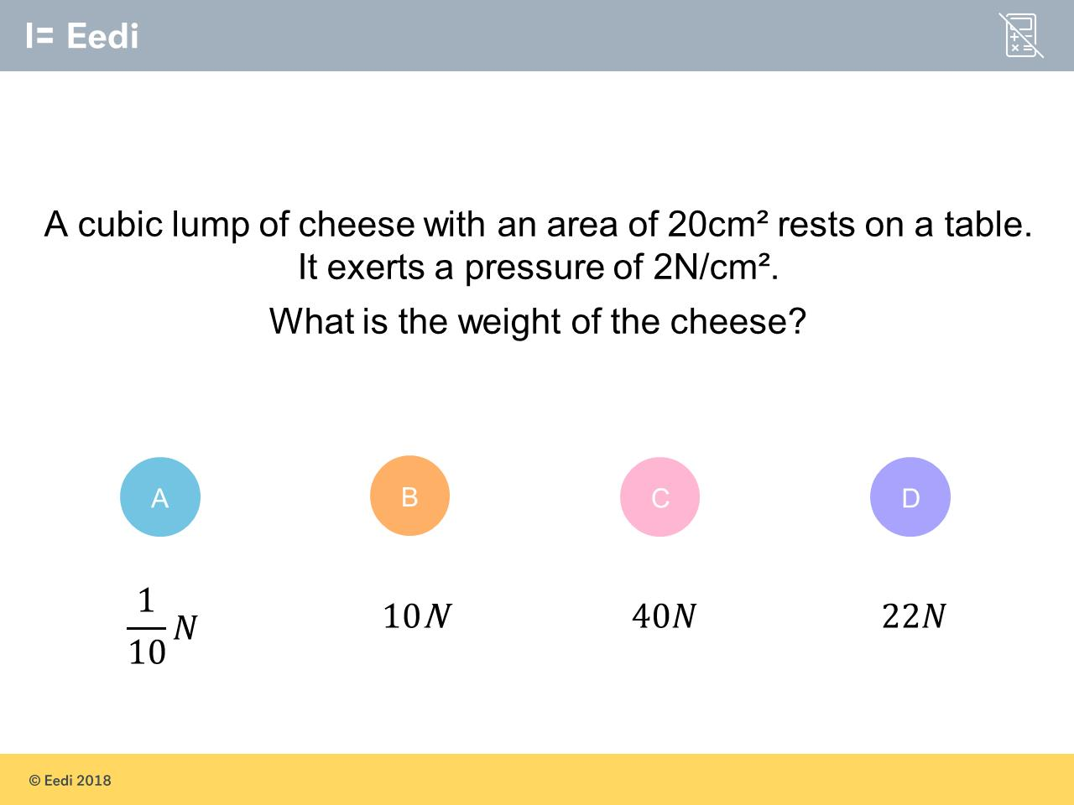
Question 8 – Compound Measures

Slide 17
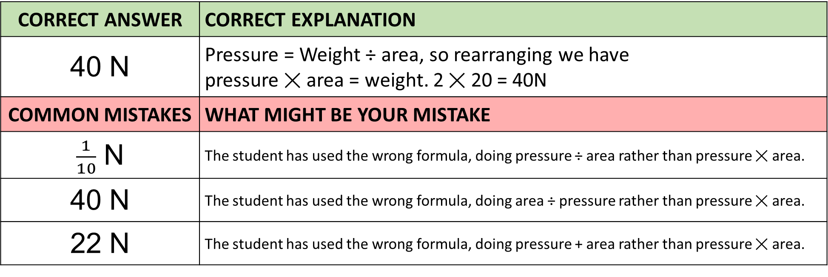
Answer 8 – Compound Measures
CORRECT ANSWER | CORRECT EXPLANATION
40 N | Pressure = Weight ÷ area, so rearranging we have pressure ✕ area = weight. 2 ✕ 20 = 40N
COMMON MISTAKES | WHAT MIGHT BE YOUR MISTAKE
$\frac{1}{10}$ N | The student has used the wrong formula, doing pressure ÷ area rather than pressure ✕ area.
40 N | The student has used the wrong formula, doing area ÷ pressure rather than pressure ✕ area.
22 N | The student has used the wrong formula, doing pressure + area rather than pressure ✕ area.

Slide 18
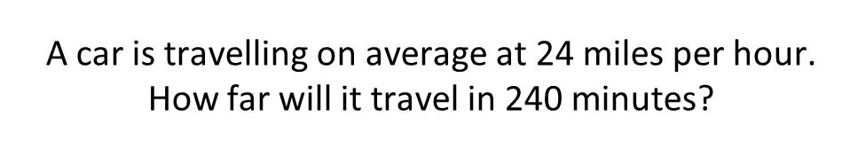
Question 9 – Compound Measures

Slide 19
Answer 9 – Compound Measures
CORRECT ANSWER | CORRECT EXPLANATION
96 miles | 24 miles per hour is 24/60 miles per minute. Multiplying this by 240 minutes gives 240 × 24/60 = 4 × 24 = 96 miles.
COMMON MISTAKES | WHAT MIGHT BE YOUR MISTAKE
10 miles | The student has divided the numbers in the question, without converting the time units.
240 miles | The student may have just used the number in the question.
100 miles | The student may have guessed. They may benefit from revising distance and speed.

Slide 20
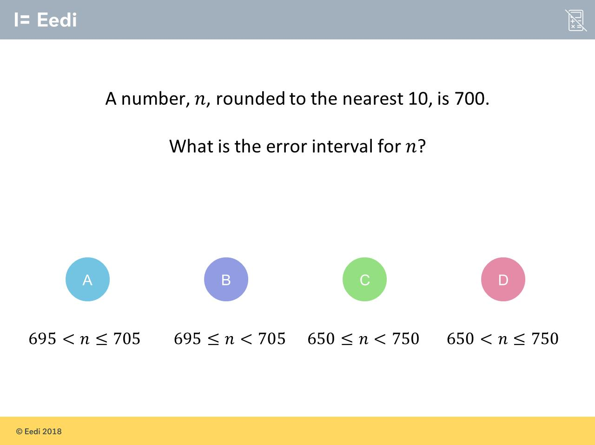
Question 10 – Bounds

Slide 21
Answer 10 – Bounds
CORRECT ANSWER | CORRECT EXPLANATION
B | 695 is the smallest number that rounds to 700 to the nearest 10, and 705 is the largest number. The inequality symbols should be written as ≤ and <, as 705 does not round to 700.
COMMON MISTAKES | WHAT MIGHT BE YOUR MISTAKE
A | The student has the symbols the wrong way around.
C | The student has rounded to the nearest 100.
D | The student has rounded to the nearest 100, and has written the symbols the wrong way around.

Slide 22
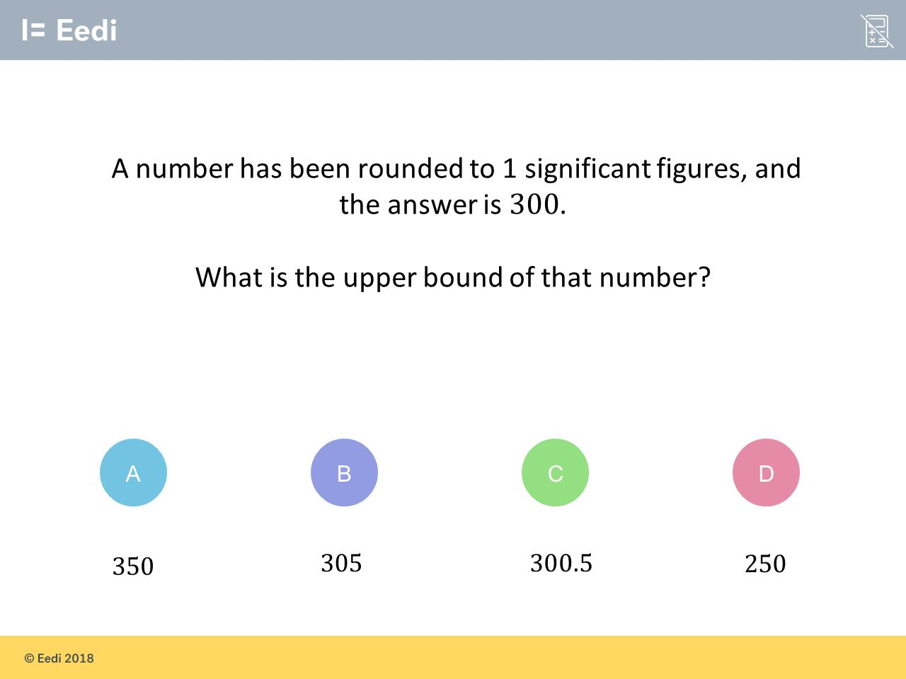
Question 11 – Bounds

Slide 23
Answer 11 – Bounds
CORRECT ANSWER | CORRECT EXPLANATION
350 | The larger number that rounds to 300 to one significant figure is 349.99... = 350.
COMMON MISTAKES | WHAT MIGHT BE YOUR MISTAKE
305 | The student has rounded to two significant figures, rather than one.
300.5 | The student has rounded to one decimal place, rather than one significant figure.
250 | The student has found the lower bound.

Slide 24
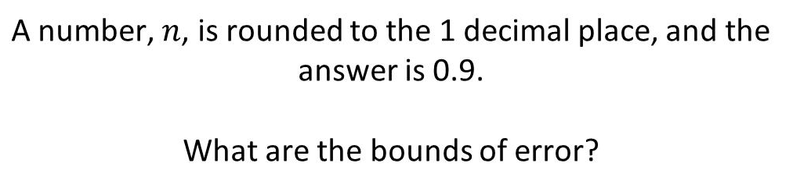
Question 12 – Bounds

Slide 25
Answer 12 – Bounds
CORRECT ANSWER | CORRECT EXPLANATION
C | To find the bounds of error, we add and subtract 0.05 to 0.9 to get 0.85 and 0.95. The inequality symbols should be ≤ and <.
COMMON MISTAKES | WHAT MIGHT BE YOUR MISTAKE
A | The student has just added and subtracted 0.1 for each.
B | The student has just added and subtracted 0.1 for each, and used the wrong inequality signs.
C | The student has got the inequality signs the wrong way around.

Slide 26
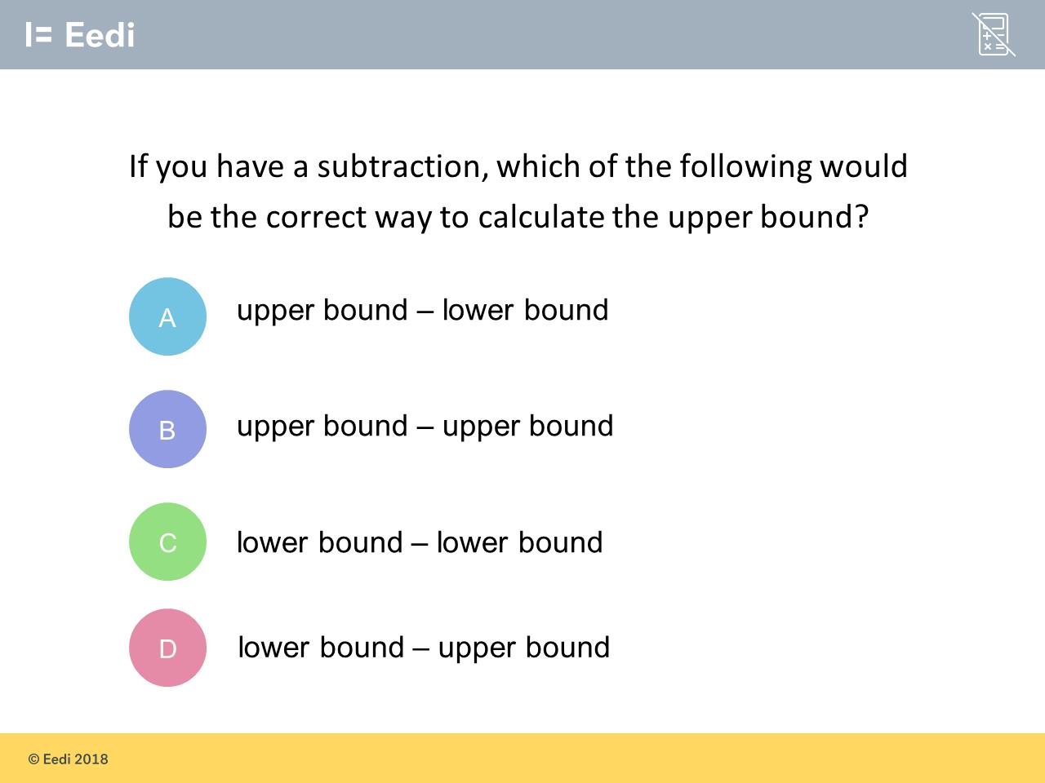
Question 13 – Calculating Bounds

Slide 27
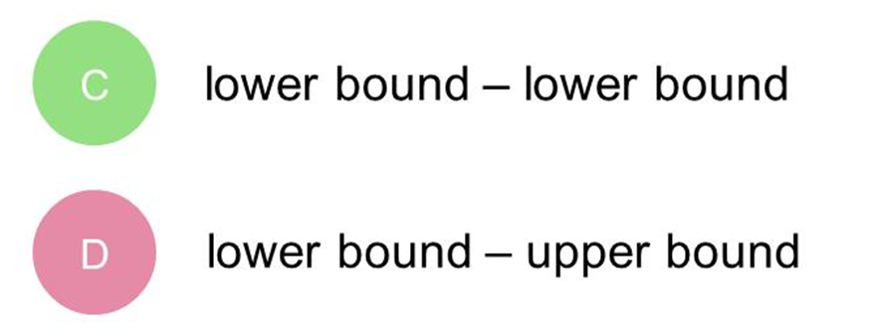
Answer 13 – Calculating Bounds
CORRECT ANSWER | CORRECT EXPLANATION
A | As we are subtracting the second number, we want to use the lower bound. This will give a higher upper bound for the calculation.
COMMON MISTAKES | WHAT MIGHT BE YOUR MISTAKE
B | The student has not adjusted the second number to account for the subtraction.
C | The student has used the lower bound for the first number.
D | The student has found the lower bound.

Slide 28
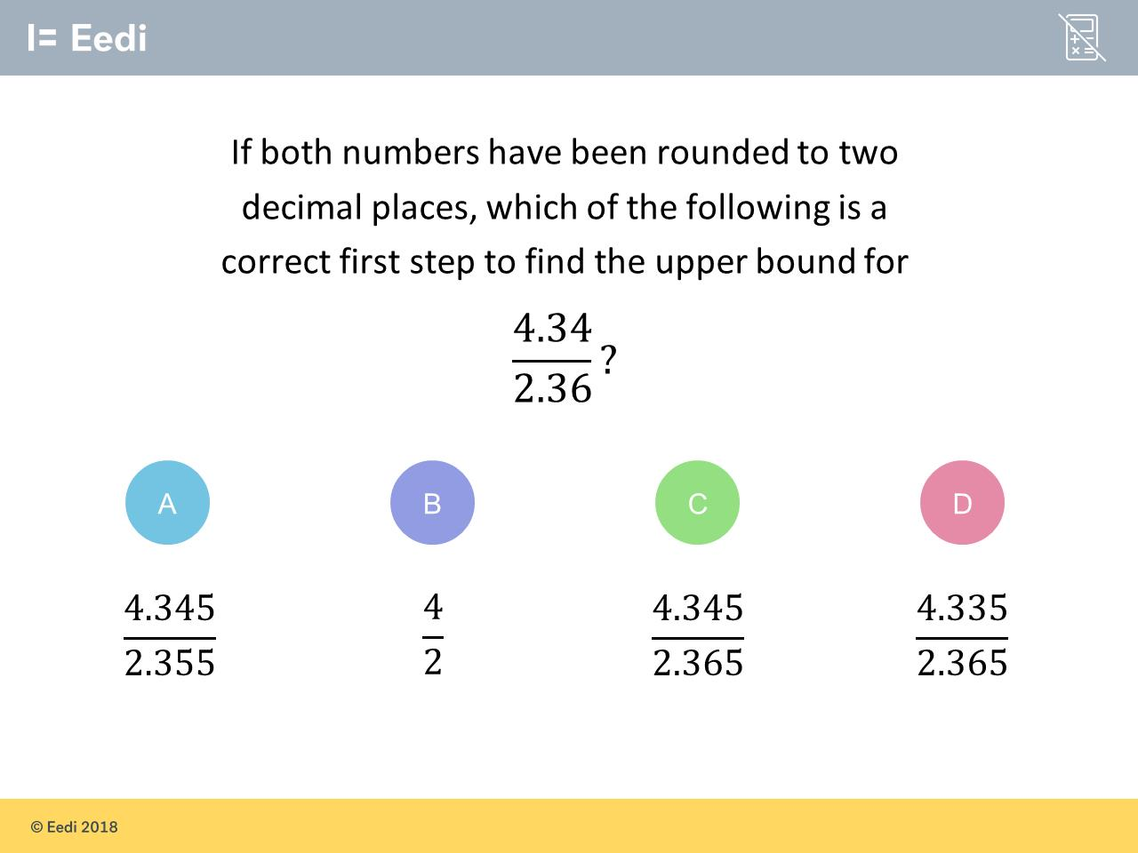
Question 14 – Calculating Bounds

Slide 29
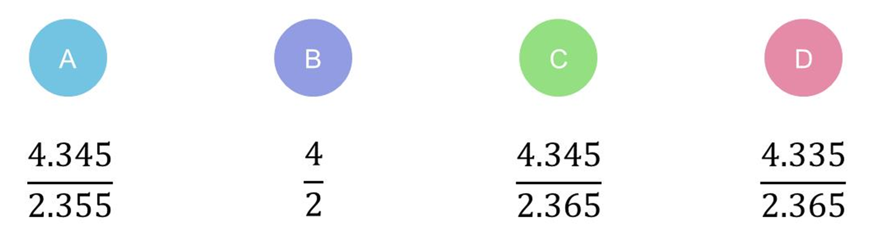
Answer 14 – Calculating Bounds
CORRECT ANSWER | CORRECT EXPLANATION
A | We need the upper bound for the top number, and the lower bound for the bottom number, as we are dividing by the bottom number.
COMMON MISTAKES | WHAT MIGHT BE YOUR MISTAKE
B | The student has rounded as if we were asked to estimate.
C | The student has used upper bounds for both numbers.
D | The student has used given a lower bound.

Slide 30
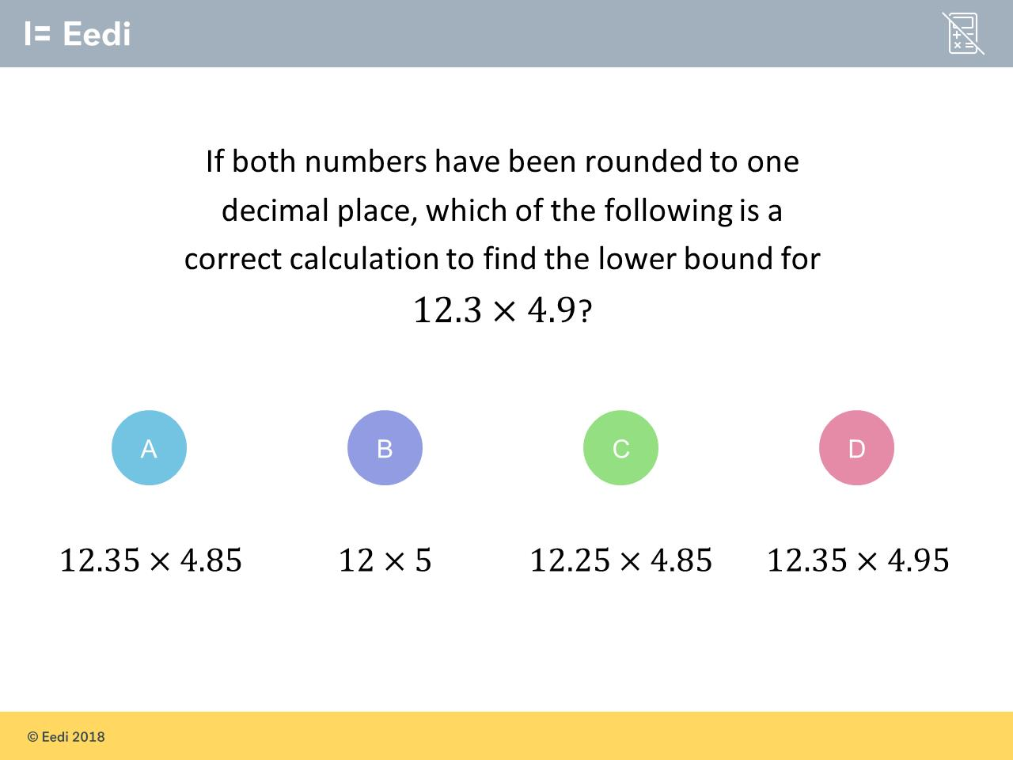
Question 15 – Calculating Bounds

Slide 31
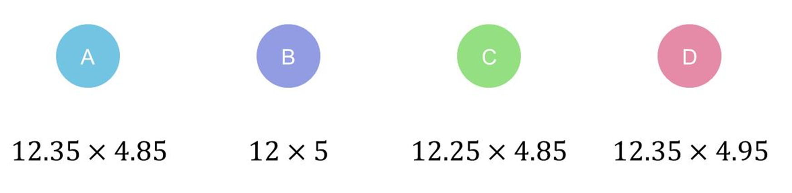
Answer 15 – Calculating Bounds
CORRECT ANSWER | CORRECT EXPLANATION
C | We use the lower bounds of both numbers, which are 12.25 and 4.85.
COMMON MISTAKES | WHAT MIGHT BE YOUR MISTAKE
A | The student has used the upper bound for 12.3, rather than the lower bound.
B | The student has rounded as if we were asked to estimate.
D | The student has used the upper bounds, rather than the lower bounds.

