Slide 1
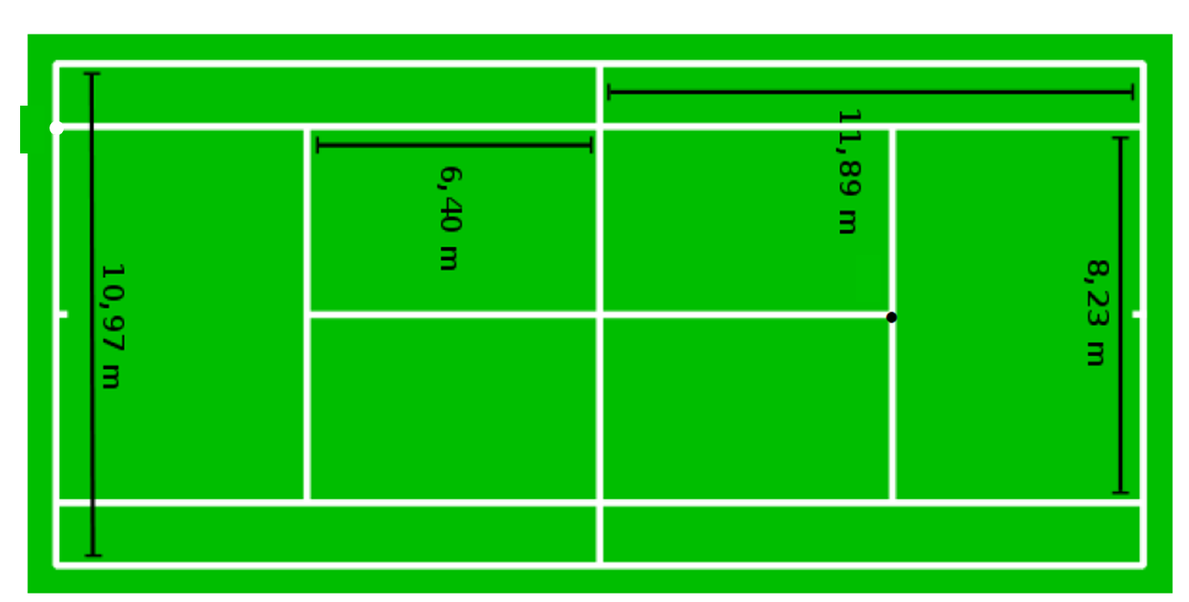

The Perfect Serve
What is the perfect height at A to serve the ball from so that:
the ball clears the net with no room to spare
the ball lands at point B
B
Net is 0.91m
A
A
B

Slide 2
Answer

Slide 3
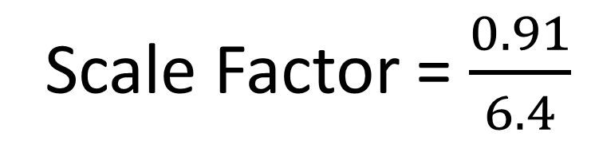
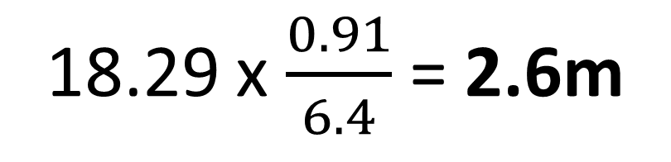
Scale Factor = $\frac{0.91}{6.4}$
18.29 x $\frac{0.91}{6.4}$ = 2.6m
h
0.91
6.4
A
18.29
B

