Slide 1
Elastic, Strings and Springs
Hooke’s Law - Equilibrium
Chapter 3
(Part 1 of 5)

Slide 2
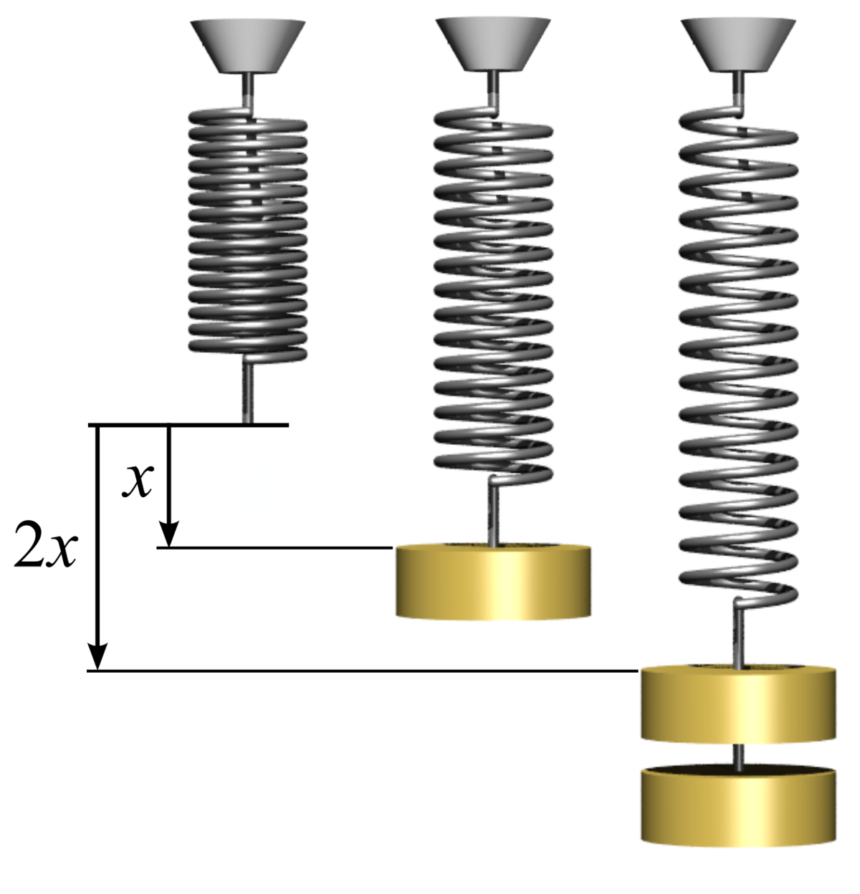
1kg
1kg
1kg

Slide 3
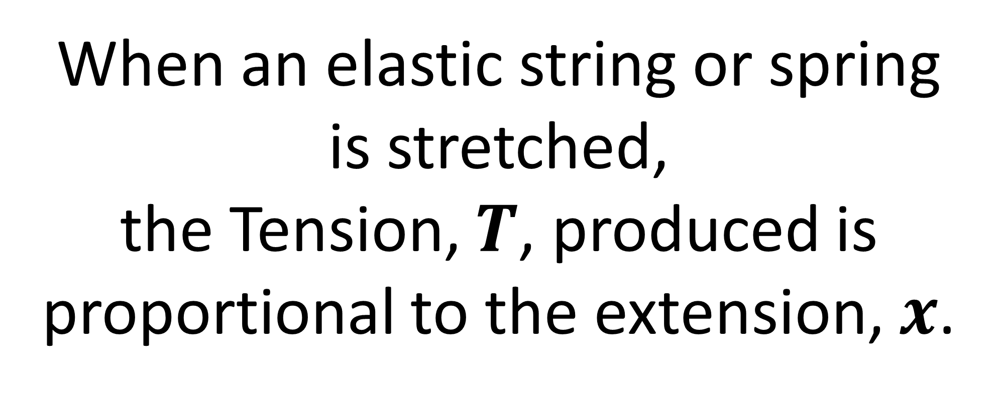
Hooke’s Law
When an elastic string or spring is stretched,
the Tension, $T$, produced is
proportional to the extension, $x$.

Slide 4


Slide 5
Unstretched
(natural length)
l
x
The extension
T
mg

Slide 6
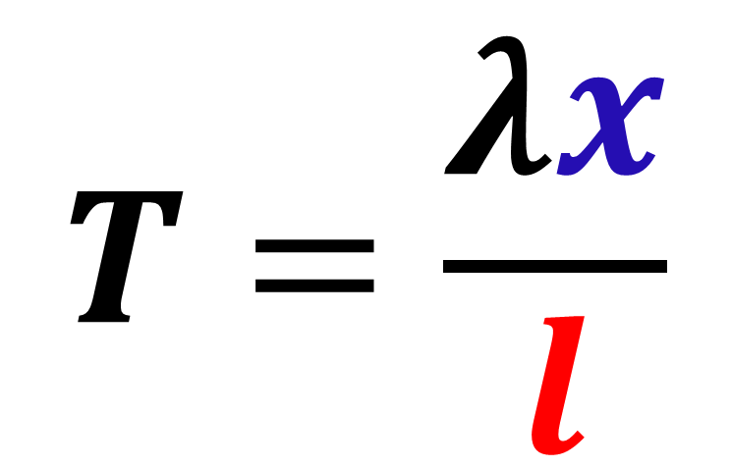
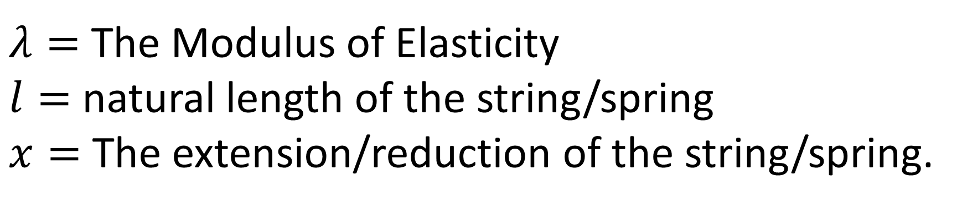
Hooke’s Law
$$T=\frac{λx}{l}$$
$λ=$ The Modulus of Elasticity
$l=$ natural length of the string/spring
$x=$ The extension/reduction of the string/spring.

Slide 7
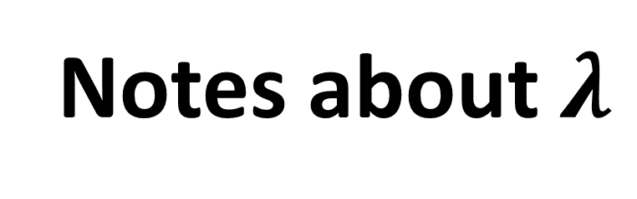
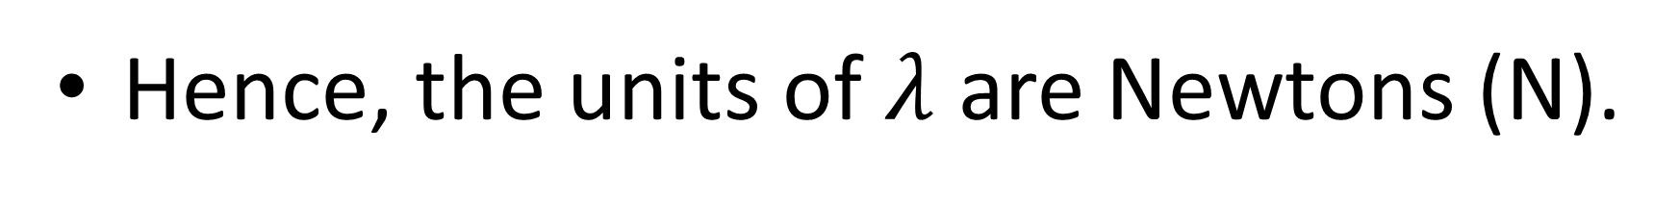
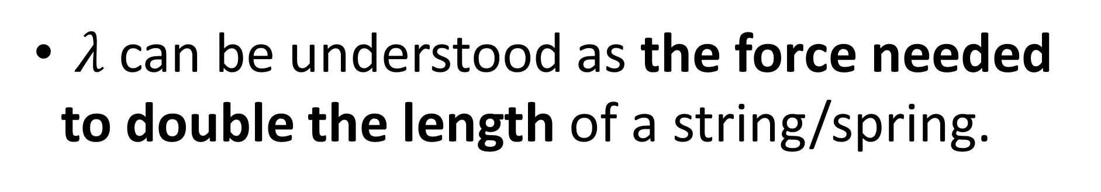
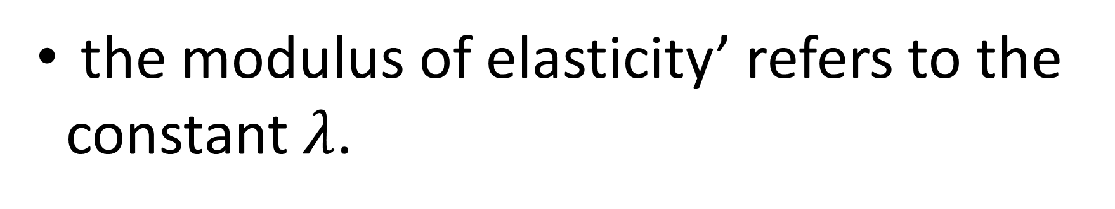
Notes about $λ$
the modulus of elasticity’ refers to the constant $λ$.
$λ$ can be understood as the force needed to double the length of a string/spring.
Hence, the units of $λ$ are Newtons (N).

Slide 8
Hooke’s Law: When it Applies
Many springs, strings, wires and solids obey Hooke’s Law in a limited range.
Hooke’s law only ever applies up to a maximum force known as the elastic limit which varies for each spring etc.
Under very large forces springs deform and break.
If a string or spring obeys Hooke’s Law it is called elastic.

Slide 9
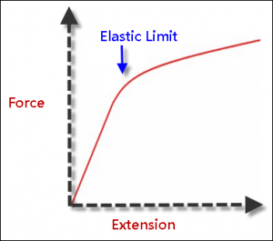
The variables are in direct proportion (obeying Hooke’s Law) up to the ‘elastic limit’ beyond which the law doesn’t hold.

Slide 10
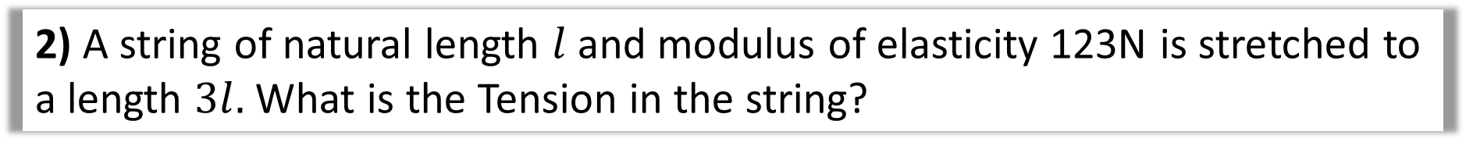

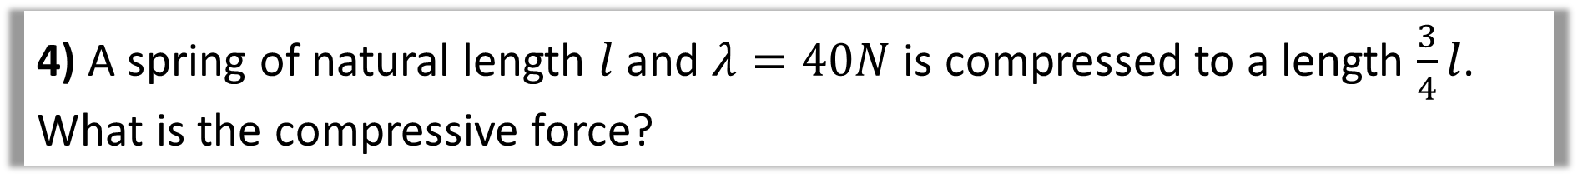
1) A string of natural length $l$ and modulus of elasticity 123N is stretched to a length $2l.$ What is the tension in the string?
2) A string of natural length $l$ and modulus of elasticity 123N is stretched to a length $3l.$ What is the Tension in the string?
3) A spring of natural length 3m is stretched to a length of 5m by applying a force of 99N. What is the modulus of elasticity of the spring?
4) A spring of natural length $l$and $λ=40N$ is compressed to a length $\frac{3}{4}l$.
What is the compressive force?

Slide 11


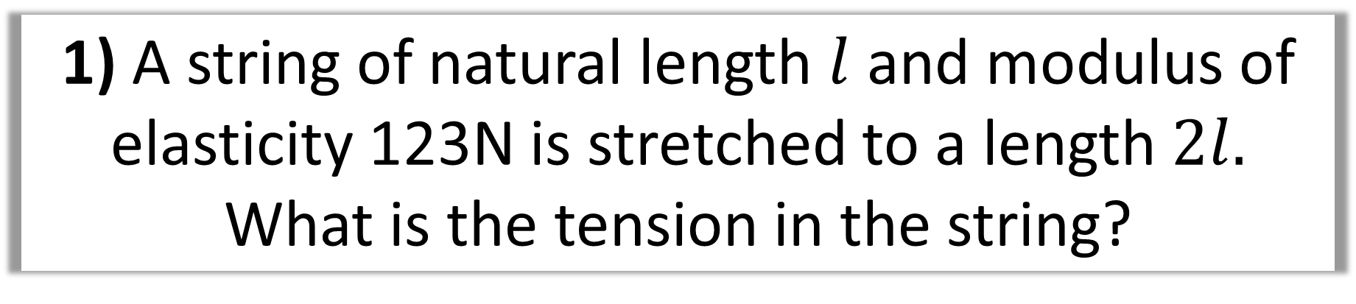




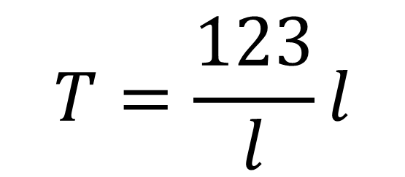


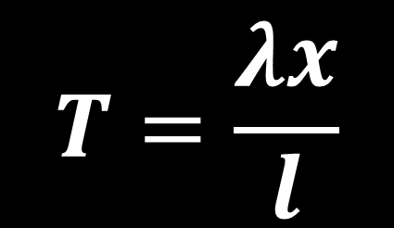


1) A string of natural length $l$ and modulus of elasticity 123N is stretched to a length $2l.$
What is the tension in the string?
$$T=\frac{λx}{l}$$
$$T=\frac{123}{l}l$$
$$l$$
$$2l$$
$$T=$$
$$T=123 N$$
$$λ=$$
$$123$$
$$x=$$
$$2l−l=l$$
$$l=$$
$$l$$

Slide 12





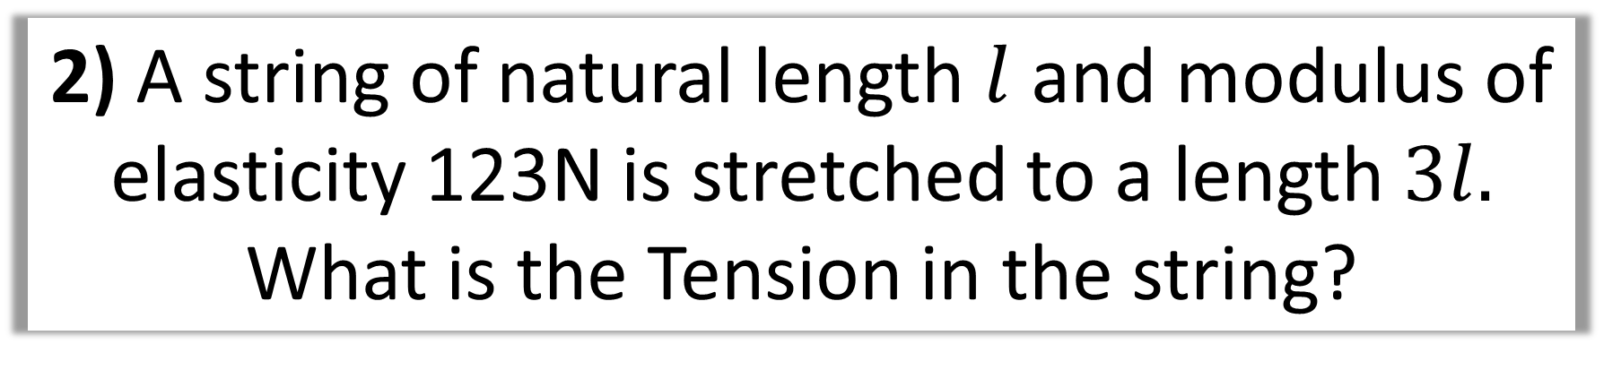




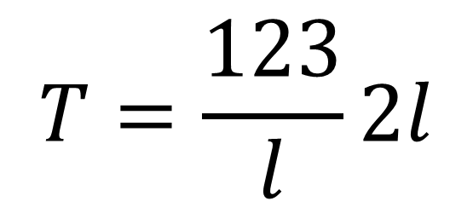


2) A string of natural length $l$ and modulus of elasticity 123N is stretched to a length $3l.$
What is the Tension in the string?
$$T=\frac{λx}{l}$$
$$T=\frac{123}{l}2l$$
$$l$$
$$3l$$
$$T=$$
$$λ=$$
$$123$$
$$T=246 N$$
$$x=$$
$$3l−l=2l$$
$$l=$$
$$l$$

Slide 13


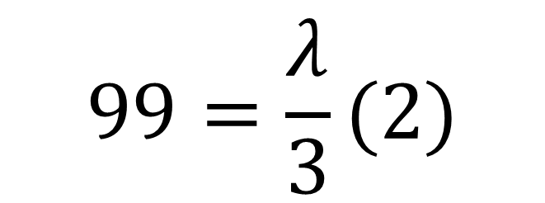


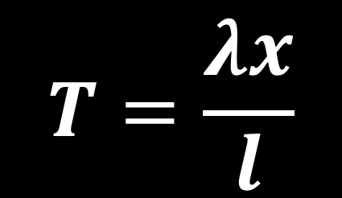





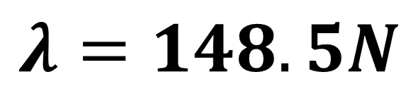


3) A spring of natural length 3m is stretched to
a length of 5m by applying a force of 99N.
What is the modulus of elasticity of the spring?
$$T=\frac{λx}{l}$$
$$3$$
$$99=\frac{λ}{3}(2)$$
$$5$$
$$T=$$
$$99$$
$$T$$
$$λ=$$
$$λ=148.5N$$
$$99$$
$$x=$$
$$5−3=2$$
$$l=$$
$$3$$

Slide 14





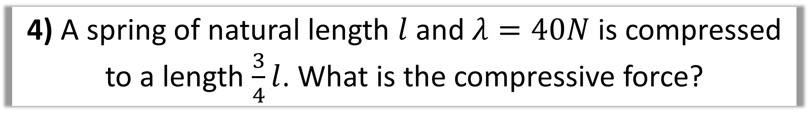

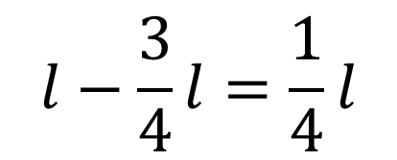


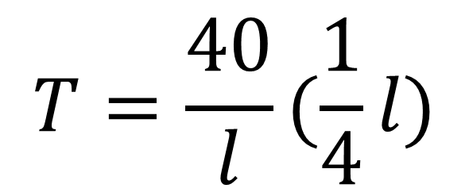

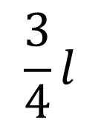
4) A spring of natural length $l$and $λ=40N$ is compressed to a length $\frac{3}{4}l$. What is the compressive force?
$$T=\frac{λx}{l}$$
$$T=\frac{40}{l}(\frac{1}{4}l)$$
$$\frac{3}{4}l$$
$$l$$
$$T=$$
$$λ=$$
$$40$$
$$T=10 N$$
$$l−\frac{3}{4}l=\frac{1}{4}l$$
$$x=$$
$$l=$$
$$l$$

Slide 15
Example A: Vertical
An elastic string of natural length 2m and modulus of elasticity 29.4N has one end fixed.
A particle of mass 4kg is attached to the other end and hangs at rest.
Find the length of the stretched string.

Slide 16


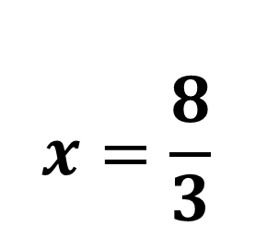


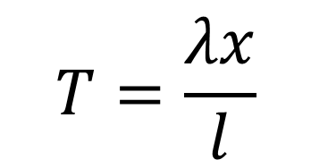
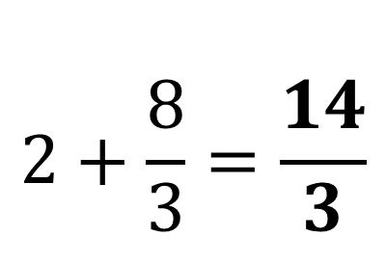

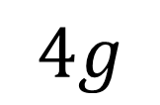
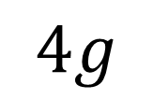

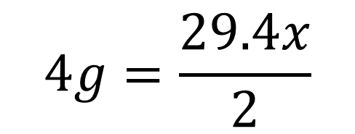


An elastic string of natural length 2m and modulus of elasticity 29.4N has one end fixed. A particle of mass 4kg is attached to the other end and hangs at rest.
Find the length of the stretched string.
$$T=\frac{λx}{l}$$
$$T=$$
$$4g$$
$$2$$
$$λ=$$
$$29.4$$
$$4g=\frac{29.4x}{2}$$
Total Length
$$T$$
$$x=$$
$$x=\frac{8}{3}$$
$$2+\frac{8}{3}=\frac{14}{3}$$
$$l=$$
$$2$$
$$4g$$

Slide 17
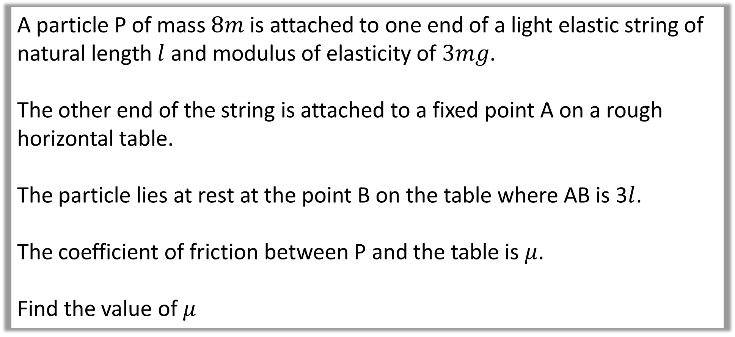
Example B: Horizontal
A particle P of mass $8m$ is attached to one end of a light elastic string of natural length $l$ and modulus of elasticity of $3mg$.
The other end of the string is attached to a fixed point A on a rough horizontal table.
The particle lies at rest at the point B on the table where AB is 3$l$.
The coefficient of friction between P and the table is $μ$.
Find the value of $μ$

Slide 18
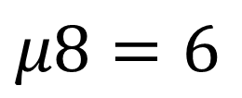


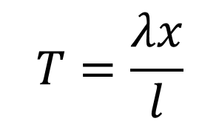
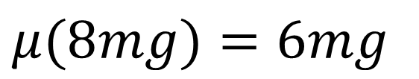


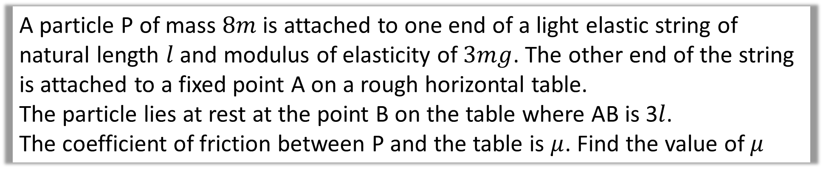


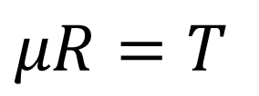





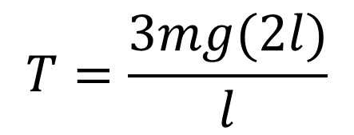
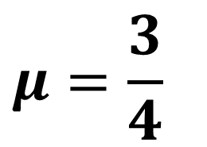

A particle P of mass $8m$ is attached to one end of a light elastic string of natural length $l$ and modulus of elasticity of $3mg$. The other end of the string is attached to a fixed point A on a rough horizontal table.
The particle lies at rest at the point B on the table where AB is 3$l$.
The coefficient of friction between P and the table is $μ$. Find the value of $μ$
$$l$$
$$T=\frac{λx}{l}$$
$$μR=T$$
$$T$$
$$μR$$
$$3l$$
$$μ(8mg)=6mg$$
$$T=$$
$$T=\frac{3mg(2l)}{l}$$
$$λ=$$
$$3mg$$
$$μ8=6$$
$$x=$$
$$3l−l=2l$$
$$μ=\frac{3}{4}$$
$$T=6mg$$
$$l=$$
$$l$$

Slide 19
Example C: Extension
An elastic spring of modulus of elasticity 20N has one end fixed.
When a particle of mass 1kg is attached to the other end and hands at rest, the total length of the spring is 1.4m.
The particle of mass 1kg is removed and replaced by a particle of mass 0.8kg
Find the new length of the spring.

Slide 20





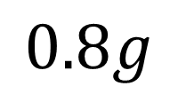
















An elastic spring of modulus of elasticity 20N has one end fixed.
When a particle of mass 1kg is attached to the other end and hands at rest, the total length of the spring is 1.4m.
The particle of mass 1kg is removed and replaced by a particle of mass 0.8kg
Find the new length of the spring.
$$l$$
$$N$$
$$1.4$$
$$T$$
$$T$$
$$0.8g$$
$$g$$
$$T=$$
$$0.8g$$
$$T=$$
$$g$$
$$λ=$$
$$20$$
$$λ=$$
$$20$$
$$x_{2}=$$
$$x_{1}=$$
$$1.4−l$$
$$l=$$
$$l$$
$$l=$$
$$l$$

Slide 21



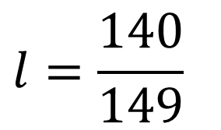

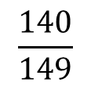








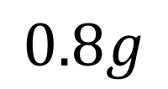

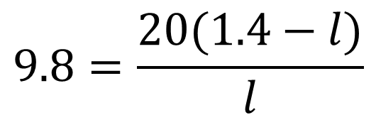


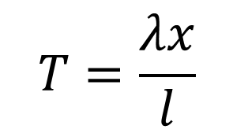
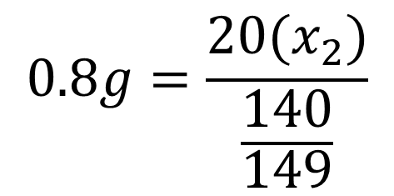






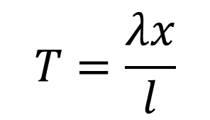
An elastic spring of modulus of elasticity 20N has one end fixed.
When a particle of mass 1kg is attached to the other end and hands at rest, the total length of the spring is 1.4m.
The particle of mass 1kg is removed and replaced by a particle of mass 0.8kg
Find the new length of the spring.
$$T=\frac{λx}{l}$$
$$T=\frac{λx}{l}$$
$$N$$
$$1.4$$
$$T$$
$$9.8=\frac{20(1.4−l)}{l}$$
$$T$$
$$0.8g=\frac{20(x_{2})}{\frac{140}{149}}$$
$$0.8g$$
$$g$$
$$9.8l=28 −20l$$
$$T=$$
$$0.8g$$
$$T=$$
$$g$$
$$λ=$$
$$20$$
$$λ=$$
$$20$$
$$l=\frac{140}{149}$$
$$x_{2}=0.368$$
$$x_{2}=$$
$$x_{1}=$$
$$1.4−l$$
$$l=$$
$$\frac{140}{149}$$
$$l=$$
$$l$$

Slide 22


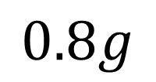

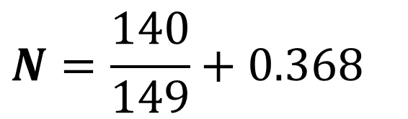




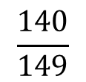


An elastic spring of modulus of elasticity 20N has one end fixed.
When a particle of mass 1kg is attached to the other end and hands at rest, the total length of the spring is 1.4m.
The particle of mass 1kg is removed and replaced by a particle of mass 0.8kg Find the new length of the spring.
The other end of the string is attached to a fixed-point A on a rough horizontal table.
$$N=\frac{140}{149}+0.368$$
$$N$$
$$T$$
$$0.8g$$
$$N=1.31$$
$$T=$$
$$0.8g$$
$$λ=$$
$$20$$
$$x_{2}=$$
$$l=$$
$$\frac{140}{149}$$

