Slide 1

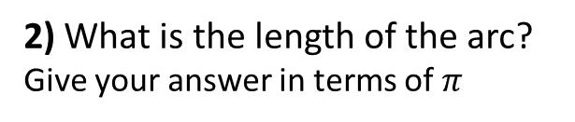
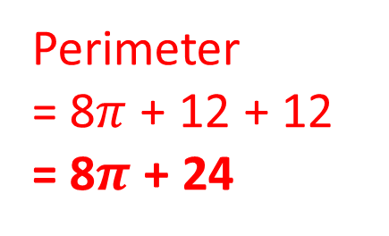
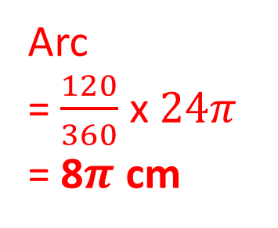
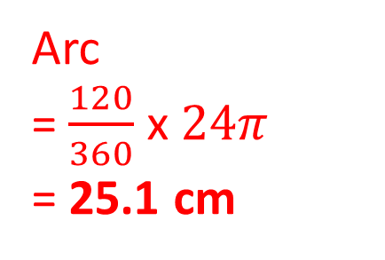
1) What is the length of the arc?
Give your answer to 1 decimal place
2) What is the length of the arc?
Give your answer in terms of $π$
12cm
12cm
Arc
= $\frac{120}{360}$ x $24π$
= 25.1 cm
Arc
= $\frac{120}{360}$ x $24π$
= 8$π$ cm
120˚
120˚
3) What is perimeter of the shape?
Give your answer to 1 decimal place
4) What is perimeter of the shape?
Give your answer in terms of $π$
12cm
Perimeter
= 25.1 + 12 + 12 = 49.1
Perimeter
= 8$π$ + 12 + 12
= 8$π$ + 24
12cm
120˚
120˚

Slide 2
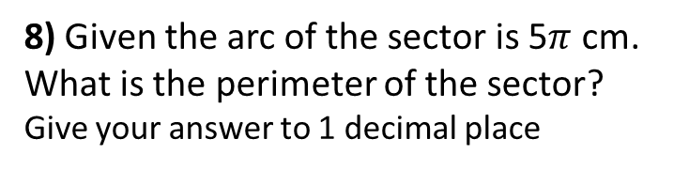

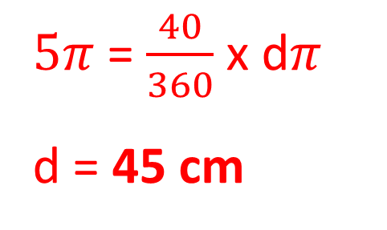
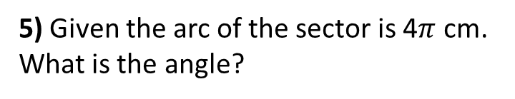
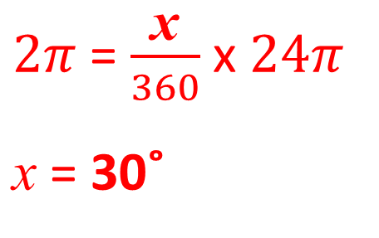


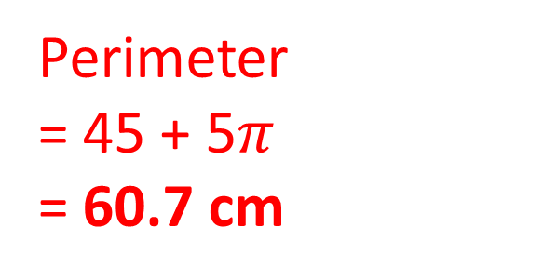
5) Given the arc of the sector is 4$π$ cm.
What is the angle?
6) Given the arc of the sector is 2$π$ cm.
What is the angle?
$4π$ = $\frac{\text{x}}{360}$ x $24π$
$\text{x}$ = 60˚
12cm
$2π$ = $\frac{\text{x}}{360}$ x $24π$
$\text{x}$ = 30˚
12cm
x˚
x˚
7) Given the arc of the sector is 5$π$ cm.
What is the diameter of the sector?
8) Given the arc of the sector is 5$π$ cm.
What is the perimeter of the sector?
Give your answer to 1 decimal place
$5π$ = $\frac{40}{360}$ x d$π$
d = 45 cm
Diameter = 45 cm
40˚
40˚
Perimeter
= 45 + 5$π$
= 60.7 cm

