Slide 1
LO: Basic
Proportion

Slide 2
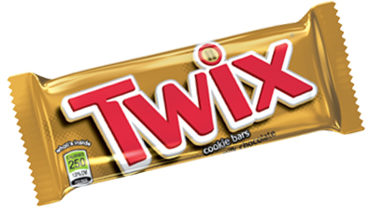

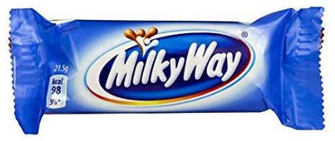

Which chocolate bar is the best value for money?
Type | Cost | Weight
Twix | 58p | 58g
Curly Wurly | 20p | 26g
Milky bar | 17p | 12g
Smarties | 45p | 21g
Price per gram
1p
0.77p
1.42p
2.14p

Slide 3
Things are in proportion if they
have the same single unit value.
Unit value is the cost of one item.

Slide 4
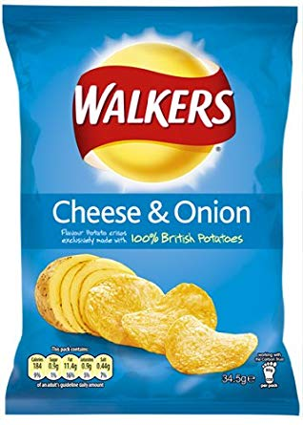
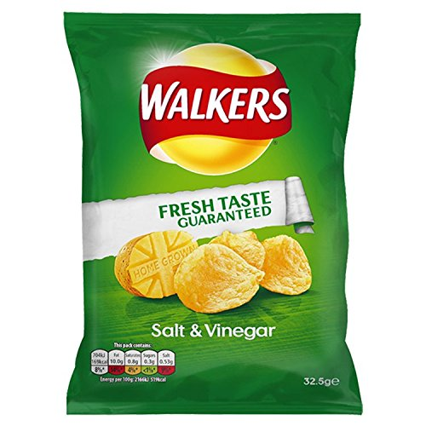
IN PROPORTION or NOT ?
1 bag = 5 dhs
2 bags = 12 dhs
NOT
Unit value = 5 dhs
Unit value = 6 dhs

Slide 5
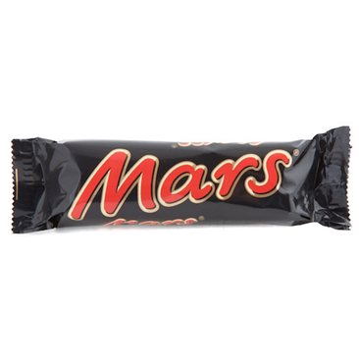
IN PROPORTION or NOT ?
1 bar = 10 dhs
3 bars = 30 dhs
IN PROPORTION
Unit value = 10dhs
Unit value = 10dhs

Slide 6
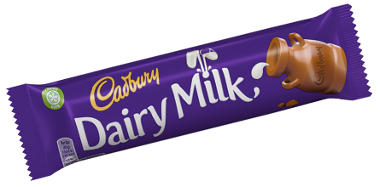
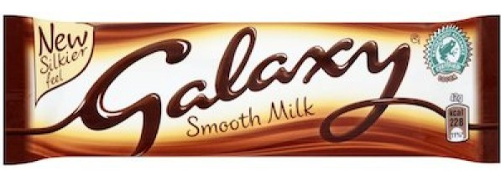
IN PROPORTION or NOT ?
2 bars = 14 dhs
4 bars = 32 dhs
NOT
Unit value = 7 dhs
Unit value = 8 dhs

Slide 7
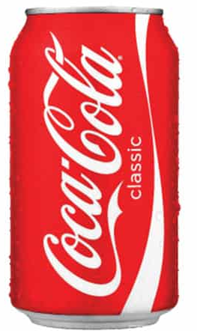
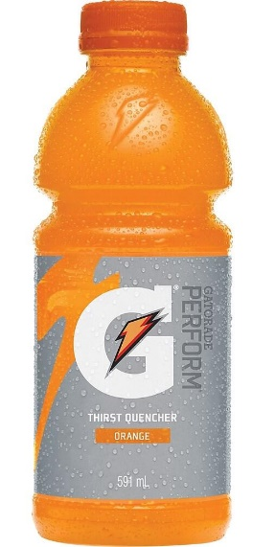
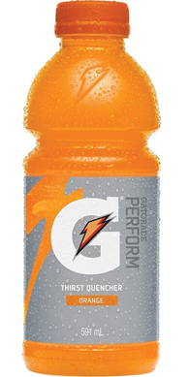
IN PROPORTION or NOT ?
3 cans = £1.20
4 bottles = £1.60
IN PROPORTION
Unit value = 40p
Unit value = 40p

Slide 8
What is the cost of 7 bars given that they are in proportion?
3 bar = £2.10
7 bars = ?
Unit value = 70p
7 bars = £4.90

Slide 9
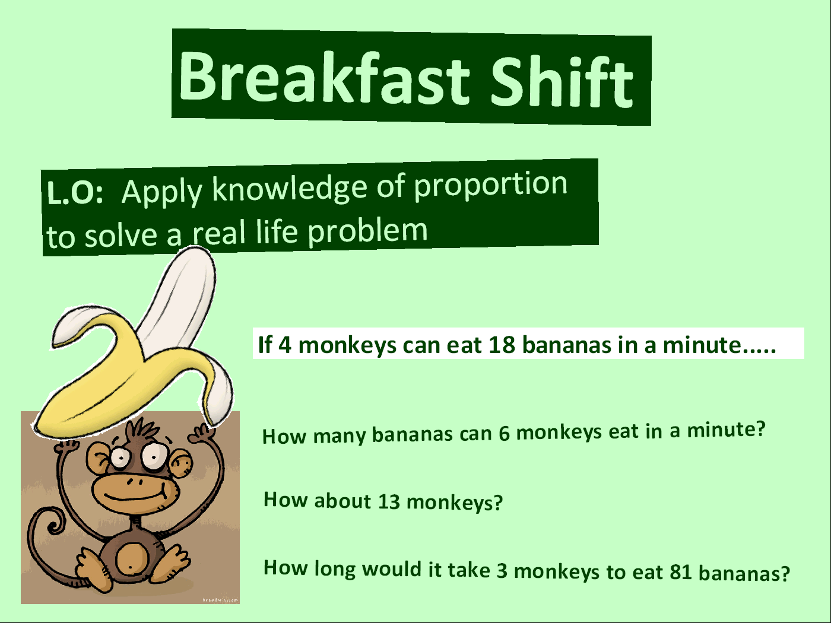
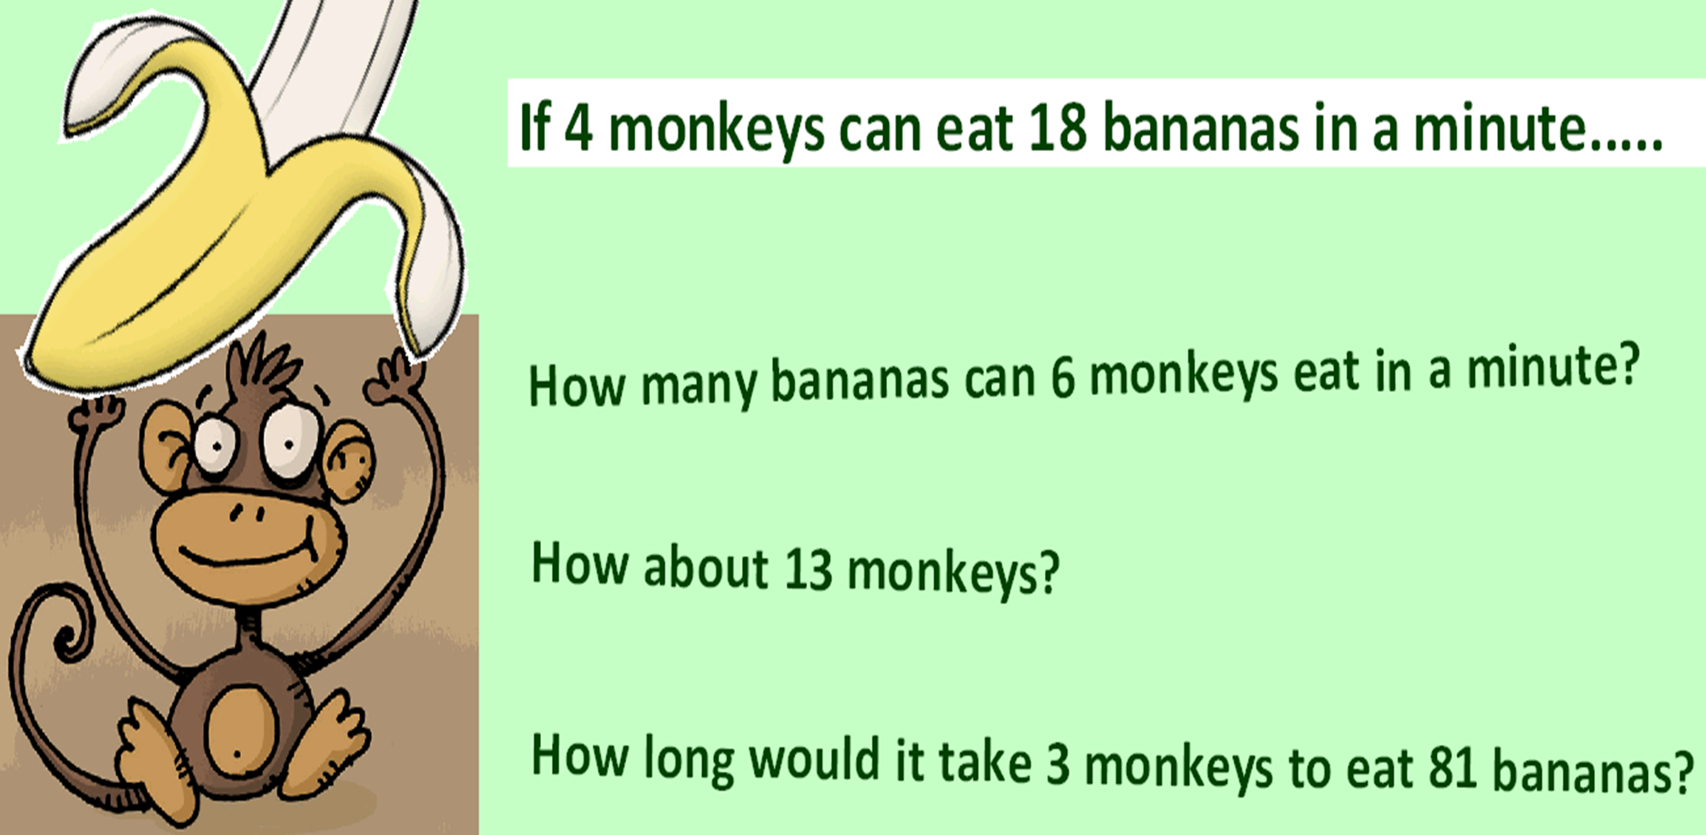
Monkey : Banana
4 : 18
1 : 4.5
27 bananas
58 bananas
6 mins

Slide 10

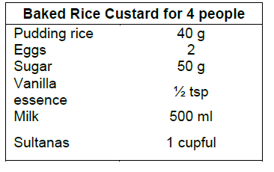
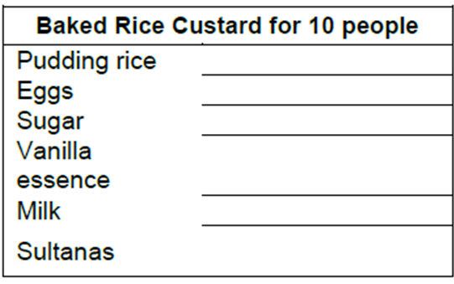
What are the ingredients needed for 10 people?
100g
5
125g
1.25 tsp
1250 ml
2.5 cupful

