Slide 1
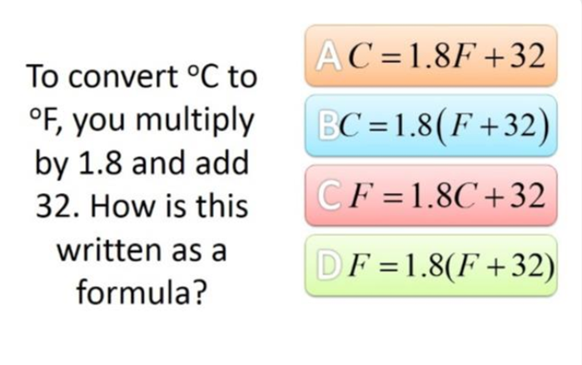
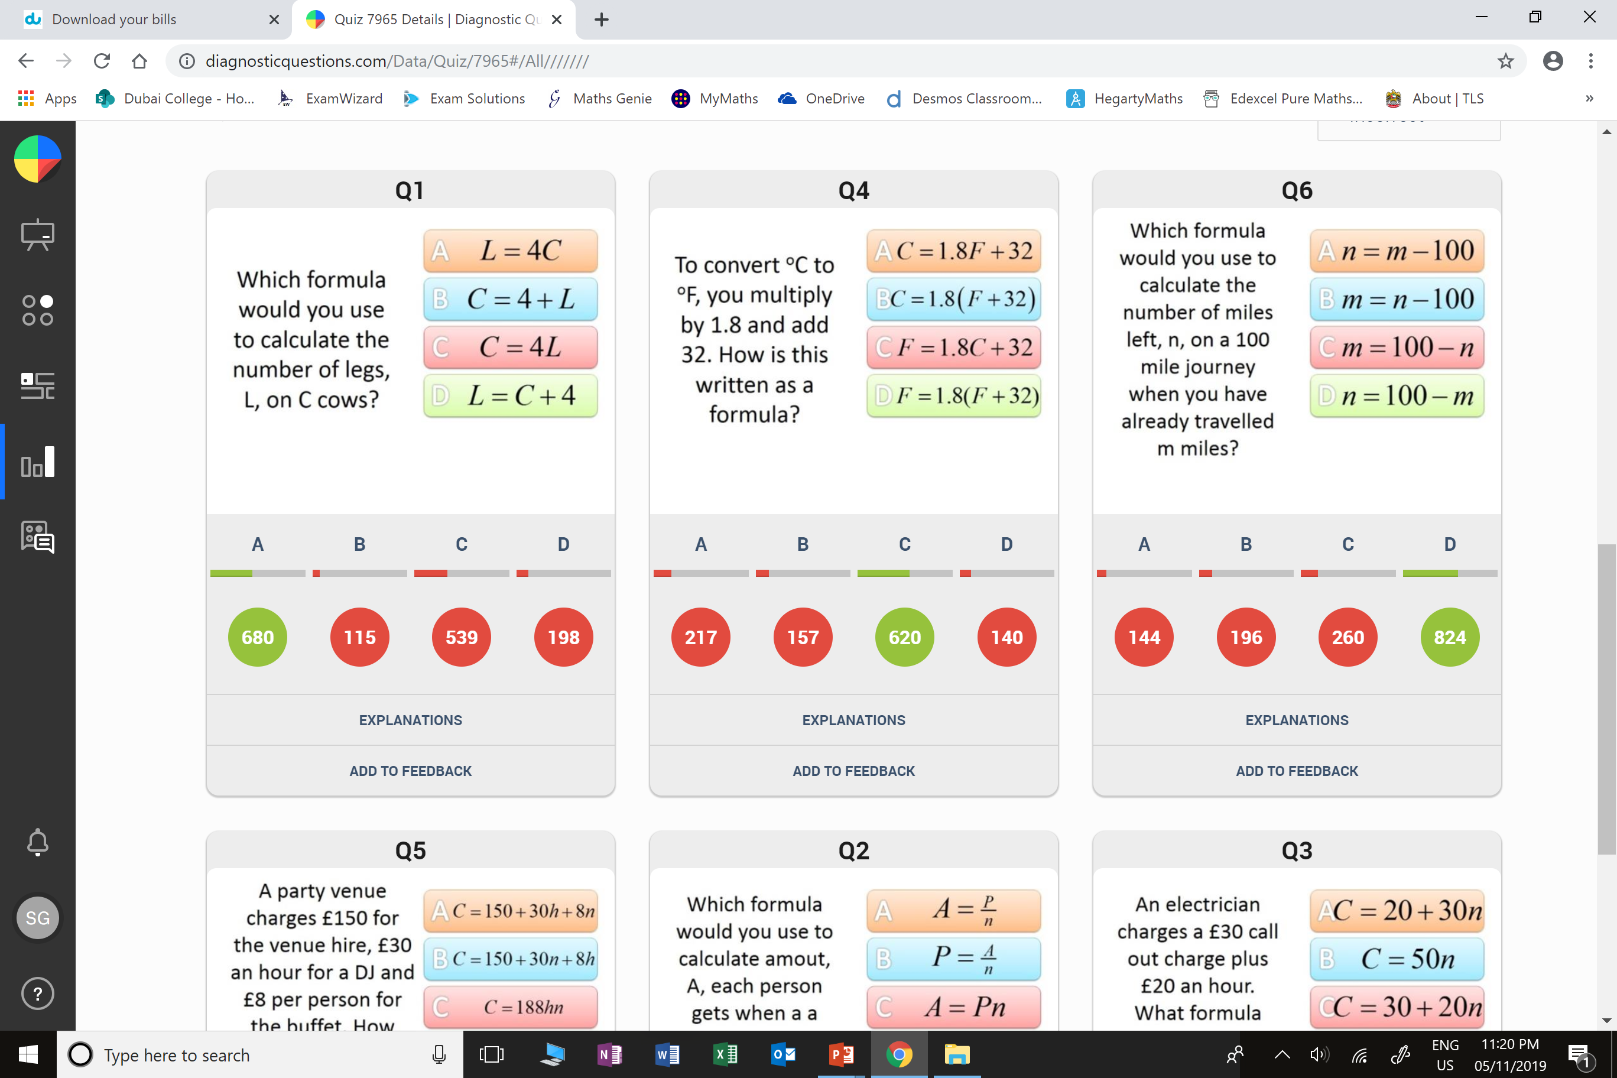
Which question was the hardest?
What was the most common wrong answer?

Slide 2
ANSWERS

Slide 3
Which question had the lowest percentage of
correct answers?

Slide 4
C
They got L and C the wrong way round.

Slide 5
A
They got F and C the wrong way round.

