Slide 1
LO: Difference of
Two Squares

Slide 2
Expanding and Simplify
(x + 7)(x – 7)
= x ² – 7x + 7x – 49
= x ² – 49

Slide 3
Expanding and Simplify
(x + 5)(x – 5)
= x ² – 5x + 5x – 25
= x ² – 25

Slide 4
Expand and Simplify
(x + a)(x – a)
= x ² – ax + ax – a²
= x² – a²

Slide 5
Factorise
x ² – 9
= x ² – 3x + 3x – 9
= (x + 3)(x – 3)

Slide 6
Factorise
x ² – 16
= x ² – 4x + 4x – 16
= (x + 4)(x – 4)

Slide 7
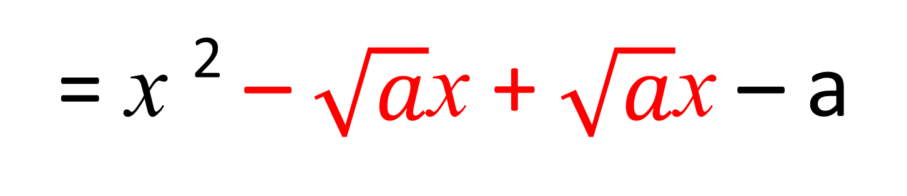
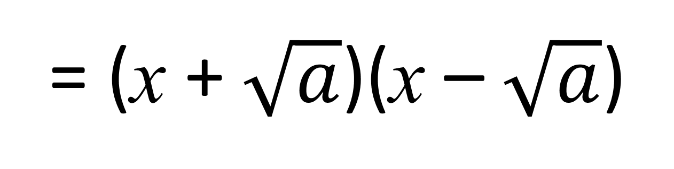
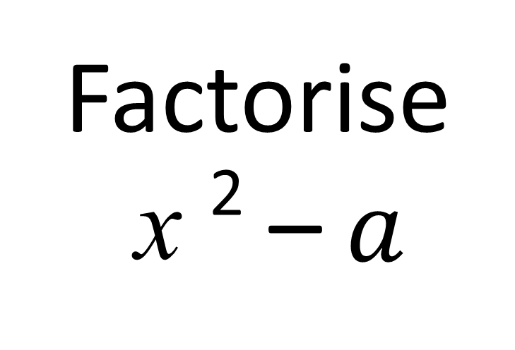
Factorise
x ² – $a$
= x ² – $\sqrt{a}$x + $\sqrt{a}$x – a
= (x + $\sqrt{a}$)(x – $\sqrt{a}$)

Slide 8
Factorise
9x ² – 16
= 9x ² – 4x + 4x – 16
= (3x + 4)(3x – 4)

Slide 9
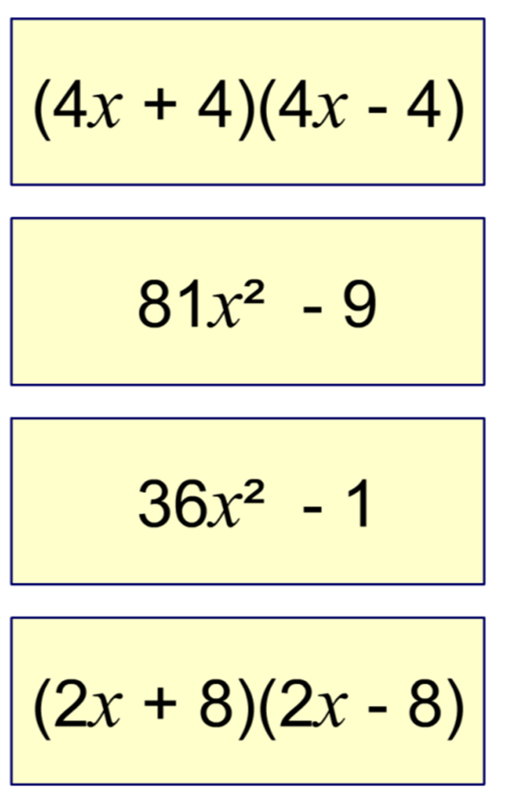
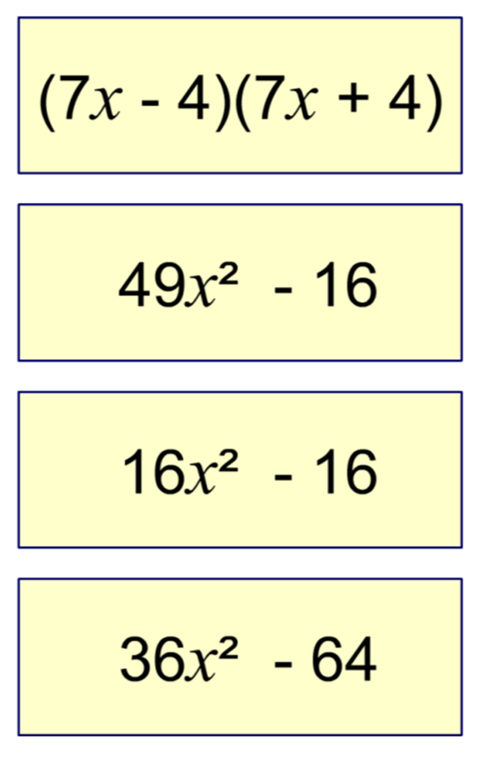
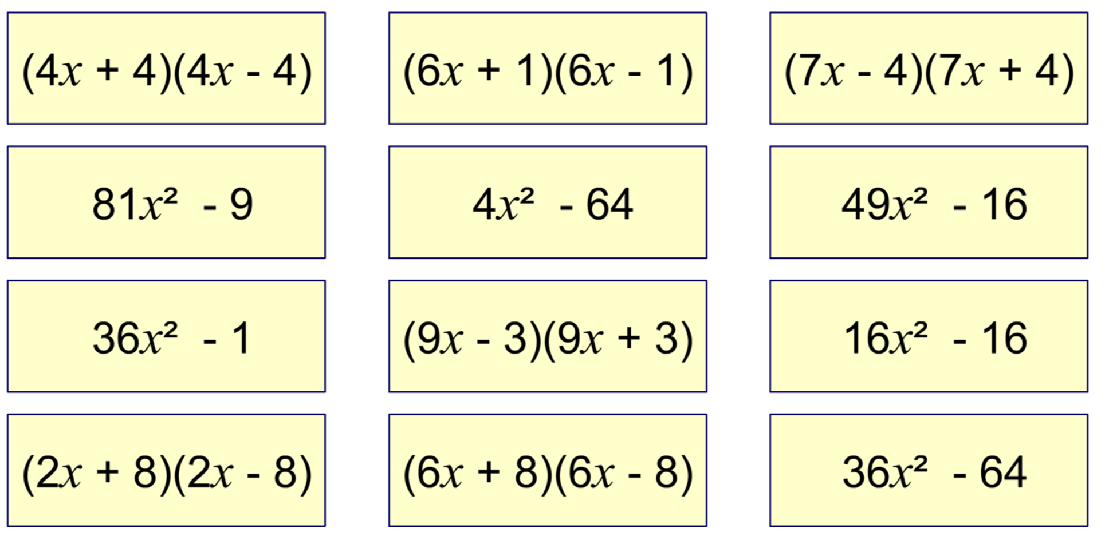
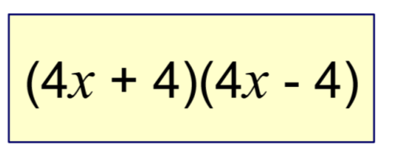
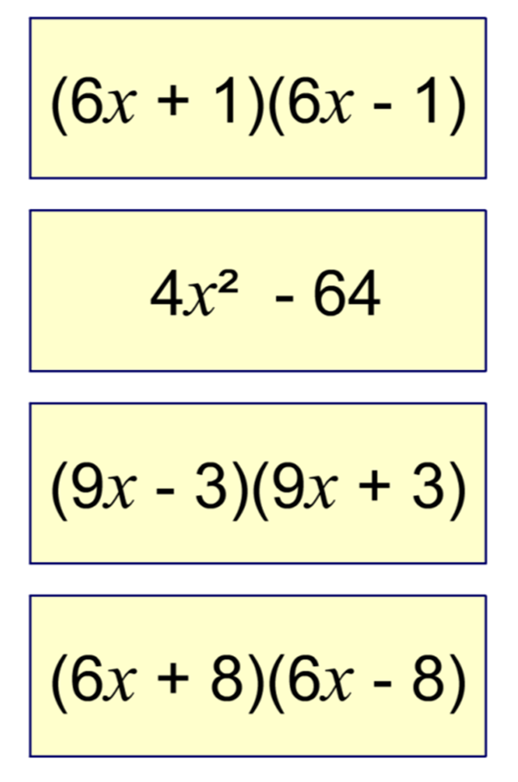
Notes:
Select a bracketed expression and ask a volunteer to find its corresponding expansion.

