Slide 1
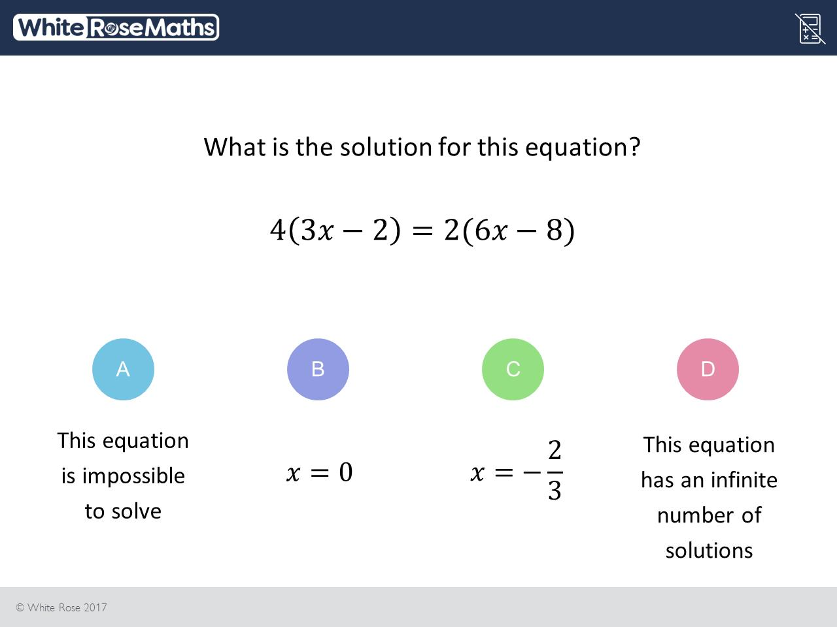
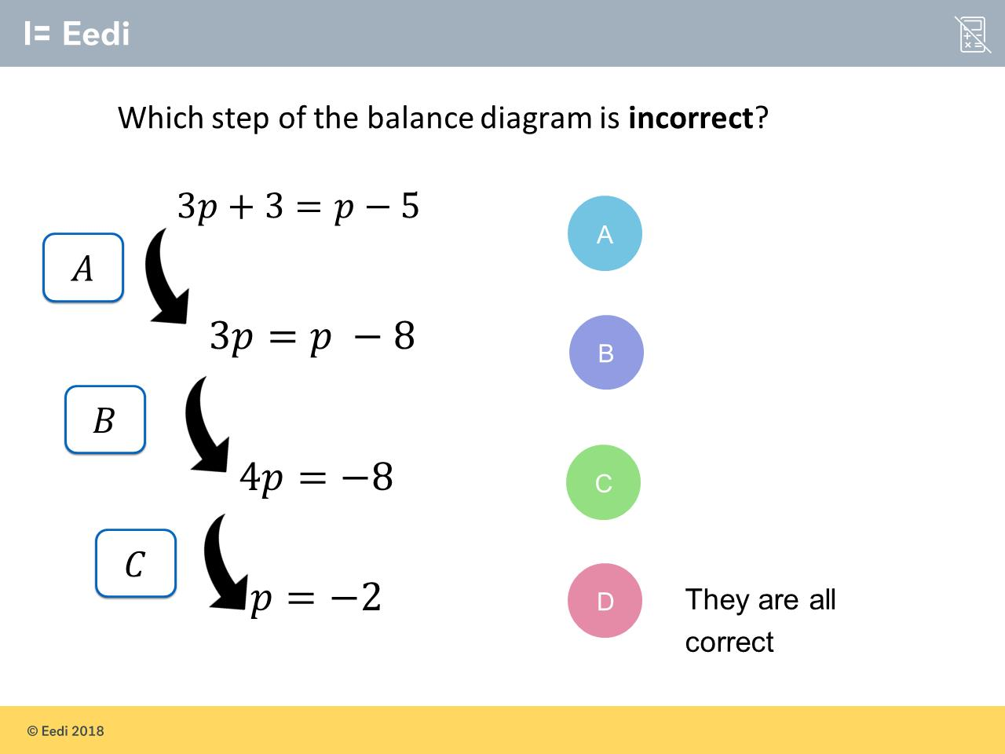
Worst answered question?
Most common wrong answer?

Slide 2
ANSWERS

Slide 3
Worst answered question?

Slide 4
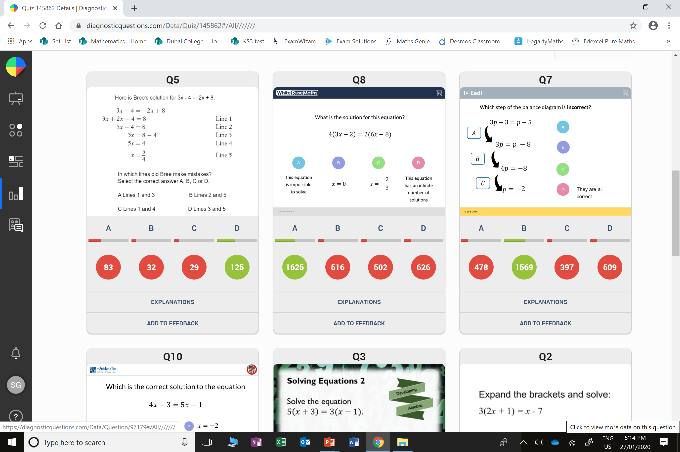
D
The student may not understand that there is not variable.

Slide 5
D
They added p instead of subtracting.

