Slide 1
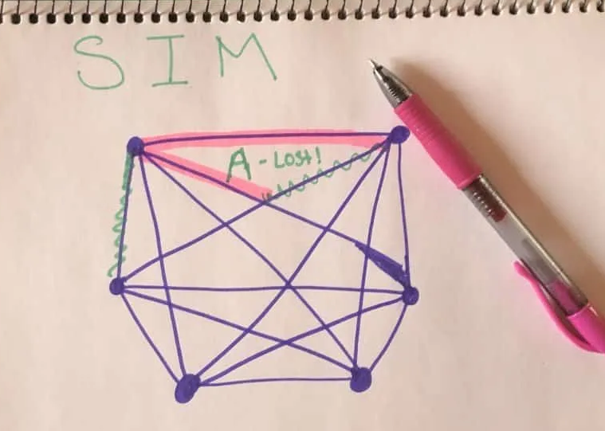
SIM
The goal is to avoid being the first person to draw a complete triangle in their color.
First, set up the game board.
Draw a hexagon, with a dot at each corner.
Then, draw lines connecting each dot to each other.
After you draw the lines, you are ready to play the game.
Players should use different colored highlighters or markers to make this game easier to play.
Players take turns coloring one line at a time.
The first player to create an entire triangle out of their color loses.

