Slide 1
Constant Acceleration
Distance Time Graphs
Chapter 9
(Part 1 of 4)

Slide 2
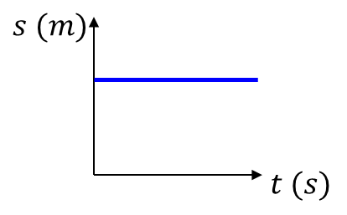
Displacement-Time Graphs
Describe the motion of each object.
Object is stationary.

Slide 3
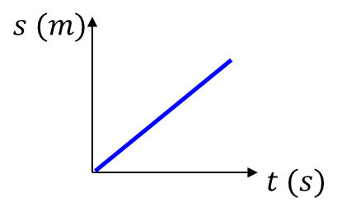
Describe the motion of each object.
Object is moving with constant velocity.

Slide 4
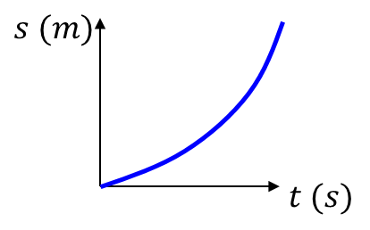
Describe the motion of each object.
Object is accelerating.

Slide 5
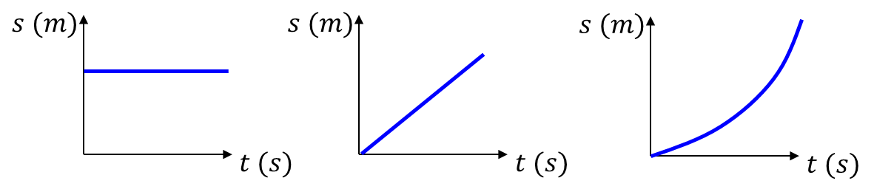

Displacement-Time Graphs
Velocity is the gradient of line
Distance travelled
Time taken
Average Speed $=$

Slide 6
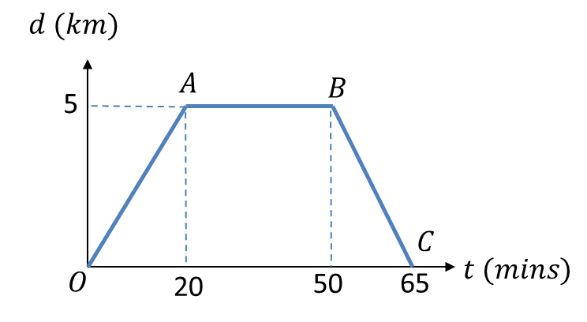

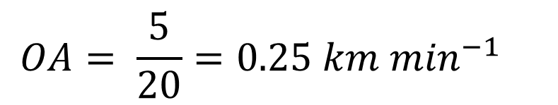


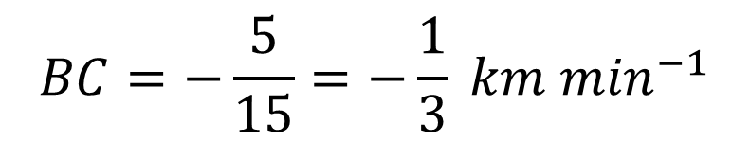
A cyclist rides in a straight line for 20 minutes. She waits for half an hour,
then returns in a straight line to her starting point in 15 minutes.
This is a displacement-time graph for her journey.
Work out the average velocity for each stage of the journey in km h⁻¹.
Write down the average velocity for the whole journey.
Work out average speed for the whole journey.
$$OA= \frac{5}{20}=0.25 km \min^{−1}$$
a)
$OA=15km h^{−1}$
$$AB=0 km h^{−1}$$
$$BC=−\frac{5}{15}=−\frac{1}{3} km \min^{−1}$$
$$BC=20 km h^{−1}$$

Slide 7
A cyclist rides in a straight line for 20 minutes. She waits for half an hour,
then returns in a straight line to her starting point in 15 minutes.
This is a displacement-time graph for her journey.
Work out the average velocity for each stage of the journey in km h⁻¹.
Write down the average velocity for the whole journey.
Work out average speed for the whole journey.
b)
0 (as displacement is 0)

Slide 8
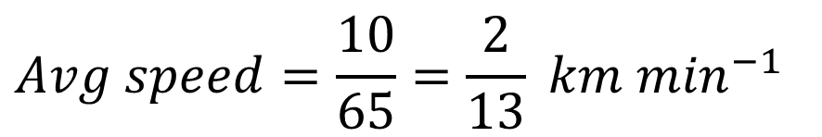
A cyclist rides in a straight line for 20 minutes. She waits for half an hour,
then returns in a straight line to her starting point in 15 minutes.
This is a displacement-time graph for her journey.
Work out the average velocity for each stage of the journey in km h⁻¹.
Write down the average velocity for the whole journey.
Work out average speed for the whole journey.
c)
Total distance: 10km.
Total time: 65 mins
$$Avg speed=\frac{10}{65}=\frac{2}{13} km \min^{−1}$$
$$Avg speed=9.23 km h^{−1} (3sf)$$

