Slide 1
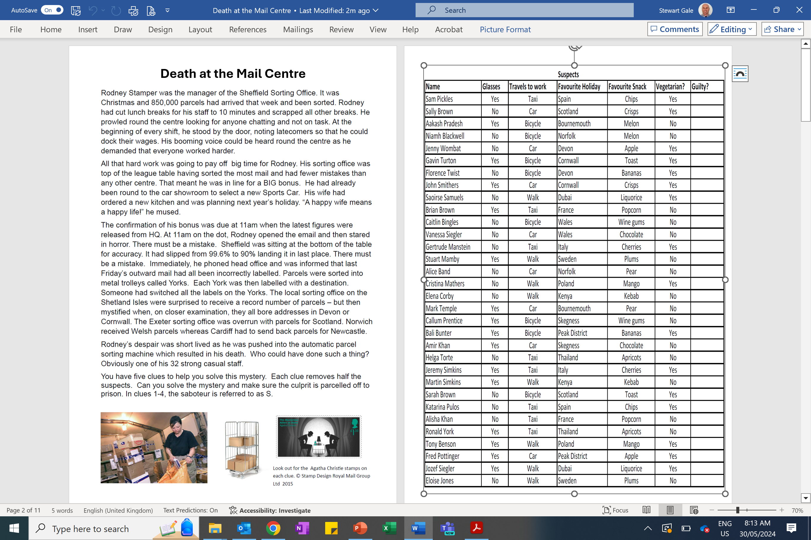
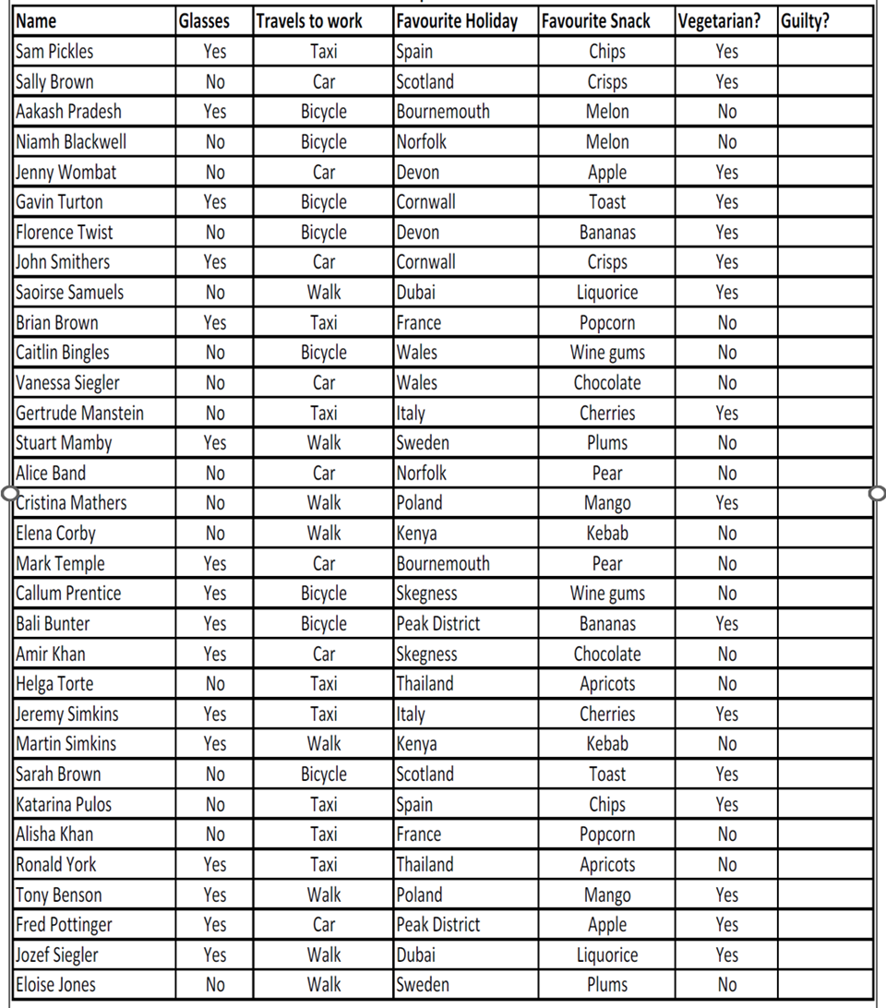

Slide 2
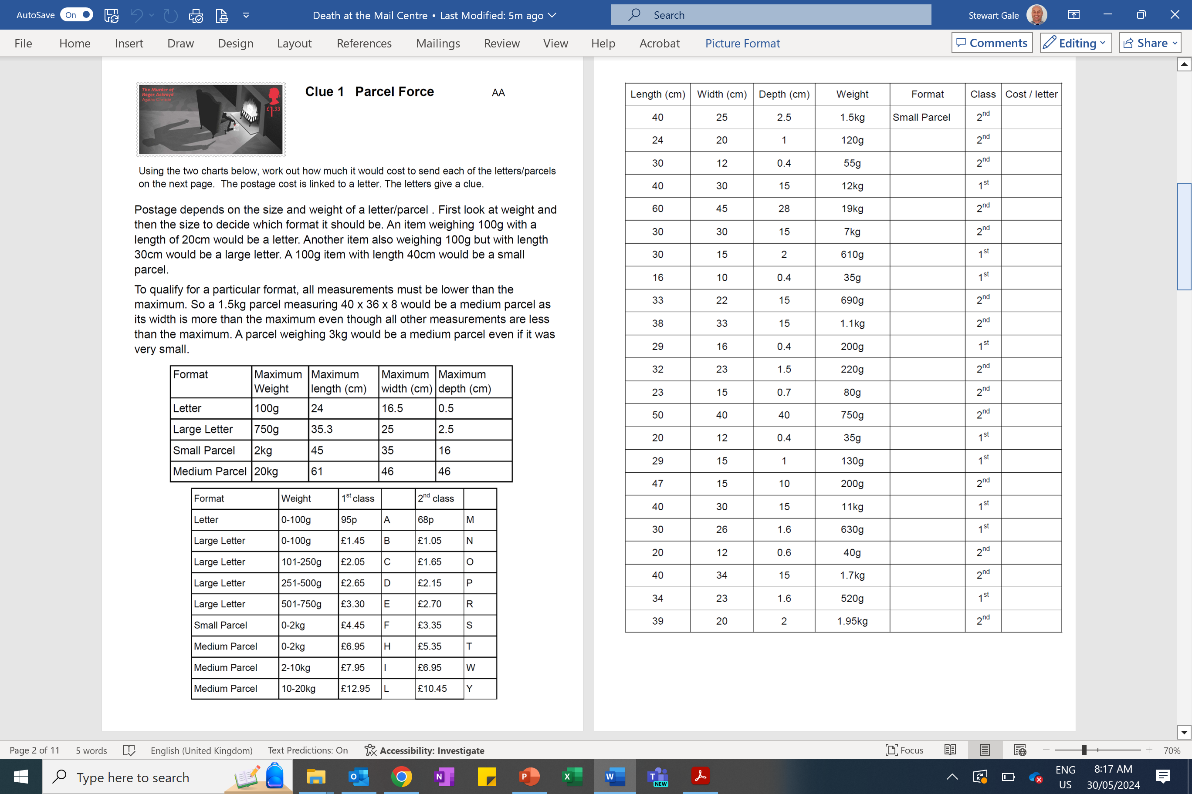

Slide 3
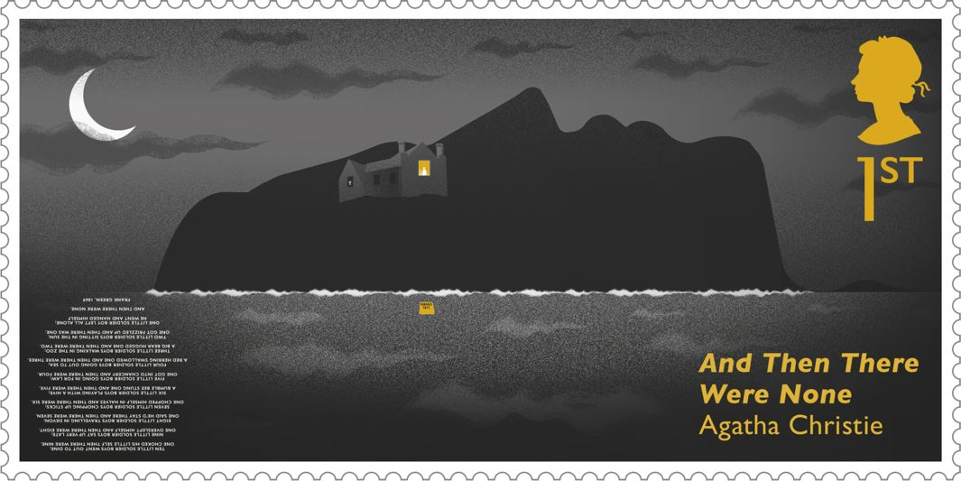
Clue 2 - Like Clockwork
Starting at N, turn in the direction instructed and then measure the distance from the centre. Record the nearest letter and start from this letter for the next turn.
N
Turn | Direction | Distance from centre | Letter
180° | clockwise | 6cm
180° | anticlockwise | 2cm
90° | clockwise | 2cm
135° | anticlockwise | 6cm
270° | anticlockwise | 4cm
45° | clockwise | 6cm
360° | anticlockwise | 4cm
270° | anticlockwise | 6cm
180° | clockwise | 2cm
135° | anticlockwise | 2cm
45° | clockwise | 6cm
315° | clockwise | 2cm
135° | anticlockwise | 2cm
45° | anticlockwise | 6cm
Turn | Direction | Distance from centre | Letter
315° | clockwise | 4cm
180° | clockwise | 6cm
360° | clockwise | 4cm
180° | anticlockwise | 6cm
90° | anticlockwise | 4cm
45° | clockwise | 6cm
315° | anticlockwise | 6cm
90° | clockwise | 6cm
270° | clockwise | 6cm
90° | anticlockwise | 4cm
270° | clockwise | 4cm
180° | anticlockwise | 6cm
270° | anticlockwise | 6cm
A
U
K
D
V
T
F
Y
W
G
M
R
L
E
O
Q
P
H
J
B
I
C
S

Slide 4
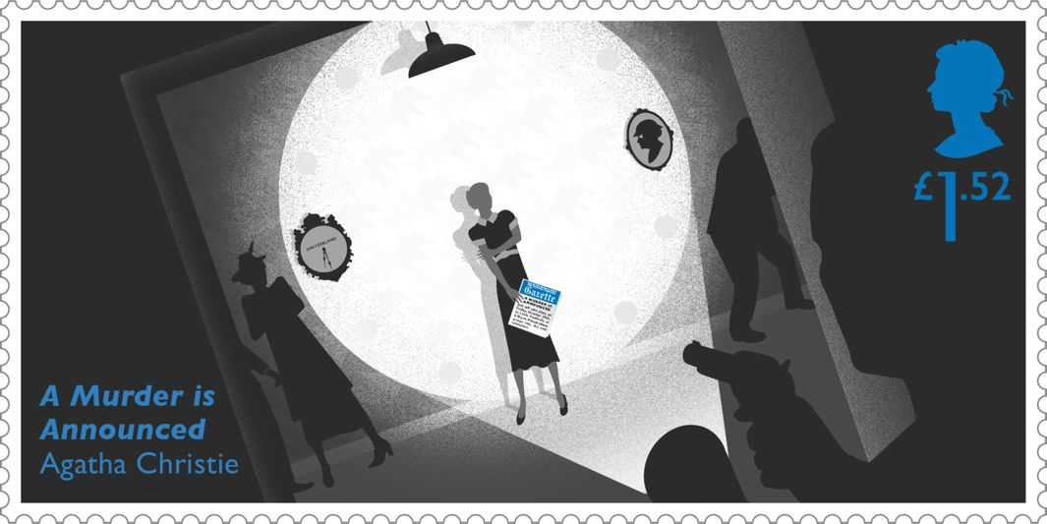
Clue 3 Stamp it Out! AA
This clue is made up of different arrangements of square postage stamps. Use the chart on the next page to work out which letter each of these shapes represents. Then decode the message on the following page.

Slide 5
Letter | Number of squares | Longest side | Shortest side | Smallest rectangle it would fit into | Shape | Lines of symmetry | Identified
A | 5 | 1 | 1 | 3x3 | dodecagon | 4
B | 5 | 4 | 1 | 4x2 | octagon | 0
C | 5 | 3 | 1 | 3x3 | octagon | 1
D | 4 | 4 | 1 | 4x1 | rectangle | 2
E | 4 | 3 | 1 | 3x2 | octagon | 1
F | 1 | 1 | 1 | 1x1 | square | 4
G | 5 | 3 | 1 | 3x2 | octagon | 1
H | 6 | 4 | 1 | 4x3 | octagon | 0
I | 6 | 3 | 1 | 4x3 | octagon | 0
J | 6 | 6 | 1 | 6x1 | rectangle | 2
K | 5 | 3 | 1 | 3x2 | hexagon | 0
L | 4 | 2 | 2 | 2x2 | square | 4
M | 5 | 3 | 1 | 3x3 | hexagon | 1
N | 6 | 4 | 1 | 4x2 | octagon | 1
O | 3 | 2 | 1 | 2x2 | hexagon | 1
P | 5 | 3 | 1 | 4x2 | octagon | 0
Q | 6 | 5 | 1 | 5x2 | hexagon | 0
R | 5 | 2 | 1 | 3x3 | decagon | 0
S | 2 | 2 | 1 | 2x1 | rectangle | 2
T | 5 | 2 | 1 | 3x3 | octagon | 0
U | 6 | 2 | 1 | 4x3 | dodecagon | 1
V | 5 | 2 | 1 | 3x3 | decagon | 1
W | 3 | 3 | 1 | 3x1 | rectangle | 2
X | 4 | 2 | 1 | 3x2 | octagon | 0
Y | 4 | 3 | 1 | 3x2 | hexagon | 0
Z | 5 | 5 | 1 | 5x1 | rectangle | 2

Slide 6
Message

Slide 7
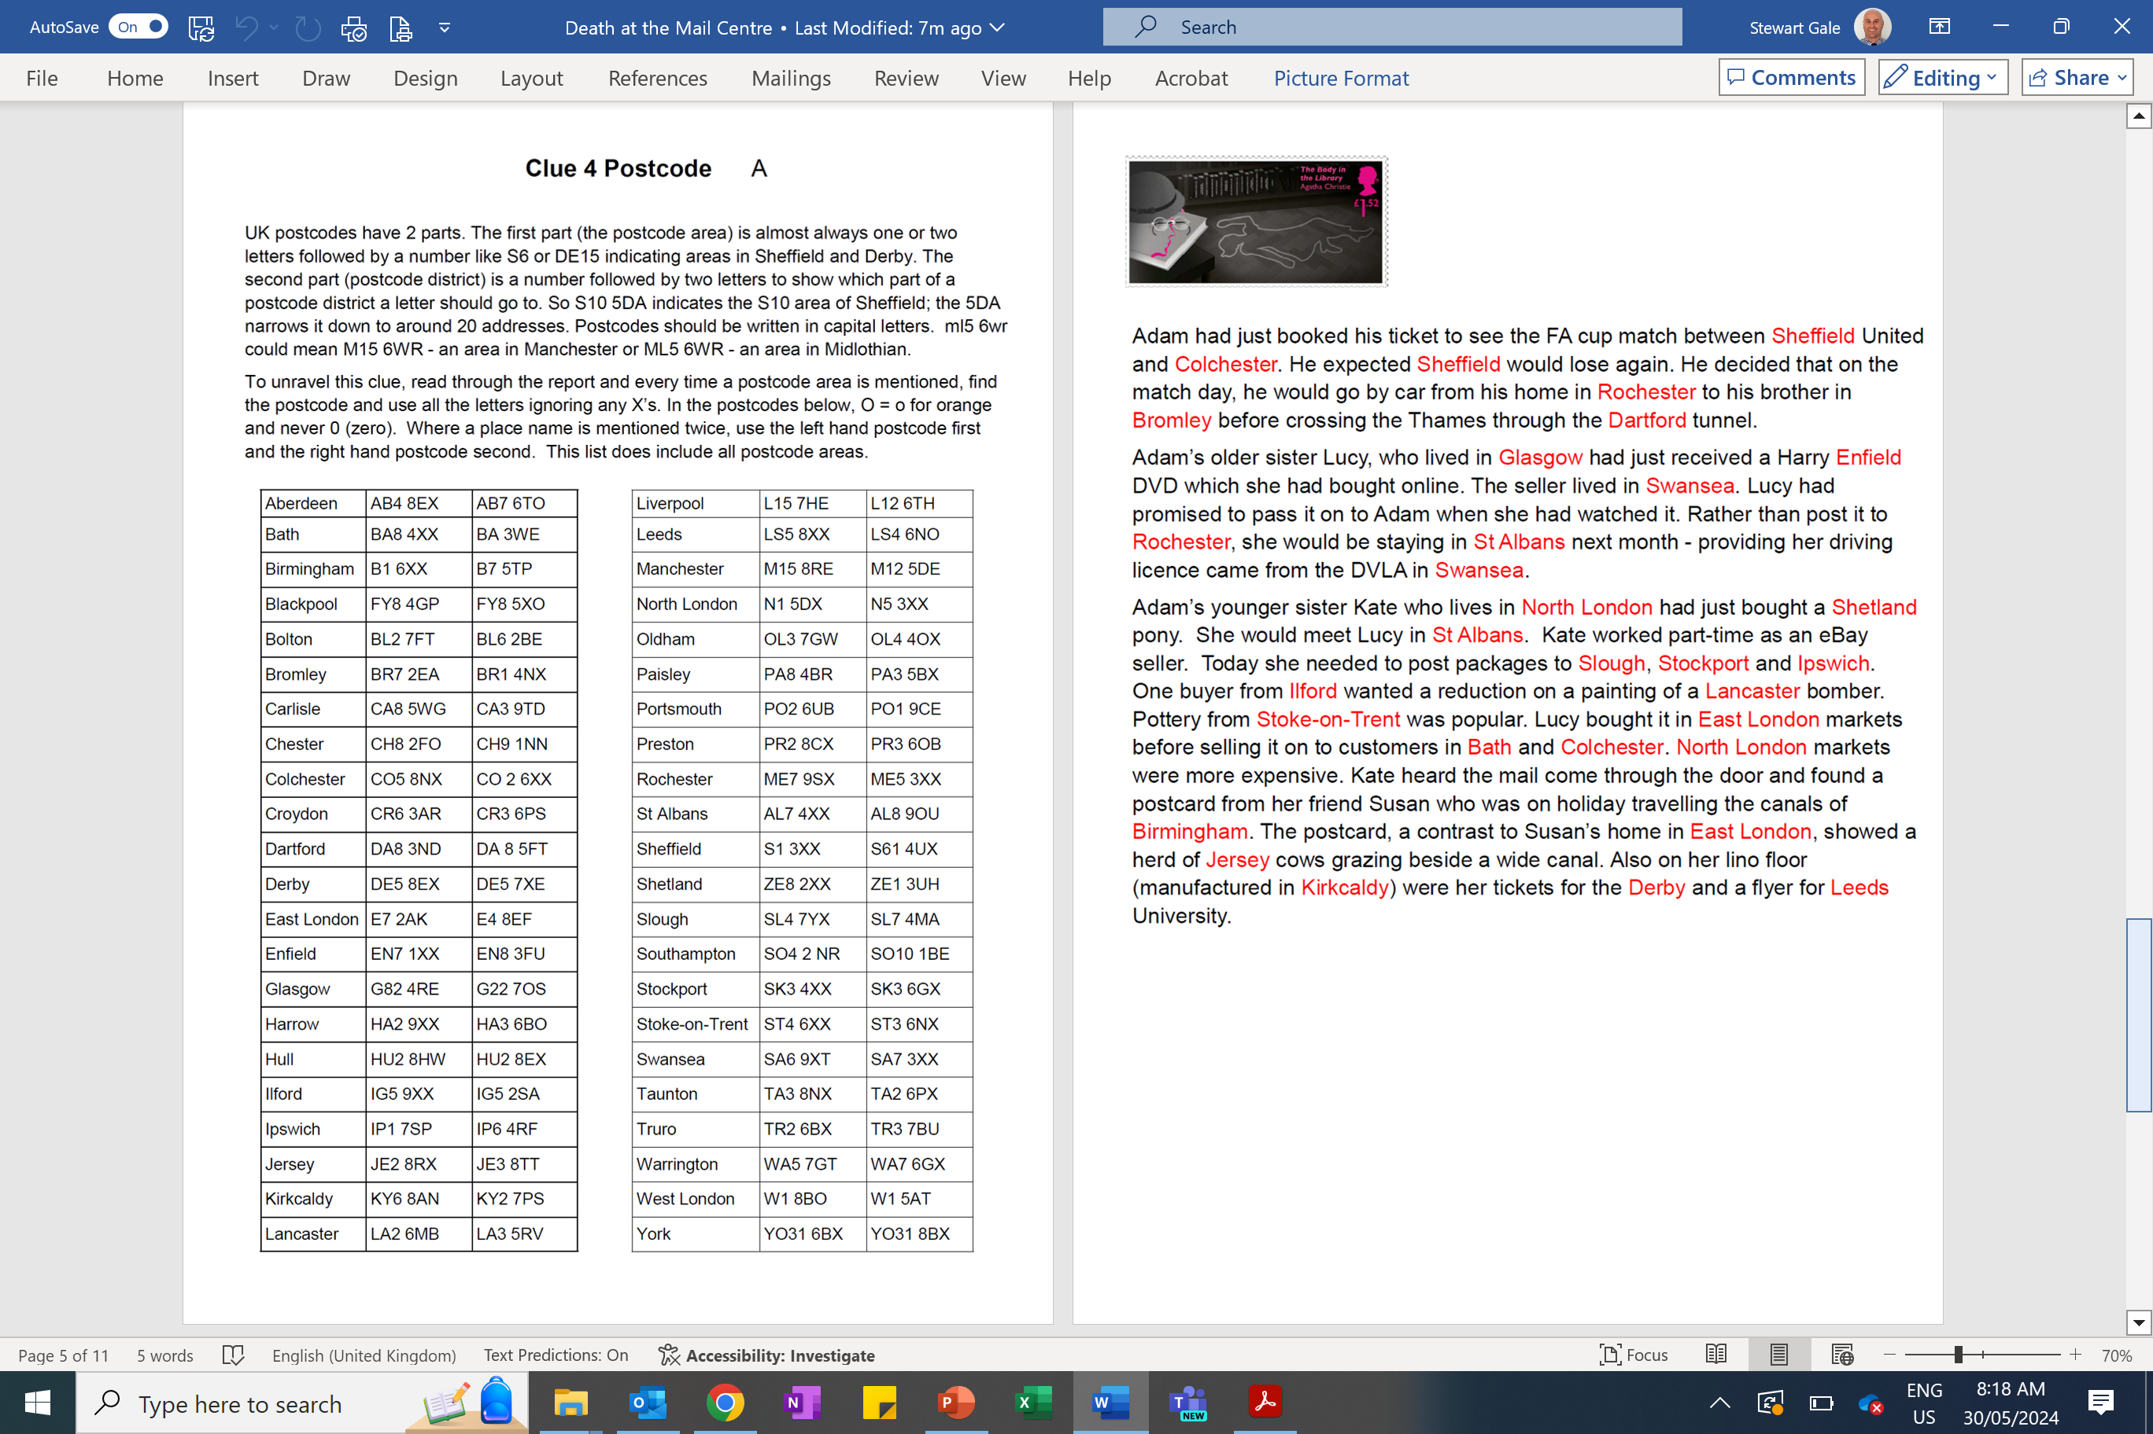

Slide 8
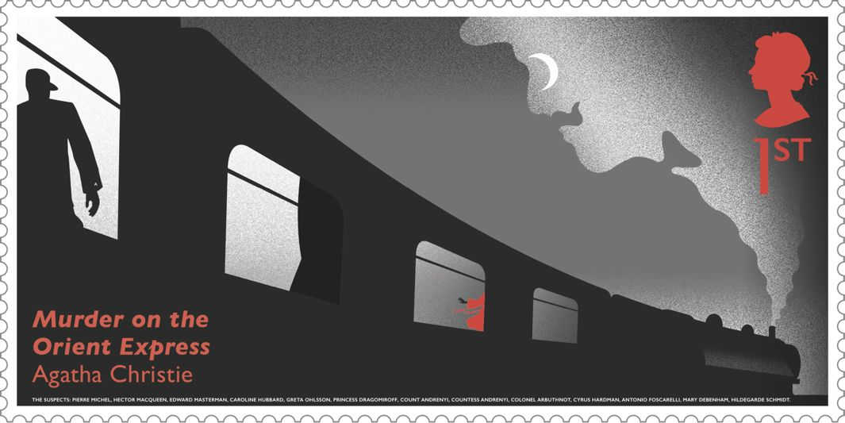
Clue 5 Stampede
There are 17 parcels which need more stamps on them. Find the least number of stamps to make up the postage from the stamps available for each parcel. Use this number to find a letter in the clue (a=1, b=2, c=3 etc). So a parcel needing 10p with only 2p stamps available would require 5 stamps, 5= e.
Stamps available | Extra Postage | Least number of stamps | Letter
£5, £3, £2, £1, 50p, 20p, 10p, 5p, 2p, 1p | £4.20
2p, 1p | 42p
20p, 10p, 5p, 2p, 1p | £2.40
10p, 5p, 2p, 1p | £1.29
£5, £3, £2, £1, 5p, 2p, 1p | £10.76
£3, £2, £1, 50p, 5p, 2p, 1p | £6.31
20p, 10p, 5p, 2p, 1p | £3.38
5p, 2p, 1p | 36p
£5, £3, £2 | £2
£2, 5p, 2p, 1p | £18. 49
20p, 10p, 5p, 2p, 1p | 54p
£3, £2, £1, 50p, 20p, 10p, 5p, 2p, 1p | £45.28
£3, £2, £1, 50p, 20p, 10p, 5p, 2p, 1p | £5.73
£3, £2, £1, 50p, 20p, 2p, 1p | £36.11
50p, 10p, 2p, 1p | £7.45
£3, £2, £1, 50p, 20p, 10p, 5p, 2p, 1p | £8.99
20p, 10p, 5p, 2p, 1p | £3.56

Slide 9
ANSWERS

Slide 10
Clue 1
Length (cm) | Width (cm) | Depth (cm) | Weight | Format | Class | Cost / letter
40 | 25 | 2.5 | 1.5kg | Small parcel | 2nd | S
24 | 20 | 1 | 120g | Large letter | 2nd | O
30 | 12 | 0.4 | 55g | Large Letter | 2nd | N
40 | 30 | 15 | 12kg | Medium Parcel | 1st | L
60 | 45 | 28 | 19kg | Medium Parcel | 2nd | Y
30 | 30 | 15 | 7kg | Medium Parcel | 2nd | W
30 | 15 | 2 | 610g | Large Letter | 1st | E
16 | 10 | 0.4 | 35g | Letter | 1st | A
33 | 22 | 15 | 690g | Large Letter | 2nd | R
38 | 33 | 15 | 1.1kg | Small Parcel | 2nd | S
29 | 16 | 0.4 | 200g | Large Letter | 1st | C
32 | 23 | 1.5 | 220g | Large Letter | 2nd | O
23 | 15 | 0.7 | 80g | Large Letter | 2nd | N
50 | 40 | 40 | 750g | Medium Parcel | 2nd | T
20 | 12 | 0.4 | 35g | Letter | 1st | A
29 | 15 | 1 | 130g | Large Letter | 1st | C
47 | 15 | 10 | 200g | Medium Parcel | 2nd | T
40 | 30 | 15 | 11kg | Medium Parcel | 1st | L
30 | 26 | 1.6 | 630g | Large Letter | 1st | E
20 | 12 | 0.6 | 40g | Large Letter | 2nd | N
40 | 34 | 15 | 1.7kg | Small Parcel | 2nd | S
34 | 23 | 1.6 | 520g | Large Letter | 1st | E
39 | 20 | 2 | 1.95kg | Small Parcel | 2nd | S
Format | Weight | Class | Cost / letter | Format | Weight | Class | Cost / letter
Small parcel | 1.5kg | 2nd | S | Large Letter | 80g | 2nd | N
Large letter | 120g | 2nd | O | Medium Parcel | 750g | 2nd | T
Large Letter | 55g | 2nd | N | Letter | 35g | 1st | A
Medium Parcel | 12kg | 1st | L | Large Letter | 130g | 1st | C
Medium Parcel | 19kg | 2nd | Y | Medium Parcel | 200g | 2nd | T
Medium Parcel | 7kg | 2nd | W | Medium Parcel | 11kg | 1st | L
Large Letter | 610g | 1st | E | Large Letter | 630g | 1st | E
Letter | 35g | 1st | A | Large Letter | 40g | 2nd | N
Large Letter | 690g | 2nd | R | Small Parcel | 1.7kg | 2nd | S
Small Parcel | 1.1kg | 2nd | S | Large Letter | 520g | 1st | E
Large Letter | 200g | 1st | C | Small Parcel | 1.95kg | 2nd | S
Large Letter | 220g | 2nd | O

Slide 11
Clue 2
Turn | Direction | Distance from centre | Letter
315° | clockwise | 4cm | u
180° | clockwise | 6cm | s
360° | clockwise | 4cm | i
180° | anticlockwise | 6cm | n
90° | anticlockwise | 4cm | g
45° | clockwise | 6cm | a
315° | anticlockwise | 6cm | n
90° | clockwise | 6cm | e
270° | clockwise | 6cm | n
90° | anticlockwise | 4cm | g
270° | clockwise | 4cm | i
180° | anticlockwise | 6cm | n
270° | anticlockwise | 6cm | e
Turn | Direction | Distance from centre | Letter
180° | clockwise | 6cm | s
180° | anticlockwise | 2cm | t
90° | clockwise | 2cm | r
135° | anticlockwise | 6cm | a
270° | anticlockwise | 4cm | v
45° | clockwise | 6cm | e
360° | anticlockwise | 4cm | l
270° | anticlockwise | 6cm | s
180° | clockwise | 2cm | t
135° | anticlockwise | 2cm | o
45° | clockwise | 6cm | w
315° | clockwise | 2cm | o
135° | anticlockwise | 2cm | r
45° | anticlockwise | 6cm | k

Slide 12
S |  |  | L |  |  |  | I |  |  |  | K |  |  | E |  |  | S |  |  | T
O |  |  | H |  |  |  | O |  |  | L |  |  |  | I |  |  | D
 | A |  |  | Y |  |  |  | I |  |  |  | N |  |  |  | T |  |  | H
 |  | E |  |  |  | U |  |  | K

Slide 13
Clue 4
Adam had just booked his ticket to see the FA cup match between Sheffield United and Colchester. He expected Sheffield would lose again. He decided that on the match day, he would go by car from his home in Rochester to his brother in Bromley before crossing the Thames through the Dartford tunnel.
Adam’s older sister Lucy, who lived in Glasgow had just received a Harry Enfield DVD which she had bought online. The seller lived in Swansea. Lucy had promised to pass it on to Adam when she had watched it . Rather than post it to Rochester, she would be staying in St Albans next month - providing her driving licence came from the DVLA in Swansea.
Adam’s younger sister Kate who lives in North London had just bought a Shetland pony. She would meet Lucy in St Albans. Kate worked part-time as an eBay seller. Today she needed to post packages to Slough, Stockport and Ipswich. One buyer from Ilford wanted a reduction on a painting of a Lancaster bomber. Pottery from Stoke-on-Trent was popular. Lucy bought it in East London markets before selling it on to customers in Bath and Colchester. North London markets were more expensive . Kate heard the mail come through the door and found a postcard from her friend Susan who was on holiday travelling the canals of Birmingham. The postcard, a contrast to Susan’s home in East London, showed a herd of Jersey cows grazing beside a wide canal. Also on her lino floor (manufactured in Kirkcaldy) were her tickets for the Derby and a flyer for Leeds University.
Sheffield, Colchester, Sheffield, Rochester, Bromley, Dartford, Glasgow, Enfield, Swansea, Rochester, St Albans, Swansea, North London, Shetland, St Albans, Slough, Stockport, Ipswich, Ilford, Lancaster, Stoke-on-Trent, East London, Bath, Colchester, North London, Birmingham, East London Jersey, Kirkcaldy, Derby, Leeds.
S1 3XX, CO5 8NX, S61 4UX, ME7 9SX, BR7 2EA, DA8 3ND, G82 4RE, EN7 1XX, SA6 9XT, ME5 3XX, AL7 4XX, SA7 3XX, N1 5DX, ZE8 2XX, AL8 9OU, SL4 7YX, SK3 4XX, IP1 7SP, IG5 9XX, LA2 6MB, ST4 6XX, E7 2AK, BA8 4XX, CO 2 6XX, N5 3XX, B1 6XX, E4 8EF, JE2 8RX, KY6 8AN, DE5 8EX, LS5 8XX
S consumes bread and greens at meals and zealously skips pig, lamb, steak, bacon, beef jerky and eels.

Slide 14
Clue 5
Stamps available | Extra Postage | Least number of stamps | Letter
£5, £3, £2, £1, 50p, 20p, 10p, 5p, 2p, 1p | £4.20 | 3 | C
2p, 1p | 42p | 21 | U
20p, 10p, 5p, 2p, 1p | £2.40 | 12 | L
10p, 5p, 2p, 1p | £1.29 | 16 | P
£5, £3, £2, £1, 5p, 2p, 1p | £10.76 | 18 | R
£3, £2, £1, 50p, 5p, 2p, 1p | £6.31 | 9 | I
20p, 10p, 5p, 2p, 1p | £3.38 | 20 | T
5p, 2p, 1p | 36p | 8 | H
£5, £3, £2 | £2 | 1 | A
£2, 5p, 2p, 1p | £18. 49 | 20 | T
20p, 10p, 5p, 2p, 1p | 54p | 5 | E
£3, £2, £1, 50p, 20p, 10p, 5p, 2p, 1p | £45.28 | 19 | S
£3, £2, £1, 50p, 20p, 10p, 5p, 2p, 1p | £5.73 | 6 | F
£3, £2, £1, 50p, 20p, 2p, 1p | £36.11 | 18 | R
50p, 10p, 2p, 1p | £7.45 | 21 | U
£3, £2, £1, 50p, 20p, 10p, 5p, 2p, 1p | £8.99 | 9 | I
20p, 10p, 5p, 2p, 1p | £3.56 | 20 | T

Slide 15
Answer Summary
Clue 1 | S only wears contact lenses.
Clue 2 | S travels to work using an engine.
Clue 3 | S likes to holiday in the UK.
Clue 4 | S consumes bread and greens and meals and zealously skips pig, lamb, steak, bacon, beef jerky and eels.
Clue 5 | Culprit hates fruit.
This will reveal the murderer to be Sally Brown.

