Slide 1

Intermediate Challenge 3
GOLD

Slide 2
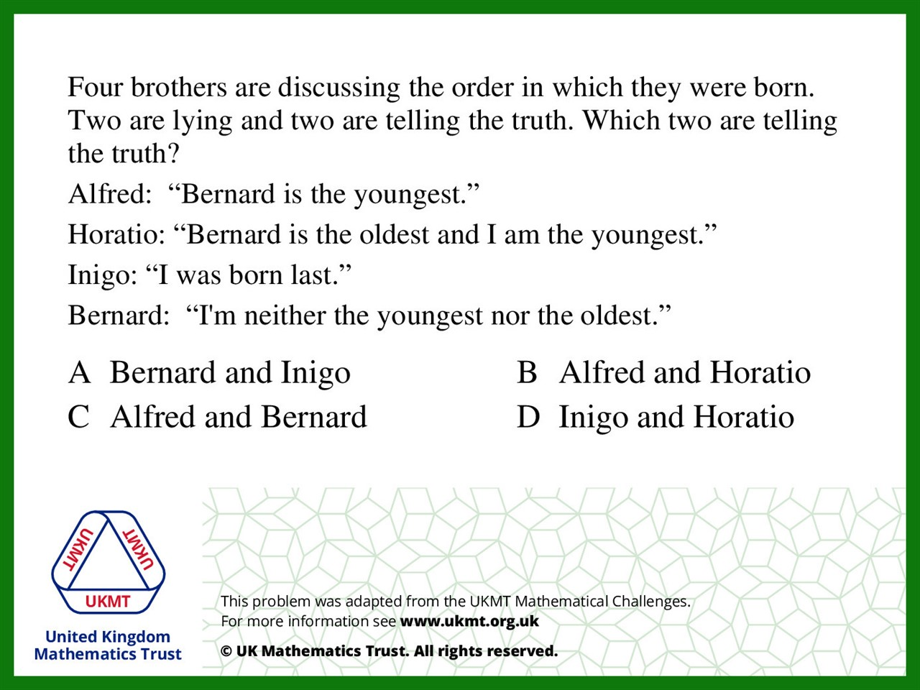
Q1.
Inigo and Bernard do not contradict each other, unlike the other brothers, so Inigo and Bernard must be telling the truth.

Slide 3
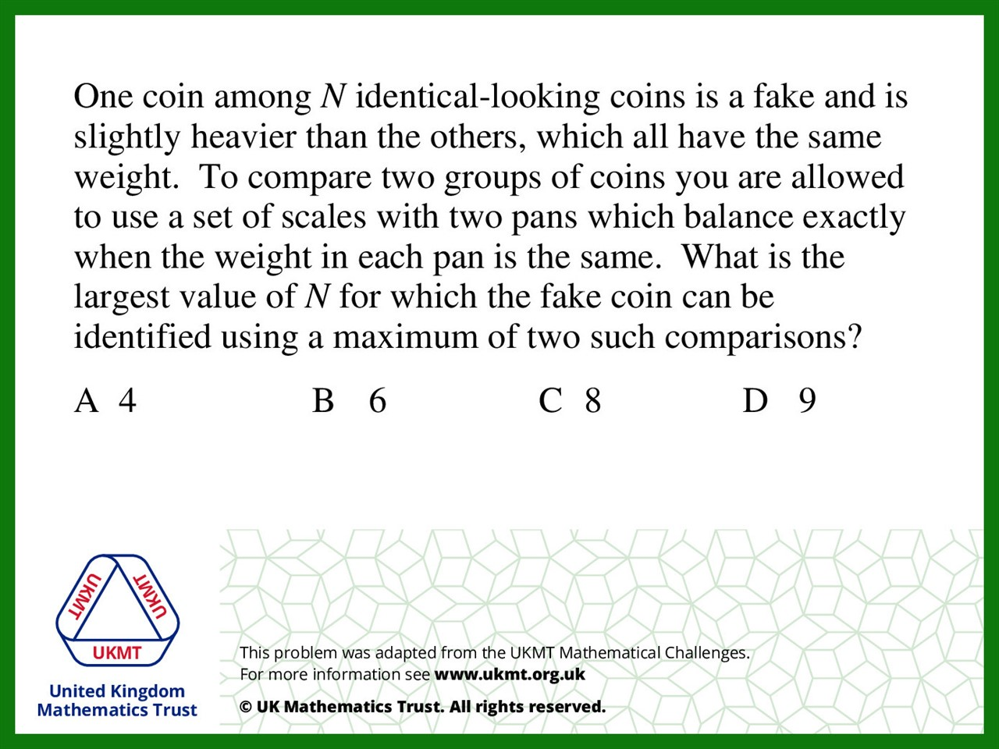
Q2.
Balance 3 coins on each scale, and 3 coins off the scale.
One weighing to identify which 3 the fake is in.
Then weigh 1 coin on each scale and 1 coin off.
Identify the fake.

Slide 4
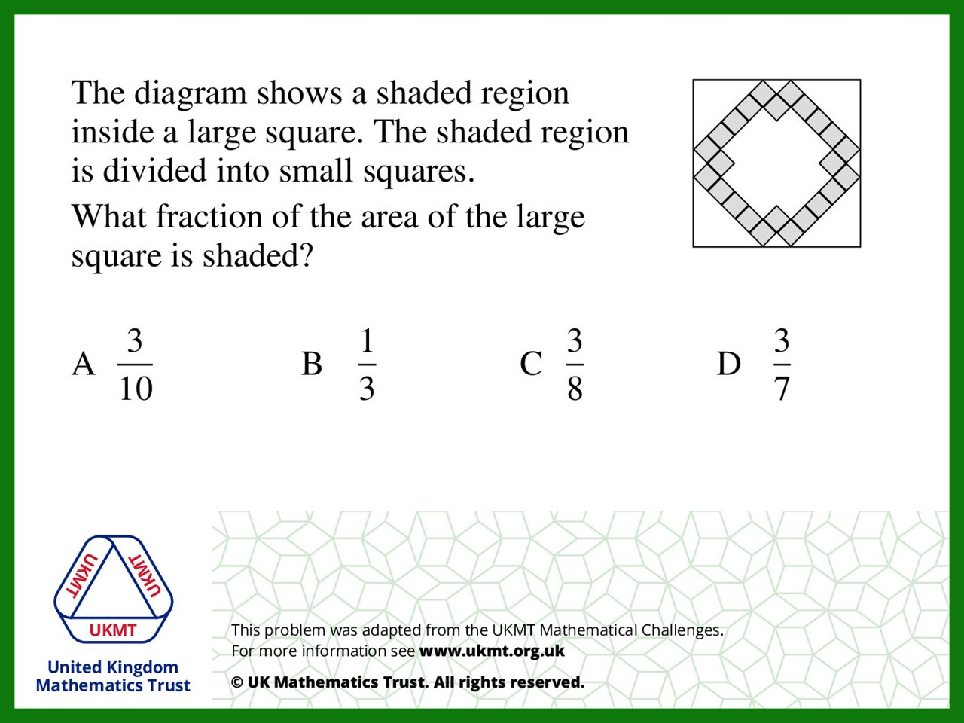
Q3.
There are 61 squares in total if we extend the lines.
There are 20 triangles at the edges and 4 smaller triangles, which they are a quarter of a square each.
So in total there are: 61 + 10 + 1 = 72 squares, of which shaded are 24. If you simplify you get1/3.

Slide 5
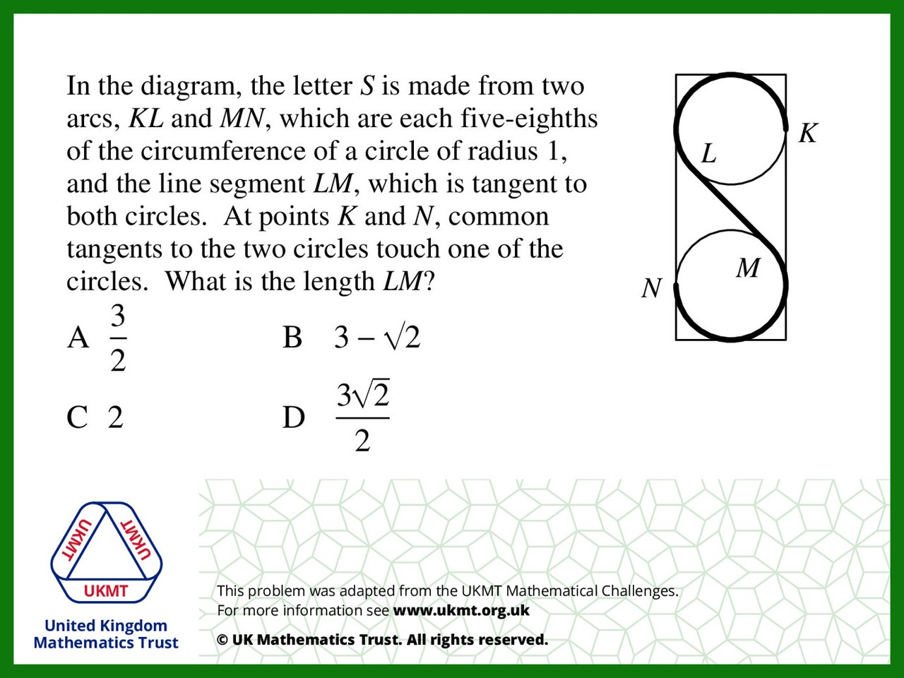
Q4.
If radius is drawn from L and M to the centre of their circle, and then a line between the 2 centres of the circles, 2 triangles can be seen. They are both congruent and isosceles triangles, with 2 sides being 1. These add up to make the line LM, which is 2

Slide 6
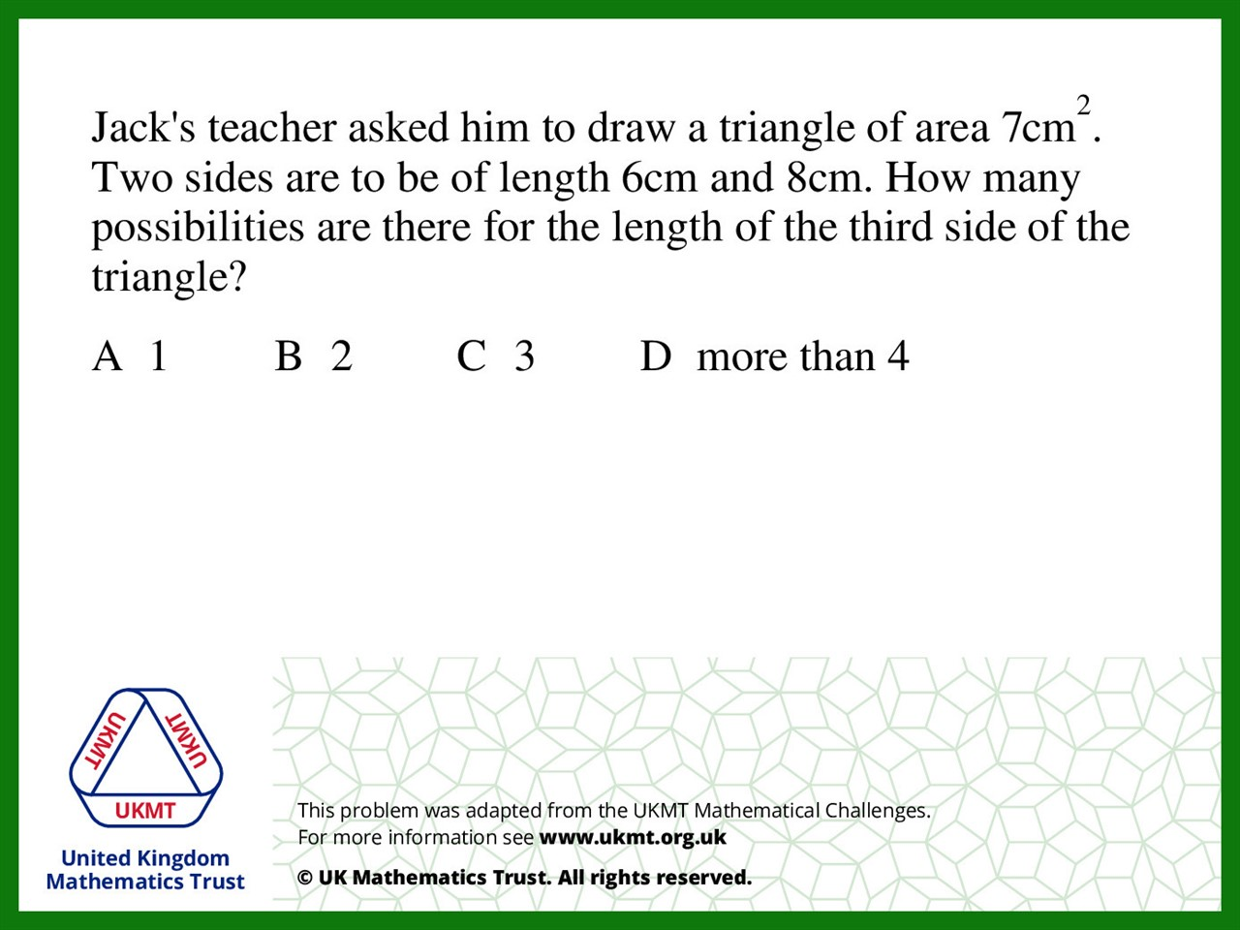
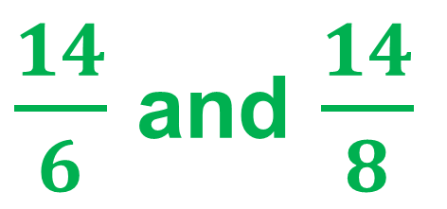
Q5.
$\frac{14}{6}$ and $\frac{14}{8}$

