Slide 1
LO: Reciprocals

Slide 2
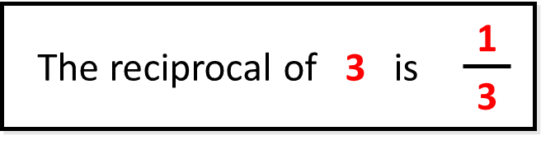
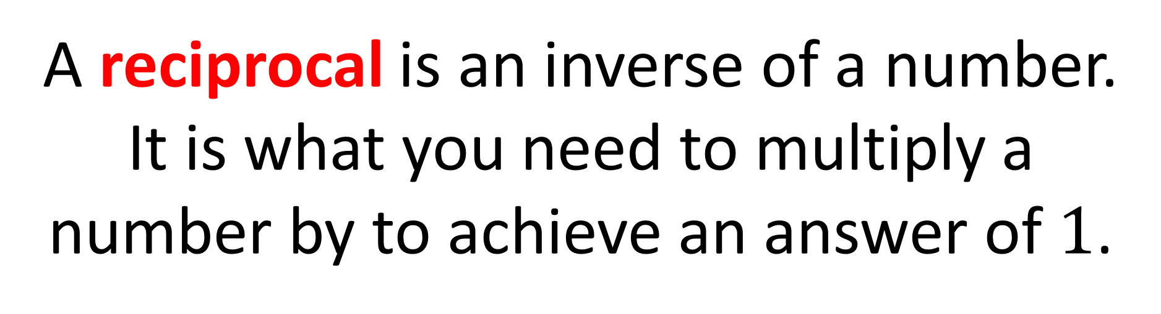
What is a reciprocal?
A reciprocal is an inverse of a number.
It is what you need to multiply a number by to achieve an answer of $1$.

Slide 3

$$\frac{1}{4}$$
What is the is reciprocal of ?
4

Slide 4

$$\frac{1}{5}$$
What is the is reciprocal of ?
5

Slide 5

7
What is the is reciprocal of ?
$$\frac{1}{7}$$

Slide 6


$$\frac{2}{5}$$
What is the is reciprocal of ?
$$\frac{5}{2}$$

Slide 7


$$\frac{7}{3}$$
What is the is reciprocal of ?
$$\frac{3}{7}$$

Slide 8

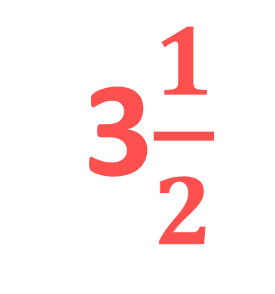
3$\frac{1}{2}$
What is the is reciprocal of ?
$$\frac{2}{7}$$

Slide 9
What is the is reciprocal of ?
0.25
4

Slide 10
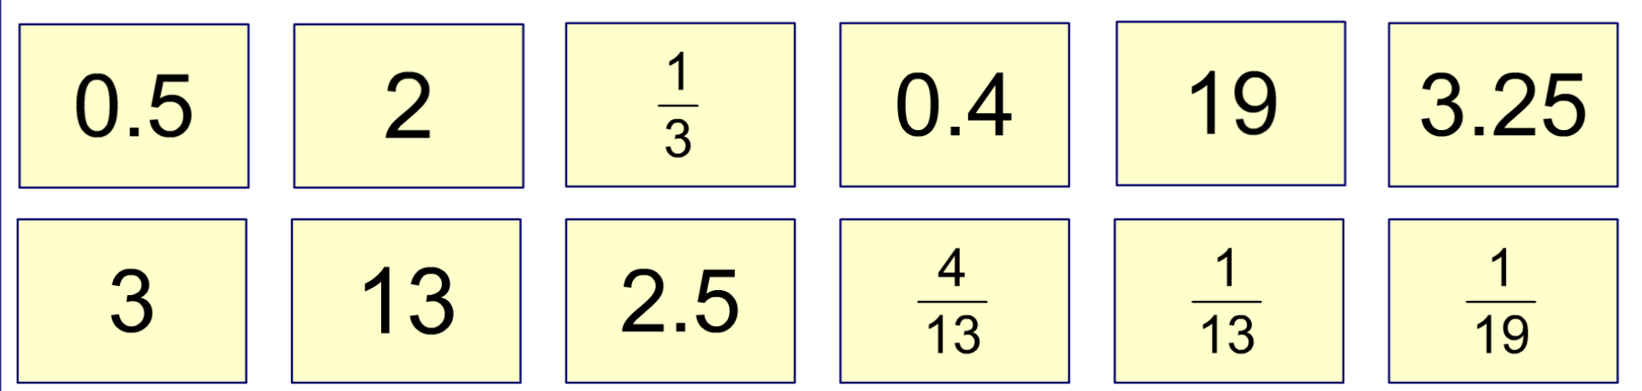
Match the reciprocal pairs.
Notes:
Establish that we have to find pairs of numbers that multiply together to make one. Each will be the reciprocal of the other.
Point out that one number in the pair must be less than 1 and one number must be more than 1.
Encourage pupils to convert decimals into fractions and mixed numbers into-top heavy fractions. The resulting fraction can then be reversed to find its reciprocal.

