Slide 1
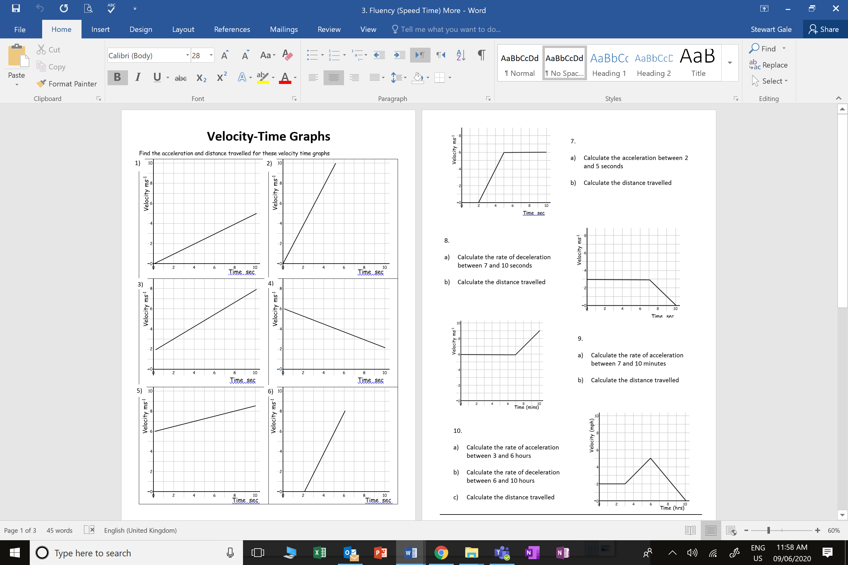

Slide 2
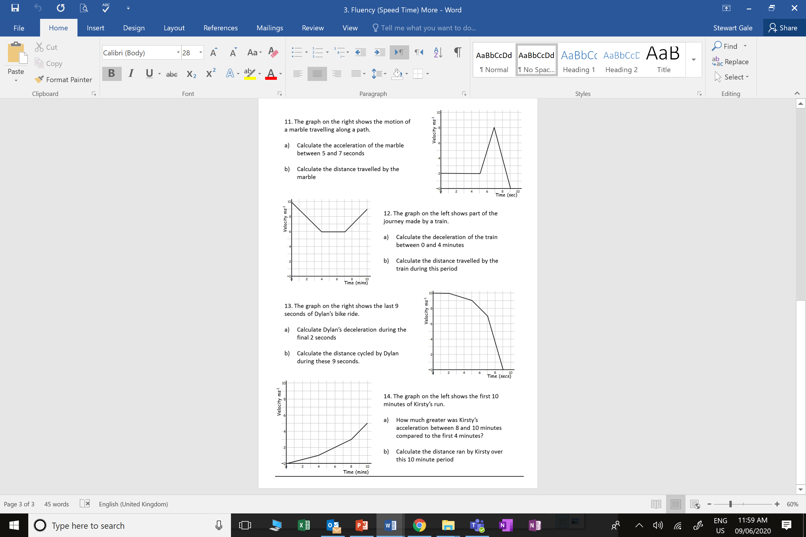
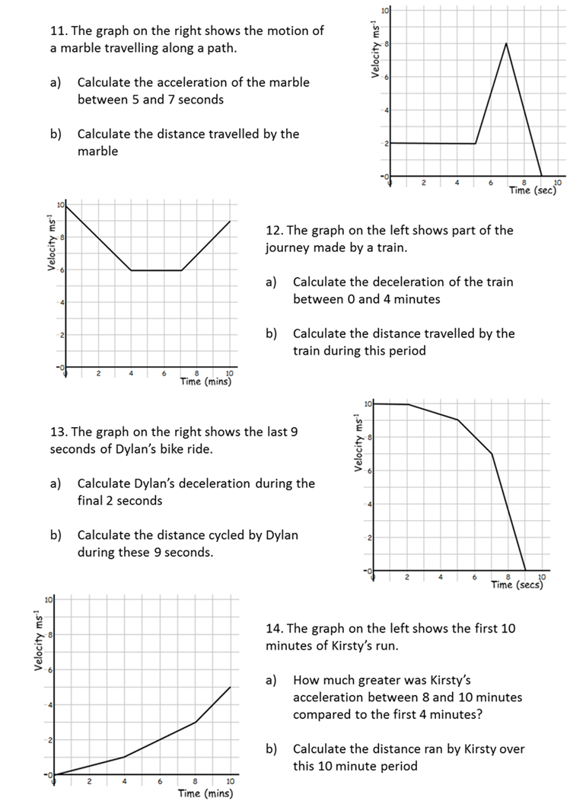

Slide 3
ANSWERS

Slide 4
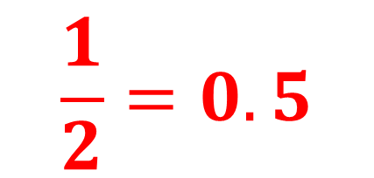
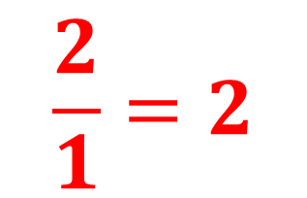
$$\frac{1}{2}=0.5$$
$$\frac{2}{1}=2$$

Slide 5
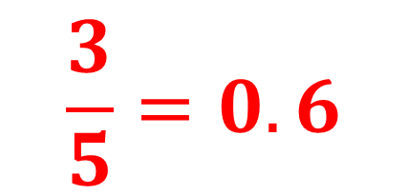
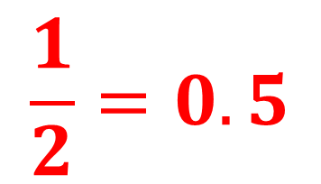
$$\frac{3}{5}=0.6$$
$$\frac{1}{2}=0.5$$

Slide 6
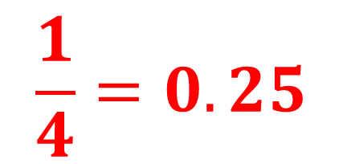

$$\frac{1}{4}=0.25$$
$$\frac{2}{1}=2$$

Slide 7
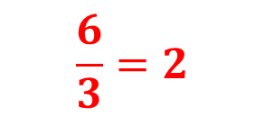
$$\frac{6}{3}=2$$
Rectangle Area = 5 x 6 = 30m
Triangle Area = 0.5 x 3 x 6 = 9m
Total Distance = 30m + 9m = 39m

Slide 8
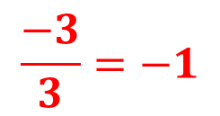
$$\frac{−3}{3}=−1$$
Rectangle Area = 3 x 7 = 21m
Triangle Area = 0.5 x 3 x 3 = 4.5m
Total Distance = 21m + 4.5m = 25.5m

Slide 9
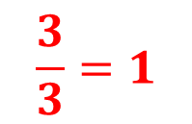
$$\frac{3}{3}=1$$
Rectangle Area = 6 x 10 = 60m
Triangle Area = 0.5 x 3 x 3 = 4.5m
Total Distance = 21m + 4.5m = 64.5m

Slide 10
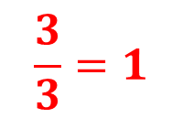
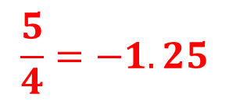
$$\frac{3}{3}=1$$
$$\frac{5}{4}=−1.25$$
Rectangle Area = 3 x 2 = 6 miles
Trapezium Area = 3 x 0.5(2 + 6) = 12 miles
Triangle Area = 0.5 x 6 x 4 = 12 miles
Total Distance = 6 + 12 + 12 = 30 miles

Slide 11
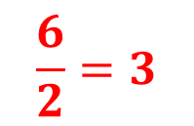
$$\frac{6}{2}=3$$
Rectangle Area = 2 x 5 = 5m
Trapezium Area = 2 x 0.5(2 + 8) = 10m
Triangle Area = 0.5 x 2 x 8 = 8m
Total Distance = 5 + 10 + 8 = 23m

Slide 12
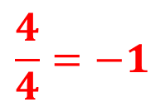
$$\frac{4}{4}=−1$$
Rectangle Area = 6 x 10 = 60m
Triangle Area = 0.5 x 4 x 4 = 8m
Triangle Area = 0.5 x 3 x 3 = 4.5m
Total Distance = 60 + 8 + 4.5 = 72.4m

Slide 13
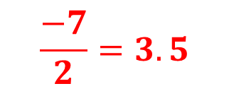
$$\frac{−7}{2}=3.5$$
Rectangle Area = 2 x 10 = 20m
Trapezium Area = 0.5 x 3(10 + 9) = 11m
Trapezium Area = 0.5 x 2(9 + 7) = 16m
Triangle Area = 0.5 x 7 x 2 = 7m
Total Distance = 20 +11 + 16 + 7 = 54m

Slide 14
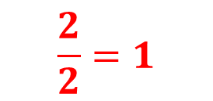
$$\frac{2}{2}=1$$
Triangle Area = 0.5 x 4 x 1 = 2m
Trapezium Area = 0.5 x 4(1 + 3) = 8m
Trapezium Area = 0.5 x 2(3 + 5) = 8m
Total Distance = 2 + 8 + 8 = 18m

